Slide 1
IC-TOA
Chad Harris, Gabriel Gallagher, Elijah molloy, sean barton, & regina burns

Slide 2
IC-TOA
I Can’t Think Of Anything
Chad Harris, Gabriel Gallagher, Elijah molloy, sean barton, & regina burns

Slide 3
[S]quarelist
Online Consumer-2-Consumer listing platform
Local listings are main focus

Slide 4
Let’s Give it a Try!!

Slide 5

Engineering
Open Source PHP Framework
Integrates with MySQL and HTML for seamless web-to-database implementation

Slide 6

Methodologies
SCRUM Methodology
Start by creating viable product
Expand by adding tables, webpages, and PHP code

Slide 7
Test Results

Slide 8
Normalization
1NF, 2NF, 3NF…

Slide 9
1st Normal Form
Each cell must be Single Valued
Entries in a column must be same type
Rows Uniquely Identified

Slide 10
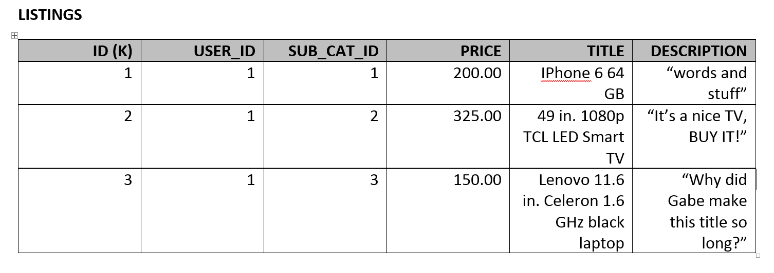
Example:

Slide 11
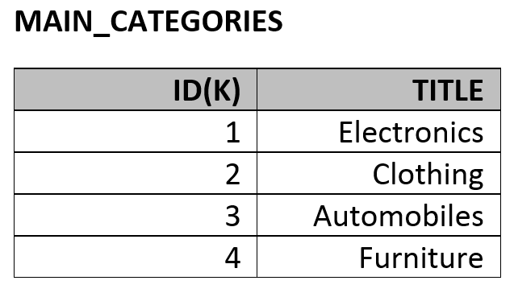
Example:

Slide 12
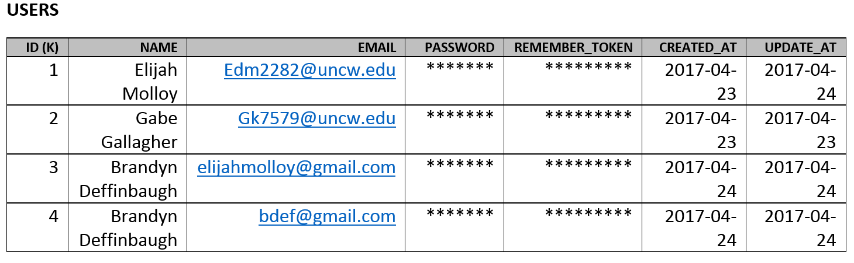
Example:

Slide 13
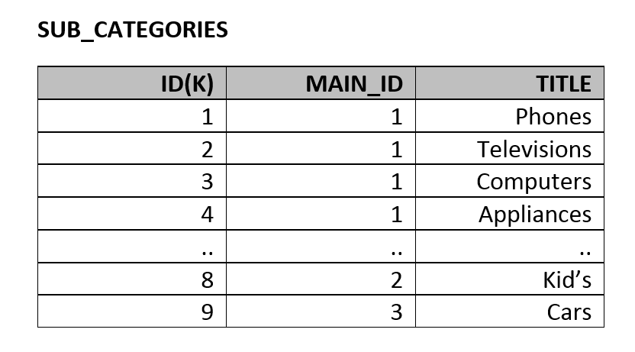
Example

Slide 14
2nd Normal Form
Each cell must be Single Valued
Entries in a column must be same type
Rows Uniquely Identified
Attributes dependent on non-primary category

Slide 15
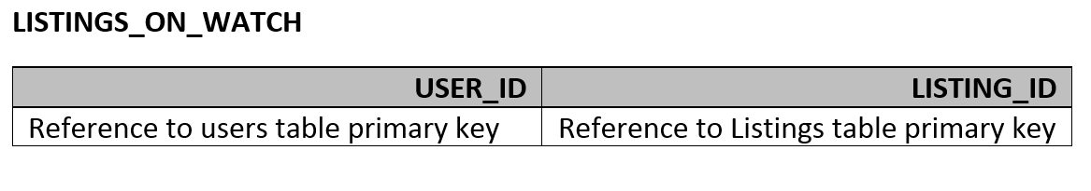
Weird Example:

Slide 16
Conclusion

