Slide 1
CUDA C++
5 JUNE 2024 | JAN H. MEINKE

Slide 2
CUDA and C++
CUDA host code has been compiled as C++ code since version 2!
Some C++ features, e.g., support for templates since CUDA 1.x
C++ 11 features supported in host and device code since CUDA 7
C++ 14 features supported in host and device code since CUDA 9
C++ 17 features supported in host and device code since CUDA 11
C++ 20 features supported in host and device code since CUDA 12
pSTL supported on GPU with NVHPC toolkit
Notes:
CUDA 9: auto lambda = [](auto a, auto b) { return a * b; };

Slide 3
A Sample of C++ 11 Features
auto
template
memory management
range-based for loops
lambdas

Slide 4
Writing Kernels for Different Data Types
__global__ void saxpy(float alpha, float* x, float* y, size_t n){
auto i = blockDim.x * blockIdx.x + threadIdx.x;
if(i < n){
y[i] = alpha * x[i] + y[i];
}
}

Slide 5
Writing Kernels for Different Data Types
__global__ void daxpy(double alpha, double* x, double* y, size_t n){
auto i = blockDim.x * blockIdx.x + threadIdx.x;
if(i < n){
y[i] = alpha * x[i] + y[i];
}
}

Slide 6
Writing Kernels for Different Data Types
template <typename T>
__global__ void axpy(T alpha, T* x, T* y, size_t n){
auto i = blockDim.x * blockIdx.x + threadIdx.x;
if(i < n){
y[i] = alpha * x[i] + y[i];
}
}

Slide 7
Exercise
05-CUDA_C++/exercises/tasks/gemm
Compile with make.

Slide 8
Struct instead of Raw Pointer
You can pass structs to kernels
Data members are trivially copyable
Free is called automatically
__global__
void mm(Matrix A, Matrix B, Matrix C);
Matrix A(1024, 1024);
…
mm<<<...>>>(A, B, C);
struct Matrix {
Matrix(int h, int w): height(h), width(w) {
cudaMallocManaged(&data, height * width *sizeof(double));
};
~Matrix(){
cudaFree(data);
}
int height;
int width;
double* data;
};

Slide 9
Transparent Types
Closely modeled after “Unified Memory in
CUDA 6” (see Refs)
class Managed {
public:
void *operator new(size_t len) {
void *ptr;
cudaMallocManaged(&ptr, len);
cudaDeviceSynchronize();
return ptr;
}
void operator delete(void *ptr) {
cudaDeviceSynchronize();
cudaFree(ptr);
}
};

Slide 10
Transparent Types
template <class T>
class Array : public Managed {
size_t n;
T* data;
public:
Array (const Array &a) {
n = a.n;
cudaMallocManaged(&data, n);
memcpy(data, a.data, n);
}
// Also have to implement operator[], for example
};

Slide 11
Transparent Types
// Pass-by-reference version
__global__ void kernel_by_ref(Array &data) { ... }
// Pass-by-value version
__global__ void kernel_by_val(Array data) { ... }
int main(void) {
Array *a = new Array;
...
// pass data to kernel by reference
kernel_by_ref<<<1,1>>>(*a);
// pass data to kernel by value -- this will create a copy
kernel_by_val<<<1,1>>>(*a);
}

Slide 12
Thrust on Device
__global__
void xyzw_frequency_thrust_device(int *count, char *text, int n)
{
const char letters[] { 'x','y','z','w' };
*count = thrust::count_if(thrust::device, text, text+n, [=](char c) {
for (const auto x : letters)
if (c == x) return true;
return false;
});
}

Slide 13
The Standard Template Library (STL)
array
sort
vector
transform
...
for_each
reduce
list
accumulate

Slide 14
The Standard Template Library (STL)
Templates
Allow different type
Iterators
Generic algorithms

Slide 15
libcu++
Implementation of some STL features, e.g.,
atomic <cuda/std/atomic>
complex <cuda/std/complex>
chrono <cuda/std/chrono>
array <cuda/std/array>
span <cuda/std/span>
mdspan (soon)
…
Header-only library with host and device functions
Comes with CUDA SDK and NVHPC SDK
Included in standard include path → no compiler options needed
https://nvidia.github.io/libcudacxx/

Slide 16
Std::SPAN
template <class T>
__global__ void foo(cuda::std::span<T> x){
auto i = threadIdx.x + blockIdx.x * blockDim.x;
if (i < x.size()){
x[i] = …;
}
}
auto main() → int {
double* x = nullptr;
std::vector<double, managedAlloc> y(10000, 2.7);
cudaMallocManaged(&x, sizeof(double) * 12000);
foo<<<40, 256>>>(y);
foo<<<47, 256>>>({x, 12000});
...
View of contiguous memory
Knows its own size
Access through operator[]
Device aware version in cuda::std::span

Slide 17
Exercise
05-CUDA_C++/exercises/tasks/axpy
Compile with make.

Slide 18
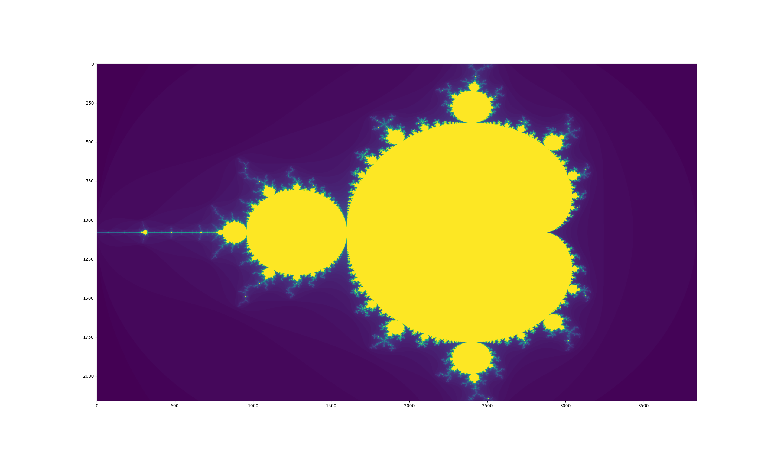
Exercise
05-CUDA_C++/exercises/tasks/mandelbrot
Compile with nvcc mandelbrot.cu -o mandelbrot.
Launch with $JSC_SUBMIT_CMD ./mandelbrot.

Slide 19
An STL Example
#include <algorithm>
#include <numeric>
#include <iostream>
#include <vector>
int main(){
size_t N = 10'000;
std::vector x(N, 1.0 / N);
std::cout << "The sum of the elements of x is " << std::reduce(x.begin(), x.end(), 0.0);
}

Slide 20
Parallel STL (PSTL)
execution::par
sort
execution::unseq
transform
execution::seq
for_each
reduce
execution::par_unseq
accumulate
https://en.cppreference.com/w/cpp/algorithm

Slide 21
A pSTL Example
Much more of this
on
Friday
#include <execution>
#include <iostream>
#include <numeric>
#include <vector>
int main(){
size_t N = 10'000;
std::vector x(N, 1.0 / N);
std::cout << "The sum of the elements of x is " <<
std::reduce(std::execution::par_unseq, x.begin(), x.end(), 0.0);
}

Slide 22
References
C++11 in CUDA: Variadic Templates - https://developer.nvidia.com/blog/cplusplus-11-in-cuda-variadic-templates
managed_allocator/README.md at master · jaredhoberock/managed_allocator · GitHub - https://github.com/jaredhoberock/managed_allocator/blob/master/README.md
Unified Memory in CUDA 6 - https://developer.nvidia.com/blog/unified-memory-in-cuda-6

Slide 23
References
Unified Memory in CUDA 6 - https://devblogs.nvidia.com/parallelforall/unified-memory-in-cuda-6
Faster Parallel Reductions on Kepler https://devblogs.nvidia.com/parallelforall/faster-parallel-reductions-kepler
CUDA 7.5 https://devblogs.nvidia.com/parallelforall/new-features-cuda-7-5/
CUDA 8.0 https://devblogs.nvidia.com/parallelforall/cuda-8-features-revealed/

