Slide 1
Multi GPU Programming with MPI and OpenACC
26.10.2023 I Jan H. Meinke

Slide 2
MPI+OpenACC
Node 0
Node 1
Node N-1
MEM
MEM
MEM
MEM
MEM
MEM
MEM
MEM
MEM
MEM
MEM
MEM
GPU
CPU
GPU
CPU
GPU
CPU
…
PCIe
Switch
PCIe
Switch
PCIe
Switch
IB
IB
IB

Slide 3
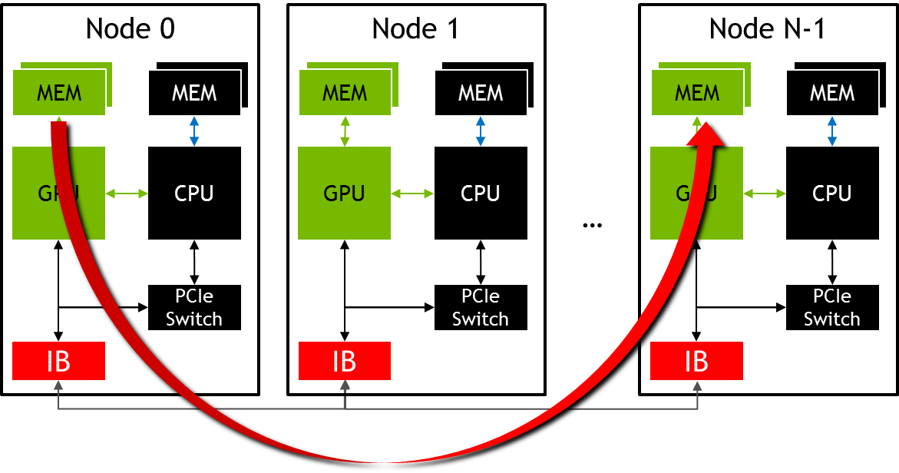
MPI+OpenACC
//MPI rank 0
#pragma acc host_data use_device( sbuf )
MPI_Send(sbuf, size, MPI_DOUBLE, n-1, tag, MPI_COMM_WORLD);
//MPI rank n-1
#pragma acc host_data use_device( rbuf )
MPI_Recv(rbuf, size, MPI_DOUBLE, 0, tag, MPI_COMM_WORLD, MPI_STATUS_IGNORE);

Slide 4
What you will learn
What MPI is
How to use MPI for inter GPU communication with OpenACC
How to use Nsight Systems for MPI+OpenACC applications
How to hide MPI communication times

Slide 5
Message Passing Interface - MPI
Standard to exchange data between processes via messages
Defines API to exchanges messages
Pt. 2 Pt.: e.g. MPI_Send, MPI_Recv
Collectives, e.g. MPI_Allreduce
Multiple implementations (open source and commercial)
Binding for C/C++, Fortran, Python, …
E.g. MPICH, OpenMPI, Parastation MPI, MVAPICH, IBM Platform MPI, Cray MPT, …

Slide 6
MPI – A minimal program
#include <mpi.h>
int main(int argc, char *argv[]) {
int rank,size;
/* Initialize the MPI library */
MPI_Init(&argc,&argv);
/* Determine the calling rank and total number of ranks */
MPI_Comm_rank(MPI_COMM_WORLD,&rank);
MPI_Comm_size(MPI_COMM_WORLD,&size);
/* Call MPI routines like MPI_Send, MPI_Recv, ... */
...
/* Shutdown MPI library */
MPI_Finalize();
return 0;
}
Remark: Almost all MPI routines return an error value which should be checked. The examples and tasks leave that out for brevity.

Slide 7
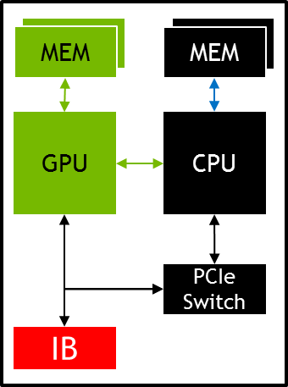
MPI – Compiling and Launching
$ mpicc -o myapp myapp.c
$ srun -n 4 ./myapp <args>
rank = 0
rank = 1
rank = 2
rank = 3
myapp
myapp
myapp
myapp

Slide 8
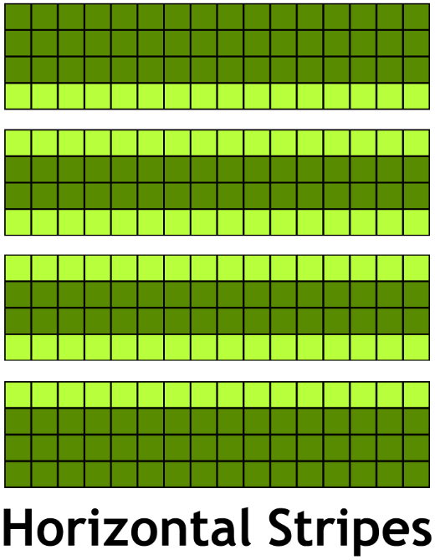
Example: Jacobi Solver
Solves the 2D-Poission Equation on a rectangle
Periodic boundary conditions
Domain decomposition with stripes

Slide 9
Example: Jacobi Solver – Single GPU
While not converged
Do Jacobi step:
for (int iy = 1; iy < ny-1; ++iy)
for (int ix = 1; ix < nx-1; ++ix)
Anew[iy*nx+ix]=-0.25f*(rhs[iy*nx+ix]
-(A[iy*nx+(ix-1)]+A[iy*nx+(ix+1)]
+A[(iy-1)*nx+ix]+A[(iy+1)*nx+ix]));
Copy Anew to A
Apply periodic boundary conditions
Next iteration

Slide 10
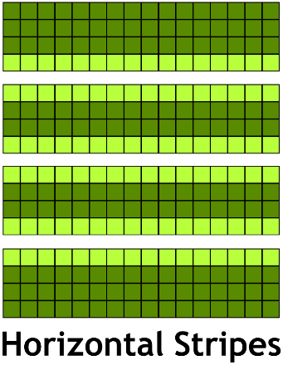
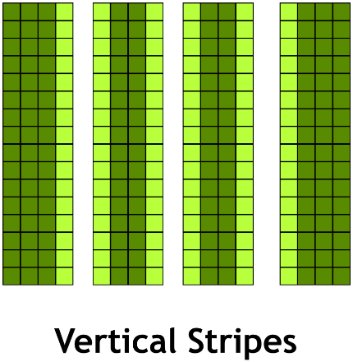
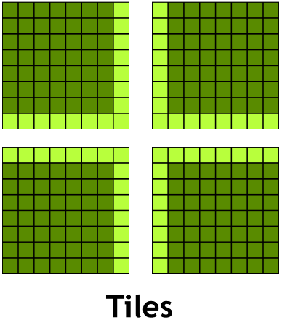
Domain Decomposition
Different ways to split the work between processes:
Minimizes number of neighbors:
Communicate to less neighbors
Optimal for latency bound communication
Minimizes surface area/volume ratio:
Communicate less data
Optimal for bandwidth bound communication
Contiguous if data is row-major
Contiguous if data is column-major

Slide 11
Example: Jacobi Solver – Multi GPU
While not converged
Do Jacobi step:
for (int iy = iy_start; iy < iy_end; ++iy)
for (int ix = 1; ix < NX-1; ++ix)
Anew[iy*nx+ix]=-0.25f*(rhs[iy*nx+ix]
-(A[iy*nx+(ix-1)]+A[iy*nx+(ix+1)]
+A[(iy-1)*nx+ix]+A[(iy+1)*nx+ix]));
Copy Anew to A
Apply periodic boundary conditions and exchange halo with 2 neighbors
Next iteration

Slide 12
Example: Jacobi – Top/Bottom Halo
#pragma acc host_data use_device ( A ) {
MPI_Sendrecv(A+iy_start*nx+1, nx-2, MPI_DOUBLE, top, 0,
A+iy_end*nx+1, nx-2, MPI_DOUBLE, bottom, 0,
MPI_COMM_WORLD, MPI_STATUS_IGNORE);
2
1
MPI_Sendrecv(A+(iy_end-1)*nx+1, nx-2, MPI_DOUBLE, bottom, 1,
A+(iy_start-1)*nx+1, nx-2, MPI_DOUBLE, top, 1,
MPI_COMM_WORLD, MPI_STATUS_IGNORE);
}
2
1

Slide 13
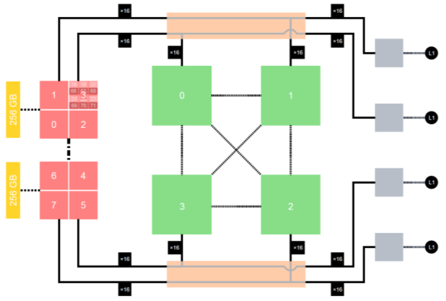
Handling GPU Affinity
…
…
…
0
1
…
3
4
5
…
7
8
9
…
11

Slide 14
Handling GPU Affinity
0
1
…
3
0
1
…
3
0
1
…
3
0
1
…
3
4
5
…
7
8
9
…
11

Slide 15
Handling GPU Affinity
int local_rank = -1;
{
MPI_Comm local_comm;
MPI_Comm_split_type(MPI_COMM_WORLD, MPI_COMM_TYPE_SHARED, rank,
MPI_INFO_NULL, &local_comm);
MPI_Comm_rank(local_comm, &local_rank);
MPI_Comm_free(&local_comm);
}
#ifdef _OPENACC
int num_devs = acc_get_num_devices(acc_get_device_type());
#else
int num_devs = 1;
#endif
#pragma acc set device_num( local_rank%num_devs )
Needed if resource manager handles GPU affinity.
Handled gracefully on JUWELS-Booster by NVHPC if omitted: “If the value of devicenum is greater than or equal to the value returned by acc_get_num_devices for that device type, the behavior is implementation-defined.”

Slide 16
Profiling MPI+OPENACC applications
Embed MPI rank in output filename, process name, and context name
srun nsys profile --trace=mpi,cuda,openacc,nvtx \
--output profile.%q{PMI_RANK} \
./application
JURECA-DC: PMI_RANK
OpenMPI: OMPI_COMM_WORLD_RANK
MVAPICH2: MV2_COMM_WORLD_RANK

Slide 17
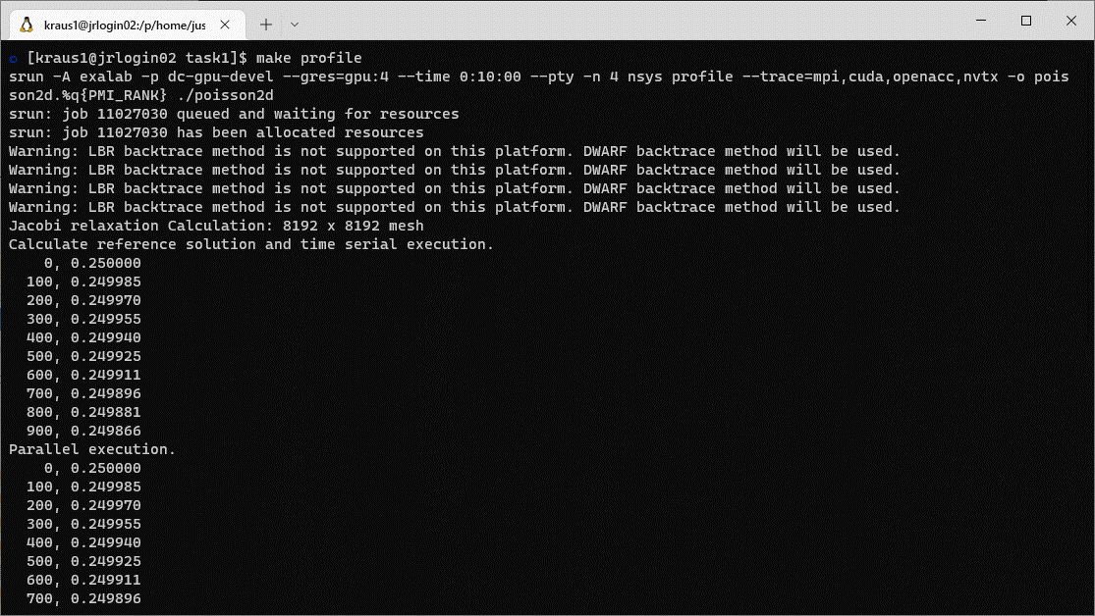
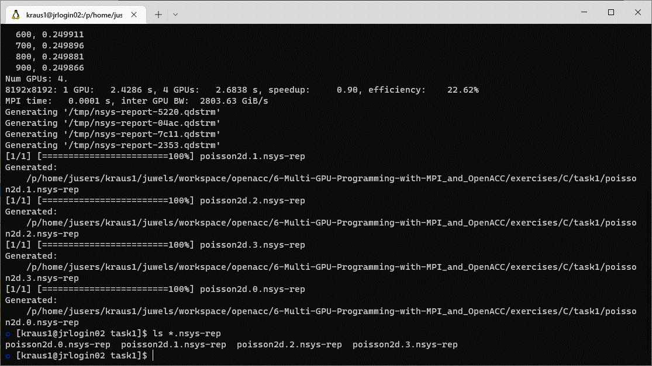
Profiling MPI+OpenACC applications

Slide 18
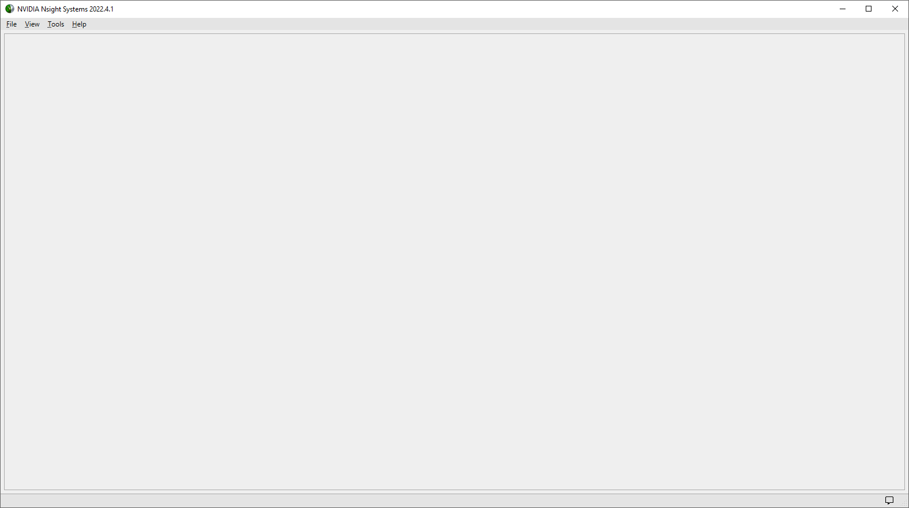
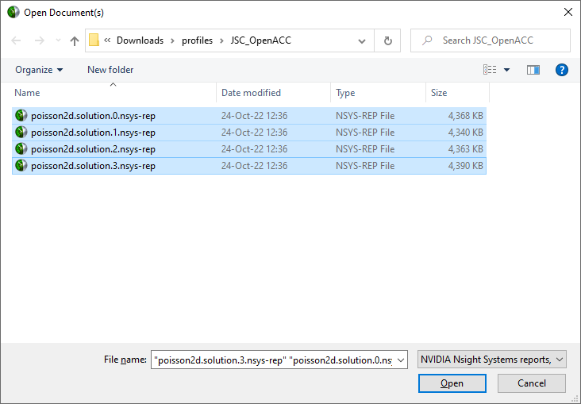

Profiling MPI+OpenACC applications

Slide 19
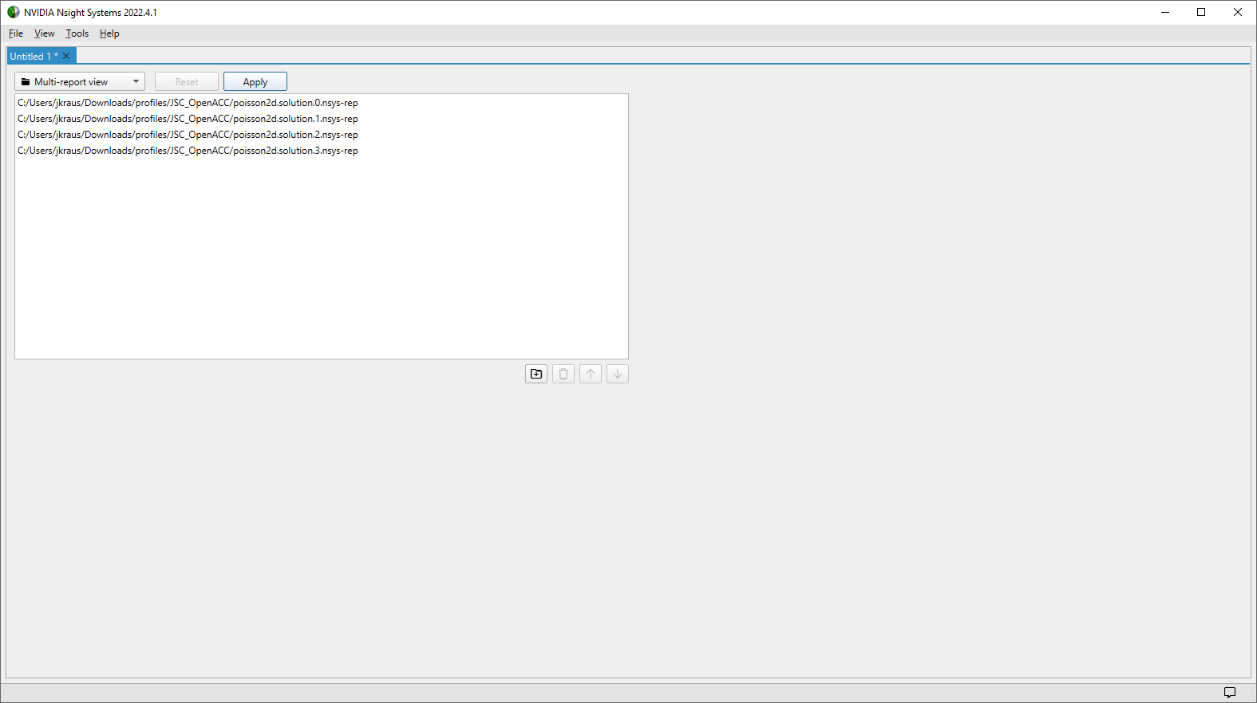
Profiling MPI+OpenACC applications

Slide 20
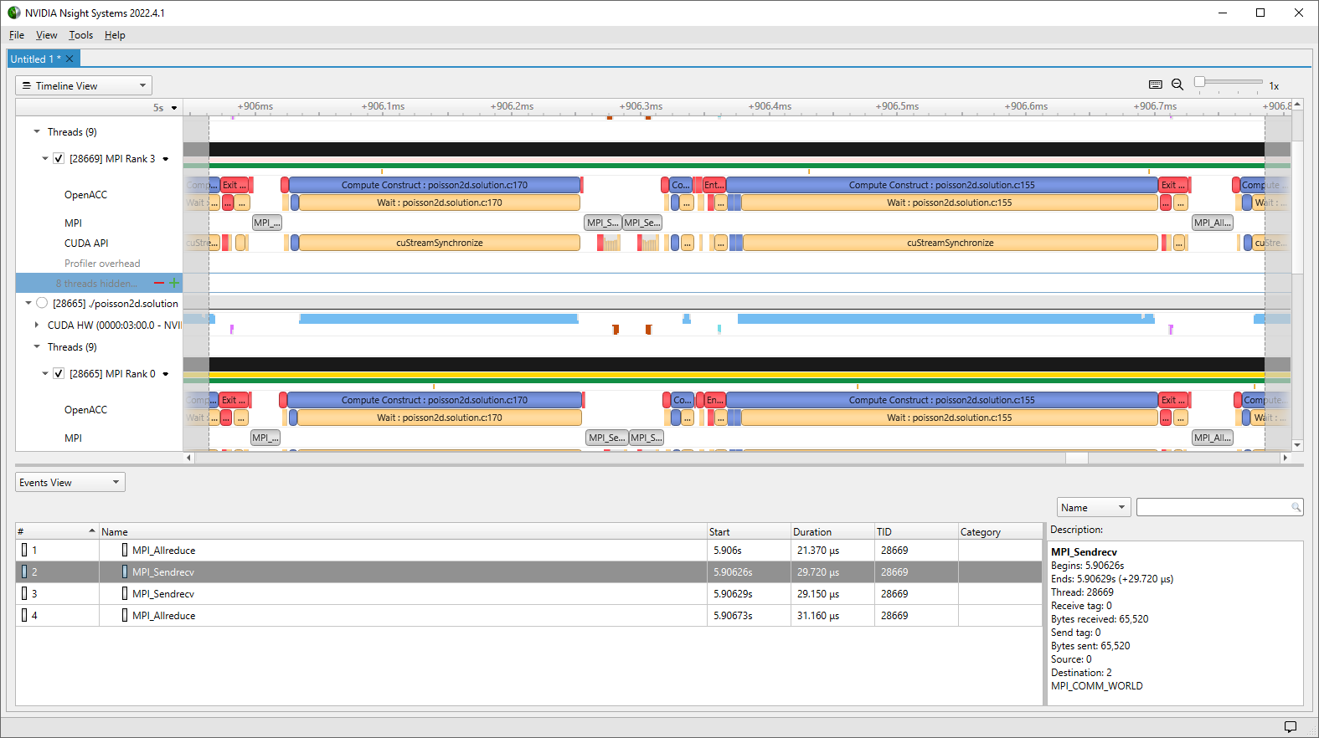
Profiling MPI+OpenACC applications

Slide 21
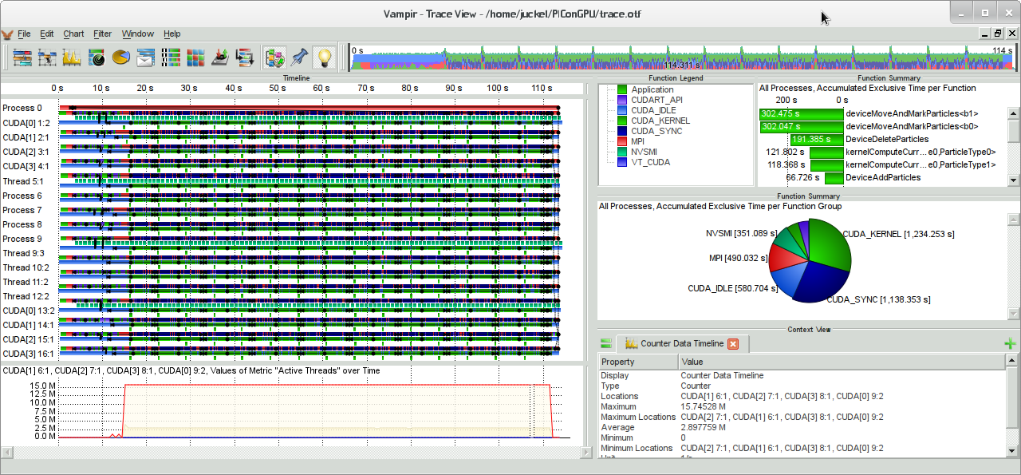
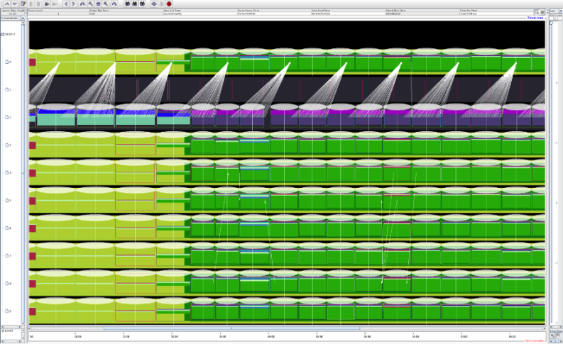
Profiling MPI+OpenACC applications
Multiple parallel profiling tools are CUDA-aware
Score-P
Vampir
Tau
These tools are good for discovering MPI issues as well as basic CUDA performance inhibitors.

Slide 22
Communication + Computation Overlap

Slide 23
Communication + Computation Overlap
No Overlapp
Process whole domain
MPI
Boundary and inner domain processing can overlapp
Overlapp
Process inner domain
Possible Speedup
Process boundary domain
MPI
Dependency

Slide 24
Communication + Computation Overlap
#pragma acc parallel loop
for ( ... )
//Process boundary
#pragma acc parallel loop async
for ( ... )
//Process inner domain
#pragma acc host_data use_device ( A )
{
//Exchange halo with top and bottom neighbor
MPI_Sendrecv( A…);
//…
}
//wait for iteration to finish
#pragma acc wait

Slide 25
Scalability Metrics For Success
Serial Time: 𝑇𝑠:
How long it takes to run the problem with a single process
Parallel Time: 𝑇𝑝
How long it takes to run the problem with multiple processes
Number of Processes: 𝑃
The number of Processes operating on the task at hand
Speedup: 𝑆=𝑇𝑠/𝑇𝑝
How much faster is the parallel version vs. serial. (optimal is 𝑃)
Efficiency: 𝐸= 𝑆/𝑃
How efficient are the processors used (optimal is 1)

Slide 26
Task 1: Apply domain decomposition
Look for TODOs
Handle GPU affinity
Halo Exchange
$ make
mpicc -c -DUSE_DOUBLE -Minfo=accel -fast -acc=gpu -gpu=cc80 poisson2d.c [...]
srun -p dc-gpu-devel --gres=gpu:4 --time 0:10:00 --pty -n 4 ./poisson2d
Jacobi relaxation Calculation: 8192 x 8192 mesh
[...]
Num GPUs: 4.
8192x8192: 1 GPU: 2.3283 s, 4 GPUs: 2.3494 s, speedup: 0.99, efficiency: 24.78%
MPI time: 0.0001 s, inter GPU BW: 4760.23 GiB/s
Make Targets:
run: run poisson2d (default)
poisson2d: build poisson2d binary
profile: profile with Nsight Systems
*.solution: same as above with solution
(poisson2d.solution.*)

Slide 27
Task 2: Hide MPI communication time
Look for TODOs
Start copy loop asynchronously
Wait for async copy loop after MPI comm. is done
$ make
mpicc -c -DUSE_DOUBLE -Minfo=accel -fast -acc=gpu -gpu=cc80 poisson2d.c [...]
srun -p dc-gpu-devel --gres=gpu:4 --time 0:10:00 --pty -n 4 ./poisson2d
Jacobi relaxation Calculation: 8192 x 8192 mesh
[...]
Num GPUs: 4.
8192x8192: 1 GPU: 2.3289 s, 4 GPUs: 0.6824 s, speedup: 3.41, efficiency: 85.32%
MPI time: 0.0373 s, inter GPU BW: 6.54 GiB/s
Make Targets:
run: run poisson2d (default)
poisson2d: build poisson2d binary
profile: profile with Nsight Systems
*.solution: same as above with solution
(poisson2d.solution.*)

Slide 28
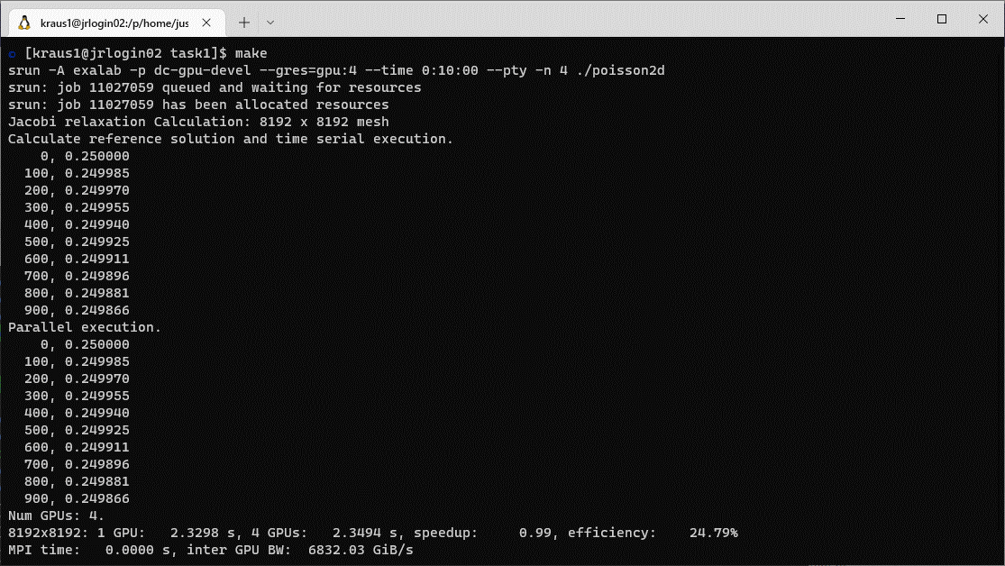
Task 1: Initial Version

Slide 29
Task 1: Solution
//Initialize MPI and determine rank and size
MPI_Init(&argc, &argv);
MPI_Comm_rank(MPI_COMM_WORLD, &rank);
MPI_Comm_size(MPI_COMM_WORLD, &size);
int local_rank = -1;
{
MPI_Comm local_comm;
MPI_Comm_split_type(MPI_COMM_WORLD, MPI_COMM_TYPE_SHARED, rank,
MPI_INFO_NULL, &local_comm);
MPI_Comm_rank(local_comm, &local_rank);
MPI_Comm_free(&local_comm);
}
#pragma acc set device_num( local_rank )
real* restrict const A = (real*) malloc(nx*ny*sizeof(real));
%num_devs omitted see slide 15

Slide 30
Task 1: Solution
// Ensure correctness if ny%size != 0
int chunk_size = ceil( (1.0*ny)/size );
int iy_start = rank * chunk_size;
int iy_end = iy_start + chunk_size;
// Do not process boundaries
iy_start = max( iy_start, 1 );
iy_end = min( iy_end, ny - 1 );

Slide 31
Task 1: Solution
int top = (rank == 0) ? (size-1) : rank-1;
int bottom = (rank == (size-1)) ? 0 : rank+1;
#pragma acc host_data use_device( A ) {
//1. Sent row iy_start (first modified row) to top receive lower boundary (iy_end)
//from bottom
MPI_Sendrecv(A + iy_start * nx + ix_start, (ix_end - ix_start), MPI_REAL_TYPE, top , 0,
A + iy_end * nx + ix_start, (ix_end - ix_start), MPI_REAL_TYPE, bottom, 0,
MPI_COMM_WORLD, MPI_STATUS_IGNORE);
//2. Sent row (iy_end-1) (last modified row) to bottom
//receive upper boundary (iy_start-1) from top
MPI_Sendrecv(A + (iy_end – 1) * nx + ix_start, (ix_end - ix_start), MPI_REAL_TYPE, bottom, 0,
A + (iy_start – 1) * nx + ix_start, (ix_end - ix_start), MPI_REAL_TYPE, top , 0,
MPI_COMM_WORLD, MPI_STATUS_IGNORE);
}

Slide 32
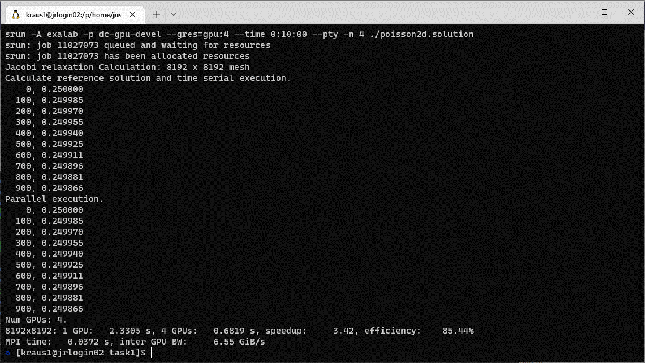
Task 1: Solution

Slide 33
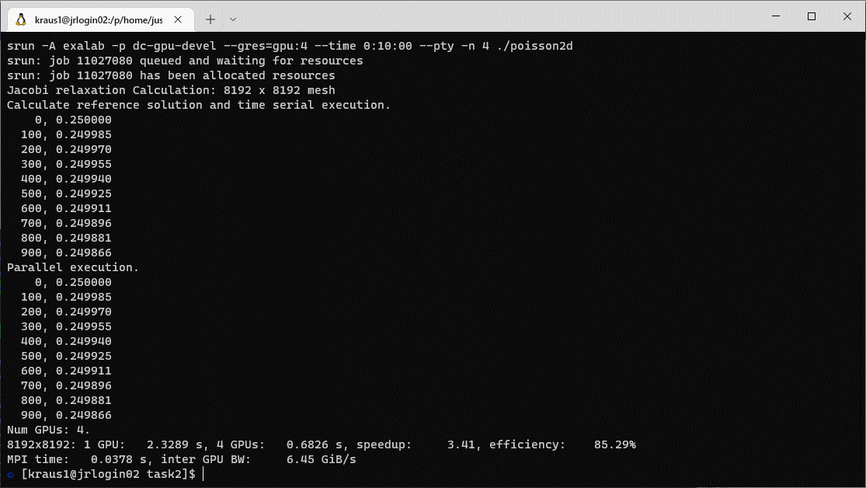
Task 2: Initial Version

Slide 34
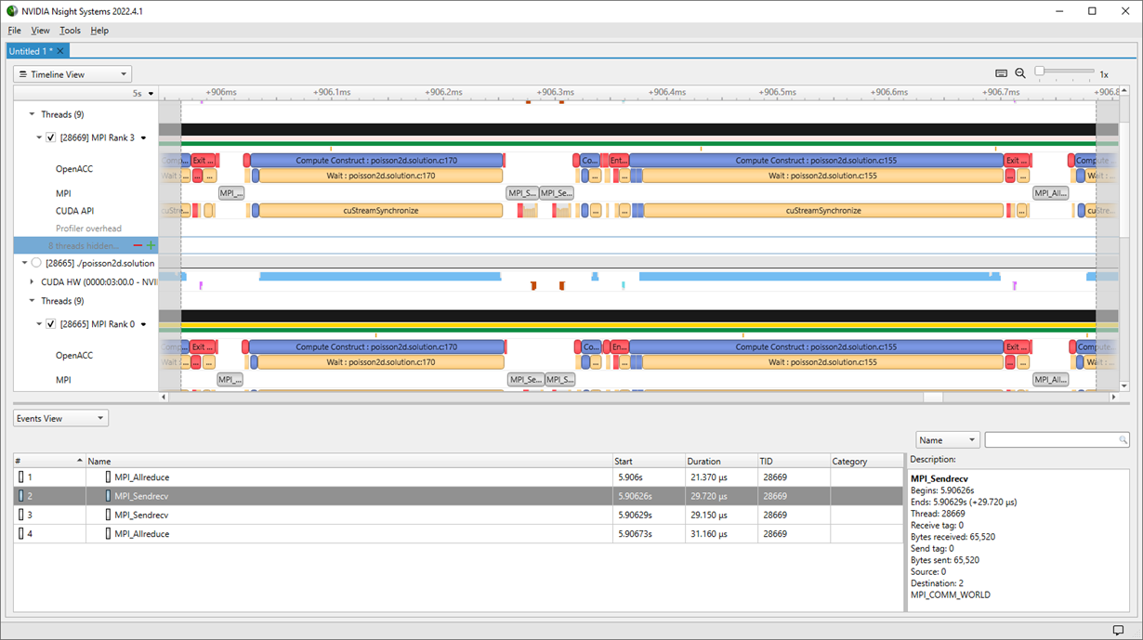
Task 2: Initial Version

Slide 35
Task 2: Solution
#pragma acc parallel loop present(A,Anew)
for( int ix = ix_start; ix < ix_end; ix++ ) {
A[(iy_start)*nx+ix] = Anew[(iy_start)*nx+ix];
A[(iy_end-1)*nx+ix] = Anew[(iy_end-1)*nx+ix];
}
#pragma acc parallel loop present(A,Anew) async
for (int iy = iy_start+1; iy < iy_end-1; iy++) {
for( int ix = ix_start; ix < ix_end; ix++ ) {
A[iy*nx+ix] = Anew[iy*nx+ix];
} }
int top = (rank == 0) ? (size-1) : rank-1;
int bottom = (rank == (size-1)) ? 0 : rank+1;
#pragma acc host_data use_device( A )
{
MPI_Sendrecv( A+iy_start*nx+ix_start, (ix_end-ix_start), MPI_REAL_TYPE, top , 0,
A+iy_end*nx+ix_start, (ix_end-ix_start), MPI_REAL_TYPE, bottom, 0,
MPI_COMM_WORLD, MPI_STATUS_IGNORE );
MPI_Sendrecv( A+(iy_end-1)*nx+ix_start, (ix_end-ix_start), MPI_REAL_TYPE, bottom, 0,
A+(iy_start-1)*nx+ix_start, (ix_end-ix_start), MPI_REAL_TYPE, top , 0,
MPI_COMM_WORLD, MPI_STATUS_IGNORE );
}
#pragma acc wait

Slide 36
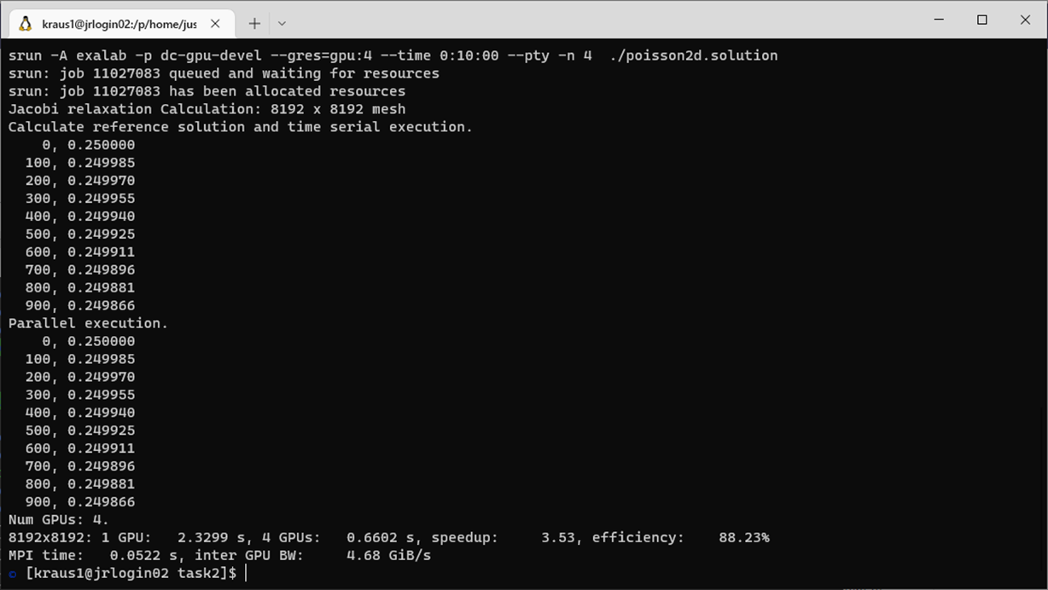
Task 2: Solution

Slide 37
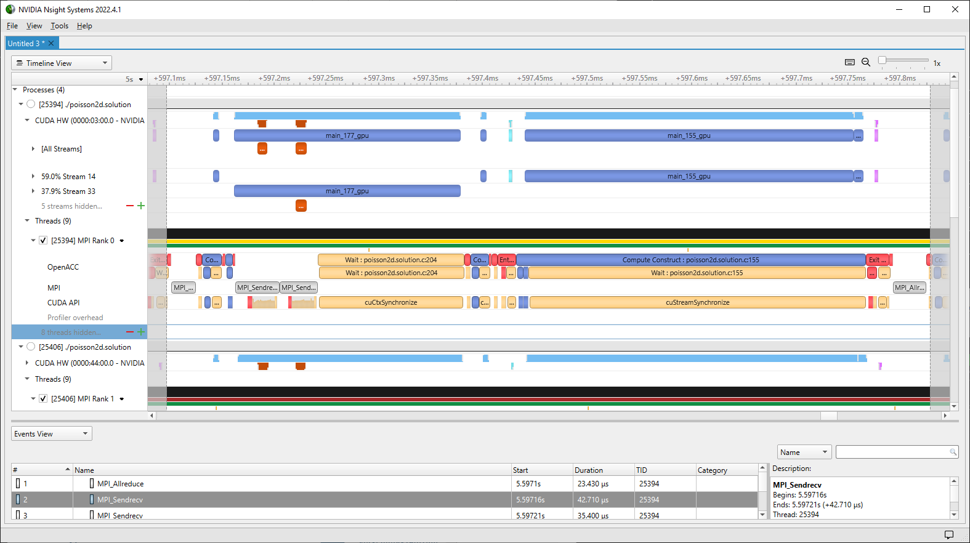
Task 2: Solution

Slide 38
Task 2: Solution
Additional kernel launch overhead larger than MPI time!

Slide 39
Hands-on Setup Environment
module load NVHPC/21.9-GCC-10.3.0
module load ParaStationMPI/5.4.10-1
module load Nsight-Systems/2021.4.1

