Slide 1
A new Italian restaurant in Toronto: where to place it?
IBM Data Science Certificate - Final Assignment

Slide 2
Business problem definition
Our stakeholder is interested to investigate which is the appropriate neighborhood in Toronto where to locate a new Italian Restaurant. Specifically they are interested to know:
the level of competition on each neighbourhood
which are the most dynamic neighbourhoods
have an idea of Toronto neighbourhoods

Slide 3
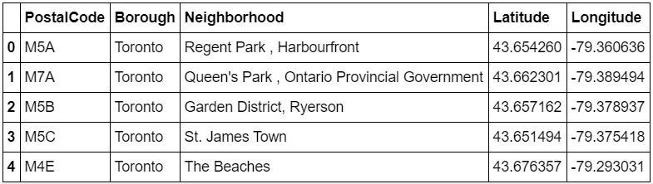
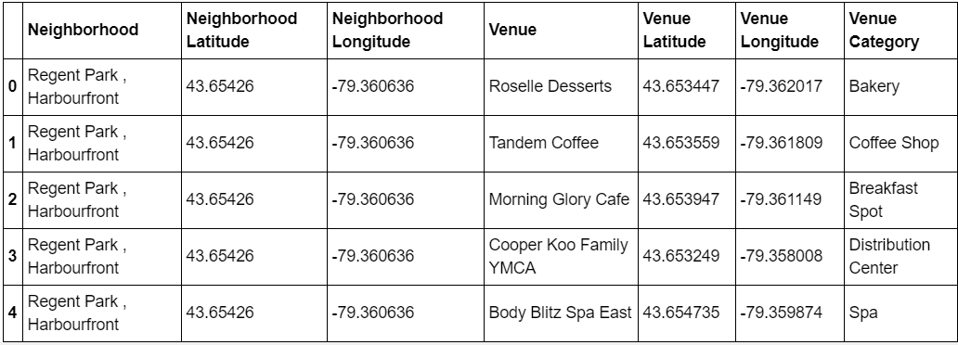
Data acquisition
Toronto neighbourhoods are defined by latitude and longitude, data are uploaded by an external file. It is publicly available for download
We use Foursquare API to obtain all the venues for each neighbourhood of Toronto city

Slide 4
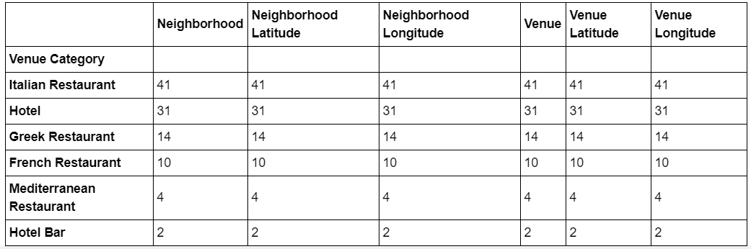
High level of competition and total Italian restaurants in Toronto
Mediterranean and European restaurants: 69
of which
41 are Italian restaurants
Total number of Hotels: 33

Slide 5
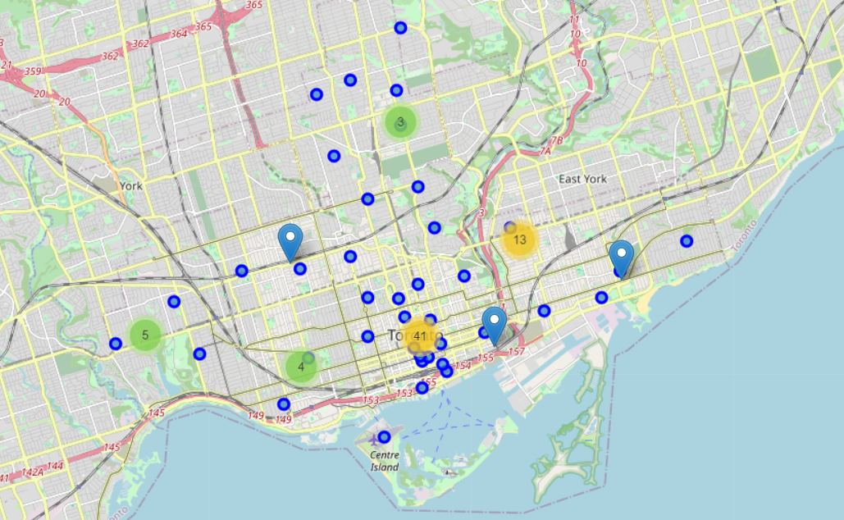
High level of competition and Italian restaurants on Toronto map

Slide 6
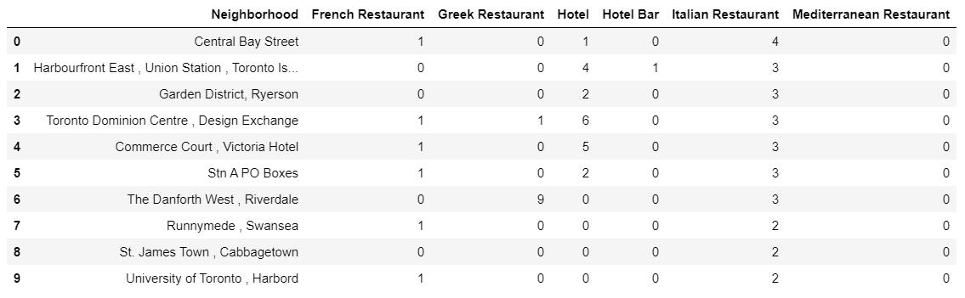
Italian restaurants for each neighborhood: highest competition
Highest number of Italian restaurants: Central Bay Street
High dynamic neighborhoods: Toronto Dominion Center and Commerce Court
Extremely high level of competition: The Danforth West … high density of Greek restaurants

Slide 7
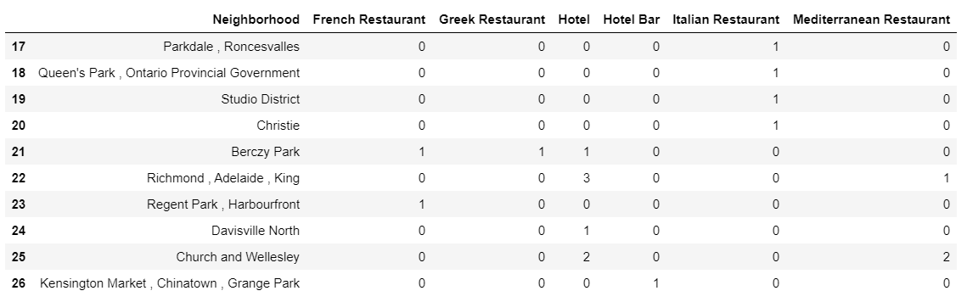
Italian restaurants for each neighborhood: lowest competition
Without Italian restaurants: six neighborhoods
of which 4 have hotels located
and 2 have Mediterranean and European cuisine present

Slide 8
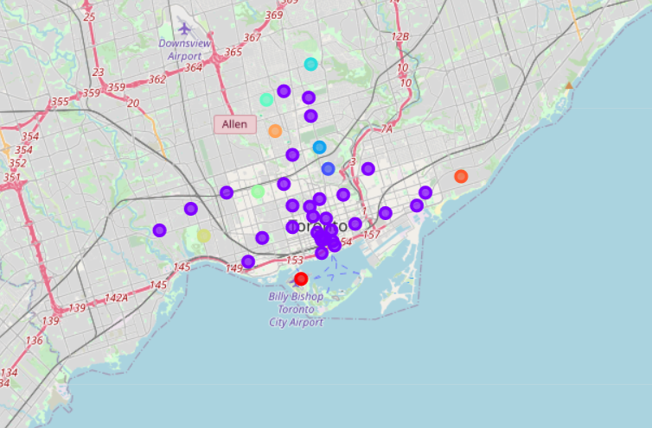
Clusters of ten most common venues for each neighborhood

Slide 9
Conclusions
The area between University of Toronto – St James Town – Berczy Park has the higher density of venues, there are 41 venues.
The second most dense are is located between The Danforth West – Studio District, there are 13 venues.
The third most dense area is located between High Park – Runnymede – Parkdale, there are 5 venues
In our opinion neighbourhoods Richmond, Adelaide, King and Davisville North are two dynamic areas and do not have Italian restaurants among the 10 common venues. They can be a good starting point to evaluate the placement of the new restaurant

