Slide 1
Messaging and
job queues
in Go
Gerrit Renker

Slide 2
Talk Structure
What is MOM, and why?
Enterprise MOMs
High-speed MOMs
Go MOMs
Wrap-up

Slide 3

Messages Decouple

Slide 4
Message Oriented Middleware
MOM= any middleware providing messaging facilities

Slide 5
Message Oriented Middleware
MOM= any middleware providing messaging facilities
asynchronous: vs “while u wait”
decoupled: mailbox functionality
reliable: store & forward, guarantees
scalable: distributed, load balancing

Slide 6
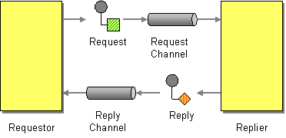
Request/Reply (RPC)

Slide 7
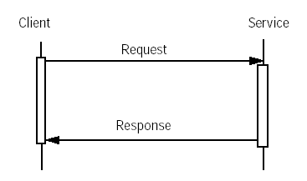
MOM vs RPC
RPC: [telephone]
synchronous, tighly coupled processing
caller is blocked until callee returns
failure if one endpoint becomes unavailable

Slide 8
MOM vs RPC
RPC: [telephone]
synchronous, tighly coupled processing
caller is blocked until callee returns
failure if one endpoint becomes unavailable
MOM: [mail]
asynchronous, simple “fire & forget” call
result is queried via message (push or pull)

Slide 9
MOM vs RPC
RPC: [telephone]
synchronous, tighly coupled processing
caller is blocked until callee returns
failure if one endpoint becomes unavailable
MOM: [mail]
asynchronous, simple “fire & forget” call
result is queried via message (push or pull)

Slide 10
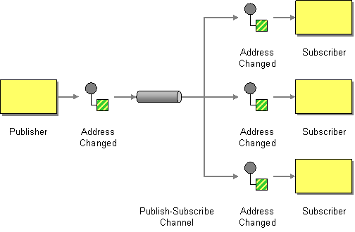
MOM service: pub/sub queue

Slide 11
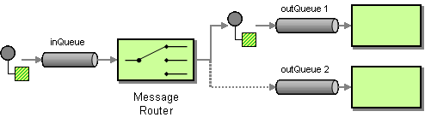
MOM service: routing

Slide 12
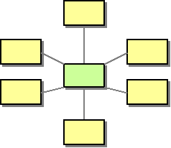
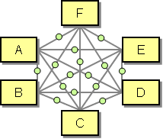
MOM service: broker

Slide 13
MOM characteristics
Queues decouple:
  FIFO or priority (job) queues
  Message Broker turns queue into service

Slide 14
MOM characteristics
Queues decouple:
  FIFO or priority (job) queues
  Message Broker turns queue into service
Endpoint models:
  point-to-point (1:1, peer-to-peer, request/reply)
  publish/subscribe (m:n)

Slide 15
MOM characteristics
Queues decouple:
  FIFO or priority (job) queues
  Message Broker turns queue into service
Endpoint models:
  point-to-point (1:1, peer-to-peer, request/reply)
  publish/subscribe (m:n)
QoS guarantees:
  at-most-once (<2, “best effort”)
  at-least-once (>0, needs idempotent receiver)
  once-and-once-only (== 1)

Slide 16
MOM uses and benefits
Reduce impact of change (EAI)
  tight coupling: 1 change => n other changes
  loose coupling: 1 change in 1 place
Simplified application design
  messaging component external
  language-agnostic

Slide 17
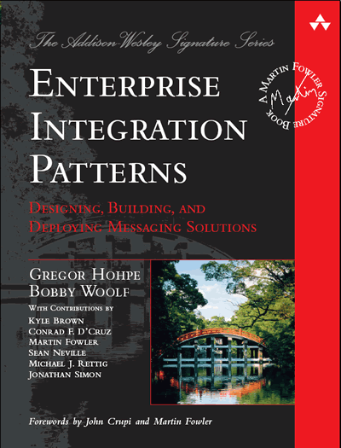

2. Enterprise MoMs

Slide 18

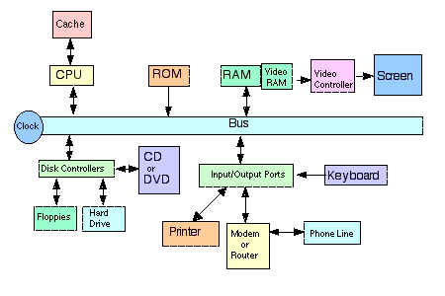
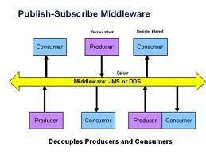
The Information Bus
1983: pub/sub origin at TIB
Uses software message bus for
    continuous operation (24/7 availability)
    dynamic evolution (room for extension & change)
    legacy systems (need to talk to new software)

Slide 19
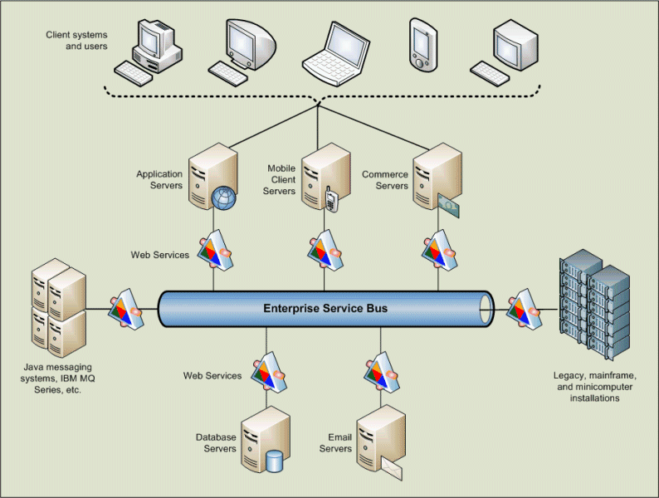
From TIB to ESB

Slide 20
From TIB to ESB
1985: Goldman Sachs
1994: Reuters buys TIBCO

Slide 21


From TIB to ESB
1985: Goldman Sachs
1994: Reuters buys TIBCO
1993: IBM MQseries (later Websphere)
1997: Microsoft Message Queue (MSMQ)
2001: Java Message Service
  tries to solve vendor-lock in
  using JDBC-like “glue API”
  JSR-000914

Slide 22

MOM Standardization

Slide 23
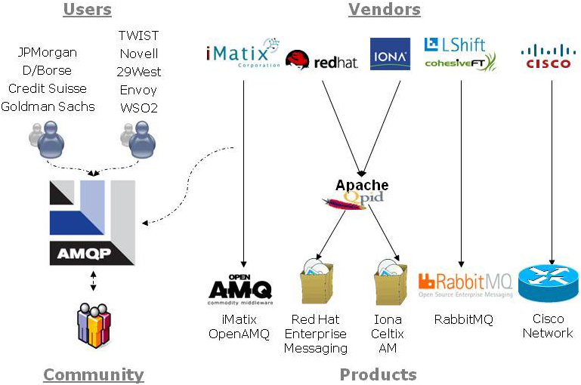
AMQP Working Group

Slide 24
AMQP Defining Features
”enough MOM semantics [...] to meet
the needs of most commercial systems”
extends popular JMS semantics

Slide 25
AMQP Defining Features
”enough MOM semantics [...] to meet
the needs of most commercial systems”
extends popular JMS semantics
unlike JMS, defines wire-level protocol:
  flow-controlled communication
  delivery guarantees (including exactly-once)
  authentication/encryption based on SASL, TLS
supports high-speed trading

Slide 26

AMQP
2003: JPMorgan Chase (John O'Hara)
2004: iMatix C broker (Pieter Hintjens)
2005: Apache Qpid (Java/C++)
2006: RabbitMQ, London (Erlang/OTP)

Slide 27
AMQP
2003: JPMorgan Chase (John O'Hara)
2004: iMatix C broker (Pieter Hintjens)
2005: Apache Qpid (Java/C++)
2006: RabbitMQ, London (Erlang/OTP)
2008: AMQP 0.9.1 (“stable”)
2011: AMQP 1.0 (“testing”)
2012: OASIS standard
2014: ISO/IEC 19464

Slide 28
AMQP Basics
defines messaging capabilities
  stores messages if receiver offline
  message tags/topics used for routing

Slide 29
AMQP Basics
defines messaging capabilities
  stores messages if receiver offline
  message tags/topics used for routing
components:
  exchange: producer publishes message to
  queue: stores message for consumer
  binding: governs message routing from exchange to particular queue(s)

Slide 30
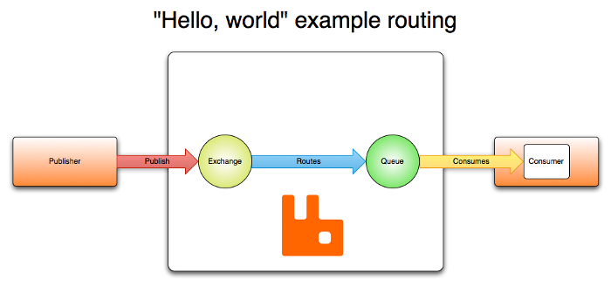
AMQP Basics

Slide 31
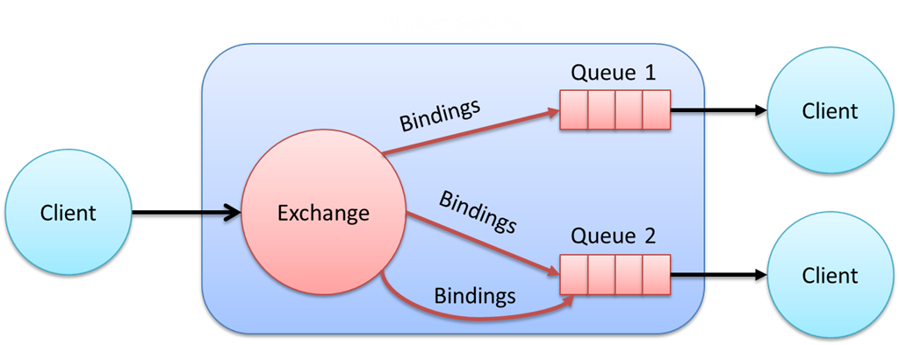
AMQP Basics

Slide 32
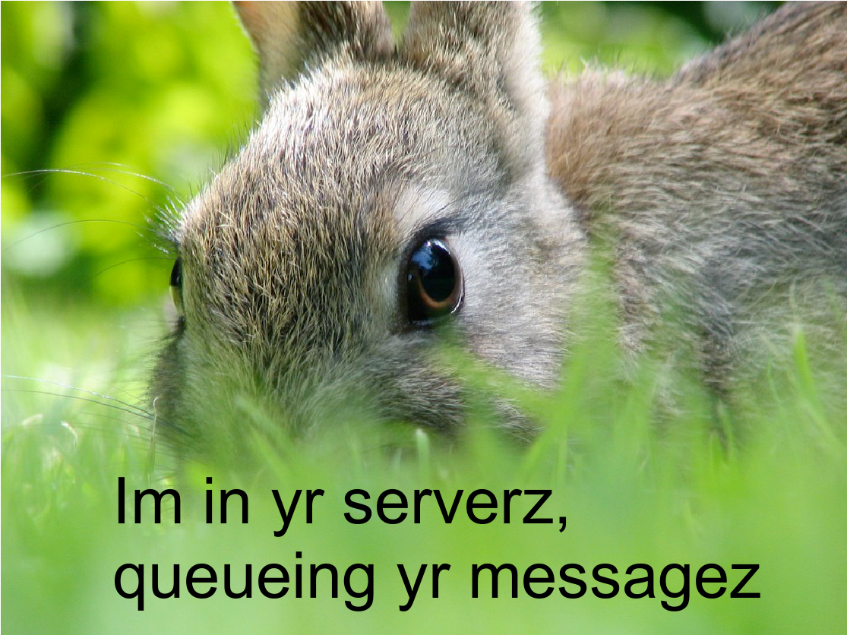

Slide 33

implements AMQP 0.9.1
rock-solid, stable
based on Erlang/OTP
see talk:
“Evolution of AMQP at Soundcloud”
Sebastian Ohm, Tomás Senart
Erlang User Conference 2013

Slide 34
AMQP to Go
Soundcloud RabbitMQ 0.9.1
https://github.com/streadway/amqp
RabbitMQ Go examples: https://github.com/rabbitmq/rabbitmq-tutorials/tree/master/go
Via RabbitMQ HTTP mgmt API: https://github.com/michaelklishin/rabbit-hole
Relay AMQP wrapper: https://github.com/armon/relay
Apache Qpid Go examples:
https://github.com/apache/qpid-proton

Slide 35
Standards after AMQP ...
AMQP 1.0 spec drops broker details
SOA demand for reactive systems:
  willing to trade off speed for consistency and/or reliability
  0MQ, LinkedIn, Twitter, Facebook ...

Slide 36


AMQP is a protocol
ØMQ is a messaging library:
  no message queues
  does not define a broker
  low-level socket/messaging primitives
  abstractions for messaging patterns
  focus on high-performance
Go clients:
  https://github.com/zeromq/goczmq ZMQ v3
  https://github.com/pebbe/zmq4 ZMQ v4
nanomsg/libmill (go-like concurrency)

Slide 37
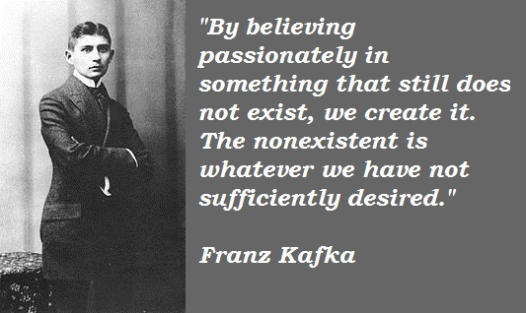
Kafka

Slide 38

Apache Kafka
broker developed at LinkedIn:
  to help with high-speed Hadoop ingest
  sustain “firehose throughput”

Slide 39
Apache Kafka
broker developed at LinkedIn:
  to help with high-speed Hadoop ingest
  sustain “firehose throughput”
unique features:
  each topic is treated as a commit log
  data partitioning
  scalable & low latency
  messages are persisted on disk and
  replicated within the cluster

Slide 40
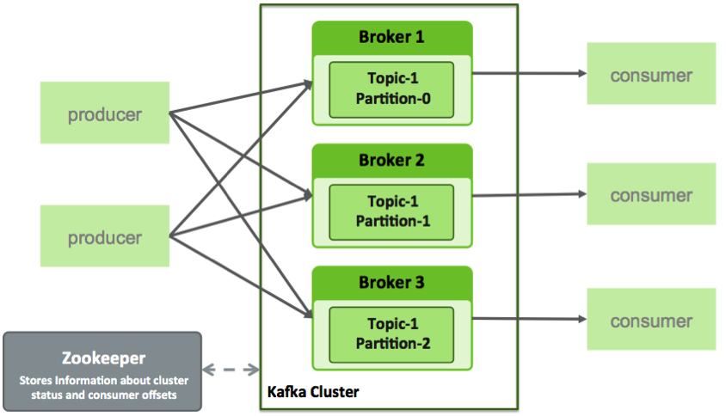
Kafka Architecture

Slide 41

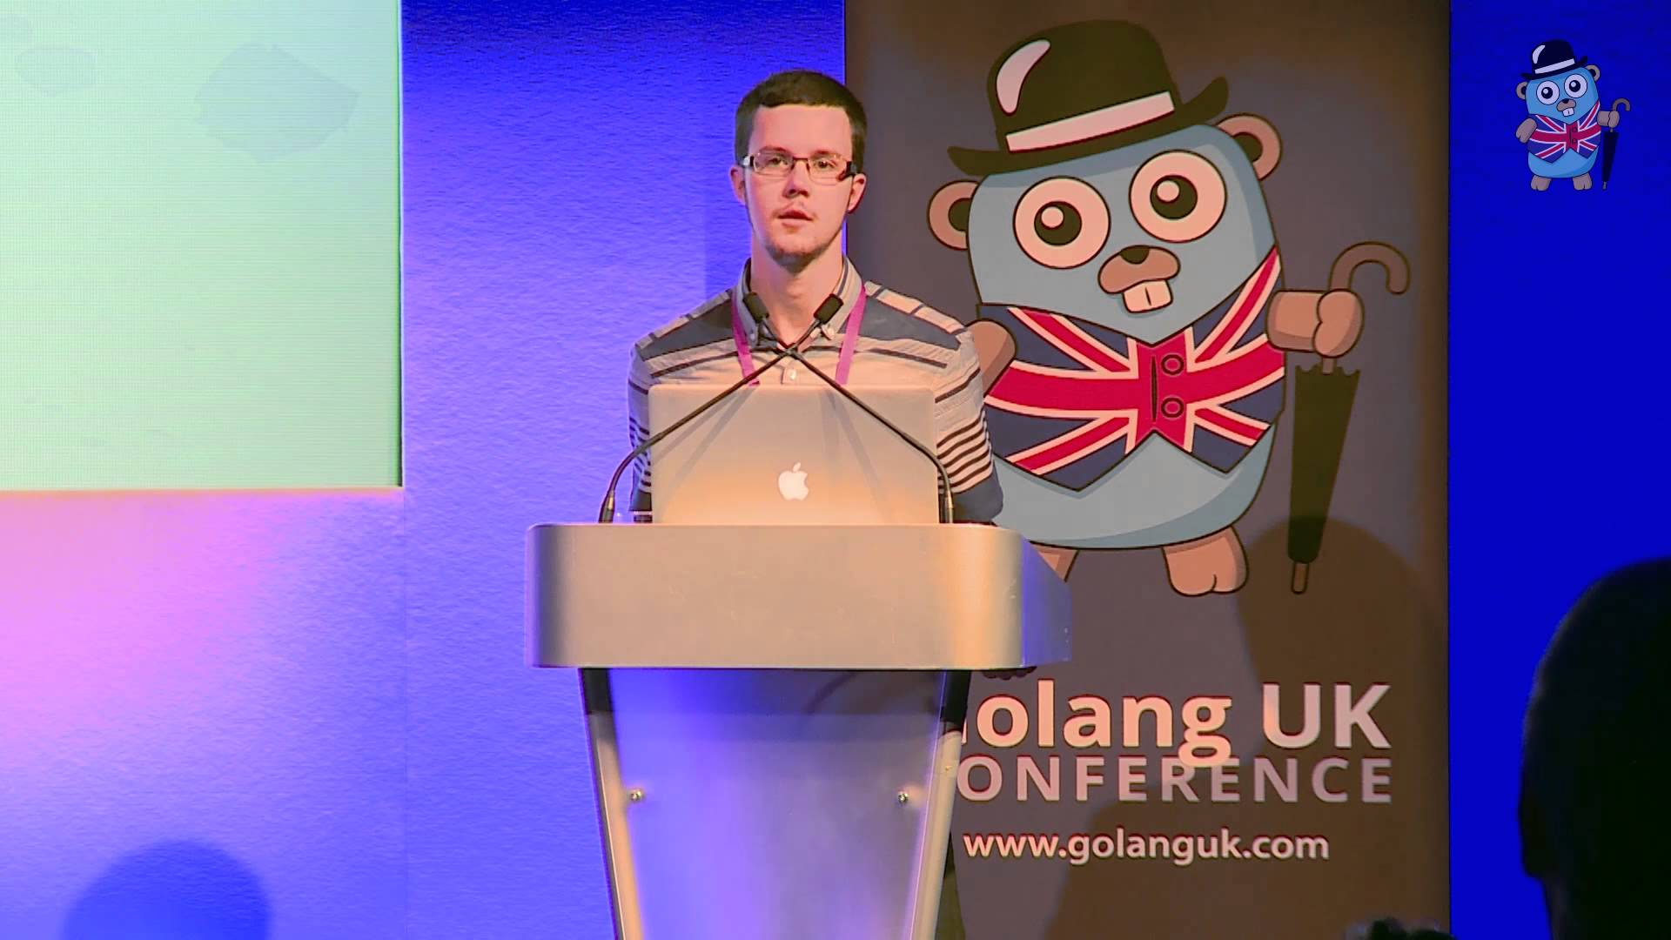
Sarama: Go 4 Kafka
developed at Shopify
Repos:
https://github.com/Shopify/sarama
https://github.com/eapache
see talk:
“Complex Concurrency Patterns in Go”
Evan Huus
Golang UK 2015

Slide 42


High-performance system used at Apcera, Baidu, Siemens, vmWare
https://github.com/nats-io/gnatsd
Trade-offs:
  lightweight (server in Go, ruby/Go clients)
  at-most-once delivery
  no persistence or transactions
see talk:
“High Performance Systems in Go”
Derek Collison (Apcera)
GopherCon 2014

Slide 43


NSQ
Trade-Offs:
  for real-time distributed messaging
  horizontal scaling without brokers
  primarily an in-memory queue
    messages not durable
    message order not guaranteed
    at-least-once delivery (idempotent receiver)
https://github.com/nsqio/nsq
see talk:
“Spray Some NSQ On It”
Matt Reiferson
GopherCon 2014

Slide 44

Redis & Go
in-memory store (like memcached)
  with persistence to disk, more datatypes
  interesting for realtime, but not reliability

Slide 45
Redis & Go
in-memory store (like memcached)
  with persistence to disk, more datatypes
  interesting for realtime, but not reliability
Redis Message Queue in Go:
https://github.com/adjust/rmq

Slide 46

Redis & Go
in-memory store (like memcached)
  with persistence to disk, more datatypes
  interesting for realtime, but not reliability
Redis Message Queue in Go:
https://github.com/adjust/rmq
Github's resque for background jobs:
http://github.com/resque/resque
https://github.com/kavu/go-resque
  resque compatible Goworker:
    10..1000 times faster than ruby-based workers
    https://www.goworker.org/

Slide 47

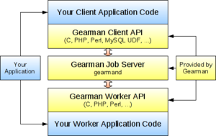
Job Server
Load-balance jobs across workers
  conceptually related to map-reduce
  binary protocol
  original in Perl,now in C
  Fitzpatrick: manaGer
Go Gearman API (client/worker):
https://github.com/mikespook/gearman-go

Slide 48

beanstalkd
fast, simple, in-memory work queue
  simple, text-based protocol a la memcached
  3 job states (ready, reserved, buried)
  transactional
Go beanstalk:
https://github.com/kr/beanstalk
https://github.com/manveru/gostalk
https://github.com/iwanbk/gobeanstalk
https://github.com/99designs/cmdstalk
https://github.com/nutrun/lentil

Slide 49
Machinery - Go
asynchronous task queue/job queue
  to execute distributed jobs in parallel
  inspired by Python celery task queue
with choice of broker:
  RabbitMQ or
  Redis
https://github.com/RichardKnop/machinery

Slide 50


STOMP
Simple Text Orientated Messaging Protocol
  Http-like commands (SEND, SUBSCRIBE, COMMIT, ACK, ABORT, ACK, NACK, …)
  https://stomp.github.io/
supported by RabbitMQ,
ActiveMQ plugins
Go Stomp:
https://github.com/go-stomp/stomp
https://github.com/gmallard/stompngo

Slide 51

In search of Patterns

Slide 52

In search of Patterns
Go-kit patterns:
  rate-limiter
  circuit breaker
  load-balancer
  tracing
https://github.com/go-kit/kit
Talk:
“Go kit: a toolkit for microservices”
Peter Bourgon
GopherCon 2015, Golang UK 2015

Slide 53
In search of Patterns
Evan Huus resiliency patterns:
  circuit-breaker
  deadline/timeout
  batching
  retrier
https://github.com/eapache/go-resiliency
Talk:
“Complex Concurrency Patterns in Go”
Evan Huus
Golang UK, August 2015

Slide 54
Wrap-up
breadth of MOM implementations
what about depth?

Slide 55
Wrap-up
breadth of MOM implementations
what about depth?
example: RabbitMQ in Erlang
  complex spec in 5000 lines of code
  solves hard concurrency problems

Slide 56
Wrap-up
breadth of MOM implementations
what about depth?
example: RabbitMQ in Erlang
  complex spec in 5000 lines of code
  solves hard concurrency problems
what are the strengths of Go here?

