Slide 1
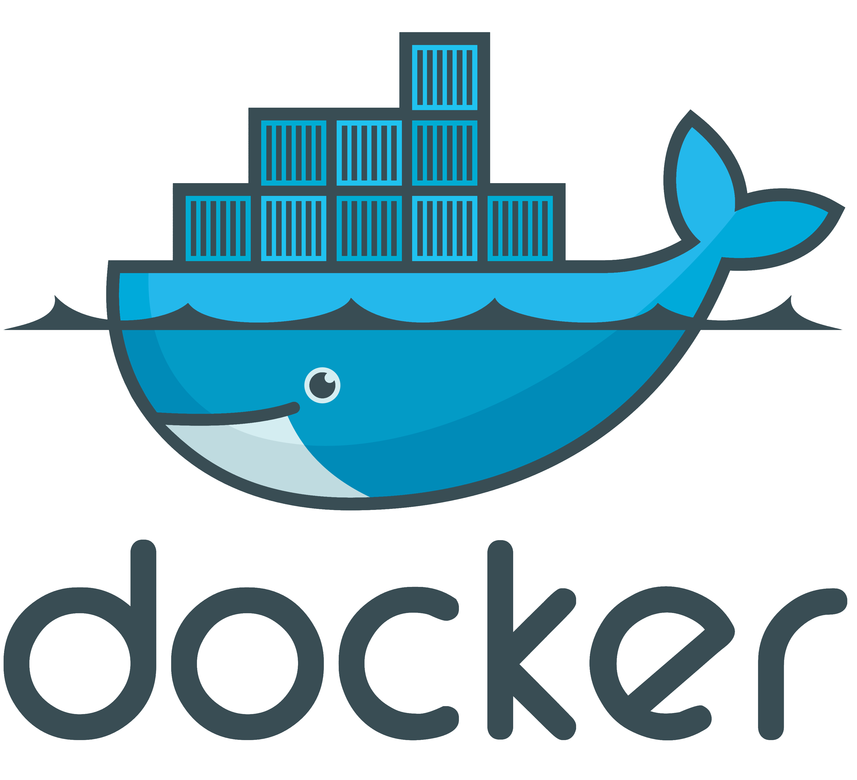
On Windows

Slide 2
Objectives
Overview to deliver applications using container technologies.
How to get image to create container?
How to create and run container?
How to check specific container’s configuration?
How to connect application and database containers?

Slide 3
What s a Container?
A containers is an isolated, resource controlled, and portable operating environment. A container provides a place where an application can run without affecting the rest of the system and without the system affecting the application.
If you were inside a container, it looks very much like you are inside a freshly installed physical computer or a virtual machine.
Looks like VM
Quick build and start up time
Light weight
Isolated environment

Slide 4
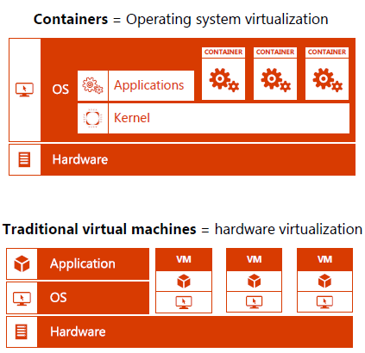
Container
Kernel:
Heart of the Operating System
Sharing OS Kernel
Managing communication with Hardware, Scheduling Processes and Resources (Memories and CPU Cycle).
Create isolation between containers and never share anything between containers.

Slide 5
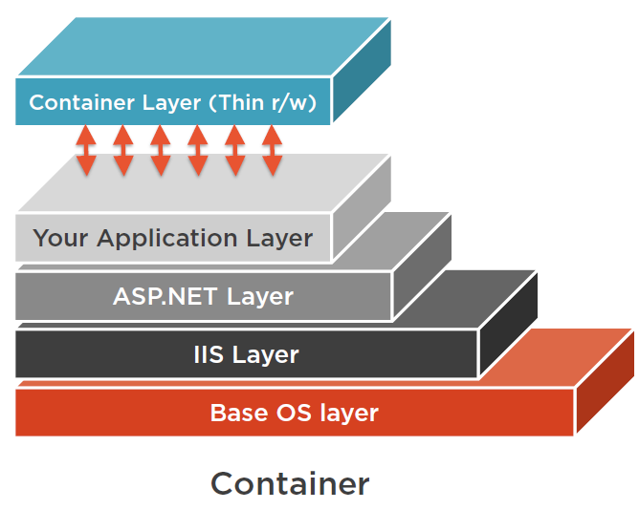
Difference Between an Image and a Container

Slide 6
Docker
Unification of container technology
A set of command-line tools to work with container
A unified way to build Container images
A unified way of maintaining
A daemon process that manages the images and networking on a host machine
Docker Compose
Compose is a tool for defining and running multi-container Docker applications.

Slide 7
Which .Net Framework to Choose?
Full .Net framework
.Net Core
Moving existing workloads to containers
Run on Windows
Feature rich workloads
Windows Server Core base image
Build new workloads
Run on Windows, Mac or Linux
Web workloads
Windows Nano Server base image

Slide 8
Dockerfile
FROM Microsoft/aspnet
ARG source
WORKDIR /inetpub/wwwroot
COPY ${source:-obj/Docker/Publish} .
The Dockerfile Debug/release Trick
Pass in argument at build
Debug -> obj/docker/empty
Release -> obj/docker/publish

Slide 9
The Yaml File {compose}
Services:
Webapplication1:
image: webapplication1
build:
context: ./WebApplication1
dockerfile: Dockerfile
The Yaml File Trick
The docker-compose file defines the services
Defines what to build

Slide 10
The Yaml File {override}
Services:
Webapplication1:
ports:
- “80”
networks:
default:
external:
name: nat
The Yaml File Trick
The override file defines the ports and networking

Slide 11
The Yaml File {Debug}
Services:
Webapplication1:
image: webapplication1:dev
build:
args:
source: ${DOCKER_BUILD_SOURCE}
volumes:
- .\WebApplication1:C:\inetpub\wwwroot
~\msvsmon:C:\msvsmon:ro
The Yaml File Trick
The arg dockerfile get’s the DOCKER_BUILD_SOURCE value == obj\docker\empty
Volume mapping to c:\inetpub\wwwroot
Volume mapping to local user folder (~) on host to remote debugger

Slide 12
The Yaml File {Release}
Services:
Webapplication1:
image: webapplication1:dev
build:
args:
source: ${DOCKER_BUILD_SOURCE}
volumes:
~\msvsmon:C:\msvsmon:ro
The Yaml File Trick
The arg dockerfile get’s the DOCKER_BUILD_SOURCE value == obj\docker\publish
Volume mapping to c:\inetpub\wwwroot
Volume mapping to local user folder (~) on host to remote debugger

Slide 13
Docker Command-Line Interface
These Docker commands start a container, create a new folder on the
file system, exits the container, thus topping it and then committing the resulting state as a new image to be used and started later
docker pull microsoft/windowsservercore
docker run –it microsoft/windowsservercore cmd.exe
docker stop <container Id> docker exec <container name> ipconfig
docker ps docker ps -a docker images docker inspect docker network
docker run -d -p 80:80 microsoft/iis docker run -d -p 1433:1433 -v C:/temp/:C:/temp/ -e sa_password=<YOUR SA PASSWORD> -e ACCEPT_EULA=Y -e attach_dbs="<DB-JSON-CONFIG>" microsoft/mssql-server-windows

Slide 14
Demo

Slide 15
Reference
https://docs.docker.com/docker-for-windows/
https://docs.docker.com/compose/reference/overview/
https://store.docker.com/images/windowsservercore
https://hub.docker.com/r/microsoft/mssql-server-windows-developer/

