Slide 1
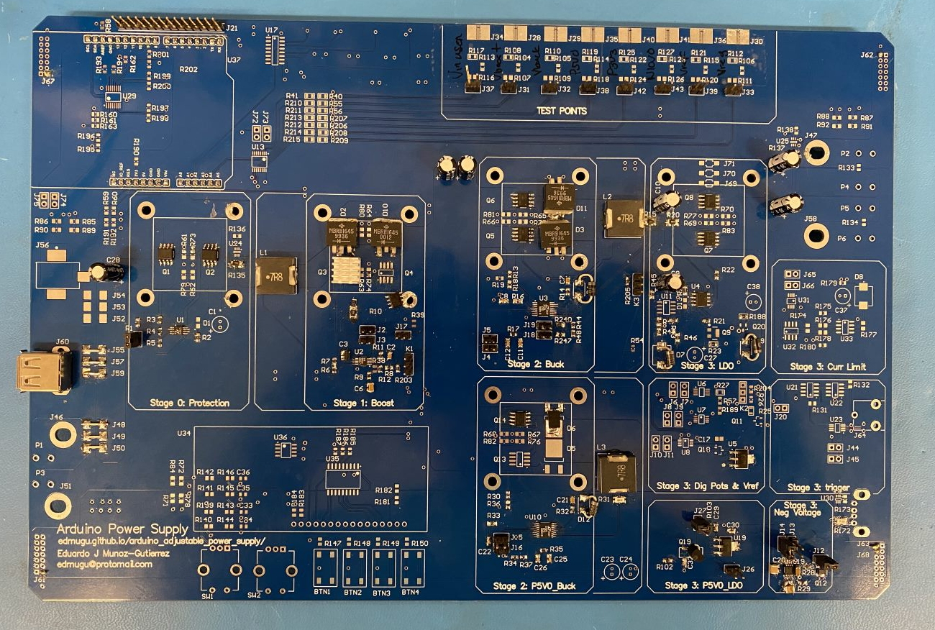
Good
Good
Good
Good
Good
Good
Good

