Slide 1
PSP0101 – PROBLEM SOLVING AND PROGRAM DESIGN
PYTHON PROJECT

Slide 2
GROUP MEMBER
NICHOLAS HO 1141128385
KEW FENG SHUN 1141128741
LIM YOU QIAN 1141128343
CHOY YOONG HONG 1141128372

Slide 3
INTRODUCTION
Why is it built?
This program is built to test users’ personality and let users learn some moral value such as rational and helpful. Throughout the story, users will know that every decision users made will affect the flow of the story negatively or positively. In detail, users have to be considerate, think of the current situation and be responsible to the every decision they made.
What kind of program is this?
This is a story game type program. Users are allowed to experience a real situation and cause the users more attracted to the story.
Who will be the user of this program?
a) Teenagers
b) Gamer

Slide 4
ROLES
a) Analyse the Requirements
Kew Feng Shun
b) Design Solution
Flowchart: Choy Yoong Hong
Algorithm:-
i. Navigation part – Nicholas Ho
ii. Storyline – Lim You Qian
iii. User Authentication – Choy Yong Hoong
iv. Records – Kew Feng Shun
c) Validate Design
Everyone, lead by Nicholas Ho
d) Implement Design
i. Navigation part – Nicholas Ho
ii. Storyline – Lim You Qian
iii. User Authentication – Choy Yong Hoong
iv. Records – Kew Feng Shun

Slide 5
USER MANUAL
1. Login with any pair of username and PIN given below:
i) username: hong
PIN: 1324
ii) username: Edmund
PIN: 4242
You have 3 chances to enter the username and PIN
2. Once you have logged in, you can see your previous record if you have played the game before.
3. You may exit if you just want to see your record or you do not want to play the game.
4. At the story part, you are allow to make some decisions by enter “a” or “b”. Every decision u made may change or affect the flow or the ending of the storyline.
5. Once you completed the story, you may choose whether you want to save your record or not.
6. You are allow to view your record.
7. You are allow to play the story again.

Slide 6
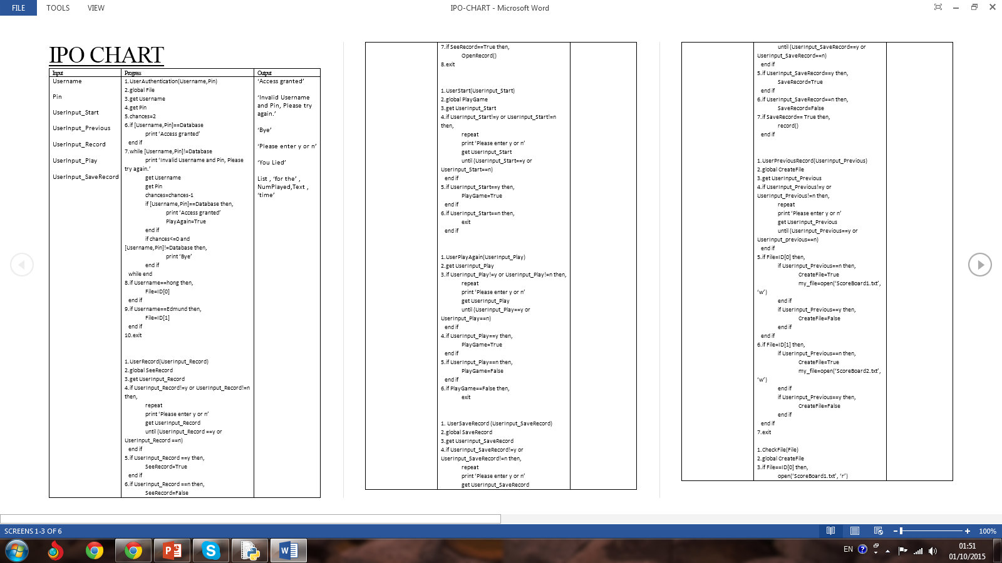
IPO CHART

Slide 7
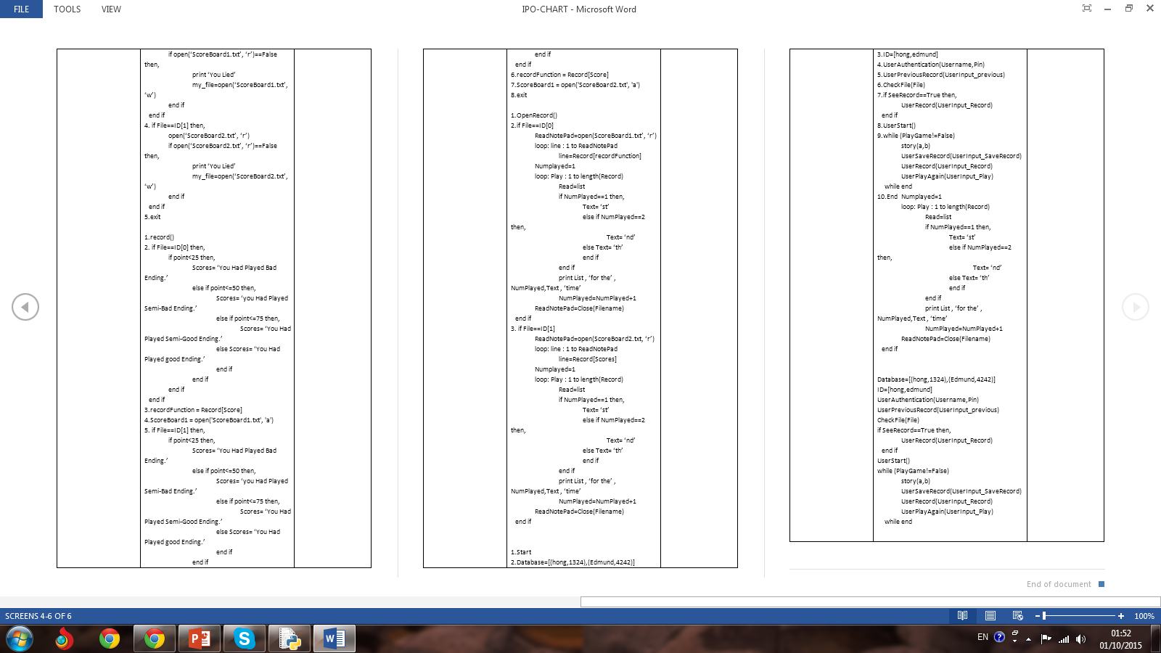

Slide 8
Flowchart

Slide 9
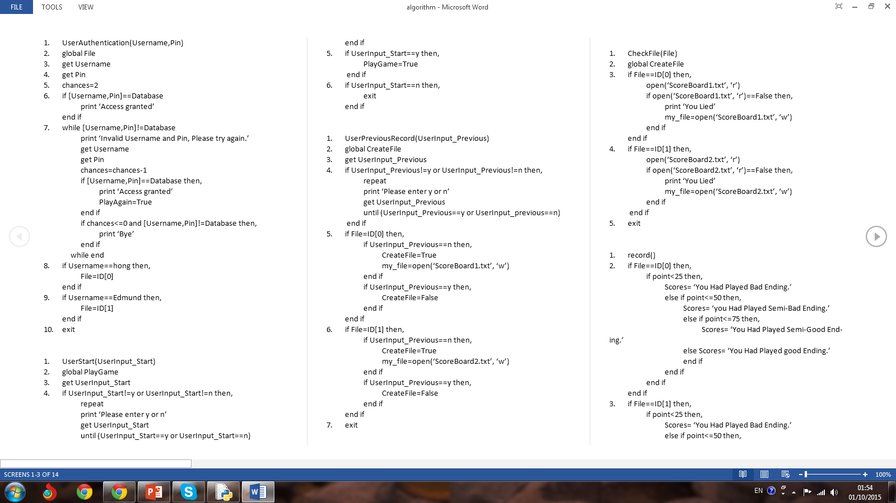
Algorithm

Slide 10
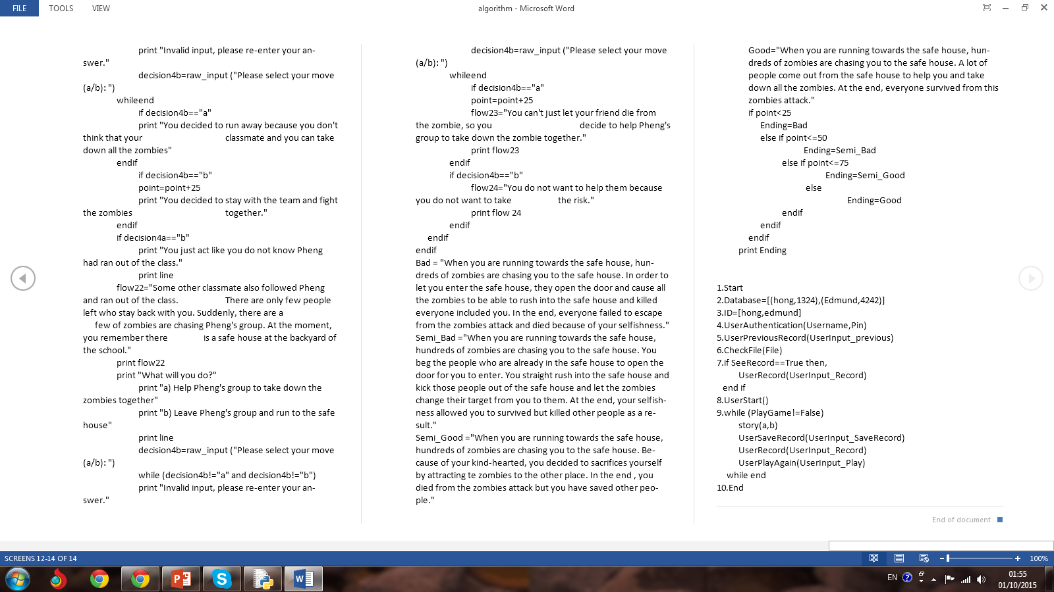

Slide 11
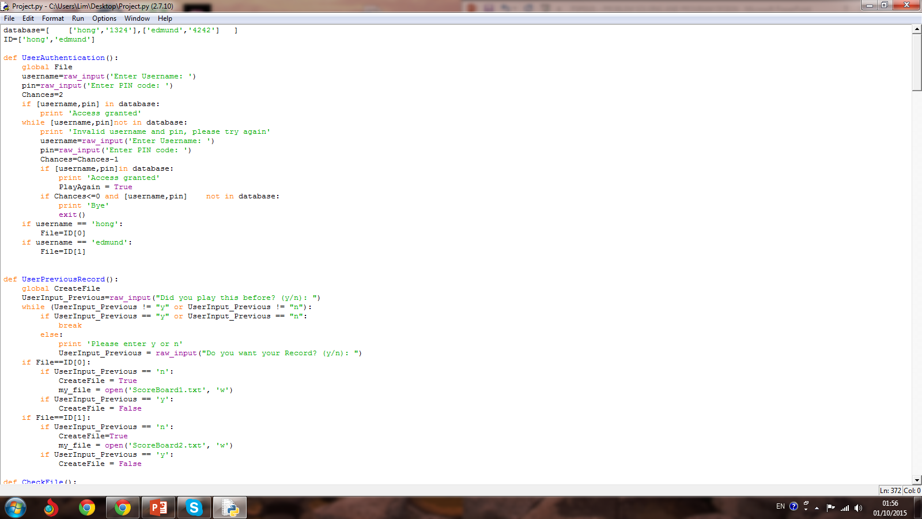
Python Code

Slide 12
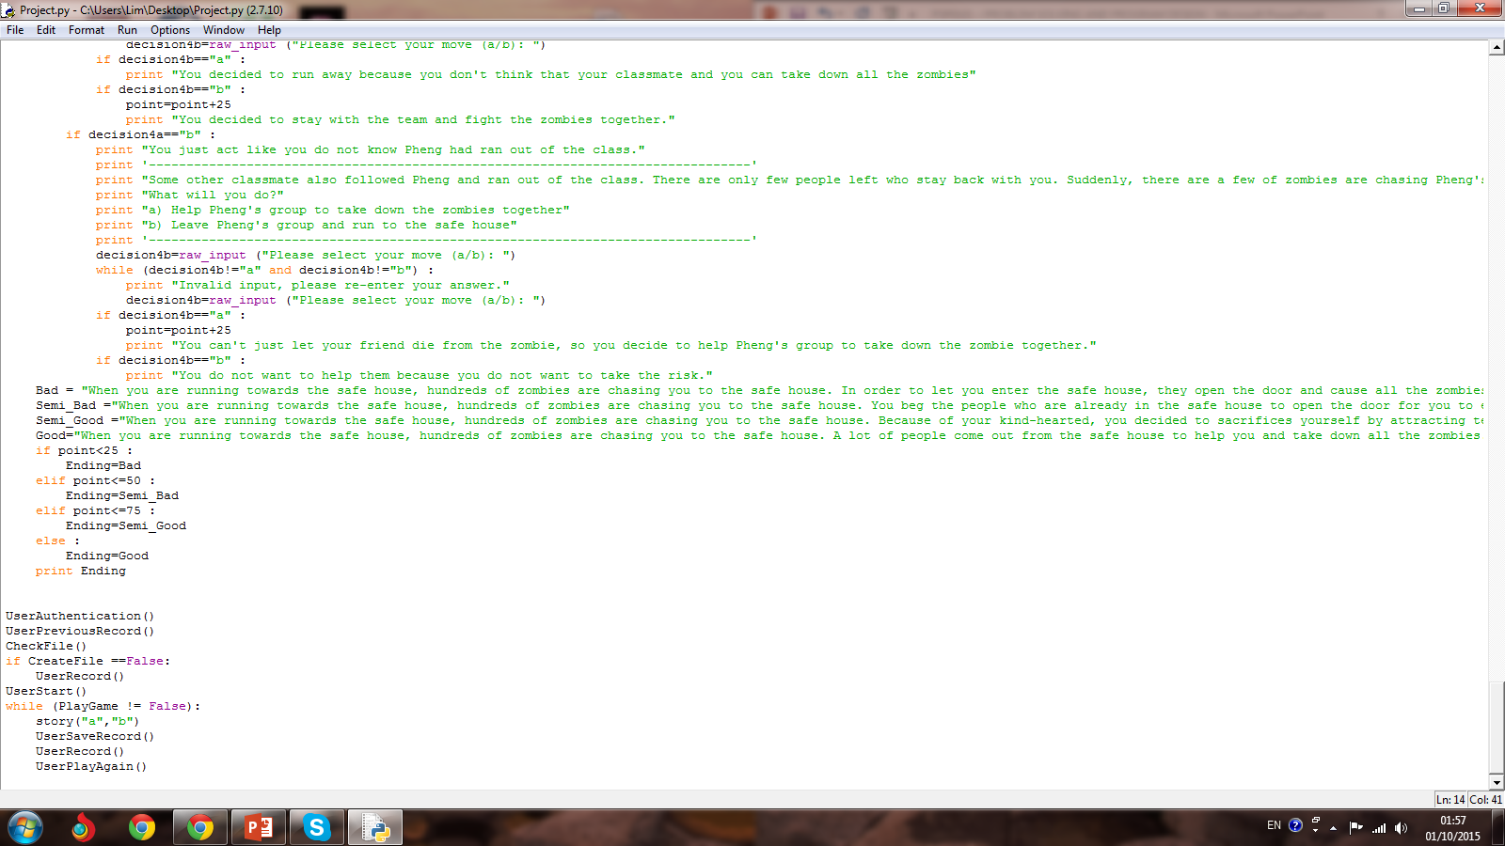

Slide 13
CONCLUSION
Recommendation and suggestion to improve the program
The completeness of the story.
the length of the storyline in the program is short.
The recording of data can be more complete.
Apply Graphical User Interface (GUI)

Slide 14
Challenges and problem faced during the program development
Arrangement of time for group meeting.
Different programming knowledge for each member.

Slide 15
WHAT WE HAVE LEARNT
Work as a team
Help each other
New knowledge that is not in syllabus

Slide 16
THANK YOU

