Slide 1
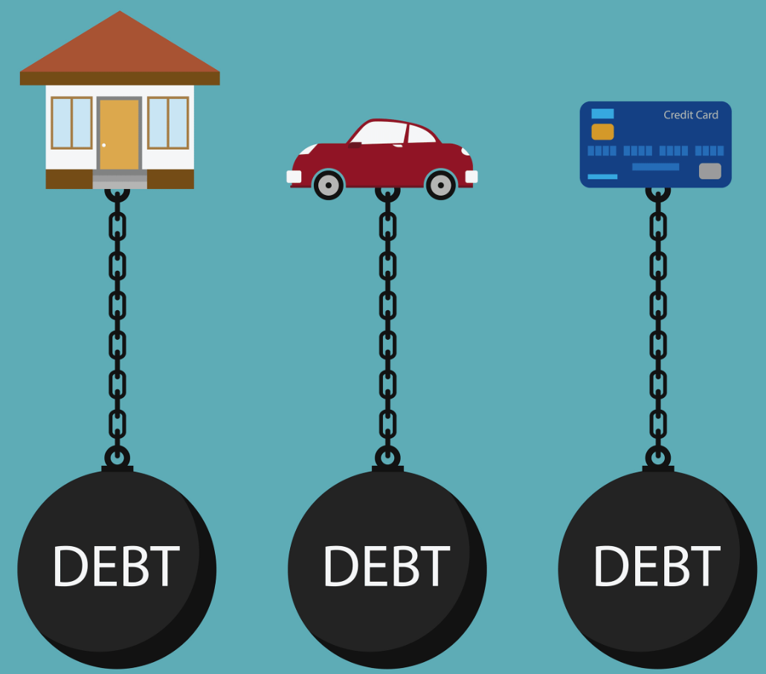
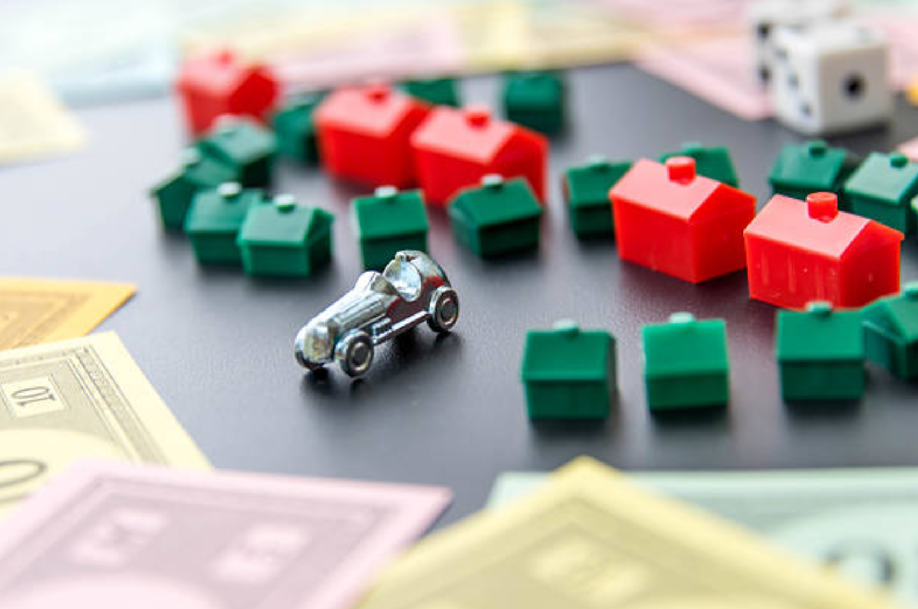
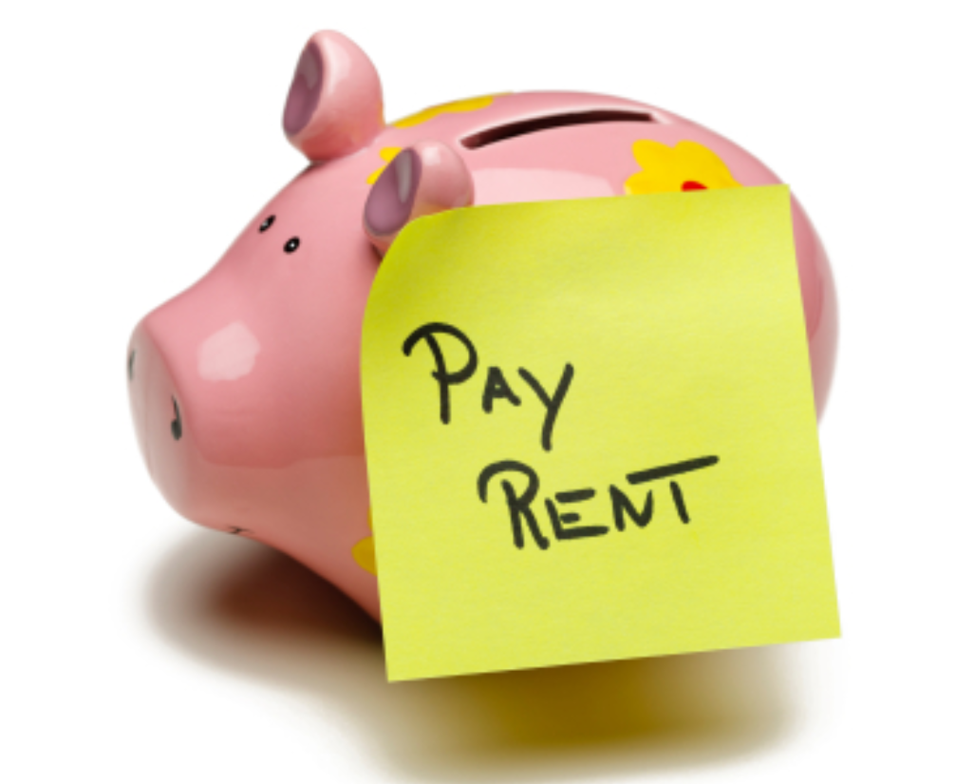
Households negatively exposed to interest rates
Households positively exposed to interest rates
High MPC
Reduce Spending
A LOT
Rate Increase $$
Low MPC
Increase Spending
A LITTLE
Households unexposed to interest rates
Very High MPC
But Spending
UNCHANGED

Slide 2
+
+
=

