Slide 1
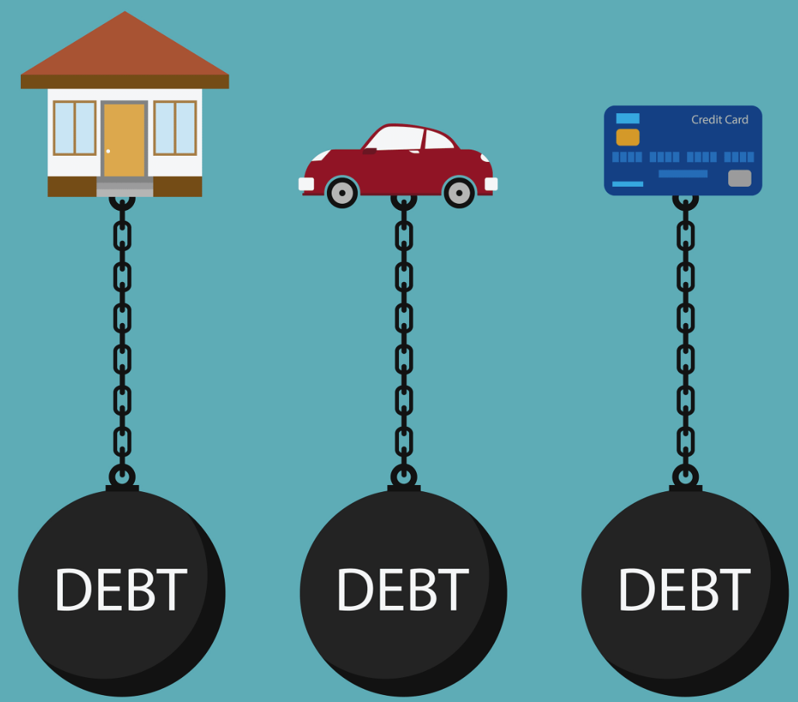
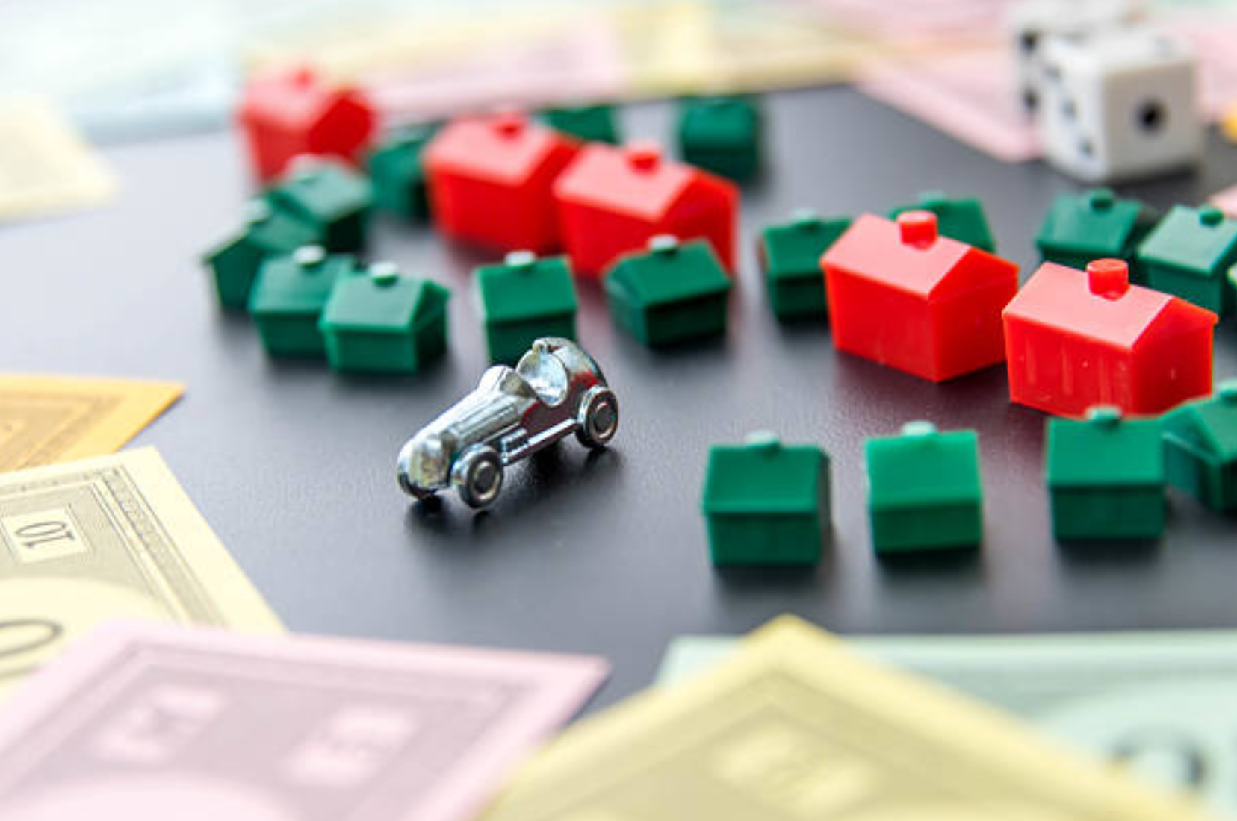
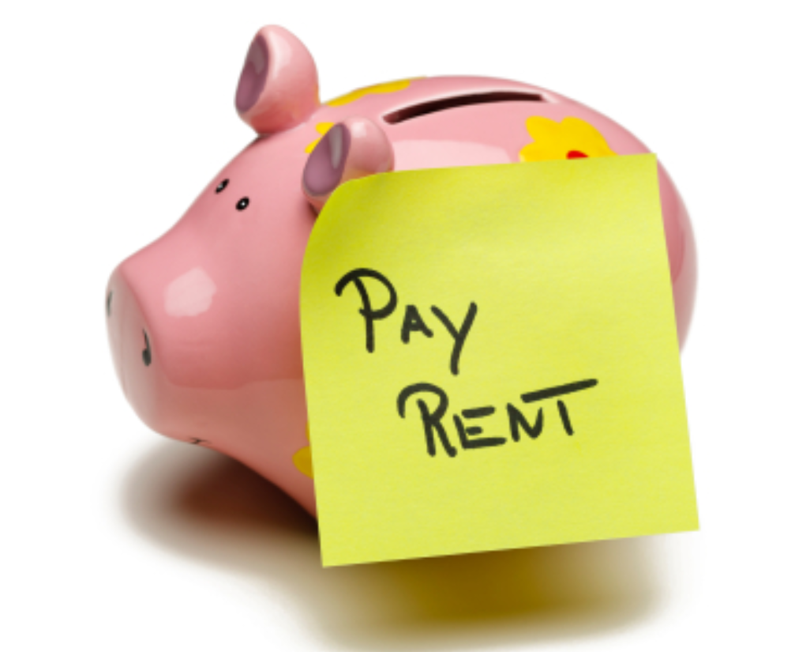
Households negatively exposed to interest rates
Households positively exposed to interest rates
High MPC
Reduce Spending
A LOT
Rate Increase $$
Low MPC
Increase Spending
A LITTLE
Households unexposed to interest rates
Very High MPC
But Spending
UNCHANGED

Slide 2
+
+
=
+
+
=

Slide 3

Wealthy Hand-to-Mouth
Poor Hand-to-Mouth
Wealthy
Spending
MPC ≈ 0.5
MPC ≈ 0.8
MPC ≈ 0.25
$$
$$
Interest Rate Hike
A one percentage point interest rate hike reduces aggregate expenditure by 26 basis points through this interest rate exposure channel alone
Redistribution > Intertemporal Substitution

Slide 4

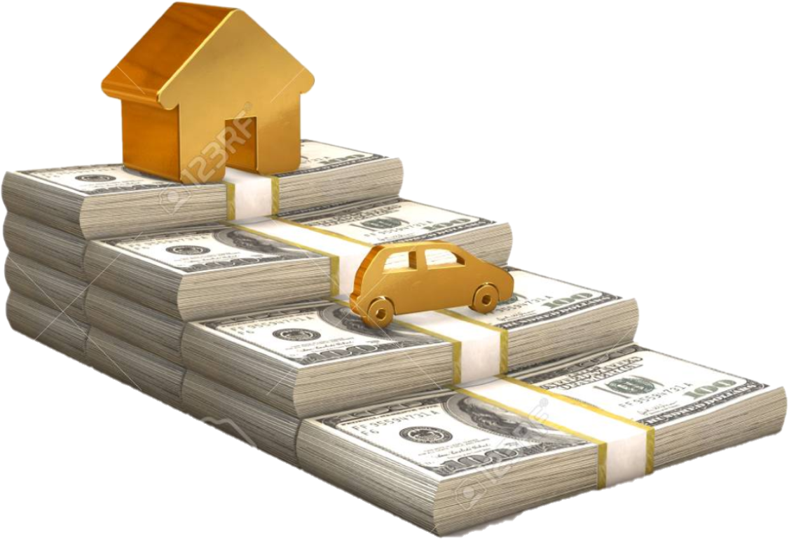
$$
Interest Rate Hike
$$
Medium MPX ≈ 0.5
High MPX
≈ 0.8
Low MPX
≈ 0.25
MPX: Marginal Propensity to eXpend (includes durables)

