Slide 1

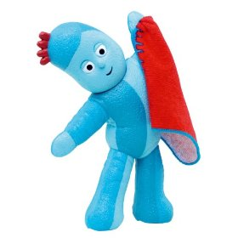
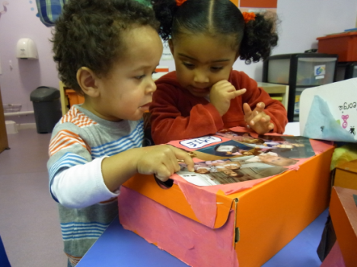

Children’s Centres
The Rowans
Sharing Stories
For fun, learning & happiness!
If you have children under 5, then join us for this fantastic, one-off workshop to learn about the value and importance of sharing stories!
Learn new tips and techniques for storytelling with your children, delivered by Michael Jones, a leading specialist in children’s speech and language development.
Thursday 2nd June 2011
At The Rowans Children’s Centre, Pondmoor Road, RG12 7JZ
There will be two workshops held during the day…
Workshop 1: 9.30 am – 11.30 am
Workshop 2: 12.30 pm – 2.45 pm
Call the centre on 01344 312800 to make your reservation
£2.00 per adult (£1.00 per adult for those in receipt of benefits)

