Slide 1
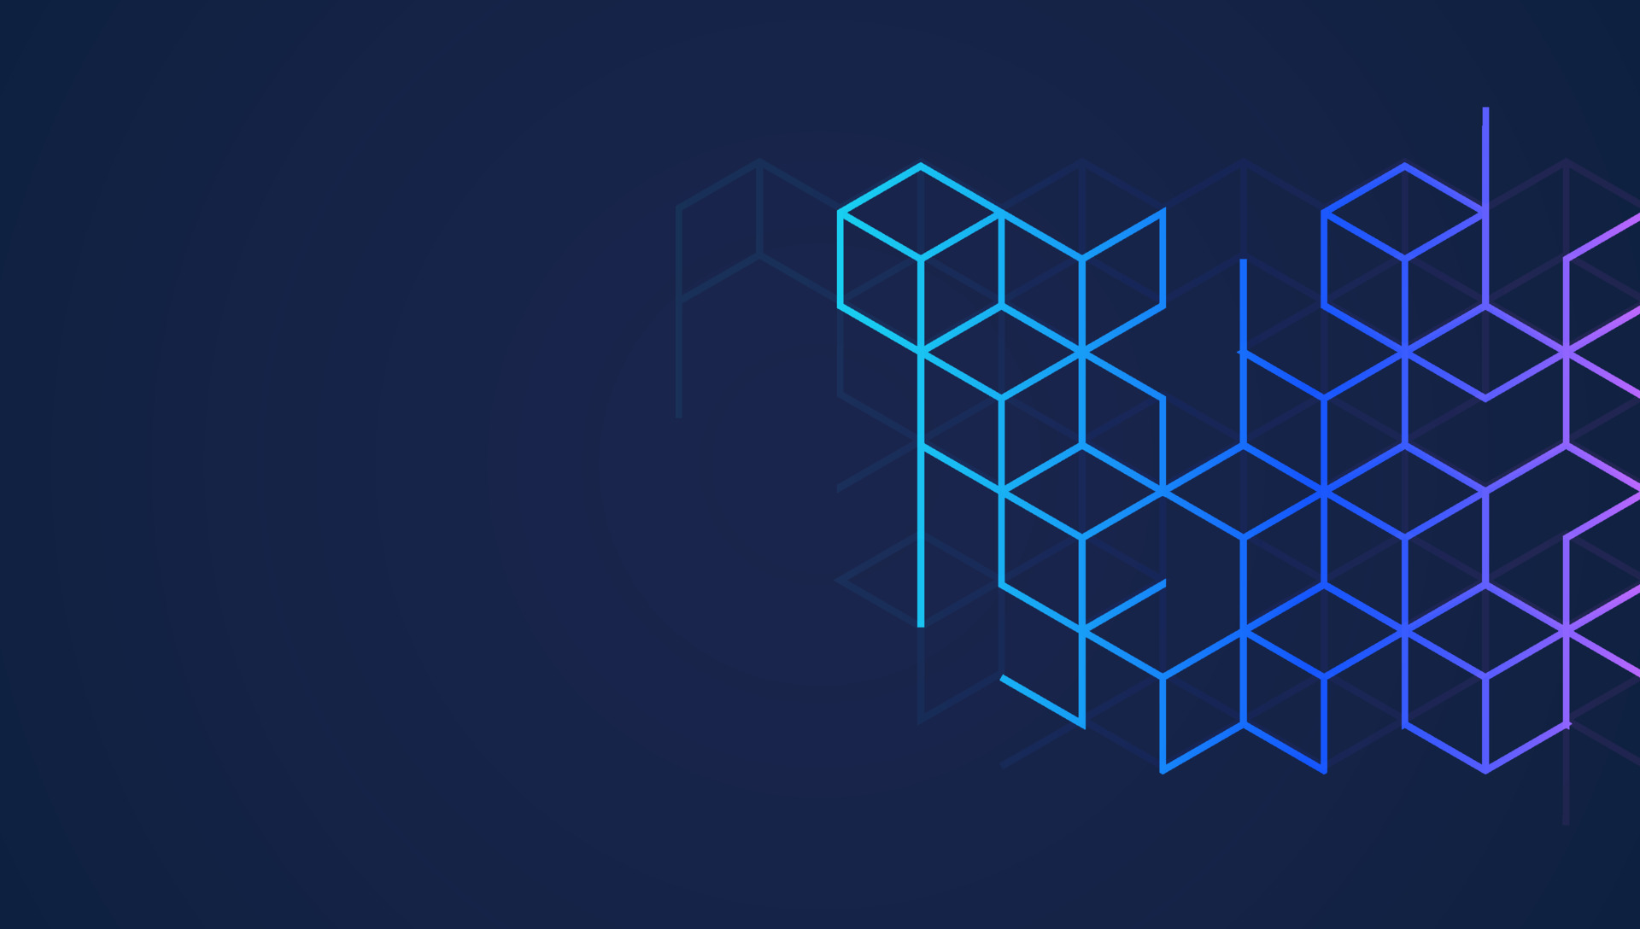
BELLS ACADEMY
COURSE TITLE : Problem Solving for IT Professionals (BC) Assessment Plan
Portfolio and Presentation (PP)
Full name : Tay Jun Xiang NRIC ( last 4 digits only ) : 737I DATE of submission : 02 Dec 2023

Slide 2
Blockchain Case Study
Solidity Smart Loyalty Application
Action Plan
By Tay Jun Xiang 737I
Notes:
Today we are presenting the action plan to implement the smart loyalty application in Solidity language to ensure the project success.

Slide 3
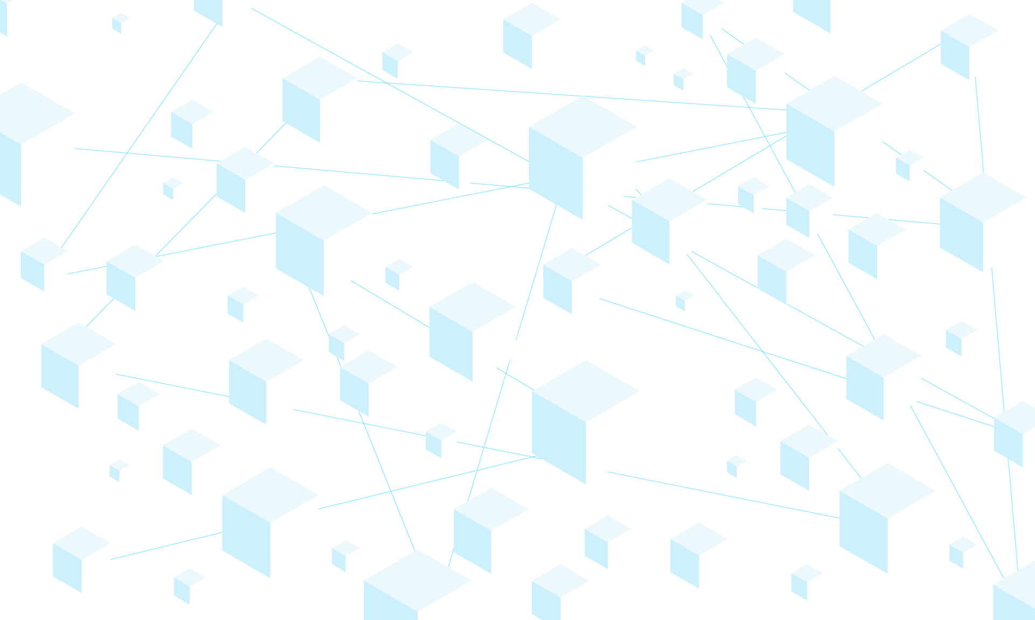
Solidity Smart Loyalty Application Action Plan
Table of Contents
Identify the Key Steps to Develop the Application
Identify the Dependencies in the Development Process
High Level Timeline
Potential Risks
Evaluation of Resources, Technologies and Team’s Capability

Slide 4
Solidity Smart Loyalty Application Action Plan
Identify the Key Steps to Develop the Application
Define the Scope and Objectives
Select the Blockchain Platform
Setup the Development Environment
Design and Develop the Smart Contract
Create the User Interface
Testing and Deployment
Post Implementation Maintenance and Updates
Notes:
Step 1: Define the Scope and Objectives
Clearly define the purpose of the application, identifying the problem it aims to solve and the value it will bring to users.
Determine the target audience and their specific needs and expectations.
Outline the core functionalities and features of the application, ensuring they align with the overall objectives.
Step 2: Select the Blockchain Platform
Research and evaluate various blockchain platforms based on factors such as scalability, security, community support, and development tools.
Consider the specific requirements of the application, such as transaction speed, gas fees, and smart contract language compatibility.
Popular options include Ethereum, Polygon, EOS, and Solana.
Step 3: Set Up Development Environment
Install the necessary software tools, including a code editor like Remix, a JavaScript runtime environment like Node.js and UI/UX editor.
Configure a local blockchain network or connect to a public testnet for testing and development purposes.
Configure a Web3 wallet
Configure a test token like Sepolia
Familiarize with the smart contract language of the chosen blockchain platform, such as Solidity.
Step 4: Design and Develop the Smart Contract
Define the smart contract's structure, including state variables, functions, and events.
Implement the smart contract's logic, ensuring it accurately represents the desired functionality of the application.
Thoroughly test the smart contract to identify and fix any bugs or security vulnerabilities.
Deploy the smart contract to the chosen testnet.
Step 5: Create the User Interface (UI)
Select appropriate front-end development tools and frameworks, such as HTML, CSS, JavaScript, and React or Angular.
Design a user-friendly interface that seamlessly interacts with the deployed smart contract.
Implement the UI logic, ensuring it securely connects to the blockchain and provides a smooth user experience.
Step 6: Testing and Deployment
Conduct rigorous testing of the dApp, including functional testing, UI/UX testing, and security testing.
Gather feedback from potential users to refine the dApp's functionality and usability.
Deploy the dApp to a production blockchain network, ensuring it is accessible to the intended audience.
Step 8: Ongoing Maintenance and Updates
Monitor the dApp's performance and address any issues that arise.
Regularly update the smart contract and front-end code to incorporate new features, fix bugs, and enhance security.
Engage with the community and respond to user feedback to maintain a vibrant and responsive dApp.

Slide 5
Solidity Smart Loyalty Application Action Plan
Identify the Dependencies in the Development Process
Level of technical expertise in the team
Level of familiarity with blockchain technologies
Accessibility to a testnet
Adequacy of hardware, software and human resources
Reliable Internet connection to the blockchain platform
Notes:
Dependencies - Elaborate more context
Technical expertise in blockchain technology, smart contract development, and front-end development
Familiarity with the chosen blockchain platform and its development tools
Access to a blockchain network or local testnet for development and testing purposes
Adequate computing resources to compile and deploy the smart contract
Reliable internet connection for interacting with the blockchain

Slide 6
Solidity Smart Loyalty Application Action Plan
High Level Timeline
Phase 1 - Planning and Design (4 weeks)
Define the scope, objectives, target audience and deliverables
Phase 2 - Development and Testing (6 weeks)
Develop the smart contract and UI
Conduct rigorous testing
Phase 3 - Deployment (2 weeks)
Deploy the application to the Ethereum network
Monitor performance, gather user feedback and address issues.
Phase 4 - Maintenance
Provide ongoing maintenance and updates
Notes:
The development timeline for a dApp will vary depending on the complexity of the application, the team's experience, and the availability of resources. However, a typical timeline might include:
Phase 1: Planning and Design (2-4 weeks)
Define the dApp's scope, objectives, and target audience
Select the blockchain platform and development tools
Design the smart contract architecture and UI mockups
Phase 2: Development and Testing (4-8 weeks)
Develop the smart contract and UI
Conduct rigorous testing to ensure functionality, security, and user experience
Phase 3: Deployment and Maintenance (2-4 weeks)
Deploy the dApp to a production blockchain network
Monitor performance, address issues, and gather user feedback
Provide ongoing maintenance and updates

Slide 7
Solidity Smart Loyalty Application Action Plan
Potential Risks
Technical challenges
The team may not have the necessary skills like front-end user interface development.
The team may not be familiar with Solidity language.
Security vulnerabilities
Security vulnerabilities may be left undetected in the development stage and lead to hacks and financial loses and affect company reputation.
Regulatory compliance
Regulations for blockchain applications are constantly changing and we need to be aware if our application comply with new regulations.
User adoption
Challenges in attracting and retaining users
Sustainability
Maintenance and regularly updating the application requires sustainable resources from the team
Notes:
Potential Risks - Emphasise that pt 1, 2 and 5 is important to the development team
Technical challenges: Smart contract development, blockchain integration, and front-end development can be complex and require specialized expertise.
Security vulnerabilities: Smart contracts and dApps are susceptible to security vulnerabilities that could lead to hacks or financial losses.
Regulatory compliance: The legal and regulatory landscape surrounding dApps is evolving, and developers need to stay informed about compliance requirements.
User adoption: Attracting and retaining users for a dApp can be challenging in a competitive market.
Sustainability: Maintaining and updating a dApp requires ongoing resources and commitment from the development team.

Slide 8
Solidity Smart Loyalty Application Action Plan
Evaluation of Resources, Technologies and Team’s Capability
Identify required resources
Assess resource availability
Evaluate the suitability of available technologies for the application development
Assess the team’s capabilities, experience and track record
Identify gaps in team and team members and recommend appropriate training
Employ evaluation tools like resource management software, project management tools and risk assessment tools.
Notes:
1. Assess Resource Availability
Identify Required Resources: Begin by listing all the resources needed to complete the task, including personnel, equipment, software, materials, and budget.
Inventory Existing Resources: Take stock of the resources currently available within the organization or project team.
Gap Analysis: Compare the required resources with the existing resources to identify any gaps or shortages.
2. Evaluate Technology Suitability
Task Requirements: Analyze the specific technical requirements of the task, such as compatibility, performance, and scalability.
Technology Assessment: Evaluate the available technologies against the task requirements, considering factors like maturity, support, and ease of integration.
Technology Readiness Level (TRL): Assess the TRL of the chosen technologies to ensure they are sufficiently mature for the project's needs.
3. Gauge Team Capability
Skills and Expertise: Evaluate the team's skills and expertise in relevant areas, such as technical skills, project management, and domain knowledge.
Experience and Track Record: Consider the team's experience in handling similar projects and their track record of success.
Capacity and Availability: Assess the team's capacity to handle the task's workload within the given time frame.
5. Employ Evaluation Tools
Resource Management Software: Utilize resource management software to track resource availability, allocation, and utilization.
Project Management Tools: Leverage project management tools to create detailed timelines, assign tasks, and monitor progress.
Risk Assessment Tools: Employ risk assessment tools to identify, analyze, and prioritize potential risks that could impact the project's timeline.

Slide 9
Solidity Smart Loyalty Application Action Plan
Credits
https://www.vecteezy.com/free-vector/blockchain-background
https://bard.google.com/chat/

Slide 10
Thank you
By Tay Jun Xiang 737I

