Slide 1
The Pentose Phosphate Pathway
Edmund Miller

Slide 2
Overview of the Pentose Phosphate Pathway
Overview

Slide 3
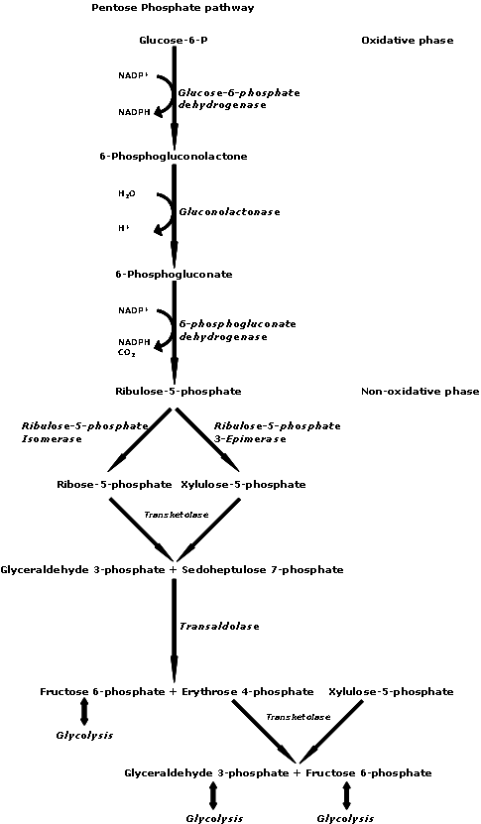
image

Slide 4
Oxidative phase
Oxidative phase
The breakdown of glucose, in glycolysis provides the first 6-carbon, glucose-6-phosphate
The steps are irreversible
Glucose-6-phosphate + 2 NADP+ ->
Noteable Products Ribulose-5-phosphate + 2 NADPH
Step 1
Glucose-6-phosphate is oxidized
NADPH is produced as a byproduct as NADP+ is reduced
6-phosphogluconate is formed
Step 2
Oxidative decarboxylation of 6-phosphogluconate
CO₂ is released
The eletrons released are used to reduce NADP+ to NADPH
Ribose-5-phosphate is produced

Slide 5
Non-oxidative phase
Non-oxidative phase
The steps are reversible
Allows different molecules to enter the pathway at different stages (interconvert sugars)
Noteable Products
Ribose-5-Phosphate
2 fructose-6-phosphate
glyceraldehyde-3-phosphate
Step 3 - Rearrangement of Ribulose-5-phosphate
Ribose-5-phosphate
isomerization (exchange of groups between carbons)
Xylulose-5-phosphate
epimerization (exchange of groups on a single carbon)
The three pentose phosphates are in equilibrium because the reactions are reversible

Slide 6
Study Guide Review
Understand that glucose can be used as a source of NADPH and of building blocks for biosynthetic pathways
Glucose is broken down in glycolysis into Glucose-6-phosphate
Glucose-6-phosphate is passed to the oxidative phase
The oxidative phase and produces 2 NADPH
The non-oxidative phase can produce ribose-5-phosphate
ribose-5-phosphate is used for nucleotide biosynthesis
Two oxidative reactions of the pathway provide NADPH for biosynthesis
The oxidative phase and produces 2 NADPH one for each oxidation
The non-oxidative reactions of the pathway provide ribose-5-phosphate for the biosynthesis of nucleotides
Rearrangement of Ribulose-5-phosphate
Produces Ribose-5-phosphate
isomerization (exchange of groups between carbons)
The products of the non-oxidative branch (fructose-6-phosphate and glyceraldehyde-3-phosphate) can be returned to glycolysis or gluconeogenesis
When more ribose-5-P than NADPH is required
Fructose-6-P and glyceraldehyde-3-P from Glycolysis are fed into the non-oxidative branch
The reaction then runs in reverse to make ribose-5-P with no NADPH generated
No carbon is returned to glycolysis
The pentose phosphate pathway can operate in four different modes according to the cell’s requirements for NADPH, ribose-5-phosphate and ATP
When both ribose-5-P and NADPH are required
When more ribose-5-P than NADPH is required
When more NADPH than ribose-5-P is required
When both NADPH and ATP are needed, but ribose-5-P is not
When both ribose-5-P and NADPH are required
The predominant mode is to make NADPH and to make ribose-5-P
The oxidative reactions predominate
no carbon is returned to Glycolysis
When more ribose-5-P than NADPH is required
Fructose-6-P and glyceraldehyde-3-P from Glycolysis are fed into the non-oxidative branch
The reaction then runs in reverse to make ribose-5-P with no NADPH generated
No carbon is returned to glycolysis
When more NADPH than ribose-5-P is required 6 Glucose-6-phosphate -> 6 ribose-5-P + 12 NADPH + 6 CO₂ by the pentose phosphate pathway
6 ribose-5-P -> 4 fructose-6-P + 2 glyceraldehyde-3-P
4 fructose-6-P + 2 glyceraldehyde-3-P -> 5-glucose-6-P by gluconeogenesis
Net reaction:
Glucose-6-phosphate + 12 NADP+ -> 6 CO₂ + 12 NADPH
When both NADPH and ATP are needed, but ribose-5-P is not
The same as the previous case, but the fructose-6-P and glyceraldehyde-3-P are fed into glycolysis to generate ATP

