Slide 1
Spatially Distributed FES for Reduced Fatigue

Slide 2
Goals of the Project
Find out if using spatially distributed electrical stimulation can reduce fatigue
Find out if using spatially distributed electrical stimulation can improve muscle contraction resolution (more control than 100% muscle contraction or no muscle contraction)
Get finer control over muscle force output over commercial FES systems

Slide 3
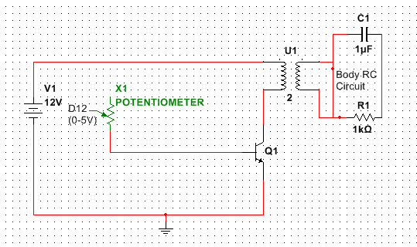
Current Working Circuit Diagram
Notes:
Currently potentiometer wired as a variable resistor, voltage measured across secondary coil, Arduino gives input to D12 from a digital output pin

Slide 4
Resistance of X1 vs. Final Voltage

Slide 5
Next Steps
Wire up digital potentiometer and analog input to give linear voltage increments
Increase # channels from a single electrode pair to several
Create PCB of a working breadboard prototype
Compare fatigue to commercial FES system/single channel system

