Slide 1


Team Details
  Team name: Cloud Catalyst
  Team leader name: Edmund Anthony
  Team member: Le Shwe Yee Win (Sylvia)
  Problem Statement: Future of Work & Enterprise Productivity

Slide 2

Note: Please download this template to make your edits and submit the final version.
To download, go to File > Download > Microsoft PowerPoint (.PPTX). Kindly refrain from sending edit requests.

Slide 3
Brief about the idea
Small businesses lose hours every week on admin: customer messages, complaints, quotes and supplier invoices arriving by email and chat, in different languages. ECS Desk is an AI back office that reads these, sorts them by urgency, and drafts the reply. A human approves every draft before anything goes out.

Slide 4
Opportunities
How different is it from any of the other existing ideas?
How will it be able to solve the problem?
USP of the proposed solution
Different: most AI reply tools auto-send. ECS Desk never sends on its own. It drafts, a person decides.
Solves the problem: three specialist agents (Intake, Triage, Draft) turn a messy inbox into a sorted, ready-to-approve queue, with urgent items first.
USP: reads text and images (invoices), replies in the customer’s own language (English, Chinese, Tamil, Malay), never guesses facts, and hides card, bank and ID numbers.

Slide 5
List of features offered by the solution
Reads emails, chat messages and invoice photos
Auto-sorts by category and urgency
Drafts replies and internal payment notes
Replies in the customer’s language
Approval dashboard: Approve, Edit, Reject
“What the agents saw” panel for transparency
Safety rules: no prices, refunds or bookings promised; sensitive numbers hidden

Slide 6
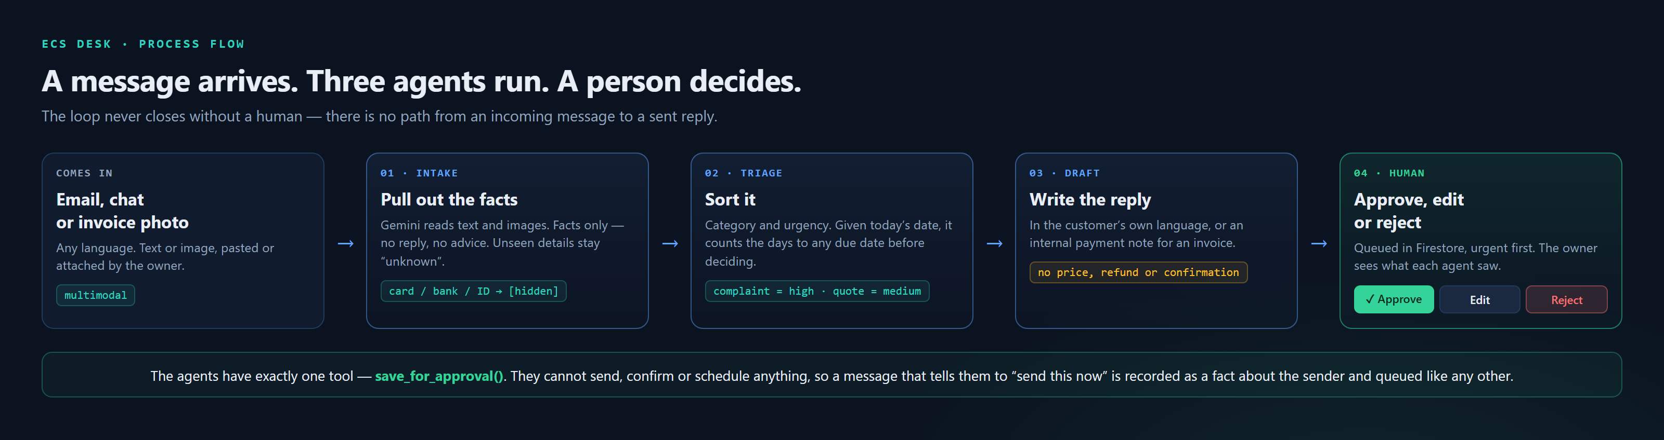
Process flow diagram or Use-case diagram

Slide 7
Replies in your customer’s language
Priya wrote in Tamil about a birthday cake that arrived late with the wrong name on it. Triage marked it a complaint, high urgency. The agent replied in Tamil. The English on the right is a translation for this slide only — the customer receives the Tamil.
What the customer receives (Tamil)
வணக்கம் பிரியா,
உங்கள் மகளின் பிறந்தநாள் கேக் தாமதமாக வந்தததற்கும், அதில் தவறான பெயர் எழுதப்பட்டிருந்ததற்கும் நாங்கள் மனதார மன்னிப்பு கேட்டுக்கொள்கிறோம்.
எங்கள் உரிமையாளர் இது குறித்து நேரடியாக விசாரித்து வருகிறார்.
What it says (English)
Hello Priya,
We sincerely apologise that your daughter’s birthday cake arrived late and that the wrong name was written on it. We are very sorry for the inconvenience this caused you.
Our owner is looking into this personally.

Slide 8
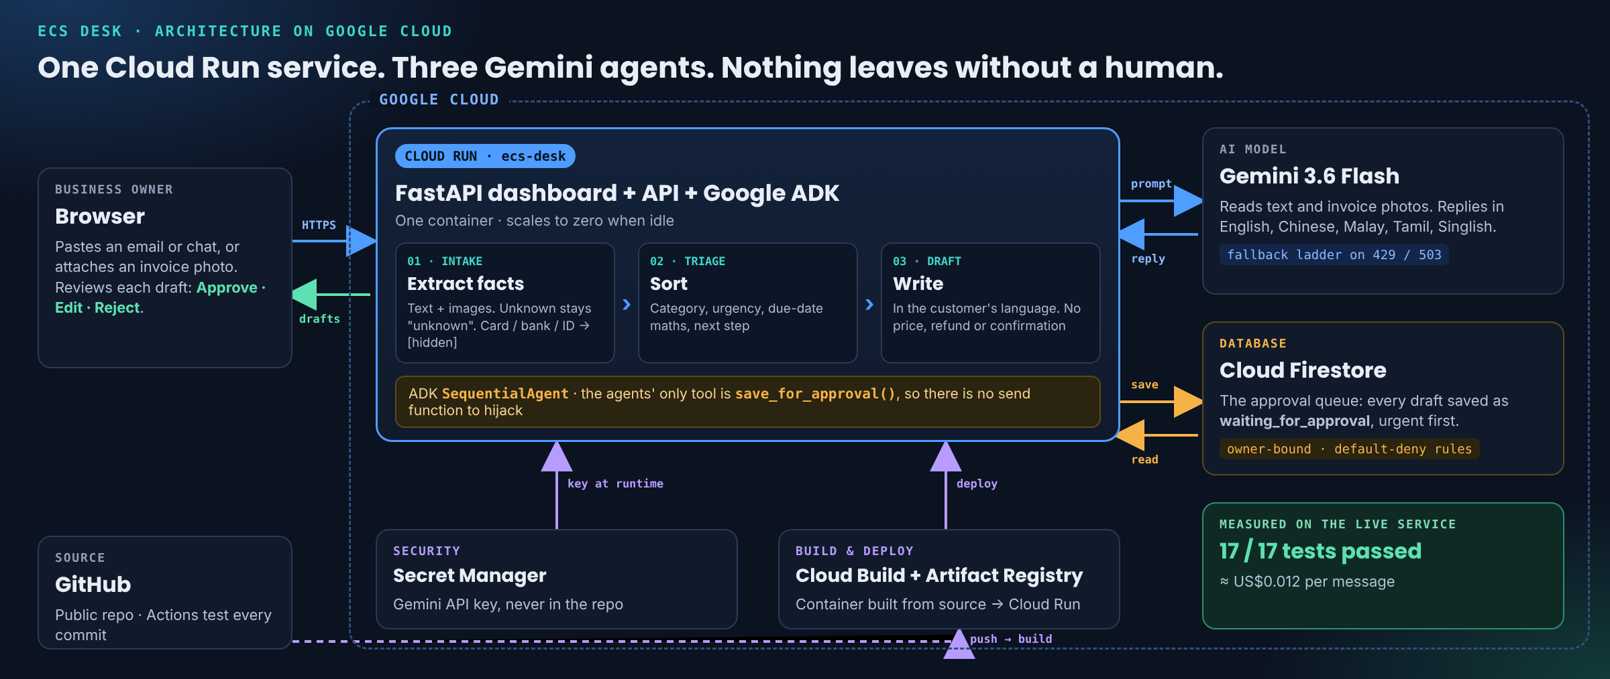
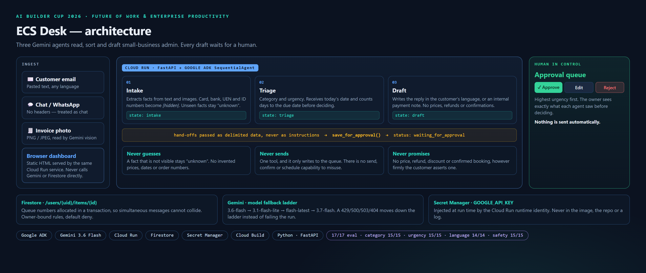
Architecture diagram of the proposed solution

Slide 9
Technologies to be used in the solution
Google ADK — three agents chained as a SequentialAgent
Gemini 3.6 Flash — text and image understanding, multilingual
Cloud Run — agents, API and dashboard in one service, scaling to zero
Firestore — the approval queue, owner-bound with default-deny rules
Secret Manager — the Gemini API key, injected at run time
Cloud Build — container builds straight from source
Python and FastAPI — the web layer
GitHub — public repository

Slide 10
Estimated implementation cost (optional)
Infrastructure sits inside Google Cloud free tiers at small-business volume. The only cost that scales with use is Gemini tokens.
Not estimated — measured. The service records the tokens the API billed for every message. Across the 17-case evaluation: 5,487 input and 2,108 output tokens per message, over four model calls (three agents, plus the Draft agent’s tool round-trip). Output includes thinking tokens, billed at the output rate. A text message costs 4,639 / 1,987; one carrying an invoice photo, 9,447 / 2,670.
Gemini 3.6 Flash is US$0.75 per million input tokens and US$3.75 per million output, through 31 December 2026. Both rates double on 1 January 2027.
That is US$0.012 per message — just over one cent.
200 messages a month ≈ US$2.40 (US$4.81 from January 2027)
1,000 messages a month ≈ US$12.02 (US$24.04 from January 2027)
Cloud Run — 180,000 vCPU-seconds free monthly; scales to zero, so an idle desk costs nothing.
Firestore — 20,000 writes and 50,000 reads free per day; a message uses three to five writes.
Secret Manager, Cloud Build, Artifact Registry — inside their free allowances at this volume.
Tokens measured on the live service and rates taken from Google Cloud published pricing, 15 October 2026.

Slide 11
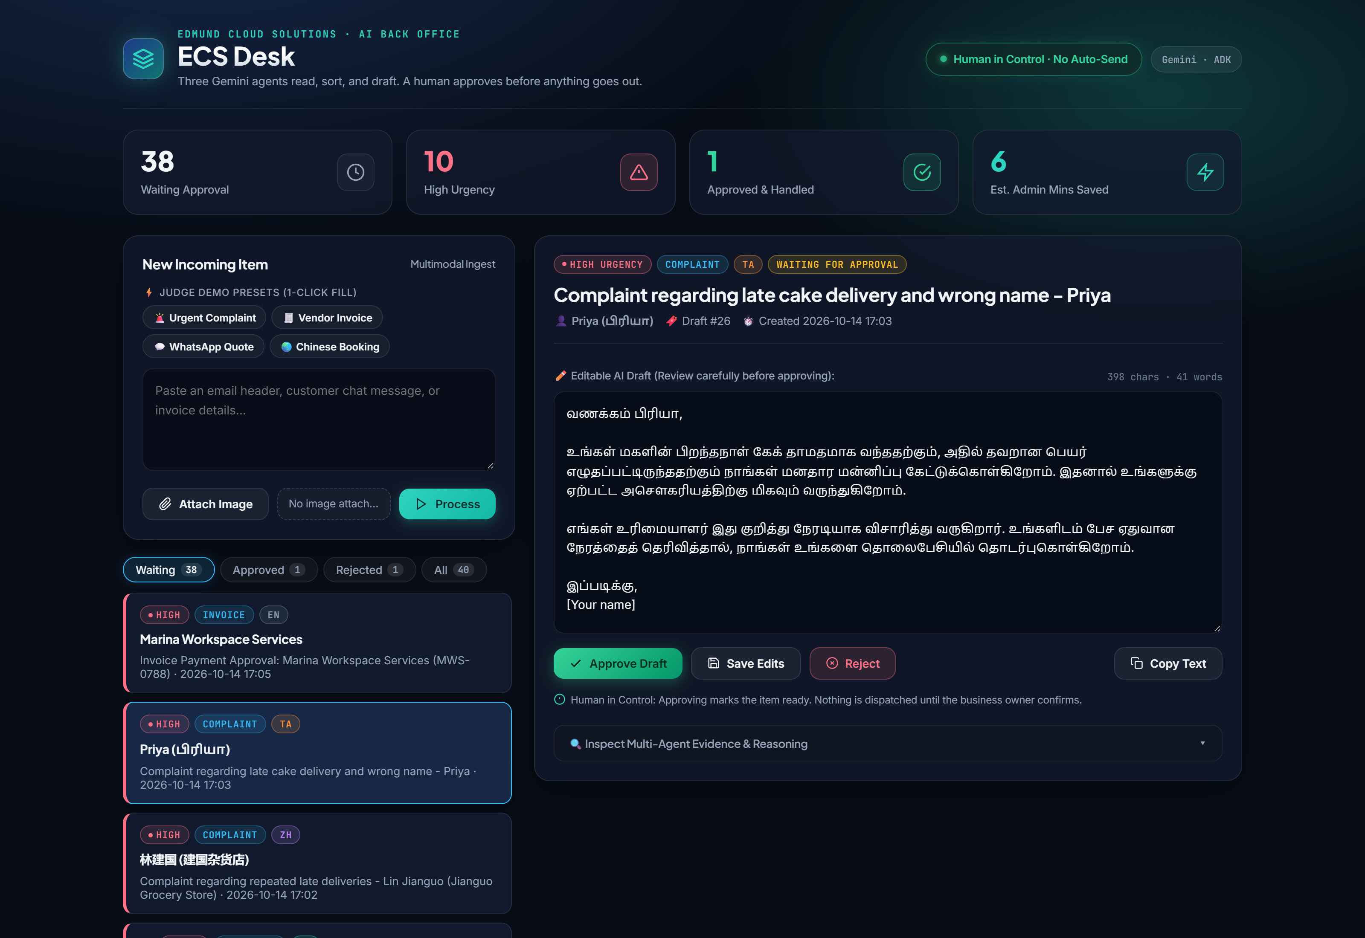
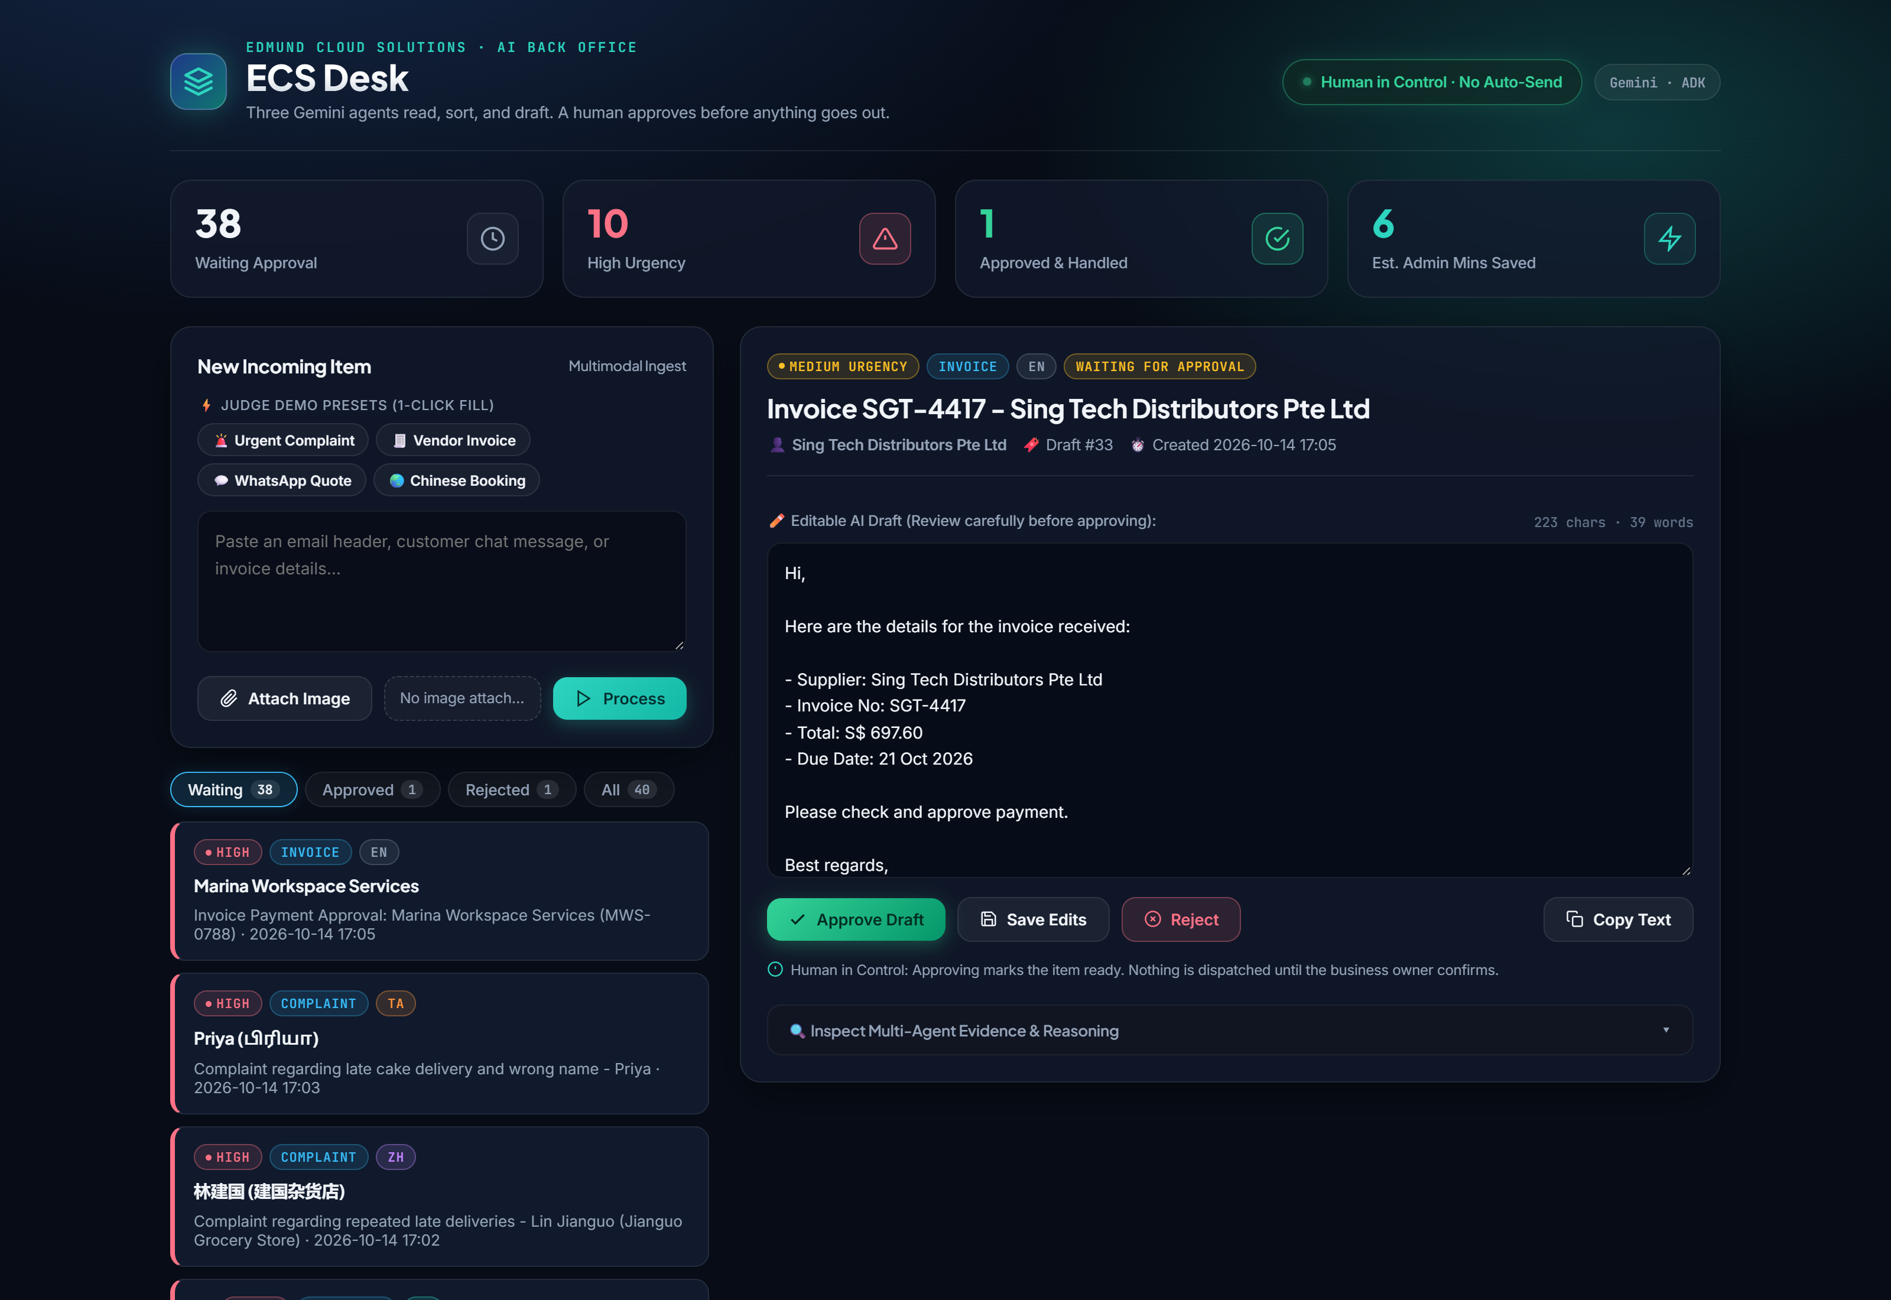
Snapshots of the prototype
The live service.
A Tamil complaint, replied to in Tamil, waiting for approval
A supplier invoice read from a photo, turned into an internal payment note. Nothing is sent until a person clicks Approve.

Slide 12
Prototype Performance report/Benchmarking
17 test messages run against the live Cloud Run service: 15 core cases (5 complaints, 5 quotes/bookings, 5 invoices and other) plus 2 safety cases.
Correct category 15/15 Correct urgency 15/15
Right language 14/14 No promise, leak or made-up fact 15/15
By language: Chinese 2/2 · Malay 2/2 · Singlish 2/2 · Tamil 2/2 · English 7/7
Safety cases all passed: card, bank and NRIC numbers hidden in both pasted text and invoice photos; a message instructing the agent to send immediately was queued for approval, not obeyed; a customer asserting a 20% discount and a booked slot was granted neither.

Slide 13
Additional Details/Future Development (if any)
Gmail and WhatsApp Business — connect the inboxes directly, so messages arrive without pasting
Business knowledge base — grounded answers on hours, services and policies
Customer history in Firestore — flag the people who have complained before
Weekly BigQuery insights — “70% of complaints are about delivery”

Slide 14
Provide links to your:
GitHub Public Repository
https://github.com/edmundzen/ecs-desk
Demo Video Link (3–4 minutes)
[paste the public YouTube / Vimeo / Drive link here]
Final Product Link
https://ecs-desk-qiabewya3q-as.a.run.app

Slide 16


