Slide 1

IoT platform for continuous monitoring of patients

Slide 2


INTRODUCTION
DOMAIN
SCOPE
STAKEHOLDERS
e-Health
guarantee a 24/7 monitoring for patients with assessed medical issues
Patients, clinicians and clinics

Slide 3
OBJECTIVES
1)Prevent
prevent critical events and/or guarantee an immediate response (such as stroke in cardiovascular patients)
2)Simplify
simplify personal therapies (such as insulin self-injection for diabetic people)
3)Automate
automate signal acquisition for easier quantification of disease evolution (such as sensorized orthesis for postural disease patients)

Slide 4
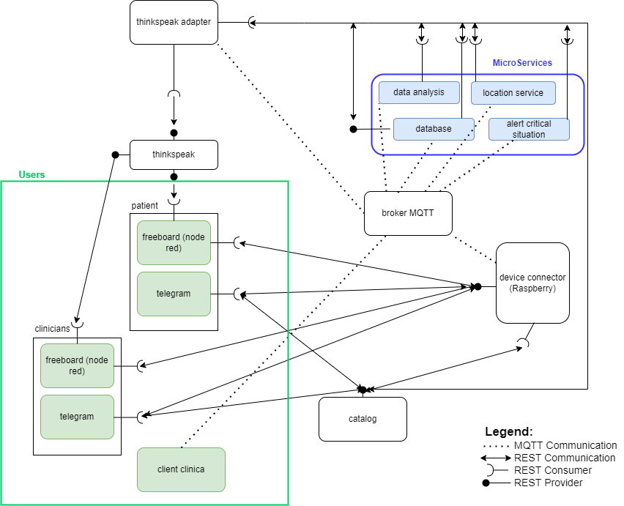
DIAGRAM OF USE - PROPOSAL

Slide 5

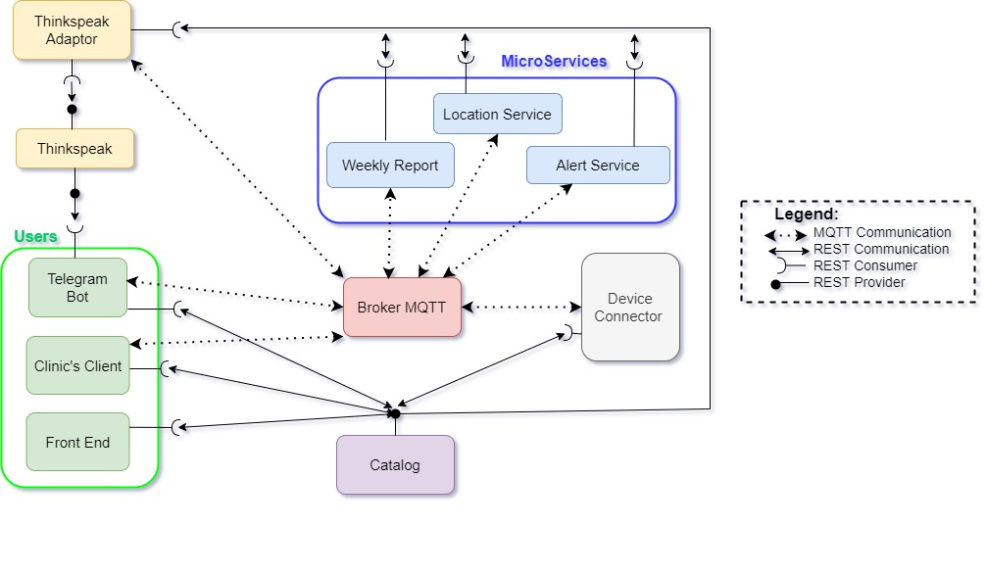
DIAGRAM OF USE – LAST UPDATE

Slide 6
PROTOCOLLI di COMUNICAZIONE
REST
MQTT

Slide 7
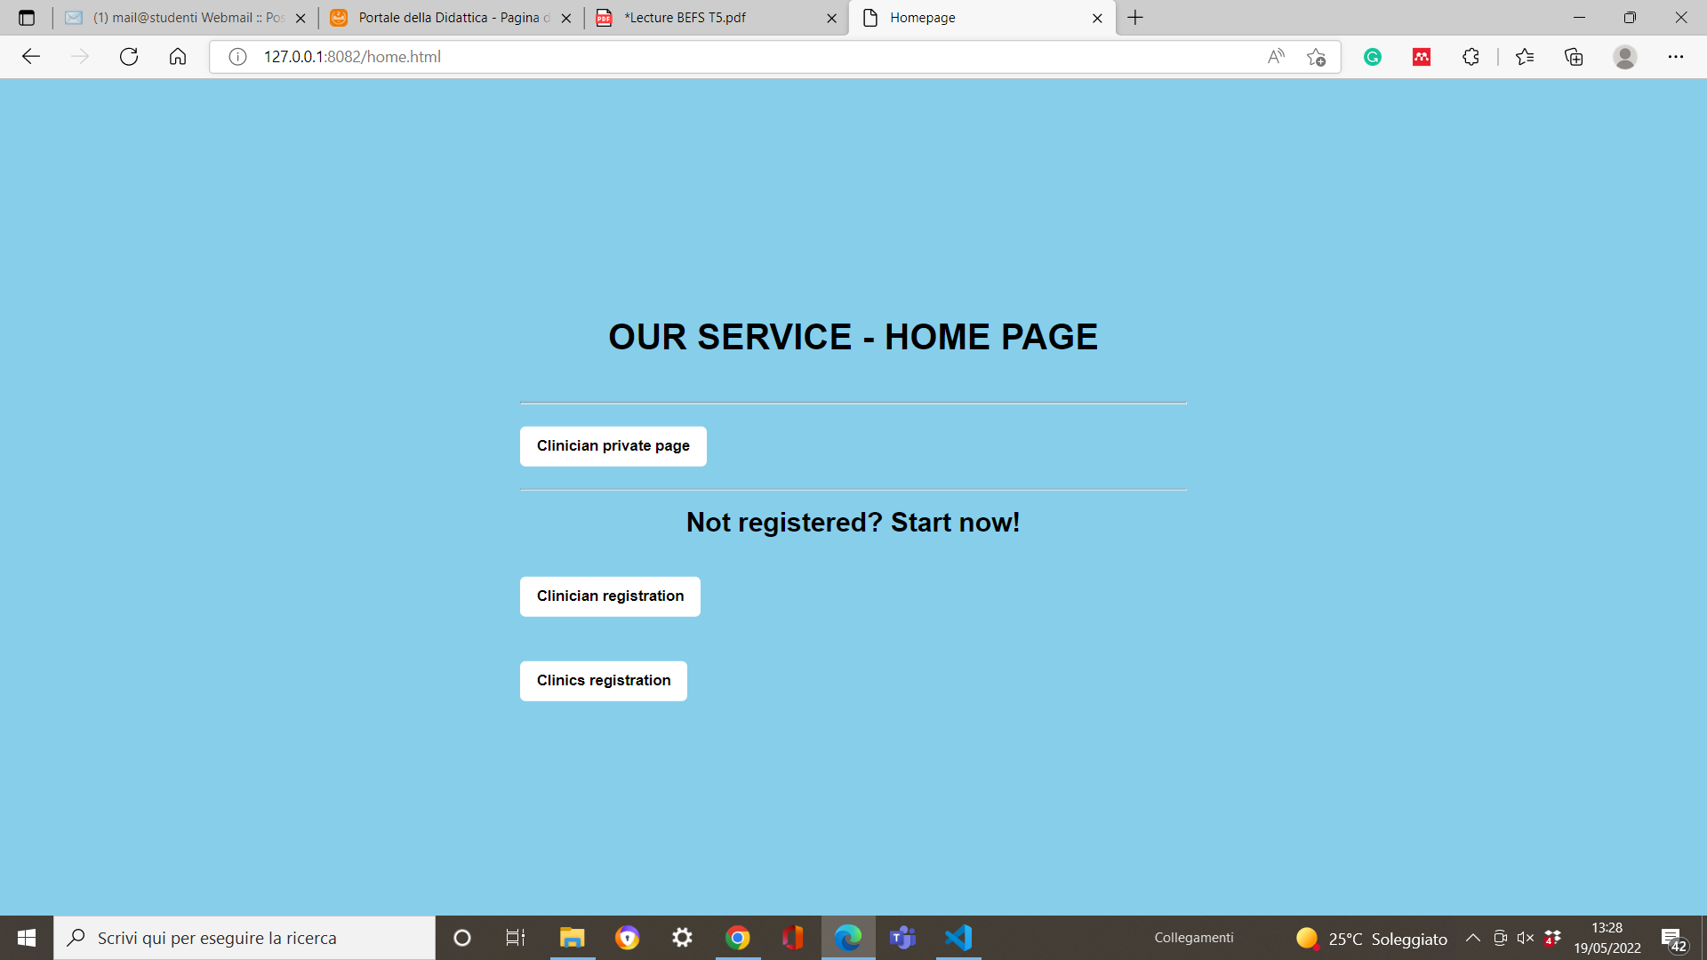
FRONT END – HOME PAGE

Slide 8
FRONT END – HOME PAGE
url of home page

Slide 9

FRONT END – HOME PAGE

Slide 10
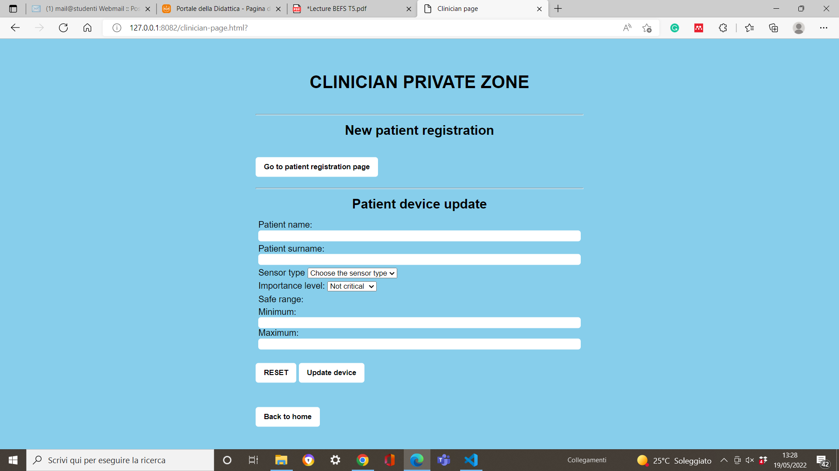
FRONT END – CLINICIAN PRIVATE ZONE

Slide 11
url of clinician private page
FRONT END – CLINICIAN PRIVATE ZONE

Slide 12
FRONT END – CLINICIAN PRIVATE ZONE

Slide 13
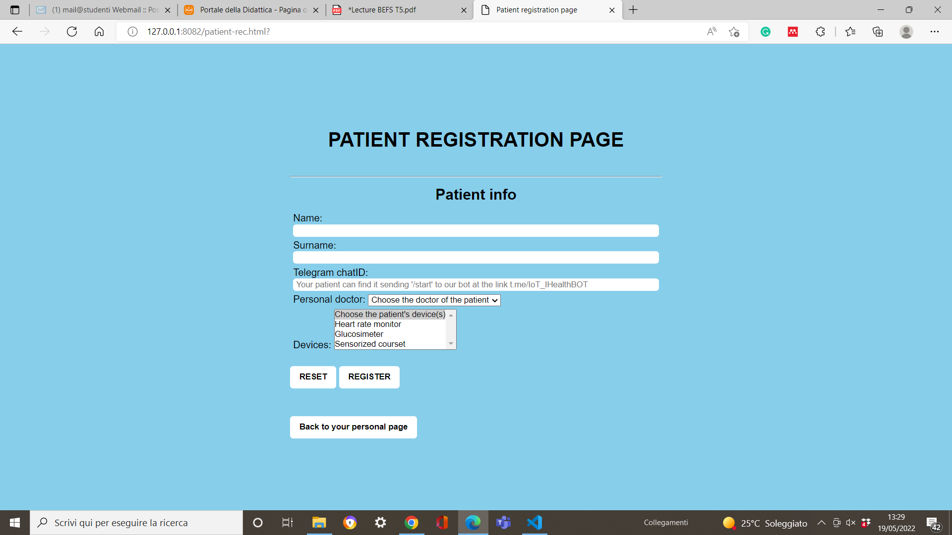
FRONT END – PATIENT REGISTRATION
url of patient registration page

Slide 14
FRONT END – PATIENT REGISTRATION

Slide 15
FRONT END – CLINICIAN PRIVATE ZONE

Slide 16
FRONT END – CLINICIAN PRIVATE ZONE

Slide 17
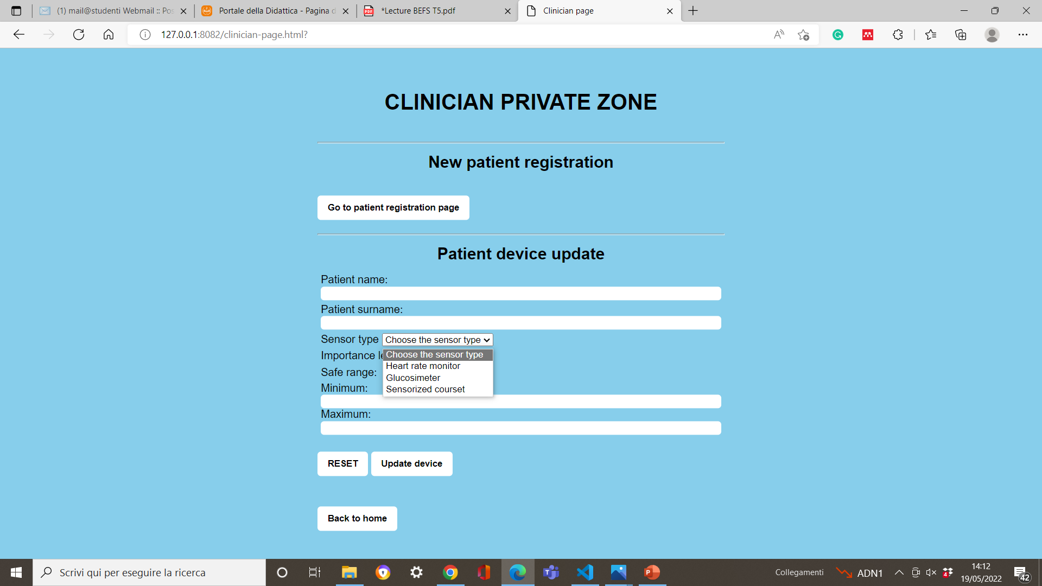
FRONT END – CLINICIAN PRIVATE ZONE

Slide 18
FRONT END – CLINICIAN PRIVATE ZONE

Slide 19
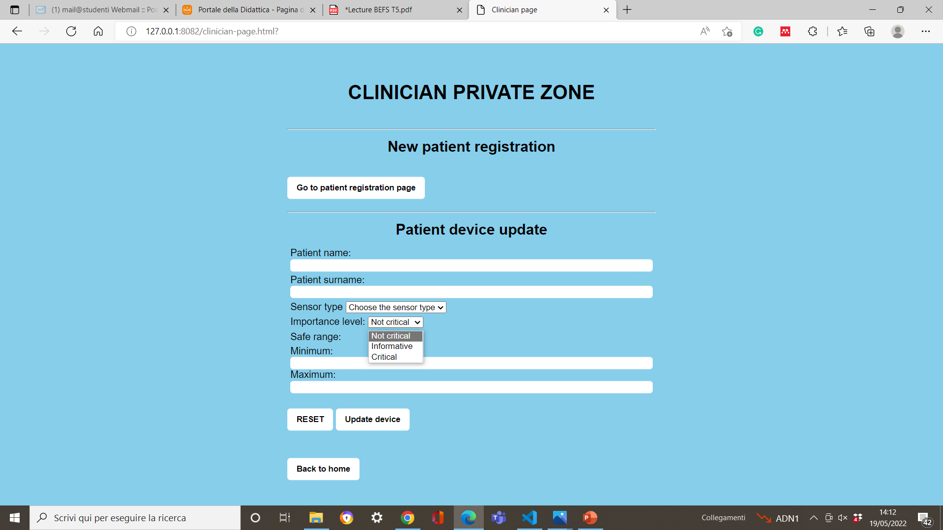
FRONT END – CLINICIAN PRIVATE ZONE

Slide 20
FRONT END – HOME PAGE

Slide 21
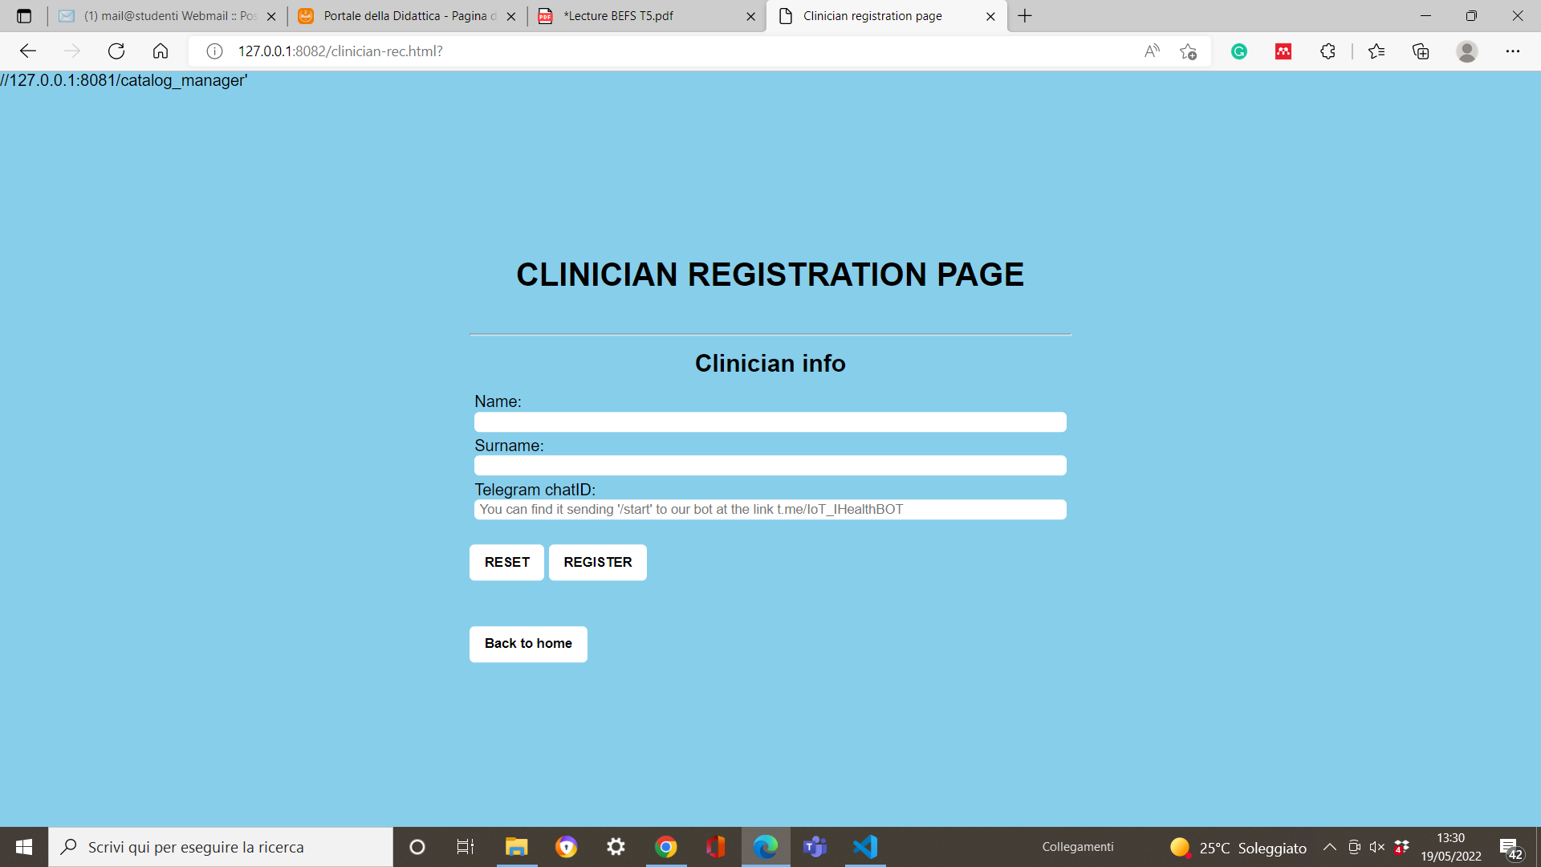
FRONT END – CLINICIAN REGISTRATION

Slide 22
FRONT END – CLINICIANS REGISTRATION
URL della clinicians registration page

Slide 23
FRONT END – HOME PAGE

Slide 24

FRONT END – CLINICS REGISTRATION

Slide 25
FRONT END – CLINICS REGISTRATION
URL della clinics registration page

Slide 26
CATALOG

Slide 27
DEVICE CONNECTOR
Communicate with:
Catalog
Scope:
Convert data from sensor type to SenMl format
Alert Service
Thingspeak Adaptor

Slide 28



DEVICE CONNECTOR
Hearth rate
Glucosimeter
Sensorized orthesis

Slide 29
ALERT SERVICE
Communicate with
Catalog
Telegram Bot
Scope:
Critical Alert to clinician
Critical Alert to clinics
Device Connector
Location Service
Clinic’s Client
Personal Alert

Slide 30
LOCATION SERVICE
Communicate with:
Catalog
Scope:
Find the nearest clinic to the patient with the critical event incoming
Alert Service

Slide 31
WEEKLY REPORT
Communicate with:
Catalog
Scope:
Give a weekly recap to every clinicians about their patients
Telegram Bot
Thingspeak

Slide 32
THINGSPEAK
Communicate with:
Catalog
Scope:
Collect data from all the device connectors
Weekly Report
Thingspeak Adaptor
Telegram Bot?
Display the trend of each sensor of each patient in diagrams

Slide 33
TELEGRAM BOT
Communicate with:
Catalog
Scope:
Guarantee a user-friendly interface
Alert Service
Thingspeak
Weekly Report
Advise clinicians in case of a critical alerts
Advise patients in case of personal alerts
Display weekly-reports to clinitians
Allow clinicians to monitor their patients as soon as they want

Slide 34
CLINIC’S CLIENT
Communicate with:
Catalog
Scope:
Guarantee a 24/7 supervision to patients
Alert Service
Receive a message with longitude and latitude of the patient in critical condition

