Slide 1

IoT platform for continuous monitoring of patients

Slide 2


INTRODUCTION
DOMAIN
SCOPE
STAKEHOLDERS
e-Health
guarantee a 24/7 monitoring for patients with assessed medical issues
Patients, clinicians and clinics

Slide 3
OBJECTIVES
1)Prevent
prevent critical events and/or guarantee an immediate response (such as stroke in cardiovascular patients)
2)Simplify
simplify personal therapies (such as insulin self-injection for diabetic people)
3)Automate
automate signal acquisition for easier quantification of disease evolution (such as sensorized orthesis for postural disease patients)

Slide 4
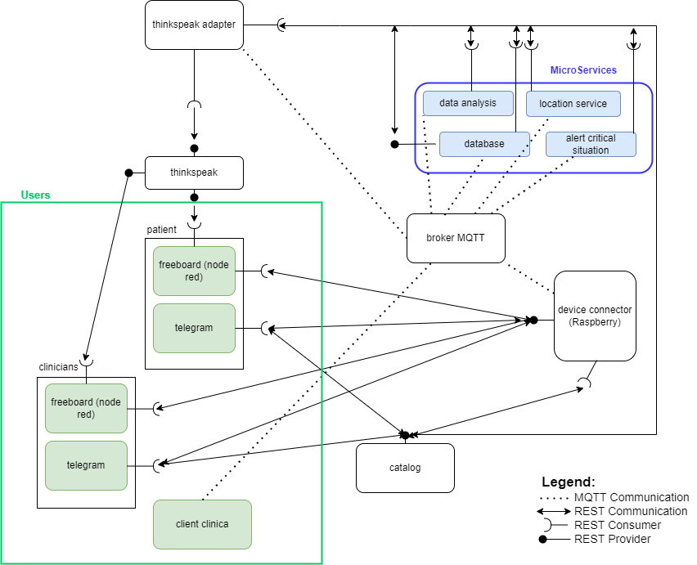
DIAGRAM OF USE - PROPOSAL

Slide 5

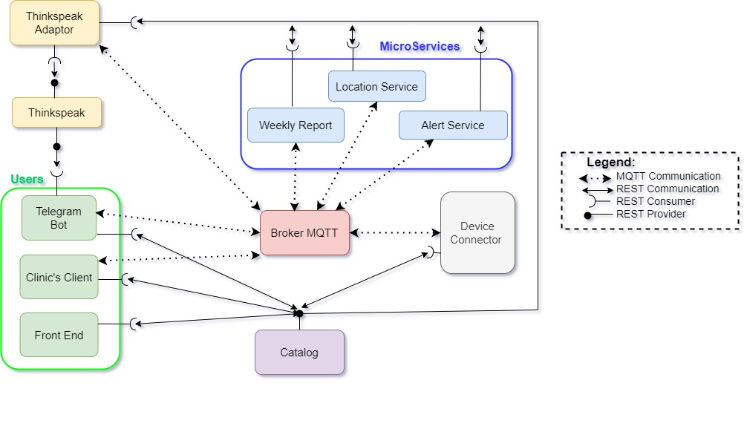
DIAGRAM OF USE – LAST UPDATE

Slide 6
4) PROTOCOLLI COMUNICAZIONE

Slide 7
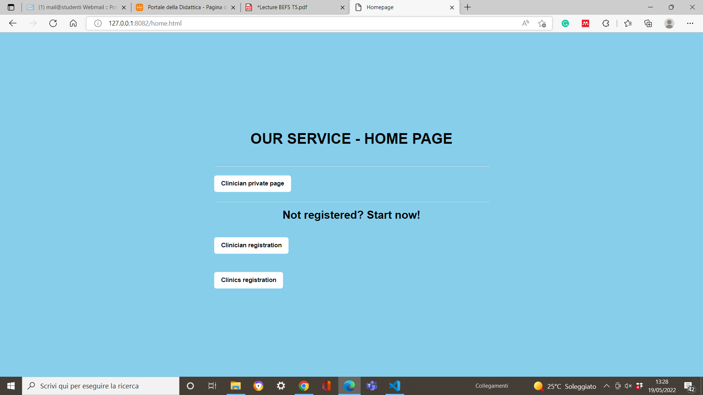
FRONT END – HOME PAGE

Slide 8
FRONT END – HOME PAGE
URL della home page

Slide 9

FRONT END – HOME PAGE

Slide 10
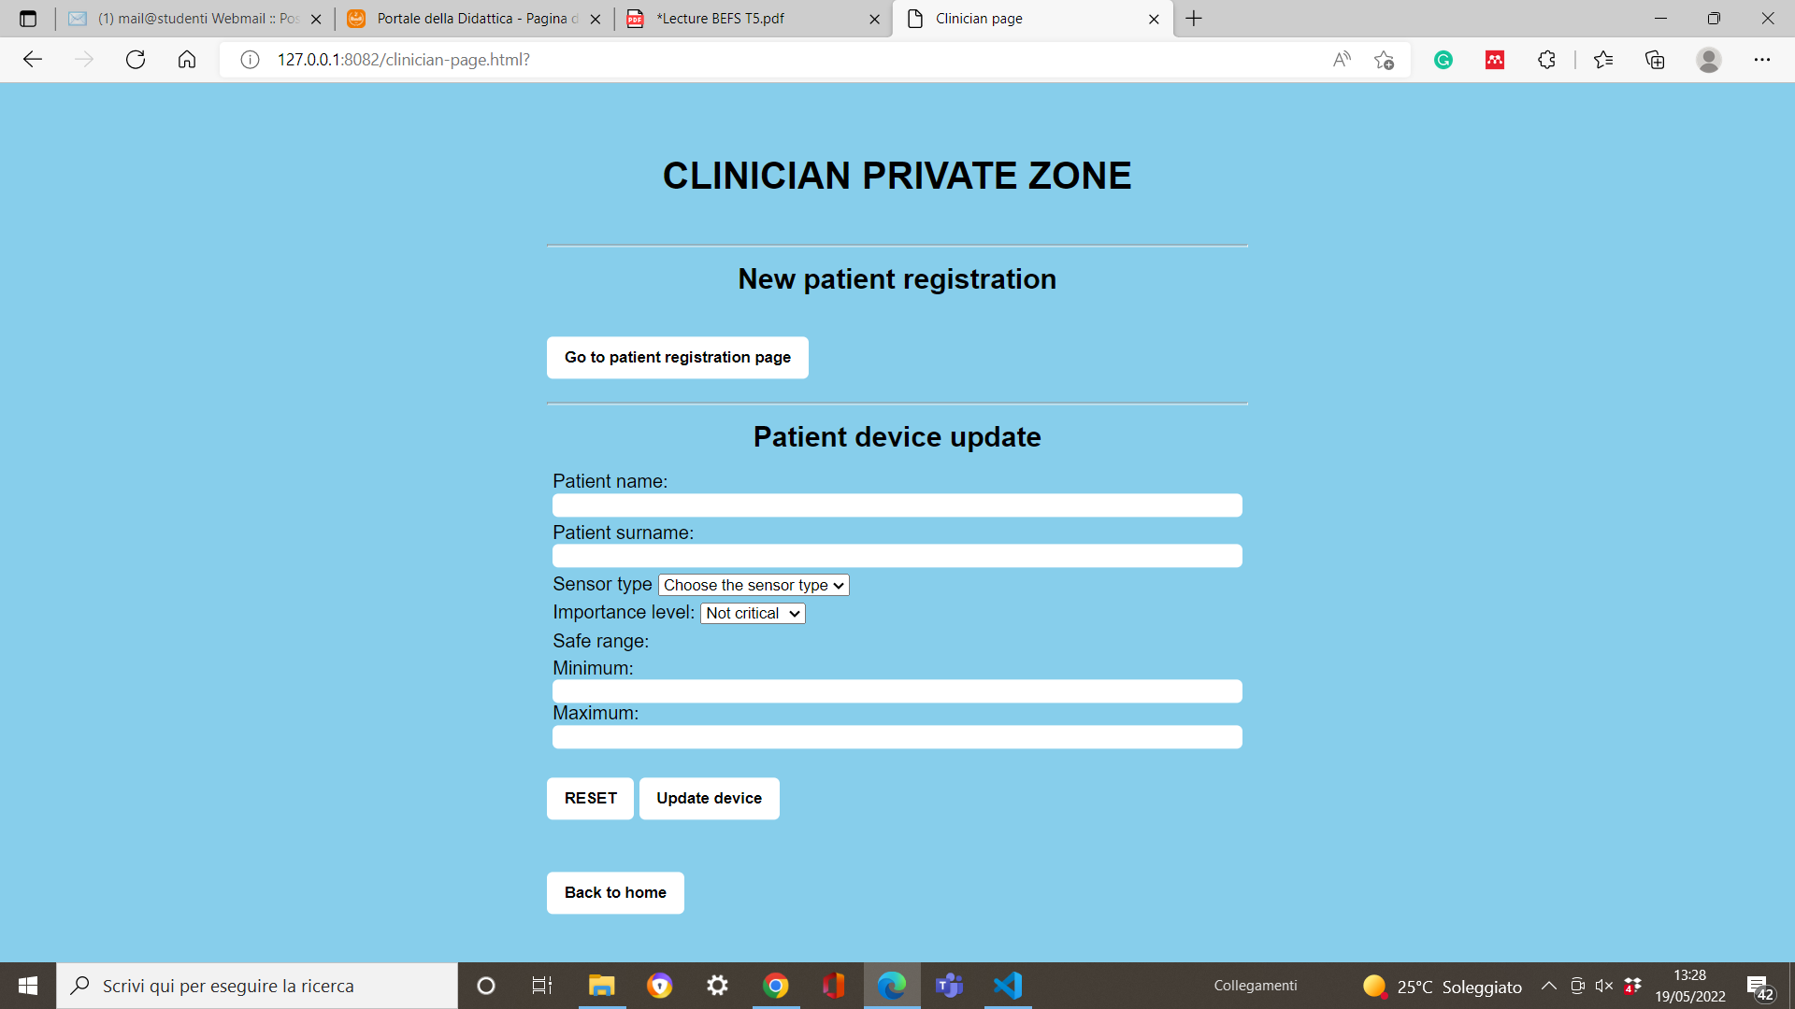
FRONT END – CLINICIAN PRIVATE ZONE

Slide 11
FRONT END – CLINICIAN PRIVATE ZONE
URL della clinician private page

Slide 12
FRONT END – CLINICIAN PRIVATE ZONE

Slide 13
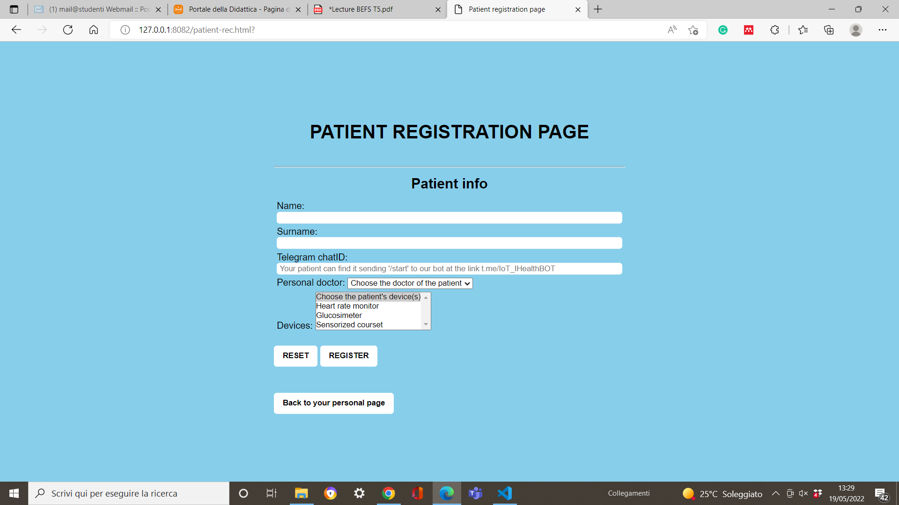
FRONT END – PATIENT REGISTRATION
URL della patient registration page

Slide 14
FRONT END – PATIENT REGISTRATION

Slide 15
FRONT END – CLINICIAN PRIVATE ZONE

Slide 16
FRONT END – CLINICIAN PRIVATE ZONE

Slide 17
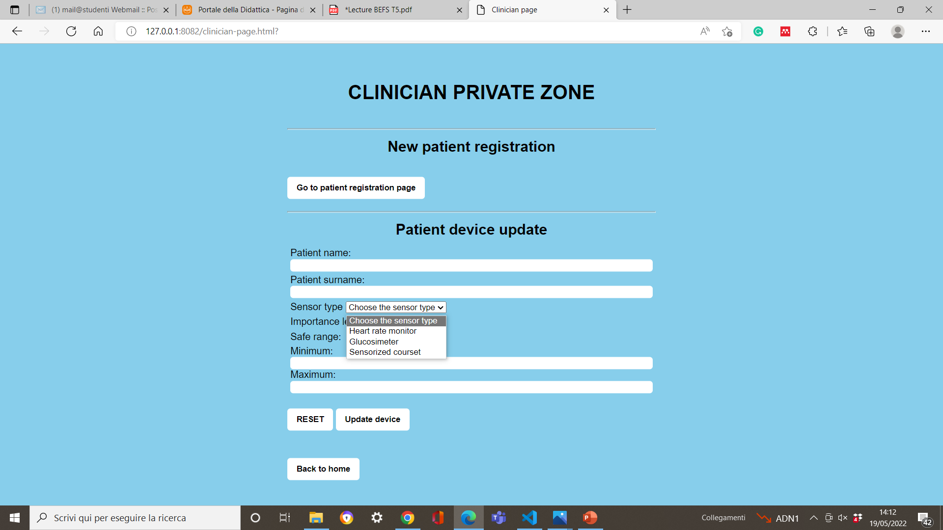
FRONT END – CLINICIAN PRIVATE ZONE

Slide 18
FRONT END – CLINICIAN PRIVATE ZONE

Slide 19
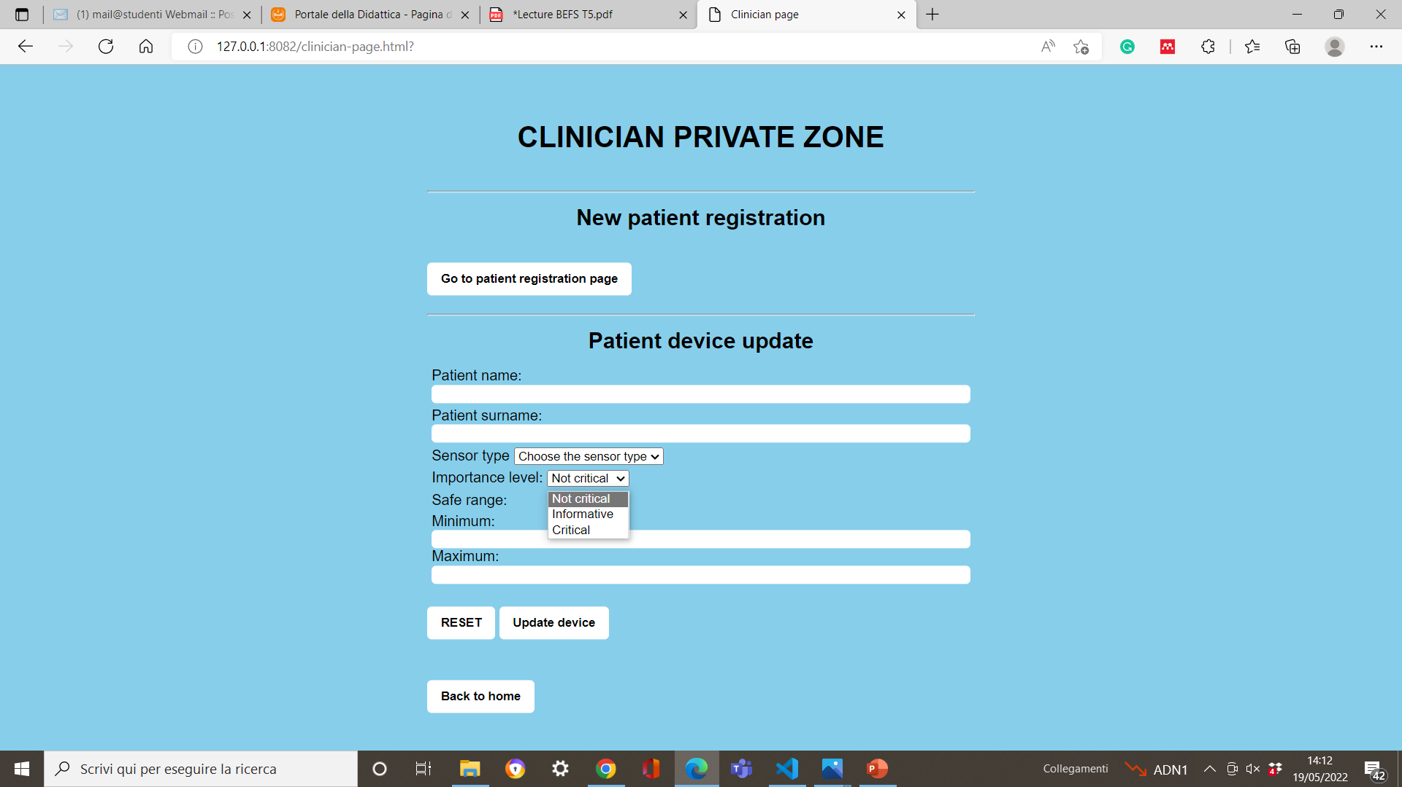
FRONT END – CLINICIAN PRIVATE ZONE

Slide 20
FRONT END – HOME PAGE

Slide 21
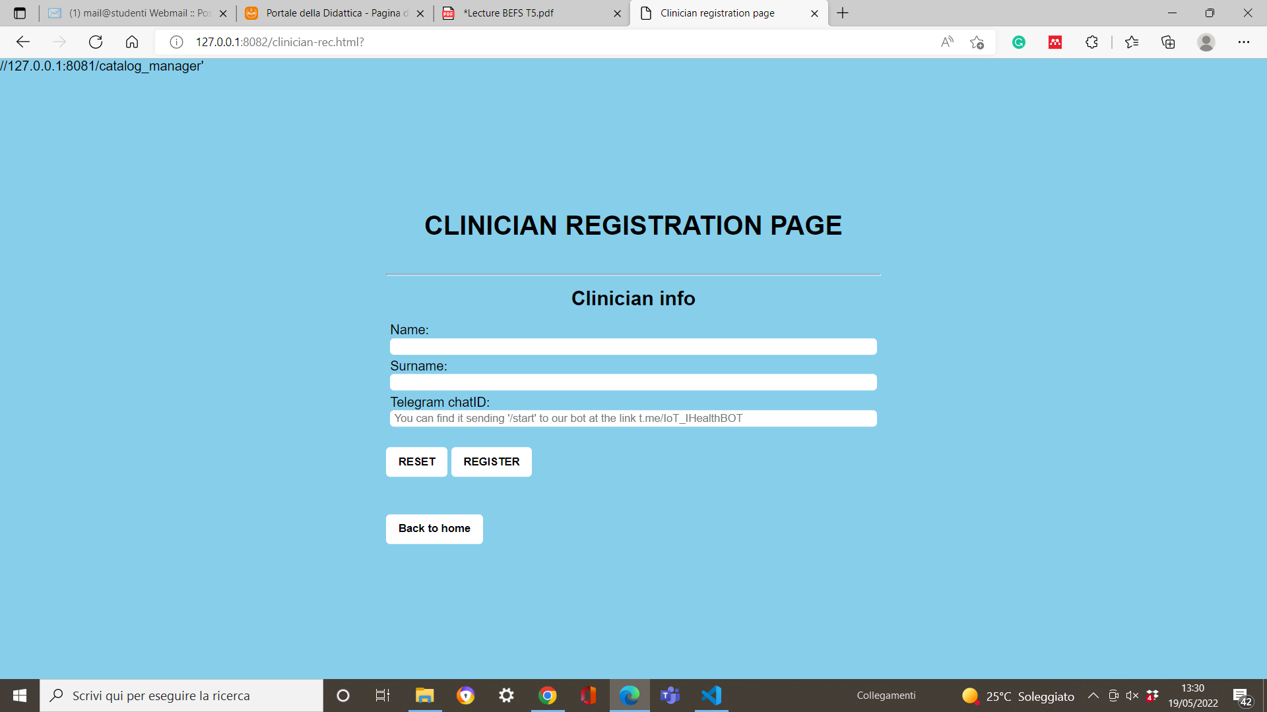
FRONT END – CLINICIAN REGISTRATION

Slide 22
FRONT END – CLINICIANS REGISTRATION
URL della clinicians registration page

Slide 23
FRONT END – HOME PAGE

Slide 24

FRONT END – CLINICS REGISTRATION

Slide 25
FRONT END – CLINICS REGISTRATION
URL della clinics registration page

Slide 26
5) CATALOG

Slide 27
6) DEVICE CONNECTOR

Slide 28
7) ALERT SERVICE

Slide 29
8) LOCATION SERVICE

Slide 30
9) WEEKLY REPORT

Slide 31
10) THINGSPEAK

Slide 32
TELEGRAM BOT

Slide 33
12) CLINIC’S CLIENT

