Slide 1

IoT platform for continuous monitoring of patients

Slide 2


INTRODUCTION
DOMAIN
SCOPE
STAKEHOLDERS
e-Health
guarantee a 24/7 monitoring for patients with assessed medical issues
Patients, clinicians and clinics

Slide 3
OBJECTIVES
1)Prevent
prevent critical events and/or guarantee an immediate response (such as stroke in cardiovascular patients)
2)Simplify
simplify personal therapies (such as insulin self-injection for diabetic people)
3)Automate
automate signal acquisition for easier quantification of disease evolution (such as oximeter)

Slide 4
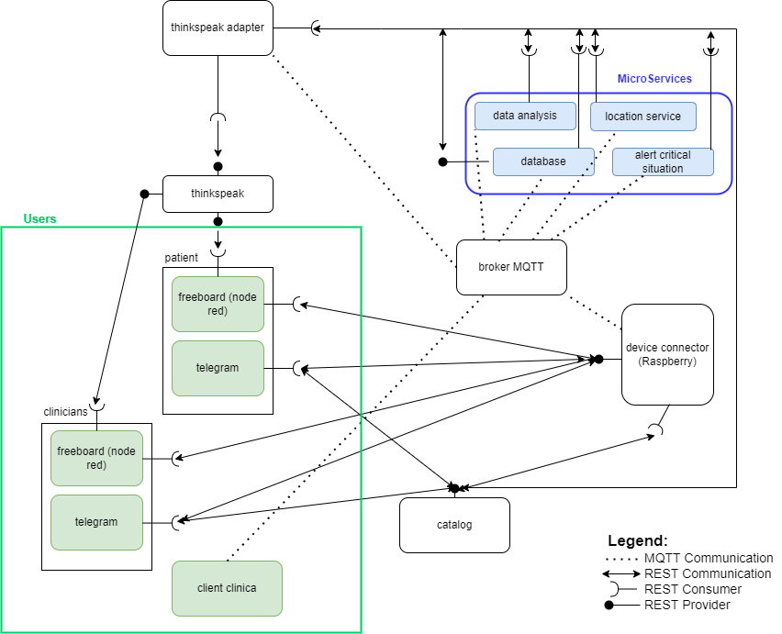
DIAGRAM OF USE - PROPOSAL

Slide 5

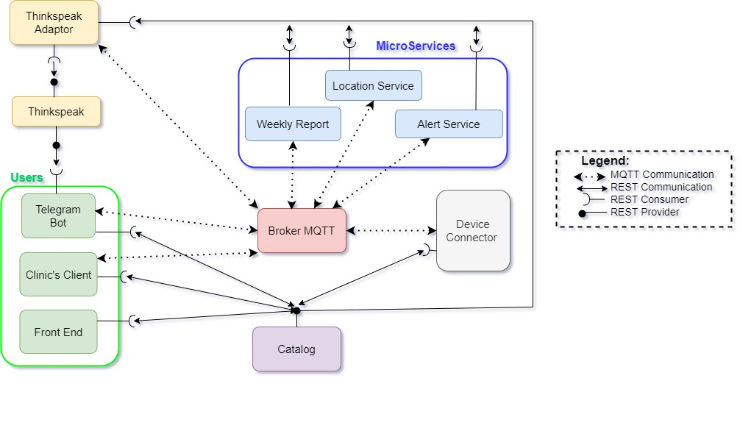
DIAGRAM OF USE – LAST UPDATE

Slide 6
COMUNICATION PROTOCOLS
REST
Client/Broker architecture
Publish/
Subscribe
MQTT
Client/Server architecture
Request/
Response
Limited Quality of Service
Heavyweight
Quality of Service 2
Lightweight
Base topic: "Iot_Healthcare"
All the communications with the catalog

Slide 7

DOCKER
What is it?
An easy-to-install application that enables you to build and share containerized applications and microservices
Why?
is used throughout the development lifecycle for fast, easy and portable application development

Slide 8
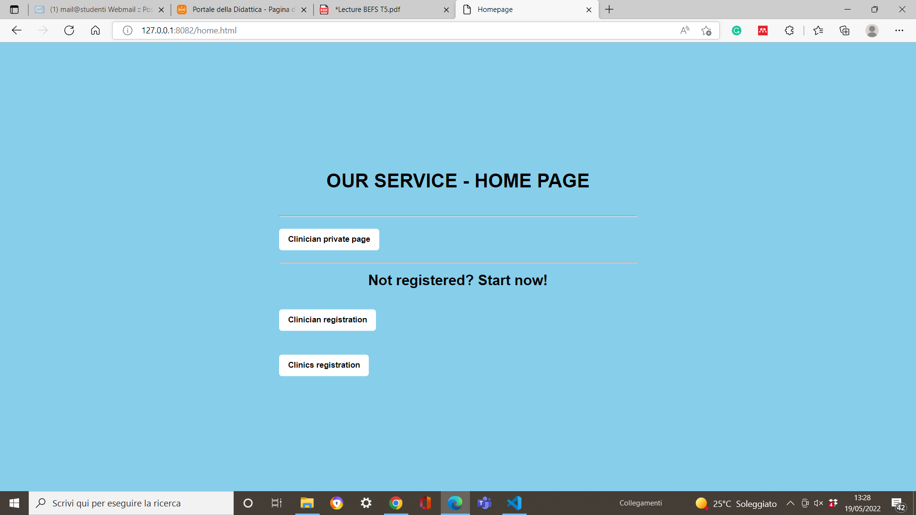

FRONT END – HOME PAGE
url of home page

Slide 9
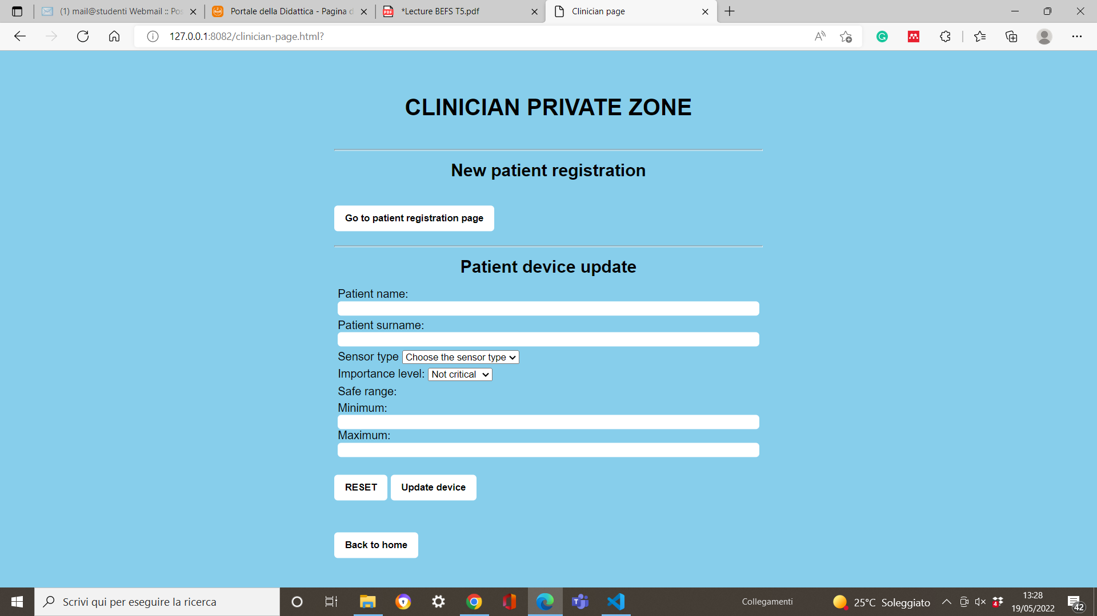
url of clinician private page
FRONT END – CLINICIAN PRIVATE ZONE

Slide 10
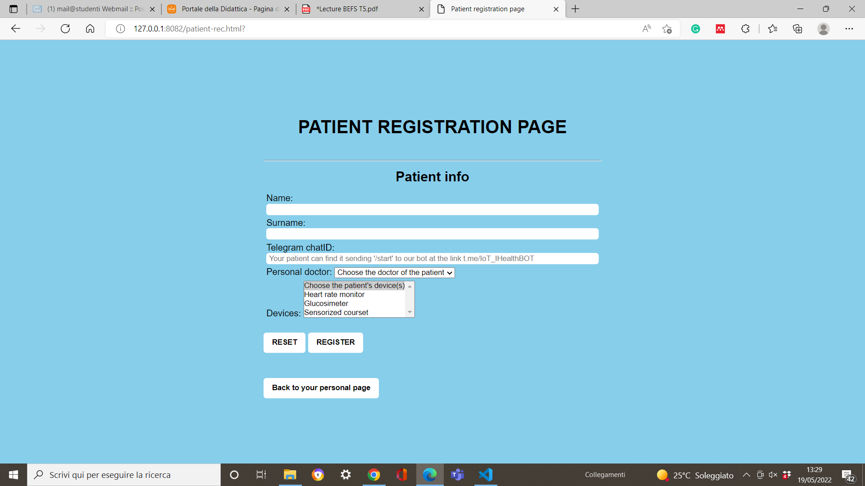
FRONT END – PATIENT REGISTRATION
url of patient registration page

Slide 11
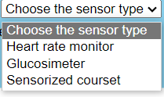
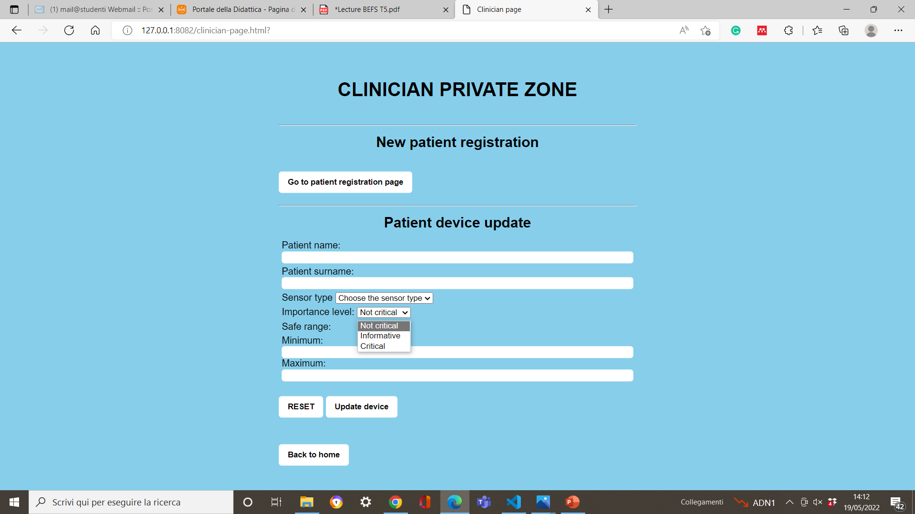
FRONT END – CLINICIAN PRIVATE ZONE

Slide 12
FRONT END – HOME PAGE

Slide 13
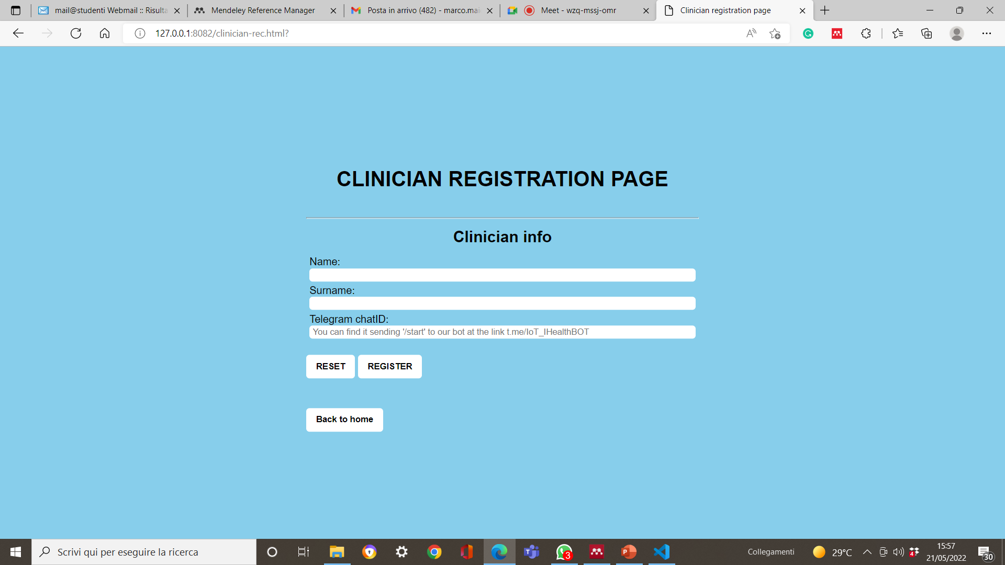
FRONT END – CLINICIAN REGISTRATION
url of clinician registration page

Slide 14
FRONT END – HOME PAGE

Slide 15
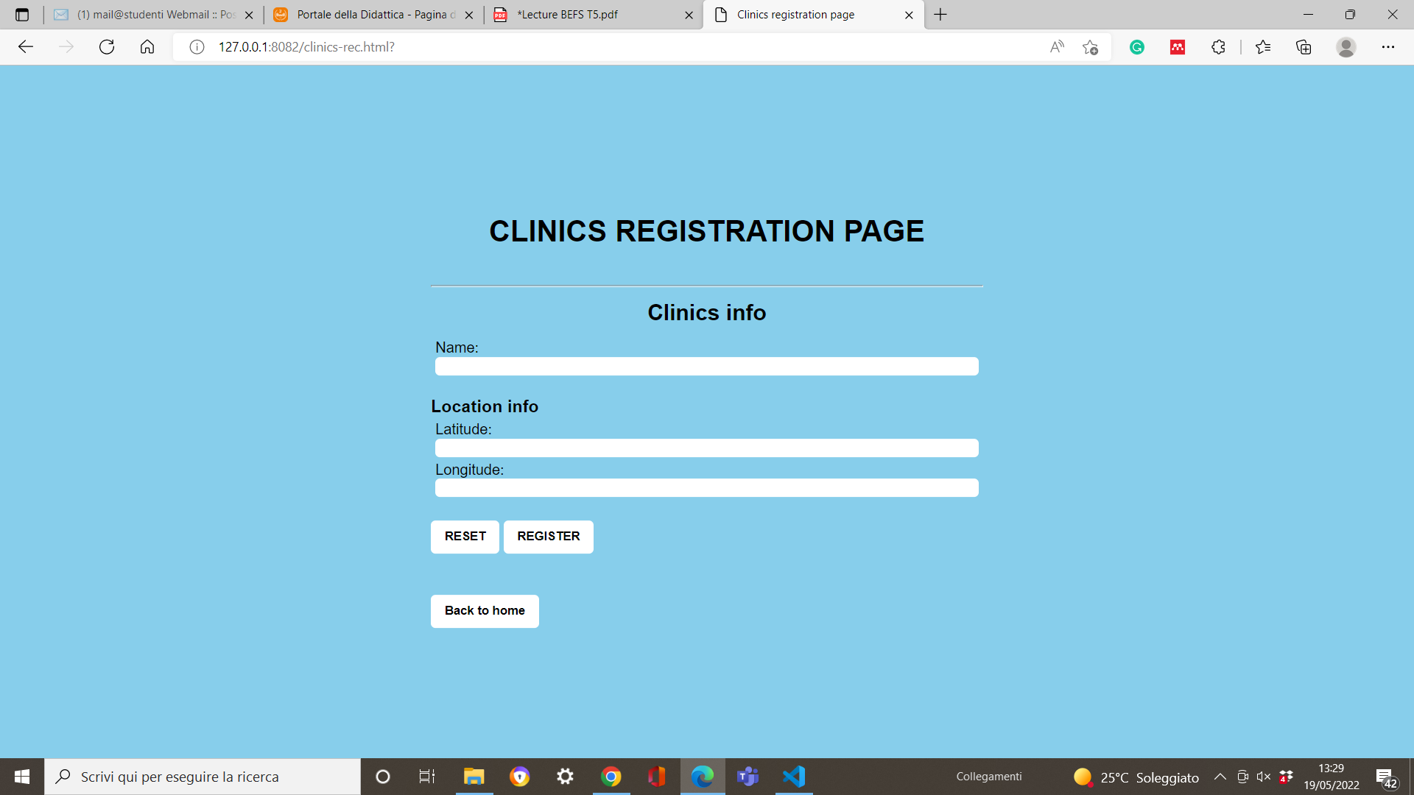
FRONT END – CLINICS REGISTRATION
URL della clinics registration page

Slide 16
CATALOG
GET
Get_dc_info
Get_sensors
POST
P_rec
C_rec
PUT
S_up
Get_clinics
Get_patient_info
Get_patients
Get_doctor_info
Avail_docs
Avail_devs
Get_service_info
Get_critical_info
D_rec
P_del
D_del
C_del

Slide 17
DEVICE CONNECTOR
Communicate with:
Catalog (REST)
Scope:
Convert data from sensor type to SenMl format
Alert Service (MQTT topic: "service/<patient_ID>)
Thingspeak Adaptor (MQTT topic: "service/<patient_ID>)
Location Service (MQTT topic: "service/<patient_ID>)

Slide 18



DEVICE CONNECTOR
Hearth rate
Glucosimeter
Oximeter

Slide 19
ALERT SERVICE
Communicate with:
Catalog (REST)
Telegram Bot
Scope:
Critical Alert to clinician
Critical Alert to clinics
Device Connector (MQTT topic: "service/<patient_ID>)
Location Service (REST)
Clinic’s Client (MQTT topic: "alert/<clinic_id>"
Personal Alert

Slide 20




ALERT SERVICE
Critical Alert
Send message to the clinician
Send message to the clinic
Personal Alert
Send message to the patient

Slide 21
LOCATION SERVICE
Communicate with:
Catalog (REST)
Scope:
Find the nearest clinic to the patient with the critical event incoming
Alert Service (REST)
Device Connector (MQTT topic: "service/<patient_ID>)

Slide 22
WEEKLY REPORT
Communicate with:
Catalog (REST)
Scope:
Give a weekly recap to every clinicians about their patients
Telegram Bot (MQTT topic: ‘weekly_report’)
Thingspeak

Slide 23
THINGSPEAK ADAPTOR
Communicate with:
Catalog (REST)
Scope:
Connect Thingspeak with the device connectors
Device Connector (MQTT topic: "service/<patient_ID>)
Thingspeak (REST)

Slide 24
THINGSPEAK
Communicate with:
Catalog (REST)
Scope:
Collect data from all the device connectors
Weekly Report
Thingspeak Adaptor (REST)
Telegram Bot
Display the trend of each sensor of each patient in diagrams

Slide 25
THINGSPEAK

Slide 26
TELEGRAM BOT
Communicate with:
Catalog (REST)
Scope:
Guarantee a user-friendly interface
Alert Service (MQTT topics: ‘telebot/personal_alert’ and ‘telebot/critical_alert’)
Thingspeak
Weekly Report (MQTT topic: ‘weekly_report’)
Advise clinicians in case of a critical alerts
Advise patients in case of personal alerts
Display weekly-reports to clinitians
Allow clinicians to monitor their patients as soon as they want

Slide 27
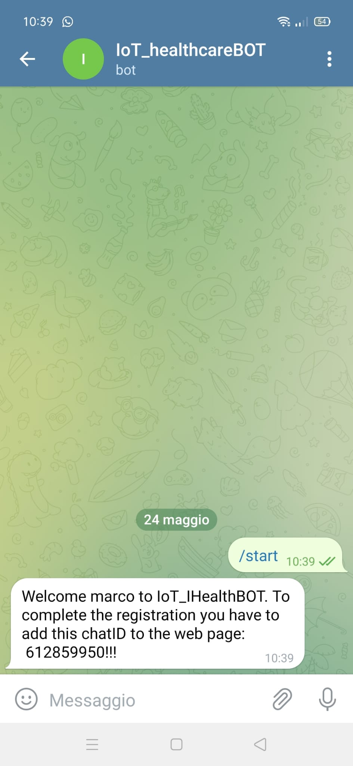
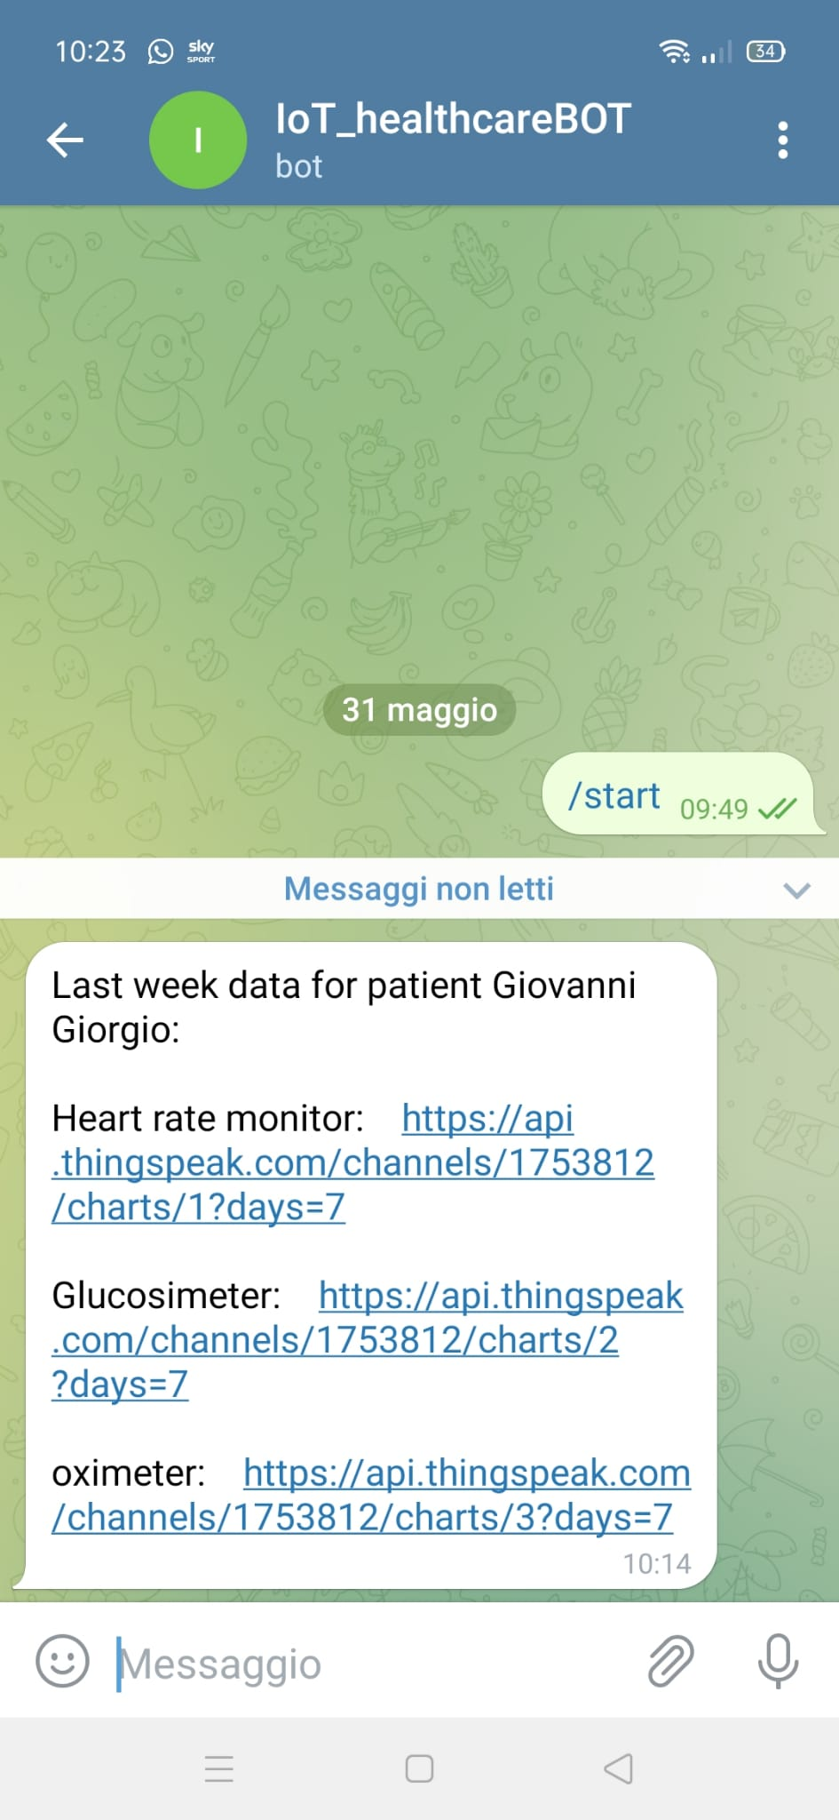
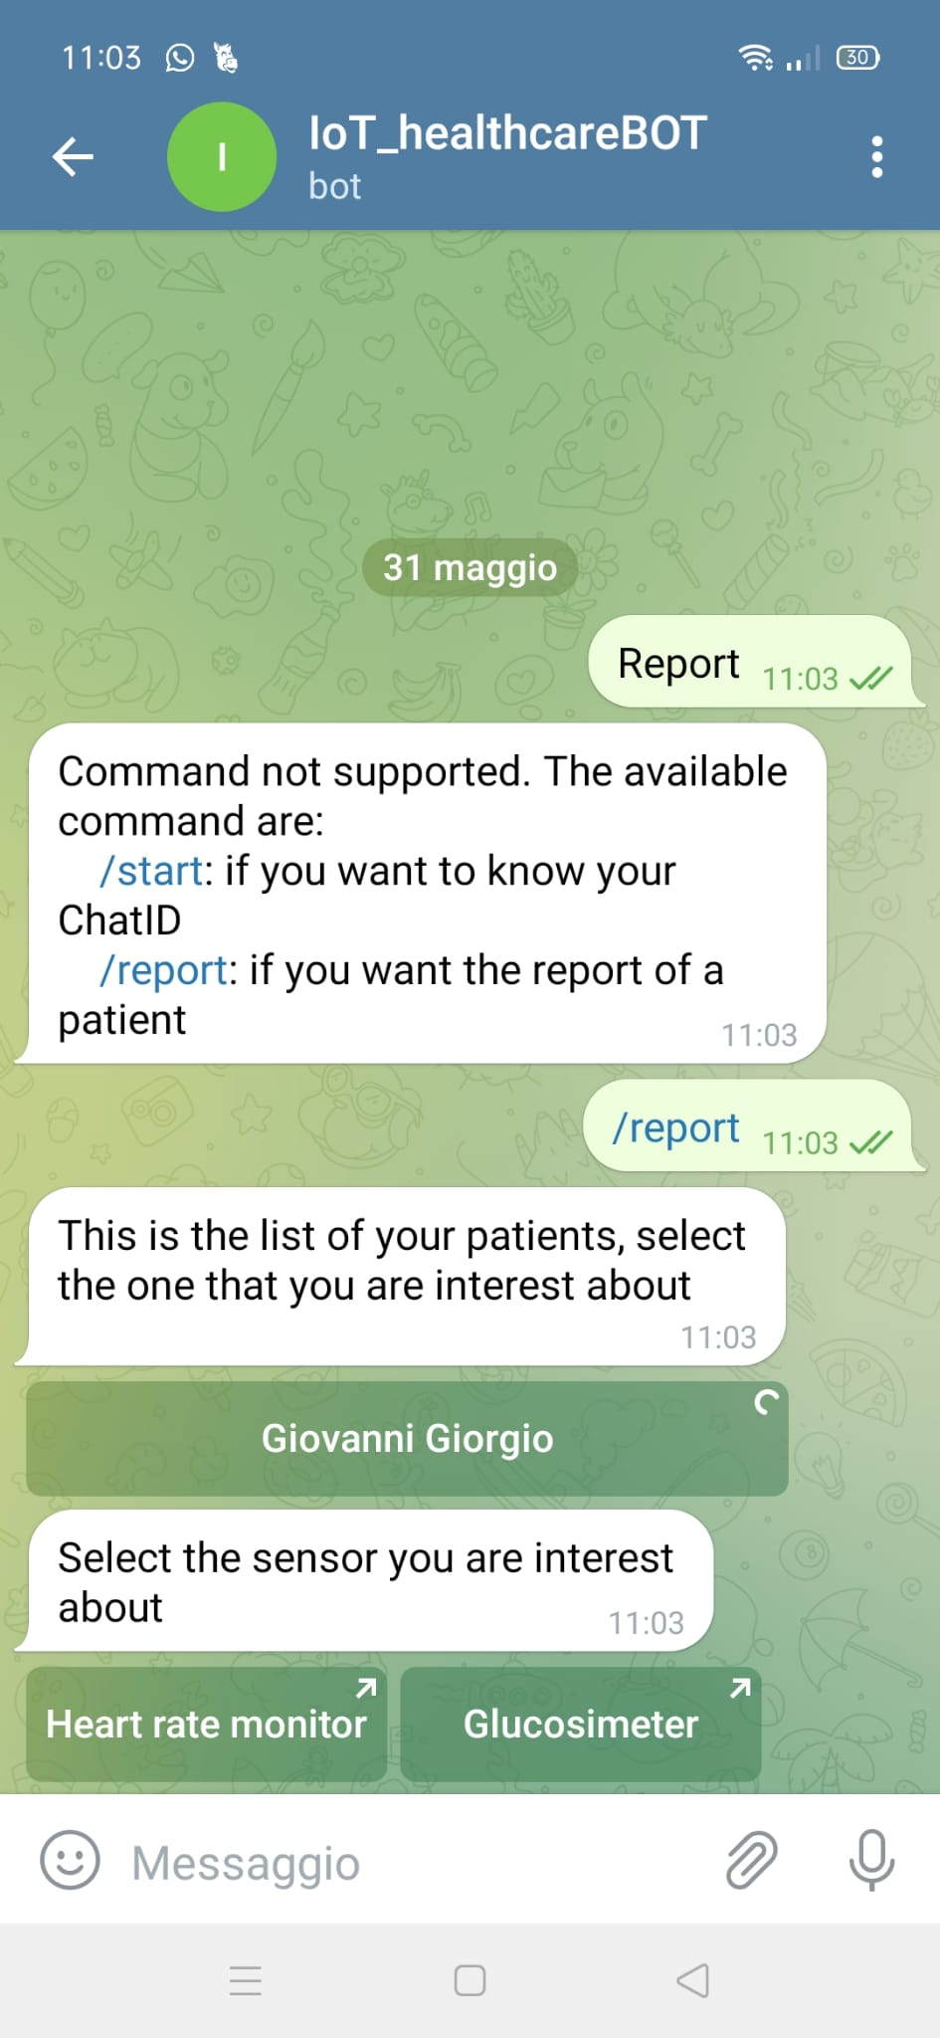
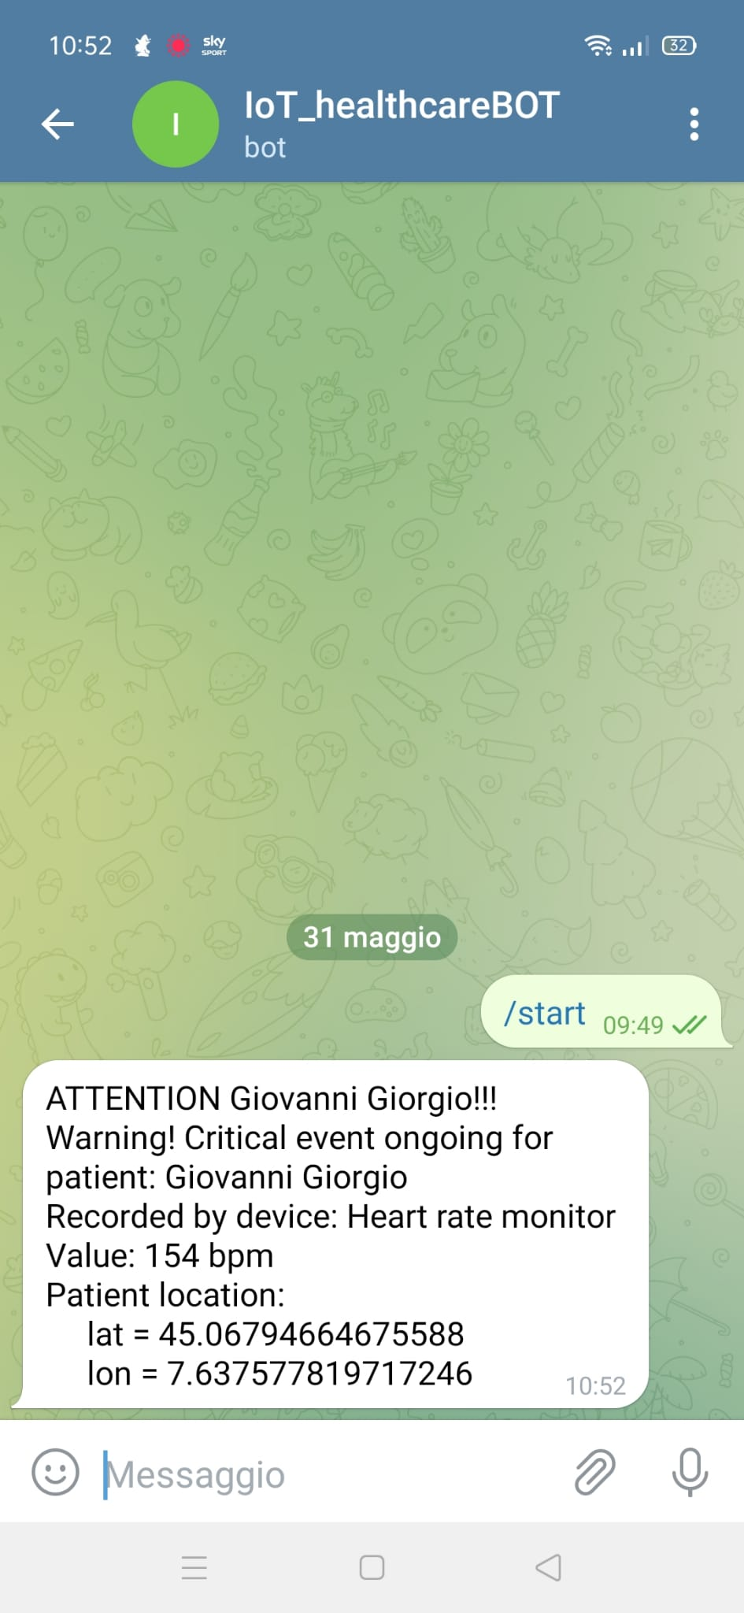
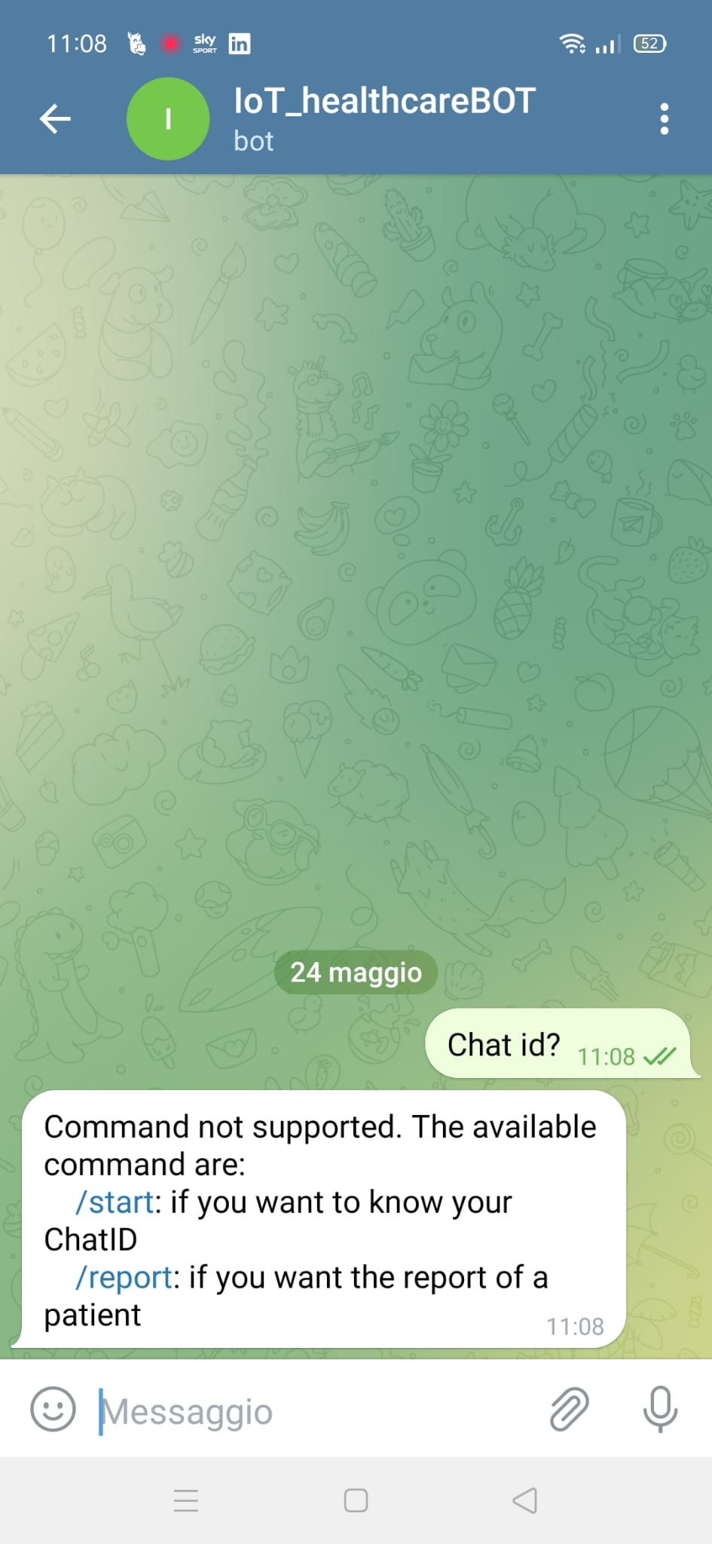
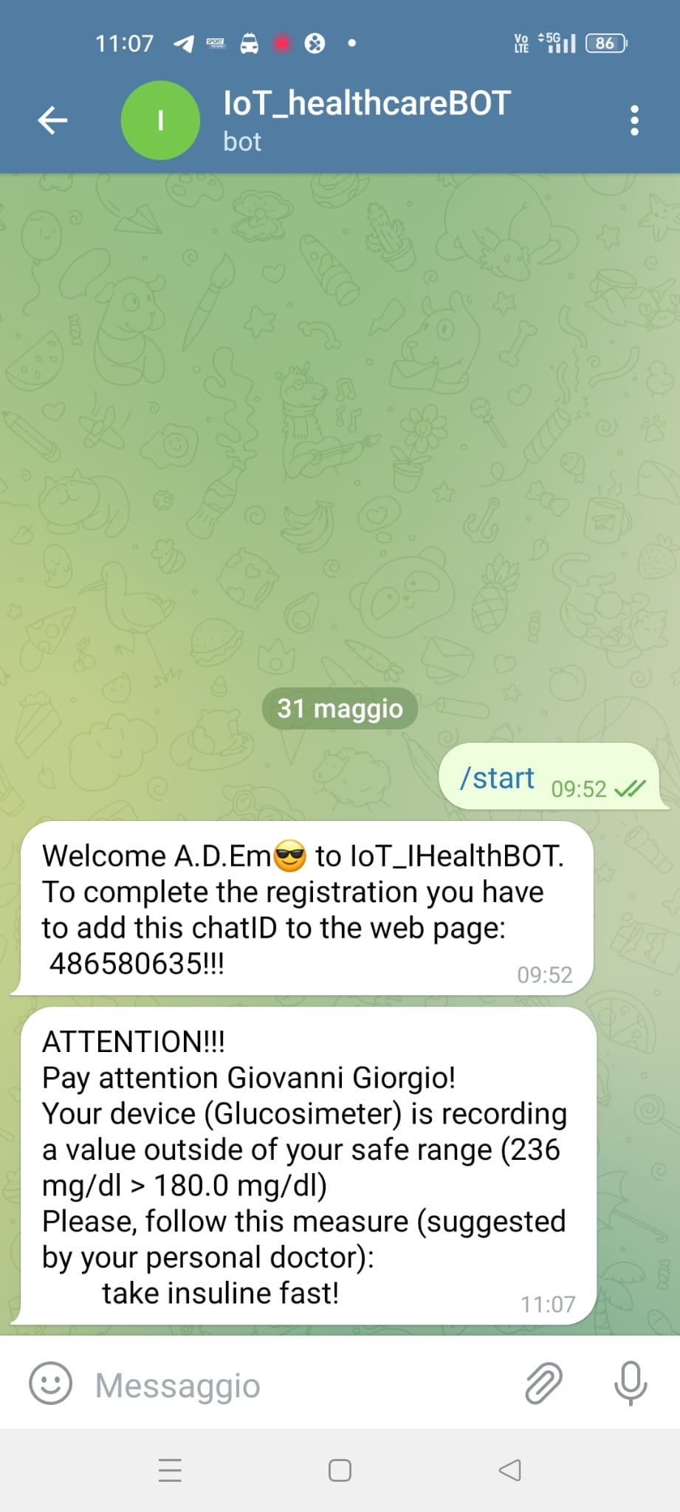
TELEGRAM BOT - MESSAGES
“/start”
“/report”
Wait for alerts
Wait for weekly reports
Errors
Patients and clinicians
Clinicians
Patients (personal alert) and clinicians
Clinicians
Patients and clinicians

Slide 28
CLINIC’S CLIENT
Communicate with:
Catalog (REST)
Scope:
Guarantee a 24/7 supervision to patients
Alert Service (MQTT topic: "alert/<clinic_id>"
Receive a message with longitude and latitude of the patient in critical condition

Slide 29
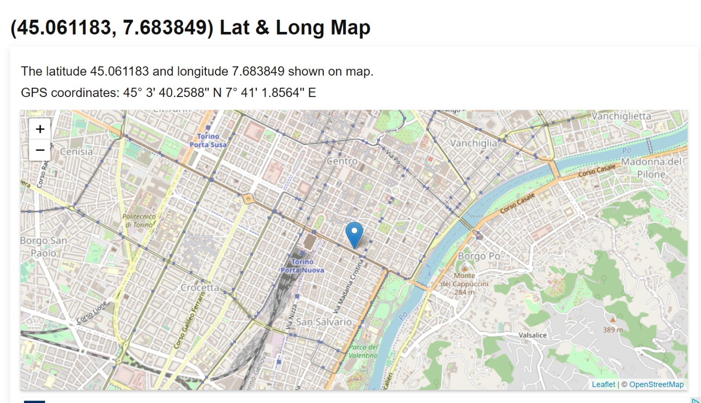
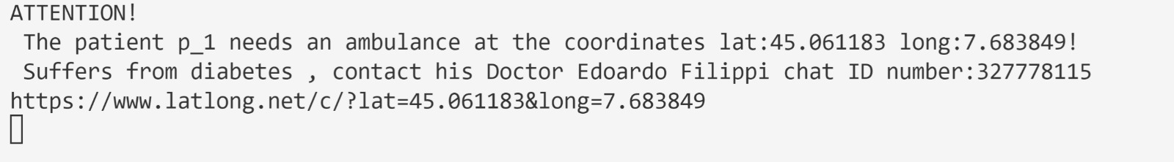
CLINIC’S CLIENT
Message received:

Slide 30
Future improvement
Per il momento solo cliniche di torino

Slide 31
Thanks for your attention
Group number 3:
Marco Gagliardi 284171
Domenico Emanuele Alessandria S292216
Davide D'Adamo289326
Edoardo Filippi 292207

