Slide 1

IoT platform for continuous monitoring of patients

Slide 2


INTRODUCTION
DOMAIN
SCOPE
STAKEHOLDERS
e-Health
guarantee a 24/7 monitoring for patients with assessed medical issues
Patients, clinicians and clinics

Slide 3
OBJECTIVES
1)Prevent
prevent critical events and/or guarantee an immediate response (such as stroke in cardiovascular patients)
2)Simplify
simplify personal therapies (such as insulin self-injection for diabetic people)
3)Automate
automate signal acquisition for easier quantification of disease evolution (such as sensorized orthesis for postural disease patients)

Slide 4
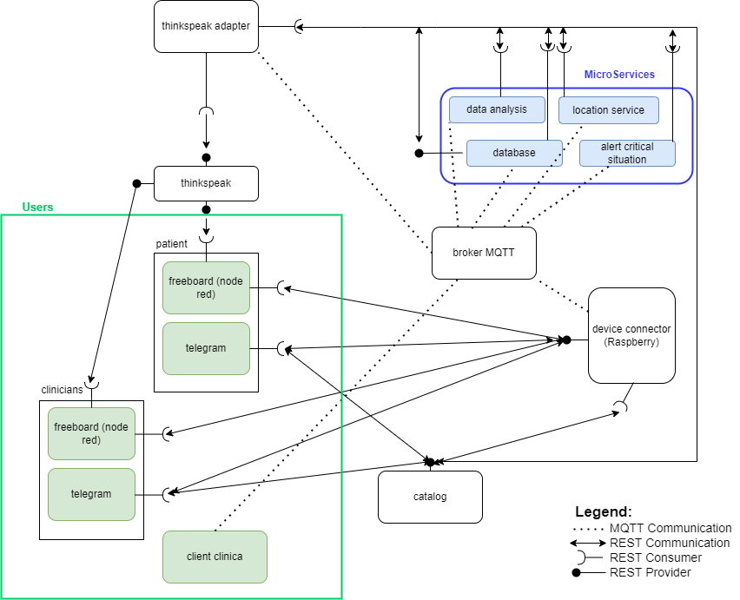
DIAGRAM OF USE - PROPOSAL

Slide 5

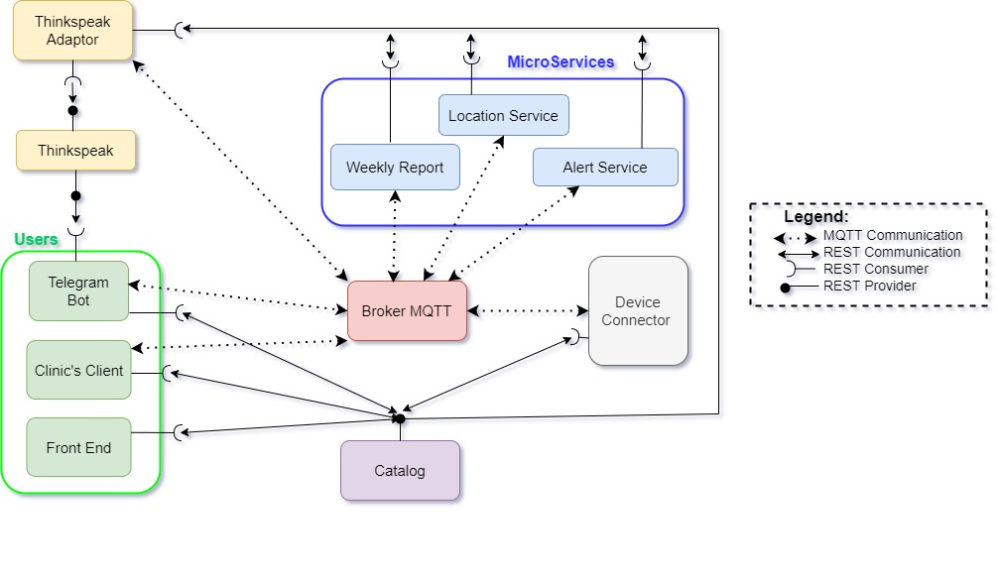
DIAGRAM OF USE – LAST UPDATE

Slide 6
4) PROTOCOLLI COMUNICAZIONE

Slide 7
5) CATALOG

Slide 8
6) DEVICE CONNECTOR

Slide 9
7) ALERT SERVICE

Slide 10
8) LOCATION SERVICE

Slide 11
9) WEEKLY REPORT

Slide 12
10) THINGSPEAK

Slide 13
TELEGRAM BOT

Slide 14
11) TELEGRAM BOT

Slide 15
12) CLINIC’S CLIENT

