Slide 1

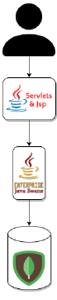
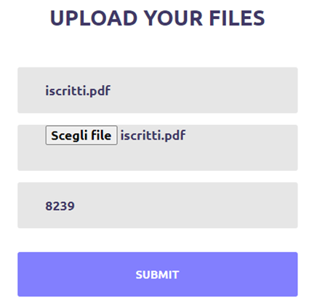
Synchronization Problem
PROBLEM :
Two o more peers can try to upload the same file, not yet present in the system, at a tracker. A race begins and it can lead to have more torrents of the same file managed by multiple trackers.
Client 1
Client 2

Slide 2

Solution: Singleton EJB
The critical section, where the new file is assigned to a given tracker, will be managed through a Singleton EJB.
In order to guarantee that concurrency is managed correctly the Container-managed Concurrency model has been adopted.
It consists of using the lock when a thread accesses the method. Two types of lock has been used: LockType.WRITE And LockType.READ

Slide 3
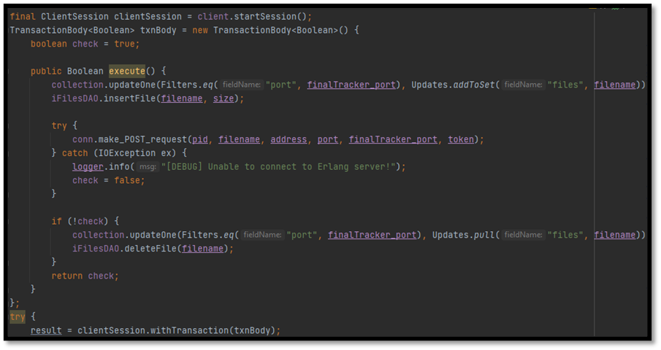

Database Consistency Problem
PROBLEM:
During the upload operation, when a new file is inserted into MongoDB, it has to be inserted, with the owner info, also in DETS database of the Cowboy Erlang Web Server and viceversa, in order to maintain the consistency.
SOLUTION:
MongoDB Transactions

