Slide 1

ML4IoT Implementation of different projects
Edoardo Fantolino s286008
Data Science and Engineering, Politecnico di Torino

Slide 2

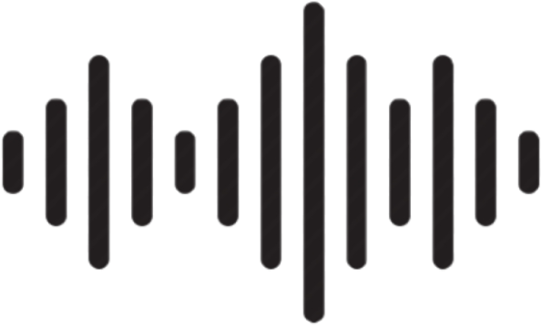

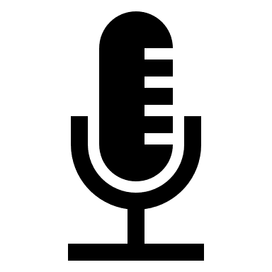


Introduction
Use Deep Learning to:
Recognize sounds
Classify images
Connect Devices as:
Cloud Servers
Sensors
Smartphones

Slide 3
Sound Recognition and Classification
Asus Keyboard
Typing
Lenovo Keyboard
Playstation joystick
Sound
Microwave
Oven
Big oven
Cooking
Coffee (in moka)
Boiling
Water

Slide 4
Banana
Image Recognition and Classification
Fruit
Apple
Orange
Images
Food
Spaghetti
Pasta
Penne
Conchiglie

Slide 5
Nutritional help Activity tracking Alarm systems
THE SENSORS ALLOW TO COOK MORE EFFICIENTLY
We can keep track of our nutritional habits and tailor them in case of needs
We can be helped by the sensors to cook better
We can keep track of our working activity
We UNDERSTANd WHEN WE NEED A BReAKE to play SOMETHING FUN
THE Sensors will keep our home safe when we are out

Slide 6
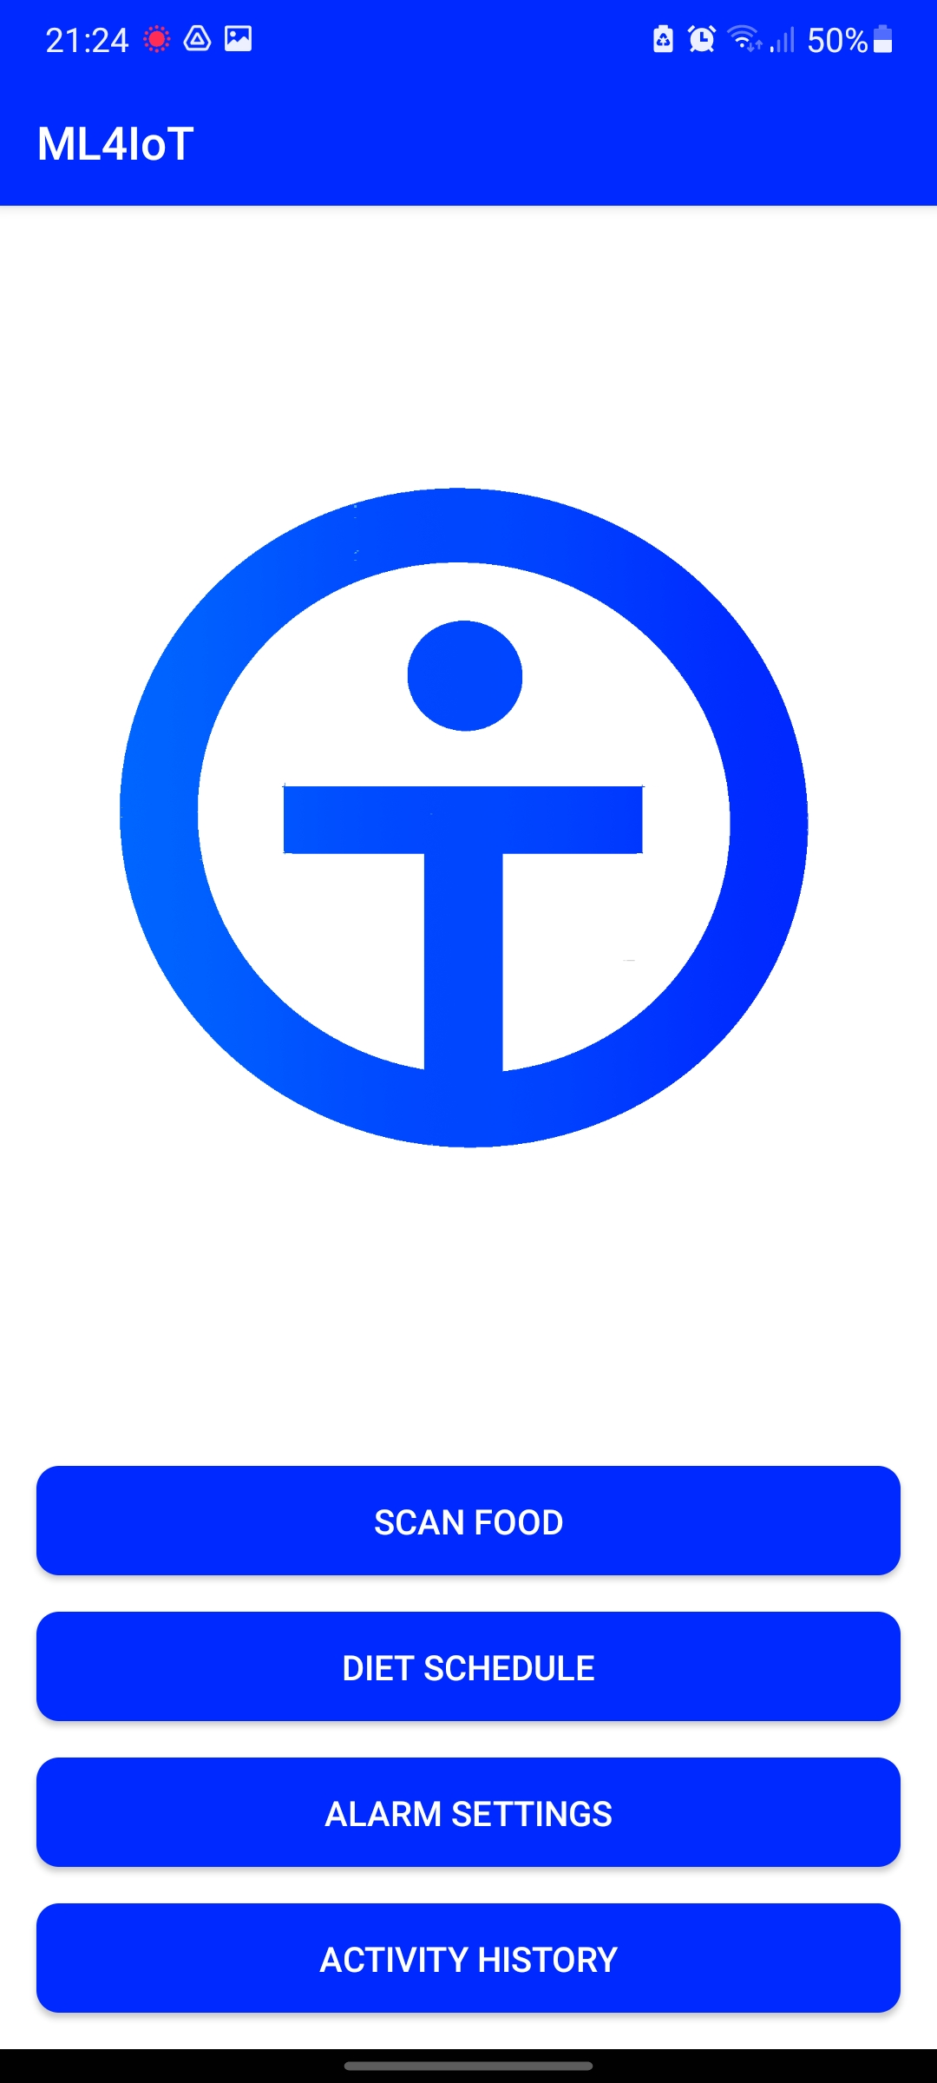
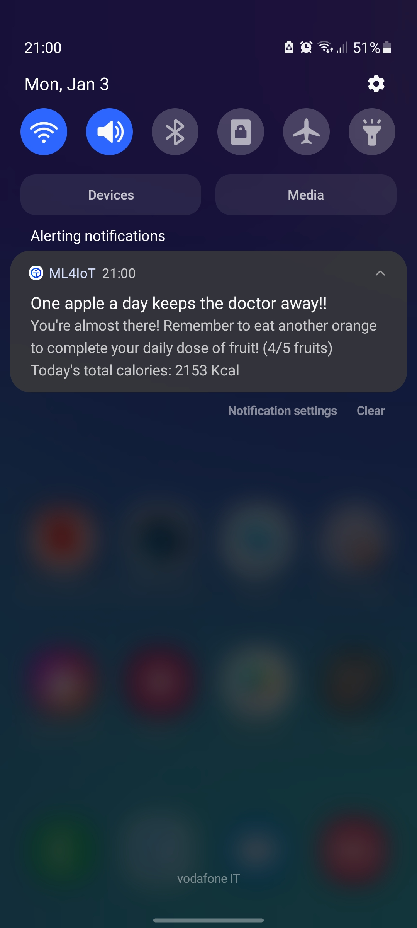
User experience is the core of our business
Mobile Application
The app make the system user friendly. The customers can easily keep track of their activity
Notification System
The notification alerting feature makes the application quickly interact with the user in case of need

Slide 7
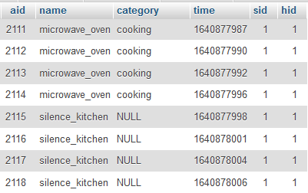
To store data and perform analysis a DBMS is created
House ID
Sensor ID
Address
has
house
sensor
(1,N)
(1,1)
(0,N)
detects
(1,1)
Activity ID
activity
Name
Time
Category

Slide 8
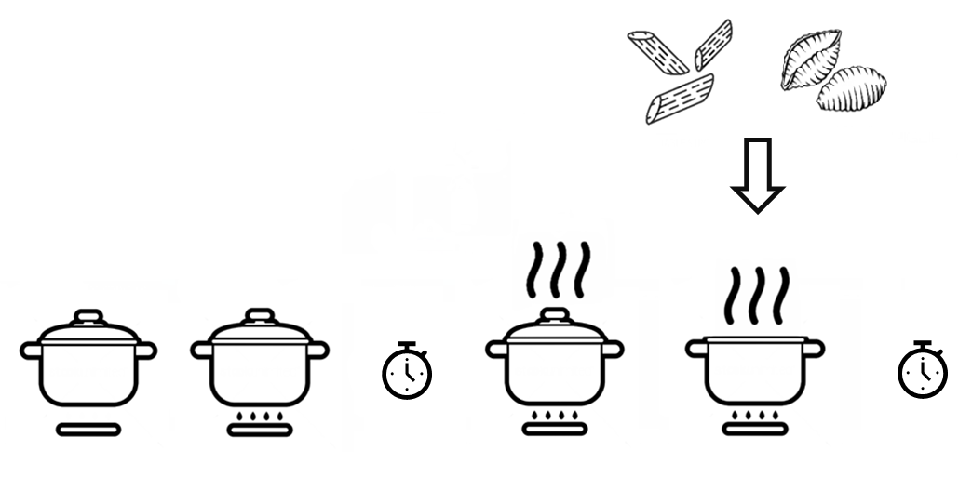
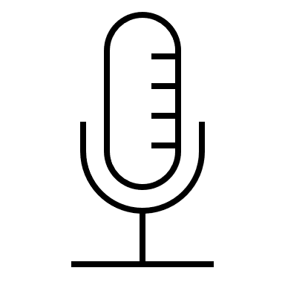


Example of enhanced cooking
Example of enhanced cooking
Penne 9 min.
The microphone monitors the state of the water and as soon as the water is boiling a notification is sent to the user.
Conchiglie 8 min.
The camera sees the type of pasta and consequently how much time it should cook. After the correct cooking time is ended, a notification is sent to the user.
*
*
READY
TO EAT!
silence
gas
boiling water
boiling water
*
= a notification is sent to the user

Slide 9


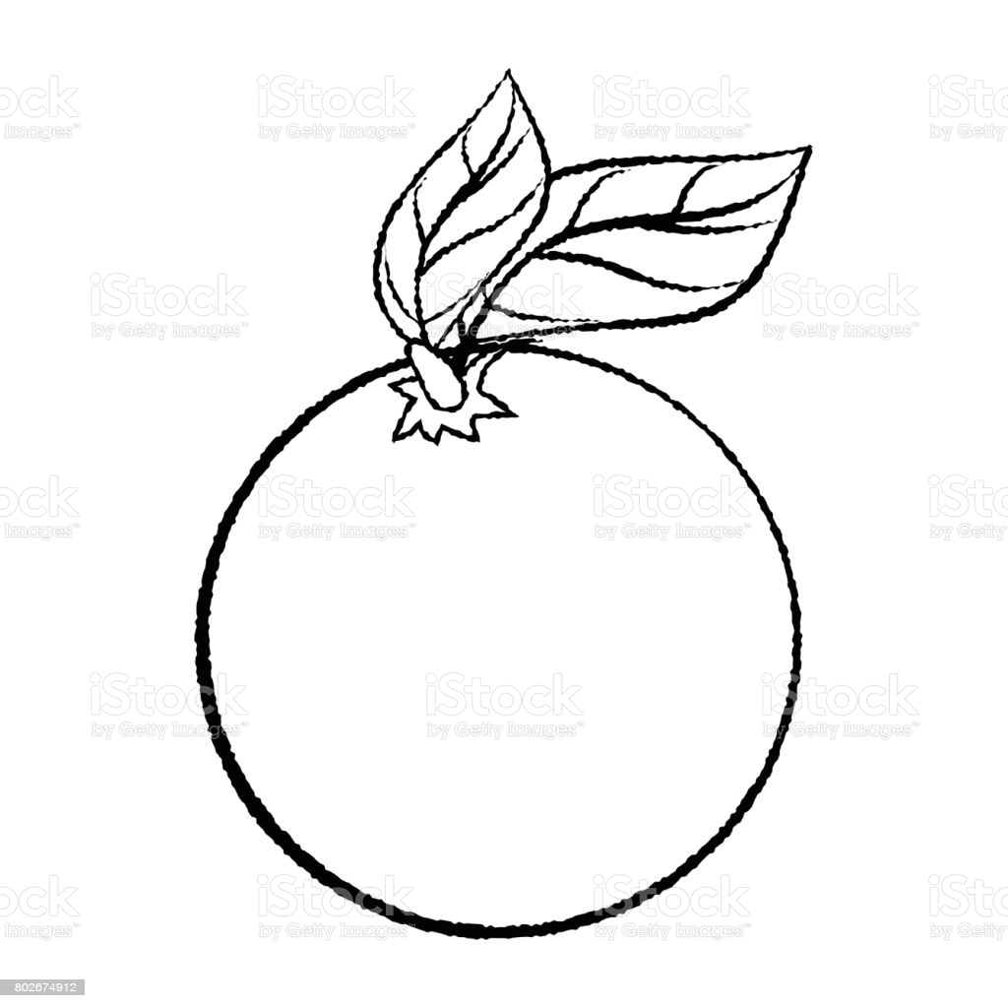
Example of food schedule and alerting
H 21:00 -> notification.
Well done! You are almost there! Eat another orange to reach the optimal daily dose of fruit.
Apple, 08:30
Banana, 10:30
Apple, 13:30
Orange, 17:30
H 09:15:01 -> notification.
Warning. Do not eat other fruits, your level of glucose could exceed the safe threshold.
Apple, 09:05
Banana, 09:10
Apple, 09:15
Apple, 10:30

Slide 10
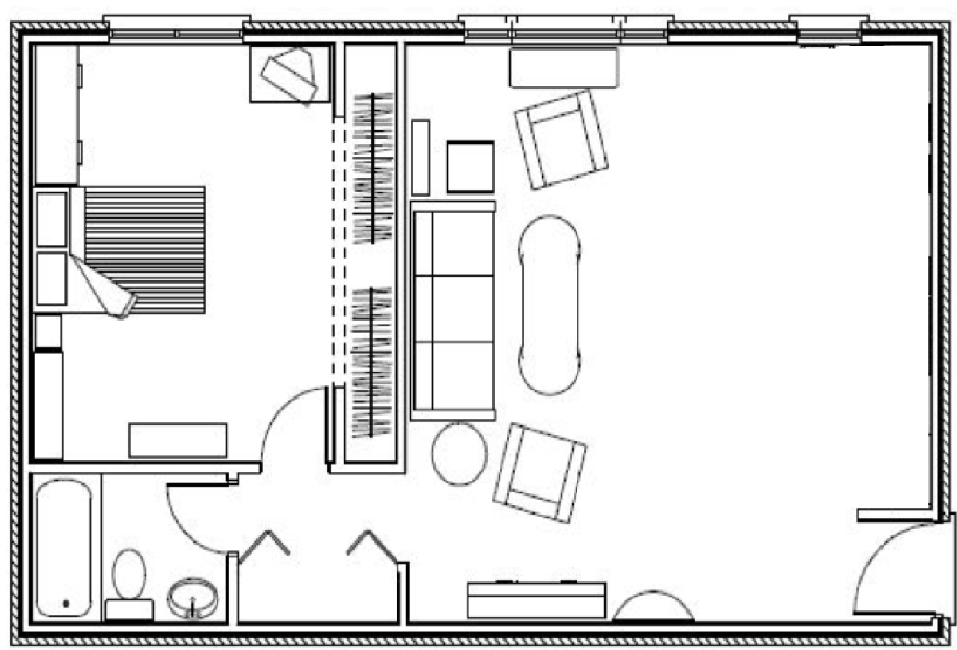
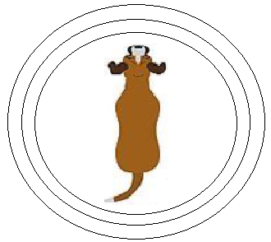
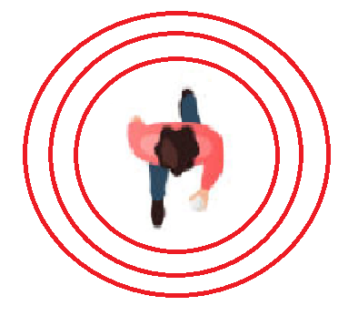

Example of Safety and Alarms
During a working day, you can turn on the alarm and the microphone will detect the sounds of the dogs as normal.
Instead, the walking noise of a thief/intruder and sounds like closing and opening doors will be identified as anomalies and the system will immediately send a notification to the user or directly to the competent authority.

