Slide 1
Graph Neural Networks:
The Convolutional Layer
Edoardo Grasso

Slide 2
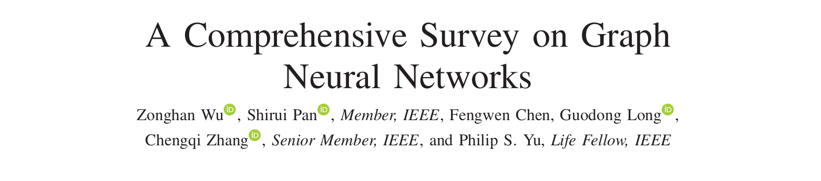
Machine Learning on Networks?
Network Embedding
GNN
Represent nodes as low dimensional
vector;
Preserve network topology structure
as well as node content information;
Use off-the-shelf ML algorithms.
Develop ad hoc algorithm to address graph-related tasks.
RecGNN, ConvGNN, GAE, GGAN, ...

Slide 3
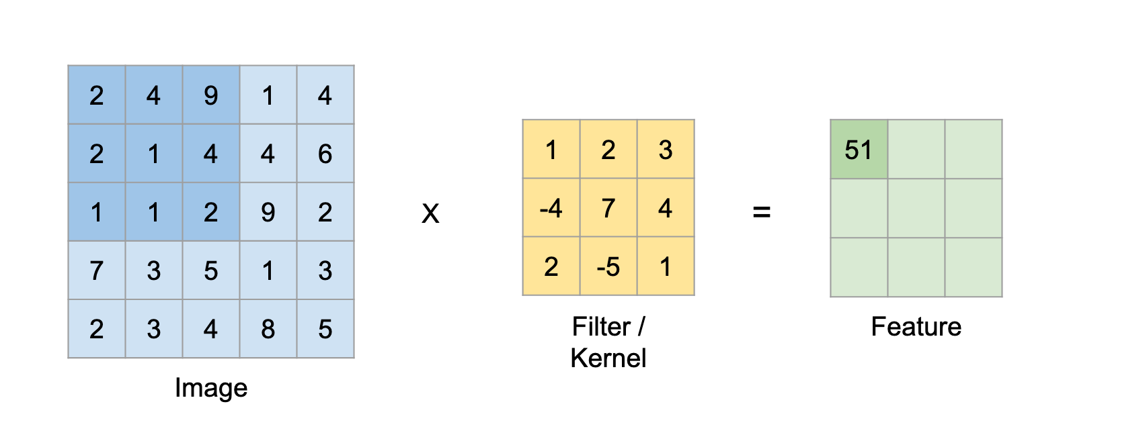
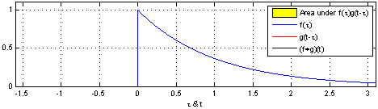

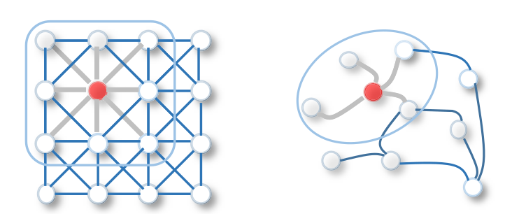
Convolutional Neural Networks
Problem:
What about non-euclidean spaces?
Spectral-based ConvGNN
Spatial-based ConvGNN

Slide 4
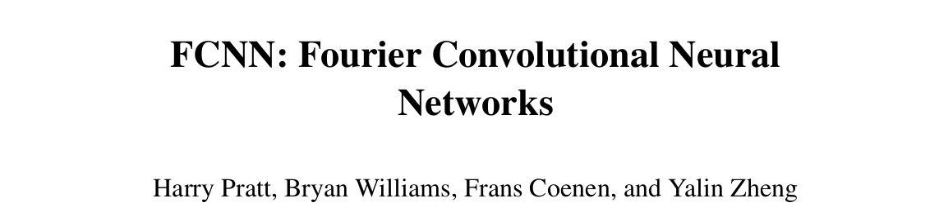

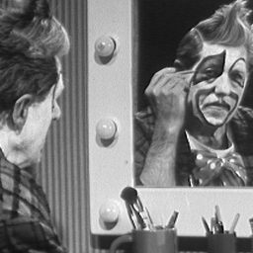
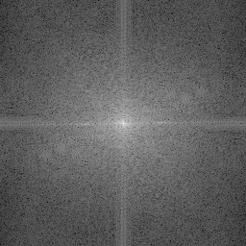

Convolution Theorem:
Shift filter and multiply
image by filter ~ N² times.
Multiply image by filter
one time;
Calculate DFT for NxN image
Cooley-Tukey → N*log(N);
Very efficient pooling.

Slide 5





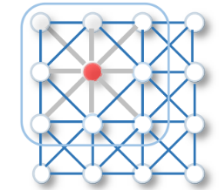
Same thing applied on Graphs
For a graph with n vertices:
Symmetrically normalized laplacian
Spectral decomposition
Let
be a graph signal, each entry xᵢ is the value of the signal for
the i-th node.
Using an analogy, this can be viewed as the greyscale
value of the pixel in a matrix-like graph.

Slide 6








Same thing applied on Graphs
The graph Fourier Transform of a signal is defined as:
And the inverse Fourier Transform:
The graph convolution of the input signal with a filter is:
x₁⊙x₂ = diag(x₂)x₁
Let

Slide 7
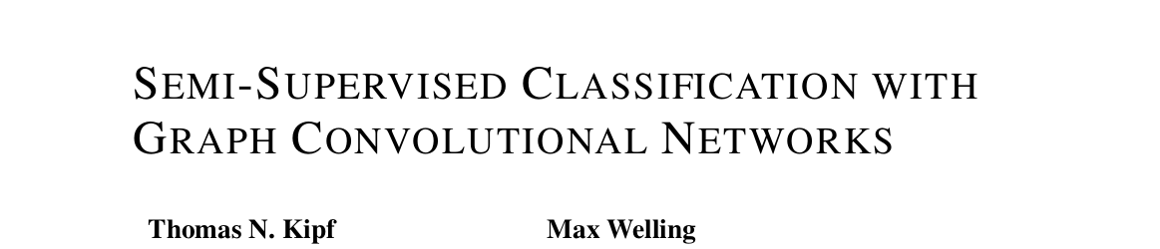






Where is a filter parametrized by in the Fourier domain.
is a function of the eigenvalues of the laplacian: .
PROBLEM
Multiplication with the eigenvector matrix U is O(N²);
Computing the eigendecomposition of L might be prohibitively expensive
for large graphs.
SOLUTION
→ Expansion in terms of the Chebychev polynomials, truncated to the
first order. [Hammond et. al (2011)]

Slide 8







The Convolutional Layer
Has eigenvalues ≤ 2 → Exploding Gradients
Renormalization:
Generalize for signal :
where is a matrix of filter parameters → learnable weigths
and is the convolved signal matrix.
Complexity:

Slide 9



The Convolutional Layer
FINAL STEP: Apply non-linearity
EXAMPLE: If we consider a two-layer GCN for semi-supervised node
classification task we will have
with .

Slide 10
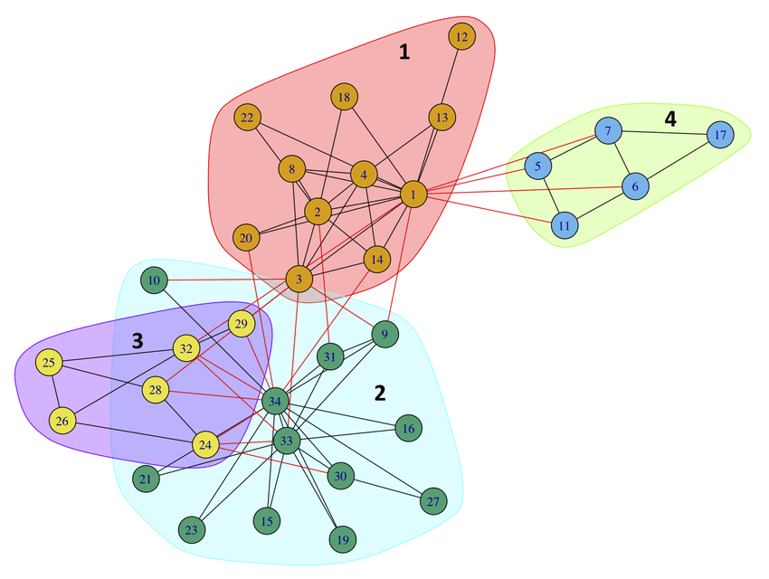
Zachary's Karate Club?

Slide 11
Questions?
Thanks for listening.

