Slide 1
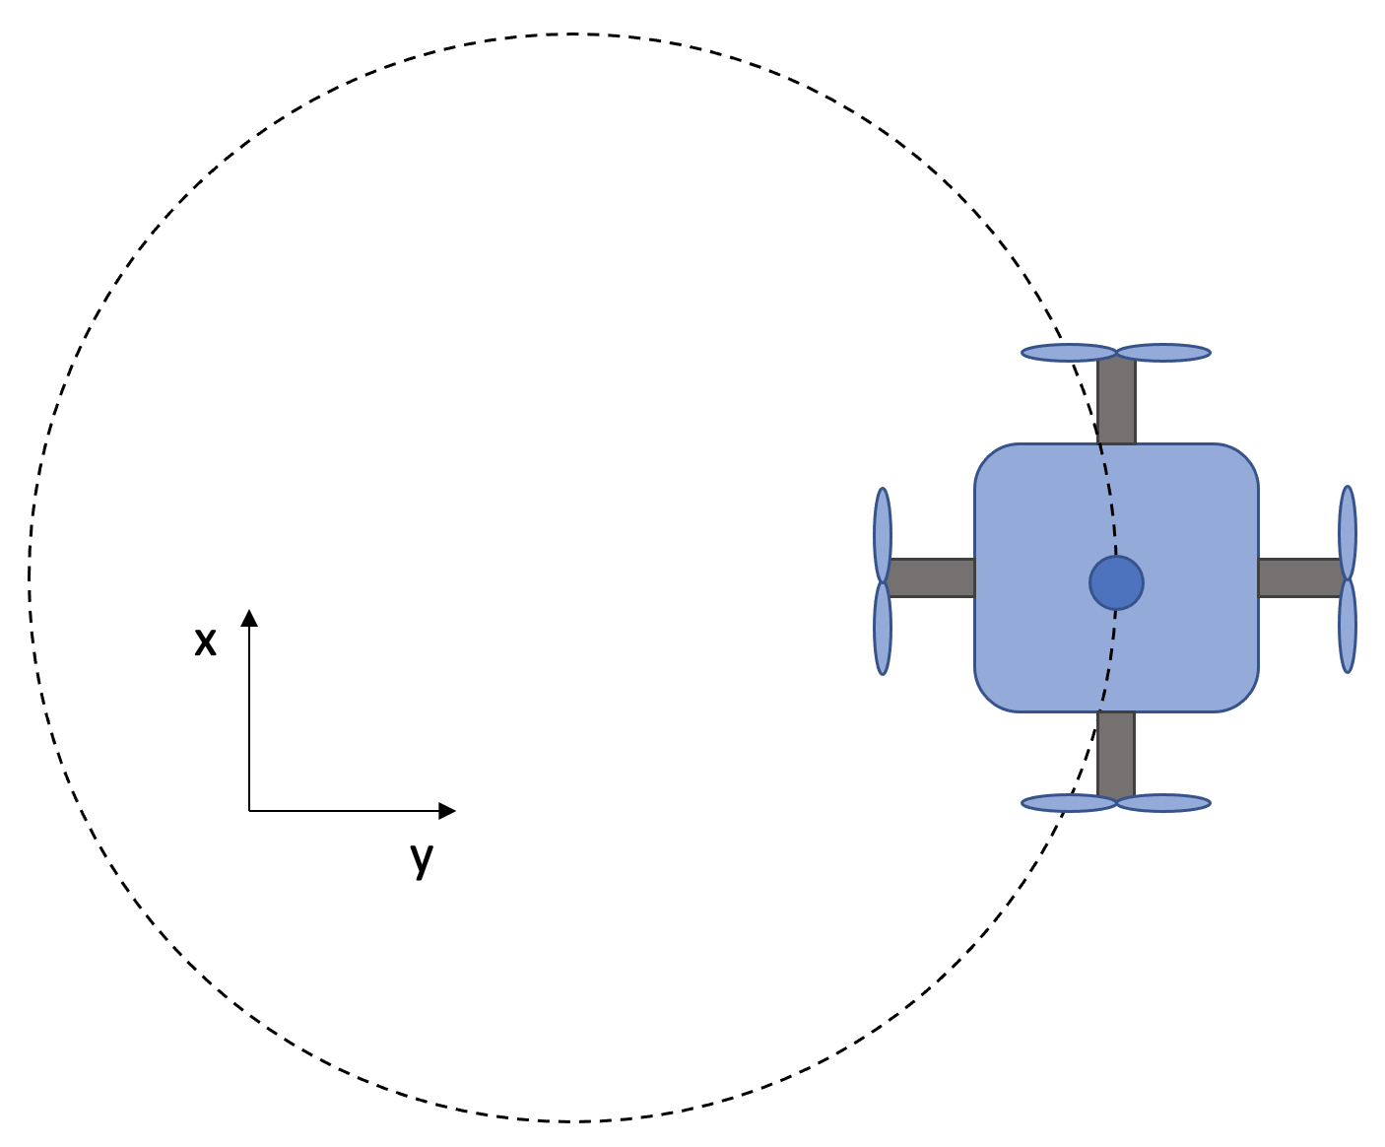
Modelling and Control of a Pole Balancing Drone
ALMA MATER STUDIORUM - UNIVERSITÀ DI BOLOGNA
CANDIDATE
Edoardo Panichi - 890516
DEGREE THESIS
in
Controlli Automatici T-2
ASSISTANT SUPERVISOR
Dott. Lorenzo Gentilini
SUPERVISOR
Professor Marconi
Academic Year 2020/2021 – Session I – 20 luglio 2021

Slide 2
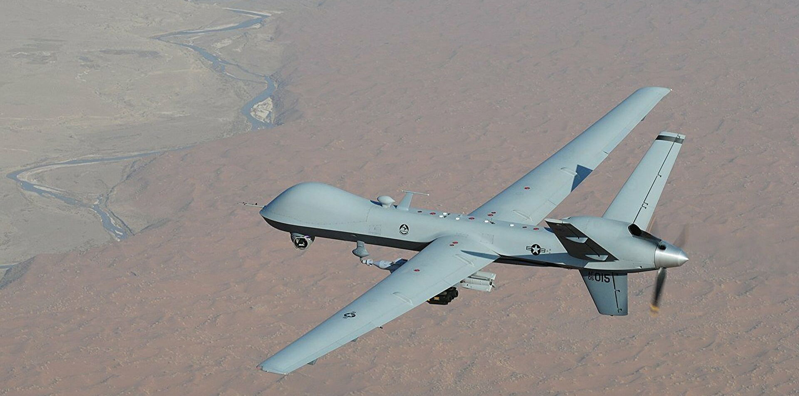
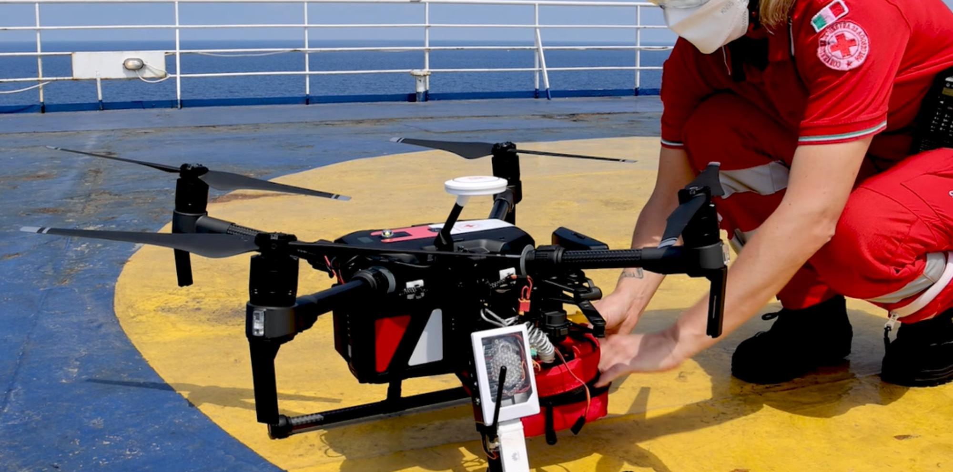
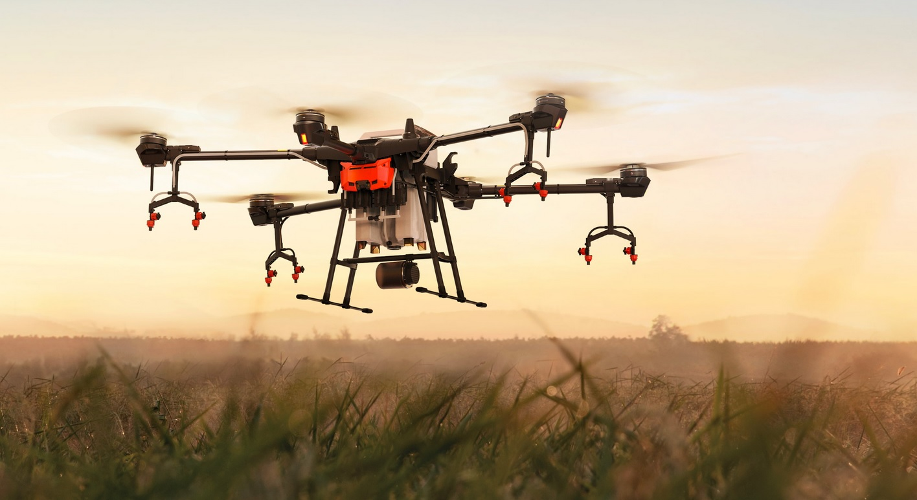
Drones: many possible applications
Military Missions
Aerial Photography
Shipping and Delivery
Disaster Management
Precision Agriculture
Weather Forecast

Slide 3
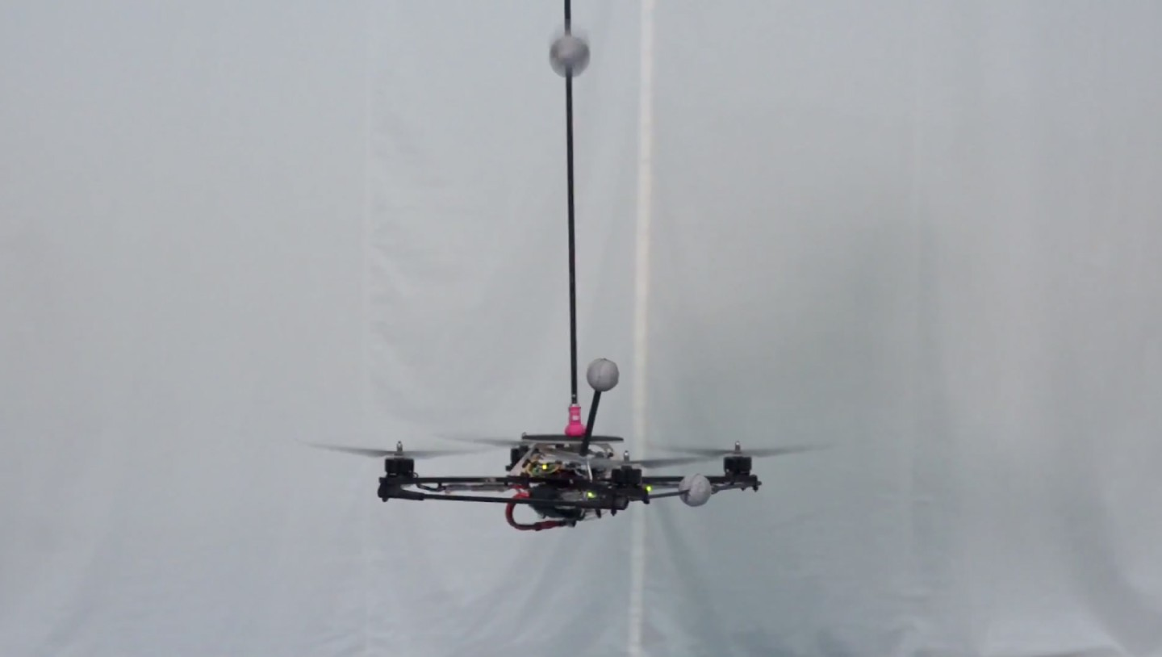
Goals
The drone must be capable of performing two types of operations:
Set-point tracking
Circumference at constant height

Slide 4
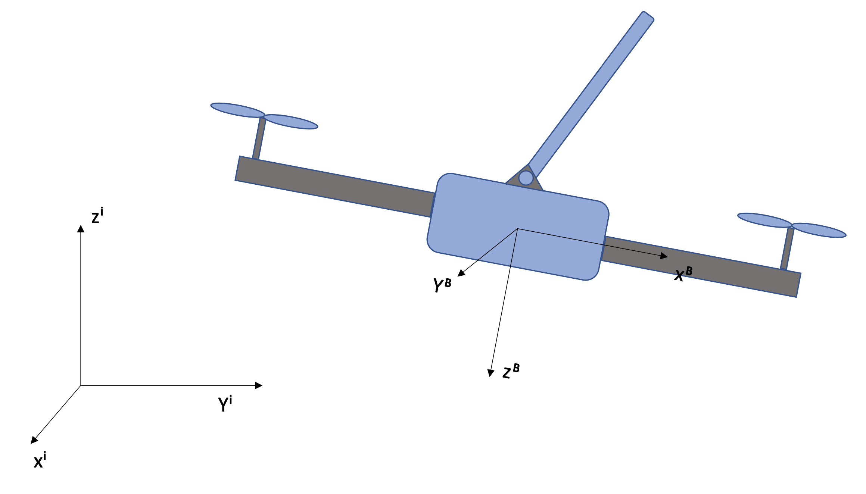

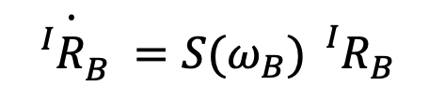


System Modelling: The Drone
$$\left\{\begin{aligned} \\ \\ \\ \\ \\ \\ \\ J{\dot{ω}}_{B}=−S\left(ω_{B}\right)Jω_{B}+τ\end{aligned}\right.$$
$$\dot{P}=V$$
$$m\dot{V}=−mge_{3}^{}−{{}_{}^{I}R}_{B}^{}Te_{3}^{}$$
$$\dot{{{}_{}^{I}R}_{B}^{}}={S(ω_{B}){}_{}^{I}R}_{B}^{}$$

Slide 5
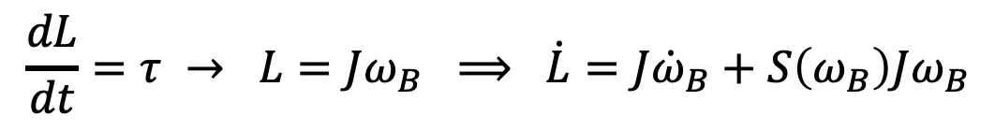

System Modelling: The Drone
$$\left\{\begin{aligned} \\ \\ \\ \\ \\ \\ \\ J{\dot{ω}}_{B}=−S\left(ω_{B}\right)Jω_{B}+τ\end{aligned}\right.$$
$$\dot{P}=V$$
$$m\dot{V}=−mge_{3}^{i}−{{}_{}^{I}R}_{B}^{}Te_{3}^{B}$$
$$\dot{{{}_{}^{I}R}_{B}^{}}={S(ω_{B}){}_{}^{I}R}_{B}^{}$$
$$\frac{dL}{dt}=τ → L=Jω_{B} ⟹ \dot{L}=J{\dot{ω}}_{B}+S\left(ω_{B}\right)Jω_{B}$$

Slide 6
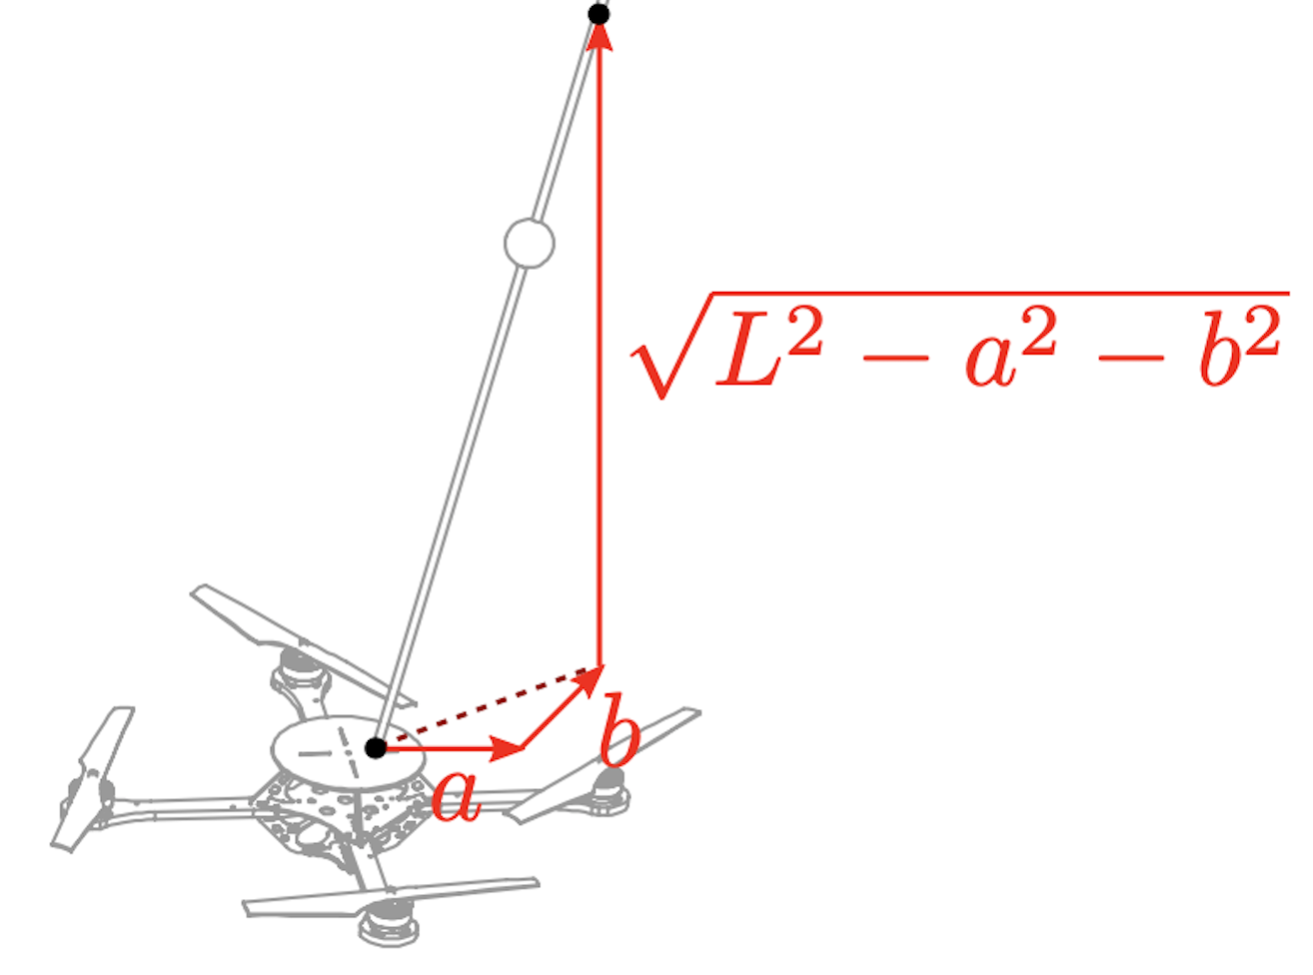
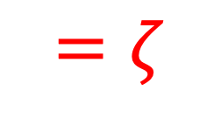

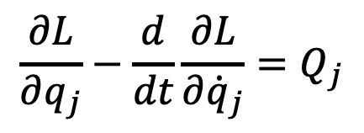
System Modelling: The Pole
$$=ζ$$
Euler – Lagrange equations of motion:
$$\frac{∂L}{∂q_{j}}−\frac{d}{dt}\frac{∂L}{∂{\dot{q}}_{j}}=Q_{j}$$
$$q_{1}=a$$
$$q_{2}=b$$

Slide 7
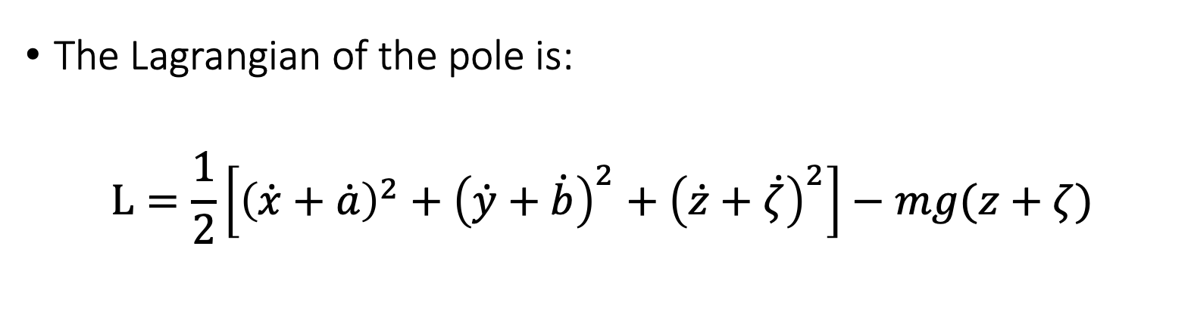
System Modelling: The Pole
The Lagrangian of the pole is:
$$L=\frac{1}{2}\left[{\left(\dot{x}+\dot{a}\right)}^{2}+{\left(\dot{y}+\dot{b}\right)}^{2}+{\left(\dot{z}+\dot{ζ}\right)}^{2}\right]−mg(z+ζ)$$

Slide 8
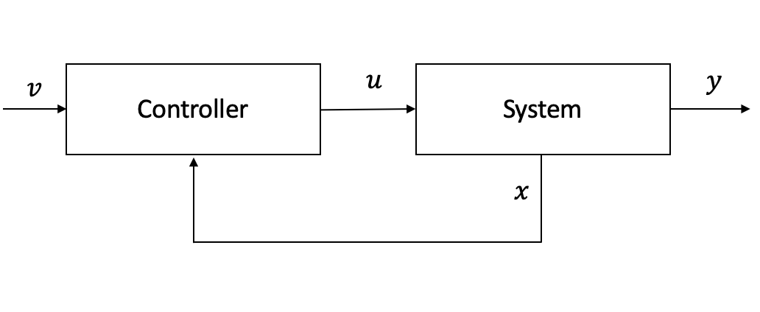
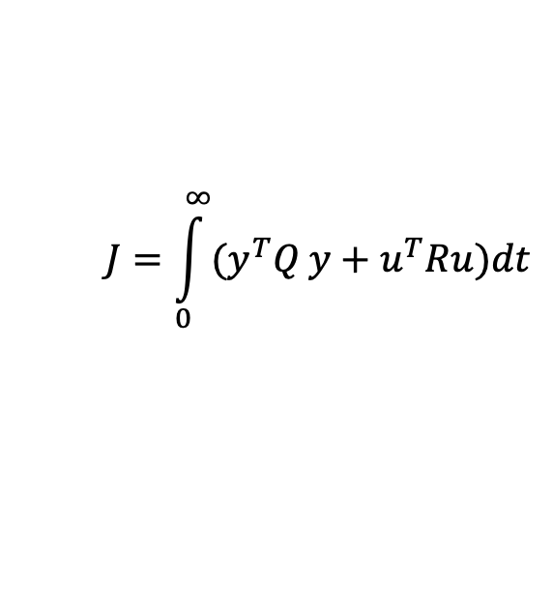
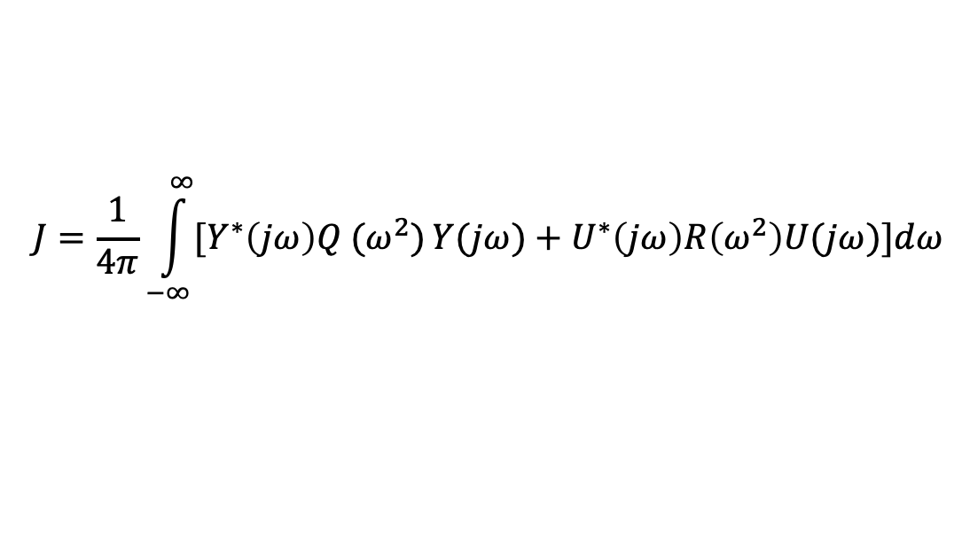
Frequency Shaped Linear Quadratic Regulator
It is based mainly on two concepts:
Full State Feedback
Optimal Control
$$J=\int_{0}^{∞}{(y^{T}Q}y+u^{T}Ru)dt$$
$$J=\frac{1}{4π}\int_{−∞}^{∞}{[Y^{∗}\left(jω\right)Q (ω^{2})}Y(jω)+U^{∗}\left(jω\right)R\left(ω^{2}\right)U(jω)]dω$$

Slide 9

Filters on the States: $x$ and $y$
Bode Diagram
Frequency (rad/sec)

Slide 10

Filters on the States: $z$
Bode Diagram
Frequency (rad/sec)

Slide 11
Filters on the Inputs

Slide 12
Performances: Set-Point Tracking

Slide 13
Performances: Set-Point Tracking

Slide 14
Performances: Set-Point Tracking

Slide 15

Performances: Set-Point Tracking
$$RPY<11˚$$

Slide 16

Performances: Set-Point Tracking
$$α<6˚$$

Slide 17
Performing a Circumference

Slide 18
Performances: Circumference

Slide 19
Performances: Circumference

Slide 20
Performances: Circumference

Slide 21

Performances: Circumference
$$RPY<30˚$$

Slide 22

Performances: Circumference
$$α<15˚$$

Slide 23
LQR: Performances

Slide 24
Future Developments
Remove the constant error
Implementation

