Slide 1
Machine Learning: How high are the recession probabilities in the United States?
Edoardo Pilla
ID: 7744044
June 2023

Slide 2
Agenda
Introduction and key steps
Model characteristics and results
Outlook
Drawbacks and remarks

Slide 3
Introduction and key steps
Recessions linked with stock market downturns
Portfolio adjustments in light of future recession beneficial
Rationale for accurate recession prediction
Usage of machine learning potentially advantageous

Slide 4
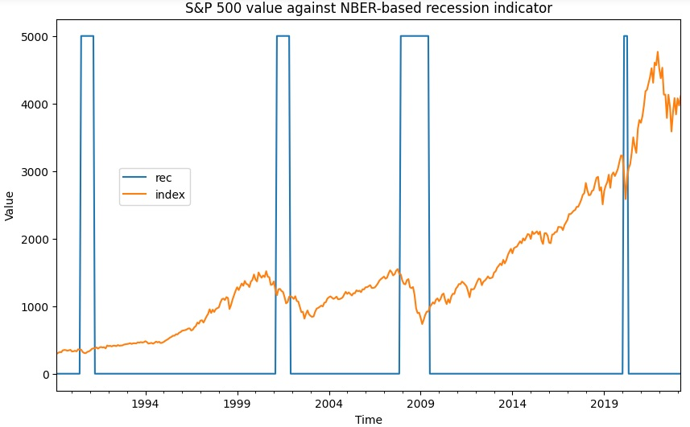
Introduction and key steps

Slide 5
Introduction and key steps
SVM & NN implementation
12-month ahead recession forecast
Probit model implementation
4-quarter ahead recession forecast

Slide 6
Introduction and key steps
Term spreads recognized as robust recession predictors
Available at high frequency
Ample literature employing term spreads justifies their usage
Data easily collected and processed
10Y-3M / 10Y-2Y spreads chosen

Slide 7
Introduction and key steps
NBER-based recession dummy chosen as output
Target series modified to positive if positive at any subsequent month in 1-year window
Increases balance in dataset (~80% / 20% vs. ~90% / 10%)
Allows to frame task as prediction in time

Slide 8
Introduction and key steps
ML-based models extended to include macroeconomic variables
Data gathered through FRED-MD (McCracken and Ng, 2015)
IP Index & Total Nonfarm Payroll
Released: Halfway through subsequent month
Look-ahead bias avoided by shifting series

Slide 9
Introduction and key steps
Neural network architecture (Puglia and Tucker, 2020)
Layer 1: 9 nodes activated by ReLU
Layer 2: 5 nodes activated by ReLU and L2 regularization parameter with penalty term 0.01
Hyperparameter tuning
SVM: Grid search over kernel/degree/C/gamma
NN: Decision threshold to maximize validation set F-beta score

Slide 10
Introduction and key steps
Probit model based on near-term forward spread (Engstrom and Sharpe, 2018)
Data gathered through www.neartermforwardspread.com (Diercks and Soques, 2019)
Quarterly averages for spreads computed with daily values
Target series captures transition into recession
Performance comparison between predictors

Slide 11
Model characteristics and results
Data span
ML-based: 1982/1 – 2023/3 (1981/12 – 2023/2)
Probit: 1981:Q4 – 2023:Q1
Splits (ML-based)
Training: 1982/1 – 2004/11
Validation: 2004/12 – 2013/3
Test: 2013/4 – 2022/3
Outlook: 2022/4 – 2023/3

Slide 12
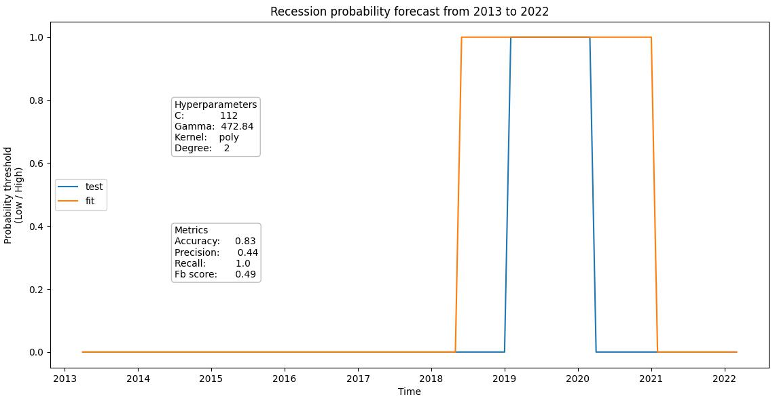
Model characteristics and results

Slide 13
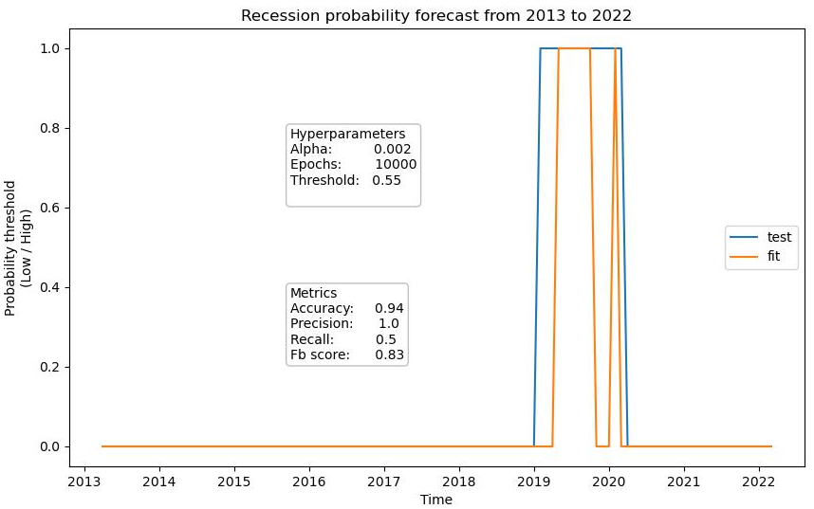
Model characteristics and results

Slide 14
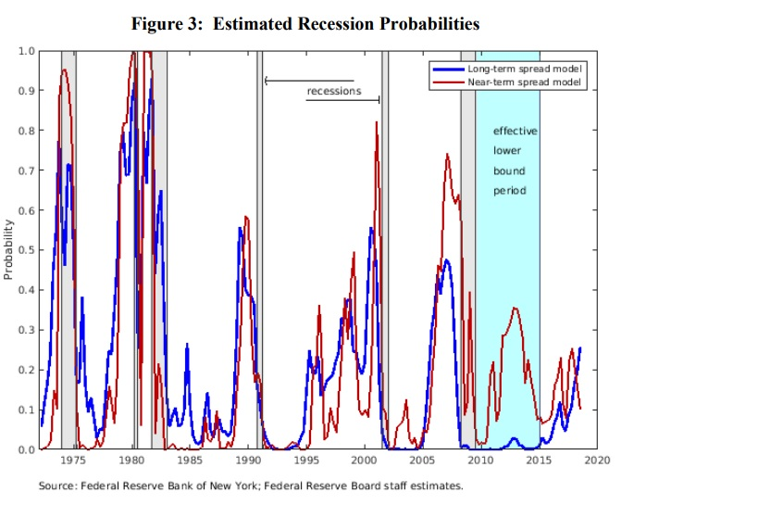
Model characteristics and results

Slide 15
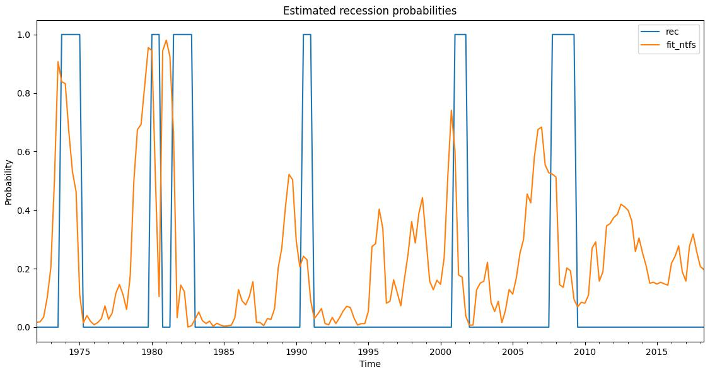
Model characteristics and results

Slide 16
Model characteristics and results
Prioritized F-beta score to embed influence of precision on task
Why? Care to accurately label true positives since recessions rarely occur and portfolio choices may depend on forecast
Performance
SVM: bad on validation, mediocre on test
NN: mediocre on validation, good on test
Adding macroeconomic variables sensibly improves SVM performance while essentially not influencing NN

Slide 17
Outlook
Both SVM specifications predict high recession likelihood starting July 2022 through March 2023
Baseline NN forecasts high recession likelihood starting August 2022 through March 2023
Macro-based NN forecasts high recession likelihood starting November 2022 through March 2023

Slide 18
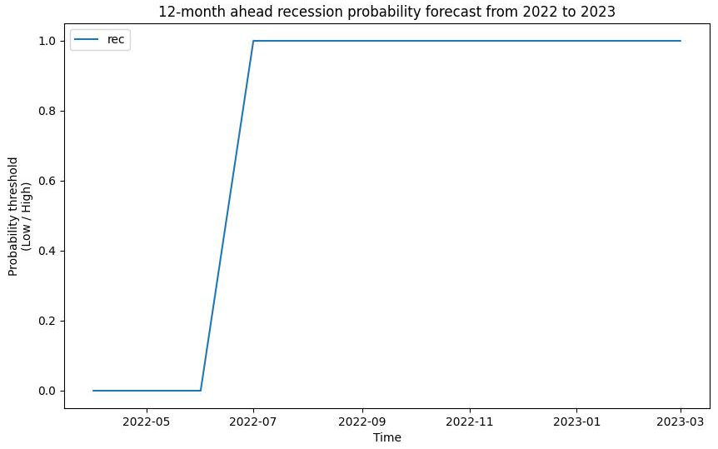
Outlook

Slide 19
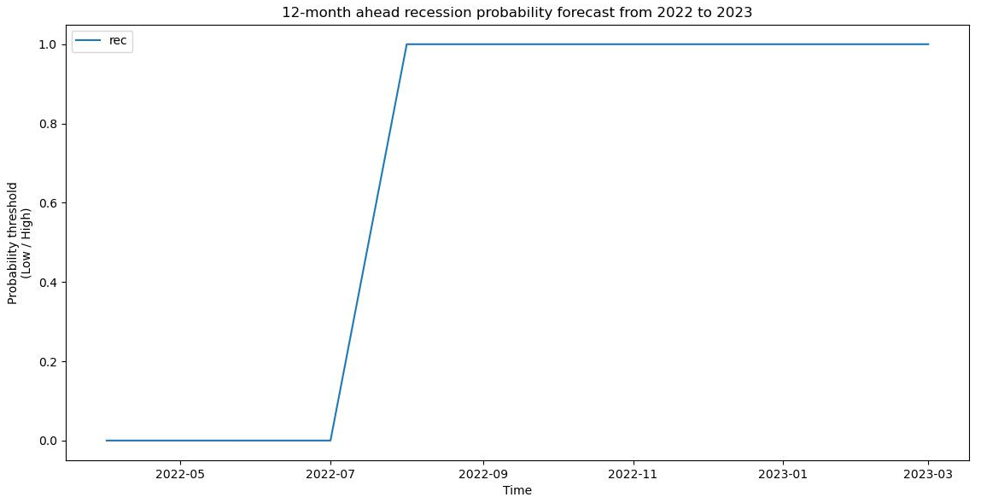
Outlook

Slide 20
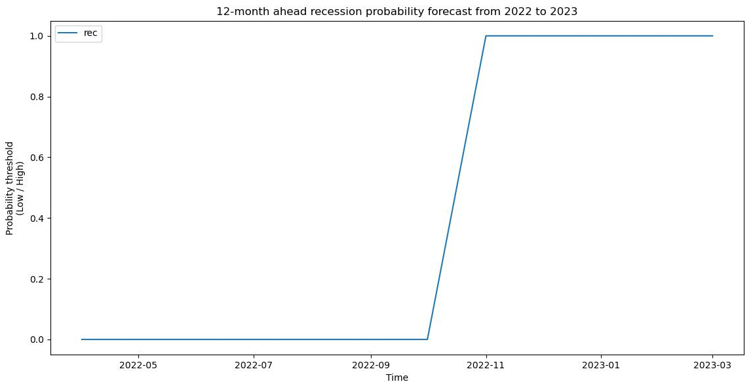
Outlook

Slide 21
Outlook
ML models foresee high recession likelihood starting July 2022 up to March 2023, effectively hinting at potential recession occurring in the window 2023/7 – 2024/3 due to output series modification
Comparing with actual NBER-based dummy series shows no recession at the time of current analysis
However model still suggests potential recession between 2023/7 and 2024/3

Slide 22
Outlook
Probit model forecasts high likelihood of transitioning into recession from 2022:Q2 up to 2023:Q1
4-quarter ahead prediction broadly consistent with ML-based algorithms firing up from 2022:Q3 up to 2023:Q1
Same prediction carried out by probit separately fed with vanilla yield spread (10Y-3M) as well as with NTFS

Slide 23
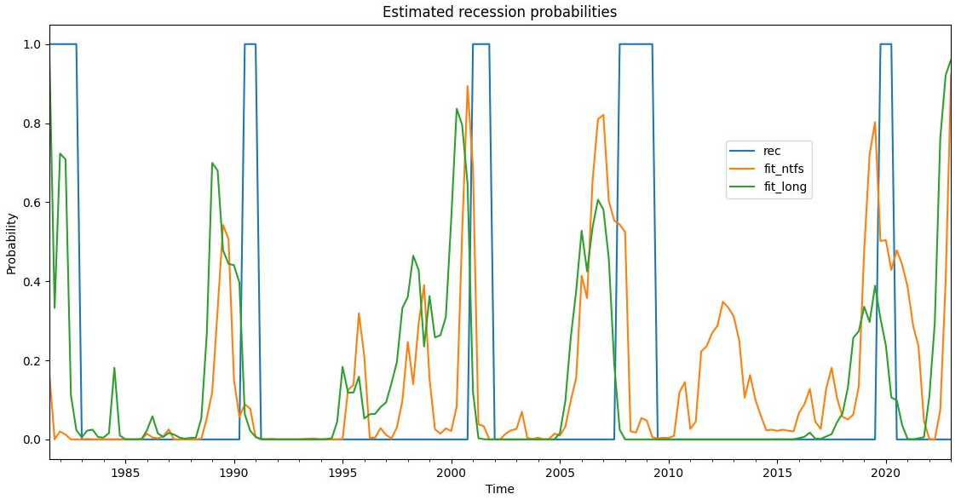
Outlook

Slide 24
Drawbacks and remarks
Drawbacks
Reduced time series length and unbalanced dataset prevent ML algorithms from working as effectively as possible
Set splits carried out to force each algorithm to face at least one recession lead to similar probability distributions for training and test sets biasing validation and test performance
Simple unique validation set chosen arbitrarily leads to less robust results albeit preserving time ordering component of data
Scaling of chosen macroeconomic predictors not rooted in literature but following common ML practice
Large C and gamma values when tuning SVM may lead to overfitting

Slide 25
Drawbacks and remarks
Remarks
Upsampling output series under appropriate assumptions and adjustments for missing values in predictor series may work as data augmentation technique to boost ML algorithms (No literature on this)
Nested time series cross validation approach (Puglia and Tucker, 2020) represents more robust solution for unbiased results when tuning hyperparameters and solve the arbitrary choice of validation set at the same time
Minimal hyperparameter tuning for NN consistent with authors but may be helpful to further improve performance

Slide 26
References
In order of appearance
McCracken, M. W., & Ng, S. (2015). FRED-MD: A Monthly Database for Macroeconomic Research. Journal of Business & Economic Statistics, 34(4), 574–589.
Puglia, M., & Tucker, A. (2020). Machine Learning, the Treasury Yield Curve and Recession Forecasting. Finance and Economics Discussion Series, 2020(038).
Engstrom, E., & Sharpe, S. (2018). The Near-Term Forward Yield Spread as a Leading Indicator: A Less Distorted Mirror. Finance and Economics Discussion Series, 2018(055).
Diercks, A., & Soques, D. (2019). Near-term Forward Spread as daily difference between expected 3-month Treasury Bill yield 6-quarters ahead and current 3-month Treasury Bill yield.

