Slide 1
Cloud Computing Fundamentals
A Technical Presentation
Evolution • Service Models • Deployment Models
Serverless • Edge Computing • Cloud-Native
Cloud Specialist Course — ITS ICT Piemonte
Notes:
Good morning everyone. Today we are talking about Cloud Computing — one of the most transformative technologies of the last twenty years. It's not just a technical topic: it's a paradigm shift in how we think about, build, and use computing resources. We'll start with the basics and gradually work our way up to more advanced concepts like Serverless and Cloud-Native applications.

Slide 2
Agenda
1. Introduction — What is Cloud Computing?
2. Evolution: From Data Centers to the Cloud
3. Service Models: IaaS, PaaS, SaaS
4. Deployment Models: Public, Private, Hybrid, Multi-Cloud
5. Advantages & Disadvantages
6. Edge Computing vs Cloud Computing
7. Serverless Computing
8. Cloud-Native Applications
9. Real-World Case Studies
10. Summary & Conclusions
Notes:
Here's our roadmap. We'll cover 10 sections: starting with what cloud computing is and how it evolved from traditional data centres, moving through the three service models and four deployment models, weighing advantages and disadvantages, then exploring the frontiers — Edge Computing, Serverless, Cloud-Native — and closing with real-world case studies.

Slide 3
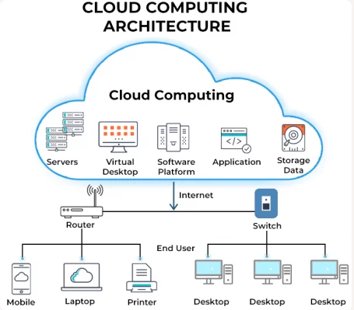
Section 1
What is Cloud Computing?
Definition, characteristics, and how it works
Notes:
Let's start with the fundamentals. What exactly is cloud computing? Let me give you a clear definition and explain the essential characteristics that make it work.

Slide 4
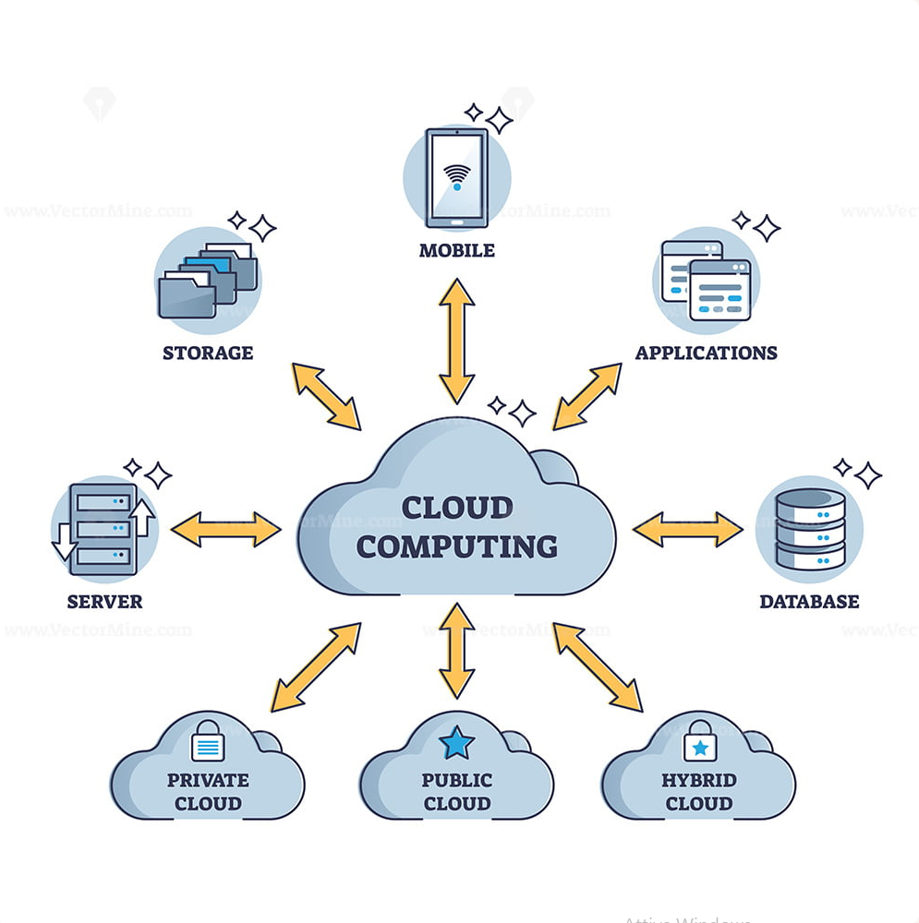
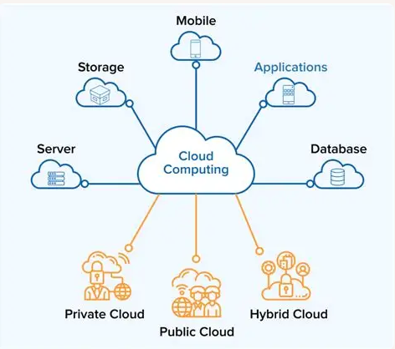
What is Cloud Computing?
Delivery of computing services over the internet ("the cloud")
Services include: servers, storage, databases, networking, analytics, software
Key characteristics:
• On-demand self-service — provision resources via API, no human interaction
• Broad network access — accessible from any device, anywhere
• Resource pooling — provider serves many customers, economies of scale
• Rapid elasticity — scale up/down automatically with demand
• Measured service — pay-as-you-go, like utilities (electricity, water)
Instead of owning physical servers, you rent what you need and pay only for what you use.
Notes:
Cloud Computing is a model that enables on-demand network access to a shared pool of configurable computing resources — servers, storage, databases, networks, software, analytics — that can be provisioned and released with minimal management effort. In plain English: instead of owning your computers, you rent them over the Internet and pay only for what you consume.
The five essential characteristics are: on-demand self-service, broad network access, resource pooling, rapid elasticity, and measured service. Think of it like electricity — you don't build a power plant, you plug into the grid and pay for what you use.

Slide 5
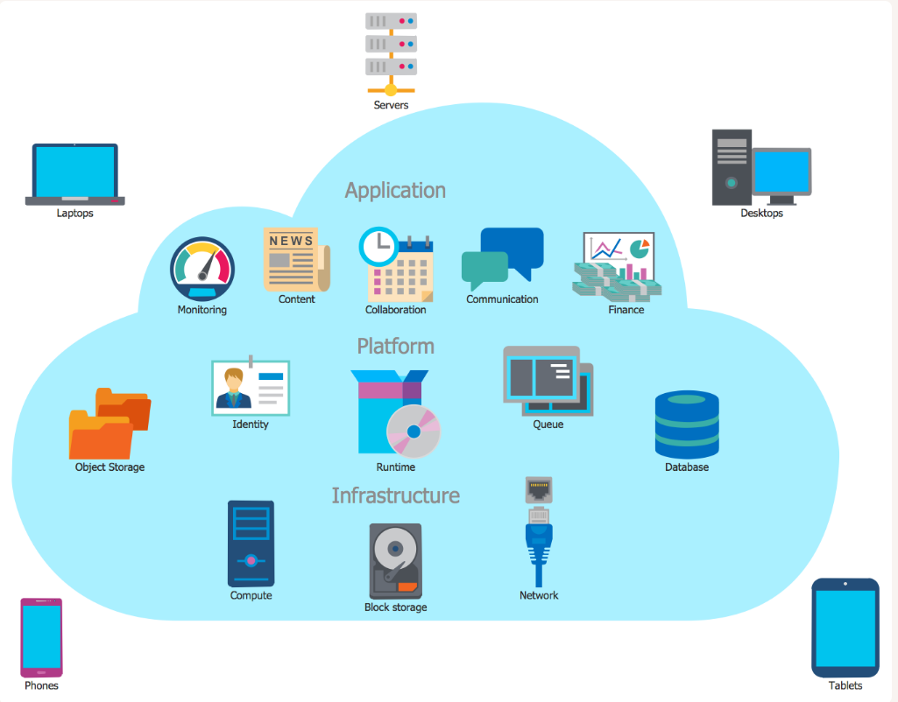
Evolution: Data Centers → Cloud
Traditional Data Centers
Cloud Computing
Physical servers bought upfront
High CapEx investment
Manual provisioning (weeks)
Fixed capacity — over-provision or under-provision
On-premise maintenance
Limited disaster recovery
Virtualized resources on demand
OpEx — pay per use
Automated provisioning (minutes)
Elastic — scales with demand
Provider handles maintenance
Geo-redundant DR built-in
Notes:
To understand why the cloud is revolutionary, look at where we came from. Until the early 2000s, companies bought physical servers, found data centre space, configured everything manually, and forecast load months in advance. If peak was higher than expected? The app crashed. Lower? Servers sat idle.
The cloud flipped this model: virtualized resources on demand, pay per use, automated provisioning in minutes, elastic scaling, and built-in geo-redundant disaster recovery.

Slide 6
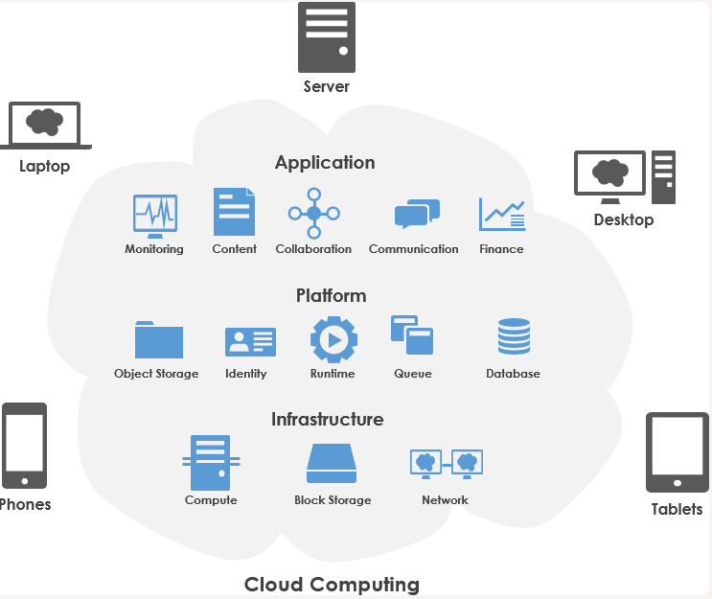
The Cloud Revolution — Key Milestones
2006: Amazon launches AWS (S3 storage + EC2 compute) — birth of public cloud
2008: Google App Engine — first PaaS offering
2010: Microsoft Azure commercially available
2014: AWS Lambda — serverless computing introduced
2015: Kubernetes 1.0 released by Google — container orchestration standard
2020s: Multi-cloud, hybrid-cloud, edge computing become mainstream
Key insight: Infrastructure shifted from a capital asset to a programmable service.
Today, infrastructure is managed as code (IaC) via tools like Terraform and CloudFormation.
Notes:
The key milestones: 2006 Amazon launches AWS with S3 and EC2 — birth of public cloud. 2008 Google App Engine, the first PaaS. 2010 Azure goes commercial. 2014 AWS Lambda introduces serverless. 2015 Kubernetes 1.0 sets the container orchestration standard. Today, infrastructure is managed as code via Terraform and CloudFormation. The data centre is no longer a place — it's an abstraction.

Slide 7
Section 2
Cloud Service Models
IaaS • PaaS • SaaS
Notes:
Now let's look at the three service models. Each represents a different level of abstraction and responsibility. The choice depends on what you want to manage yourself versus what you want the provider to handle.

Slide 8
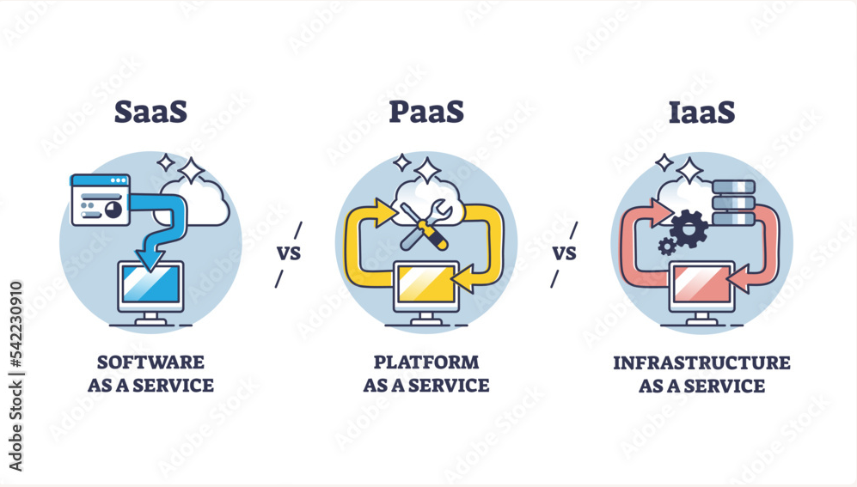
IaaS — Infrastructure as a Service
Provider offers: virtual machines, storage, networks, load balancers
You manage: OS, middleware, runtime, applications, data
Maximum control, maximum responsibility
Examples: AWS EC2, Google Compute Engine, Azure Virtual Machines
Best for: migrating existing workloads, full control over the stack
Analogy: buying land and construction materials — you build everything yourself
Notes:
IaaS is the model closest to traditional hardware. The provider gives you virtual machines, storage, and networking. You install and manage the OS, middleware, and applications. You have maximum control but also maximum responsibility. Examples: AWS EC2, Google Compute Engine, Azure Virtual Machines. A useful analogy: it's like buying land and construction materials — you build everything yourself.

Slide 9
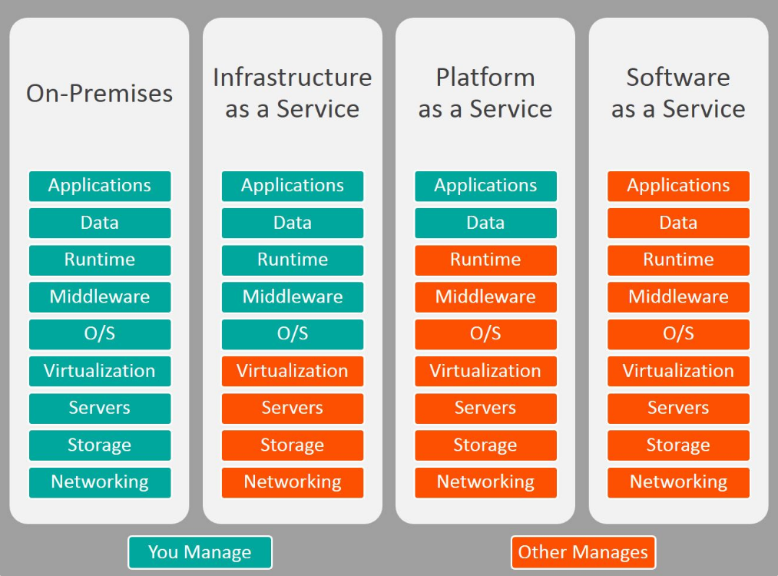
PaaS — Platform as a Service
Provider manages: OS, runtime, middleware, scaling, patching
You manage: code and data only
Focus on development, not infrastructure
Examples: Google App Engine, Heroku, Azure App Services
Best for: developers who want to deploy quickly without ops overhead
Analogy: renting a furnished apartment — everything is ready, just move in
Notes:
PaaS gives you a managed platform. The provider handles the OS, runtime, middleware, scaling, and patching. You bring only your code and data. You focus on development, not infrastructure operations. Examples: Google App Engine, Heroku, Azure App Services. The analogy: renting a furnished apartment — everything is ready, just move in.

Slide 10
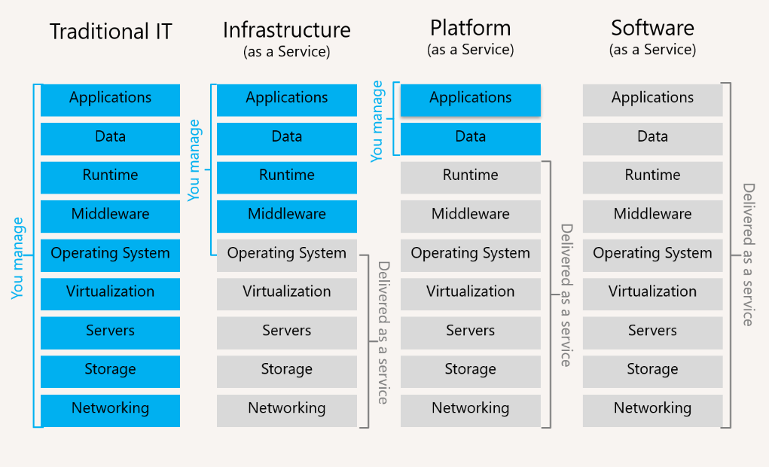
SaaS — Software as a Service
Provider manages everything: hardware, platform, application, data
You just use it — open a browser and log in
Zero installation, zero maintenance, zero management
Examples: Gmail, Microsoft 365, Salesforce, Dropbox, Slack
Best for: end users who need functionality without technical overhead
Analogy: staying in a hotel — everything is provided and maintained for you
Notes:
SaaS is the finished product, ready to use. The provider manages everything — hardware, platform, application, data. You just open a browser and log in. Zero installation, zero maintenance. Examples: Gmail, Microsoft 365, Salesforce, Dropbox, Slack. The analogy: staying in a hotel — everything is provided and maintained for you.

Slide 11
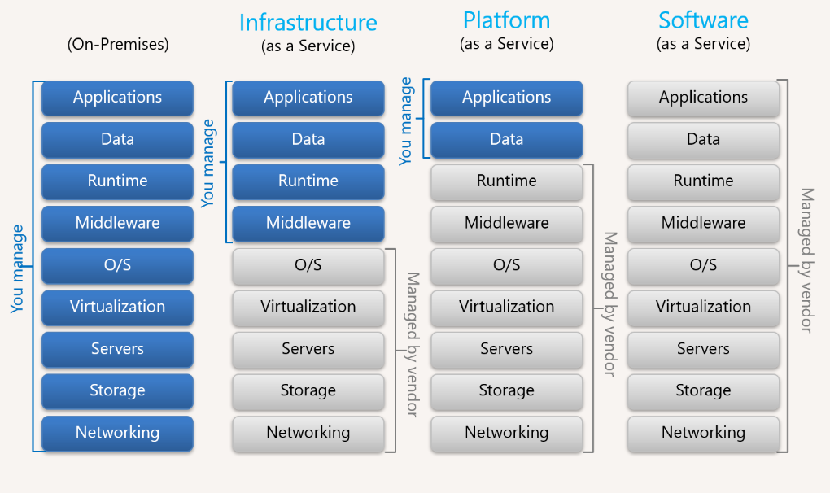
Service Models Comparison
IaaS (You manage more)
SaaS (Provider manages more)
Applications — You
Data — You
Runtime — You
Middleware — You
OS — You
Virtualization — Provider
Servers — Provider
Storage — Provider
Networking — Provider
Applications — Provider
Data — Provider
Runtime — Provider
Middleware — Provider
OS — Provider
Virtualization — Provider
Servers — Provider
Storage — Provider
Networking — Provider
Notes:
This comparison slide shows the division of responsibility across the three models. In IaaS, you manage everything from applications down to the operating system. In PaaS, the provider takes over the runtime and middleware. In SaaS, the provider manages even the application and data. Choose what fits your needs.

Slide 12
Section 3
Cloud Deployment Models
Public • Private • Hybrid • Multi-Cloud
Notes:
Not all cloud is the same. There are four main deployment models, each with different trade-offs between control, cost, and complexity.

Slide 13
Cloud Deployment Models
Public Cloud
Private Cloud
Shared infrastructure
AWS, Azure, GCP
Pros: no CapEx, elastic
Cons: less control
Dedicated infrastructure
VMware, OpenStack
Pros: full control, security
Cons: high cost, limited scale
Hybrid Cloud
Multi-Cloud
Mix on-prem + public cloud
Pros: flexibility, compliance
Cons: operational complexity
Multiple public providers
Pros: avoid vendor lock-in
Cons: multi-platform expertise
Notes:
Public Cloud: shared infrastructure, no CapEx, maximum elasticity, but less control. Private Cloud: dedicated infrastructure, full control and security, but high costs and limited scale. Hybrid Cloud: combines both, offering flexibility and compliance, but increases operational complexity. Multi-Cloud: using multiple public providers to avoid vendor lock-in, but requiring diverse expertise.
According to industry reports, over 80% of enterprises already adopt a multi-cloud or hybrid approach.

Slide 14
Section 4
Advantages & Disadvantages
A balanced look at cloud computing pros and cons
Notes:
Now let's look at this from a balanced perspective. The cloud has real advantages, but also real challenges. The key is to evaluate each workload case by case.

Slide 15
Cloud Computing: Pros & Cons
Advantages
Disadvantages
No upfront CapEx — pay-as-you-go OpEx model
Elasticity — scale instantly with demand
Faster time-to-market — infrastructure in minutes
Global reach — deploy in regions worldwide
Enterprise-grade security — billions invested
Built-in disaster recovery — geo-redundancy
Automatic updates and patching
Unpredictable costs without monitoring
Internet dependency — no connectivity, no access
Vendor lock-in — migration can be expensive
Limited control during provider outages
Compliance constraints (healthcare, finance, gov)
Data sovereignty — regulations on data location
Latency for real-time applications
Notes:
Advantages: no upfront CapEx, elasticity to scale with demand, faster time-to-market, global reach, enterprise-grade security that no average company can match, built-in disaster recovery across regions.
Disadvantages: costs can be unpredictable without monitoring, you're dependent on internet connectivity, vendor lock-in can make migration expensive, you have limited control during provider outages, and there are compliance and data sovereignty constraints — especially in healthcare, finance, and government.

Slide 16
Section 5
Edge Computing vs Cloud Computing
Centralized vs distributed processing
Notes:
So far we've talked about data traveling to centralized data centres. But there's a problem: latency. Think of a self-driving car that needs to stop for an obstacle — it can't wait for a cloud round-trip. That's where Edge Computing comes in.

Slide 17
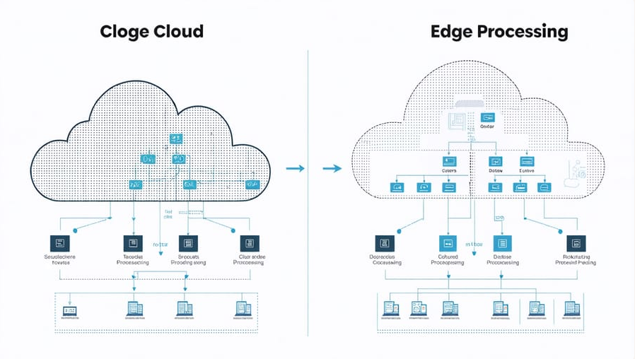
Edge vs Cloud Computing
Cloud Computing
Edge Computing
Centralized data centers
High computing power
Higher latency (50-500ms)
Best for: analytics, ML training, storage
Data travels to the cloud for processing
Processing near the data source
Limited computing power
Ultra-low latency (<10ms)
Best for: real-time decisions, IoT, autonomous vehicles
Data processed locally, results sent to cloud
Notes:
Cloud computing is centralized, powerful, ideal for heavy processing and historical data — but latency is 50-500ms. Edge computing is distributed, fast, with ultra-low latency under 10ms, ideal for real-time decisions. They are not competing — they are complementary. The modern architecture is a continuum: edge for quick decisions, cloud for complex analytics and ML training.

Slide 18
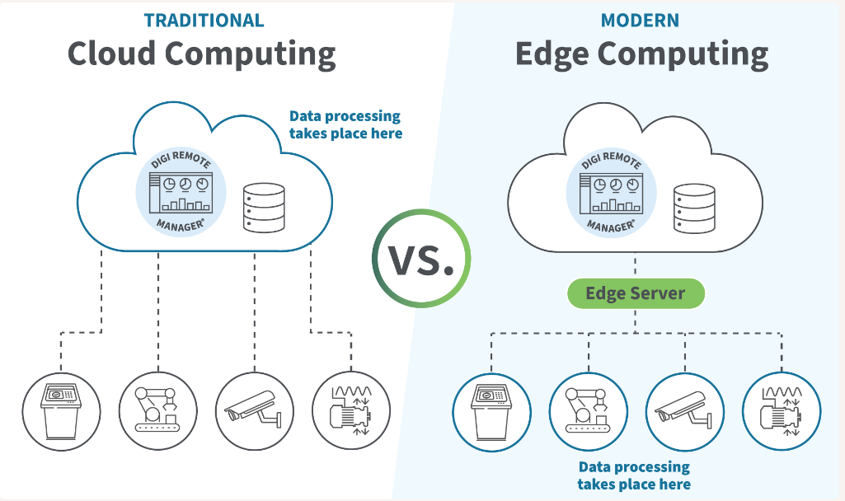
Edge Computing — Use Cases
Autonomous vehicles — must react in milliseconds, cannot wait for cloud round-trip
Industrial IoT — real-time monitoring and predictive maintenance on factory floor
Smart cities — traffic lights, surveillance cameras process data locally
Healthcare — patient monitoring devices analyze vitals at the bedside
Retail — inventory tracking and checkout systems in stores
Key insight: Edge and cloud are complementary, not competing.
Edge handles real-time decisions; cloud handles complex analytics and model training.
Gartner predicts 75% of enterprise data will be processed at the edge by 2028.
Notes:
Edge computing use cases are everywhere: autonomous vehicles that must react in milliseconds, industrial IoT for real-time monitoring on the factory floor, smart cities with local data processing, healthcare monitoring at the bedside, and retail inventory tracking. Gartner predicts that by 2028, 75% of enterprise data will be processed at the edge.

Slide 19
Section 6
Serverless Computing
Run code without managing servers
Notes:
Another step forward in abstraction: Serverless Computing. The name is misleading — servers are definitely there — but the developer doesn't see them, doesn't manage them. You just write functions and say 'run this when X happens.'

Slide 20
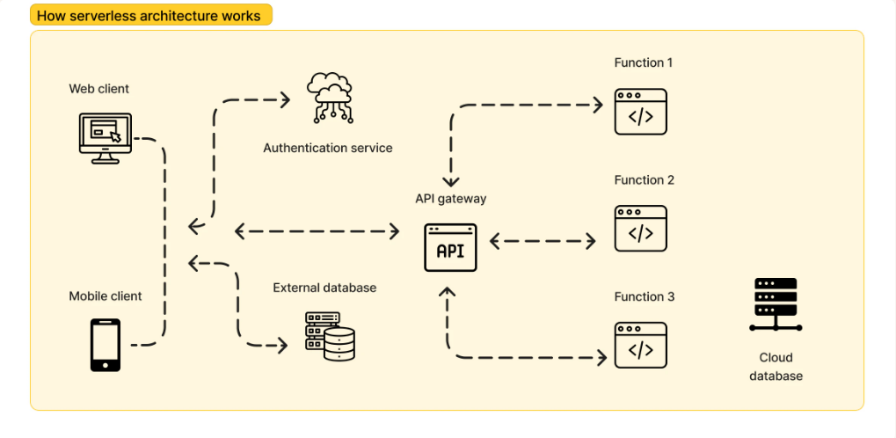
Serverless Computing
Developers write functions — the cloud provider handles everything else
No server provisioning, no OS management, no scaling configuration
How it works:
• Upload function code to the cloud
• Connect it to an event (HTTP request, file upload, database change)
• Cloud runs the function only when triggered
• Pay only for execution time — down to the millisecond
Providers: AWS Lambda, Azure Functions, Google Cloud Functions
Perfect for: intermittent workloads, microservices, webhooks, mobile backends
Limitations: cold starts, 15-minute execution cap, local debug complexity
Notes:
With serverless, you upload function code, connect it to an event — HTTP request, file upload, database change — and the cloud runs it only when triggered. If zero requests, you pay nothing. If a million come in, the cloud scales automatically. Providers: AWS Lambda, Azure Functions, Google Cloud Functions.
Limitations include cold starts (hundreds of ms delay after inactivity), a 15-minute execution cap, and complex local debugging. Perfect for intermittent workloads, microservices, webhooks, and mobile backends.

Slide 21
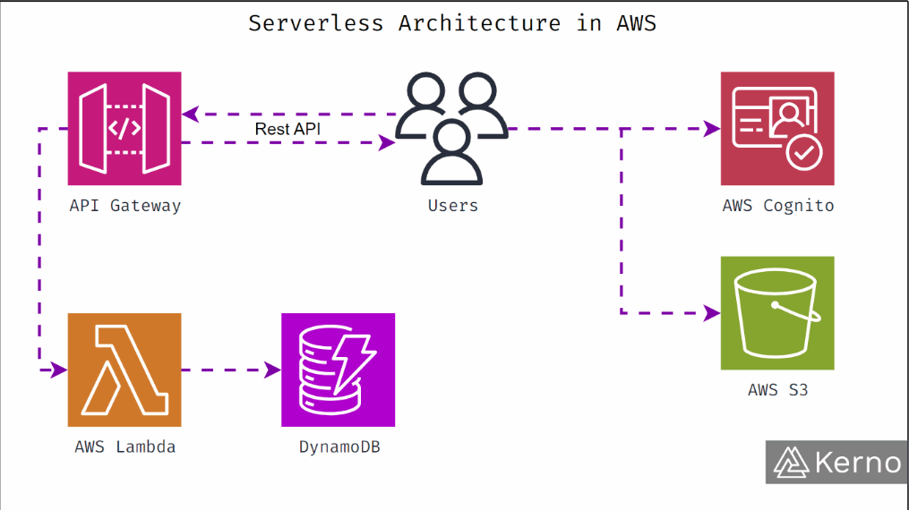
Section 7
Cloud-Native Applications
Designed for the cloud from day one
Notes:
Last major topic: Cloud-Native applications. Running on the cloud is not enough to be cloud-native. A traditional app simply migrated to a VM doesn't leverage the cloud — it lives there but doesn't use its potential.

Slide 22
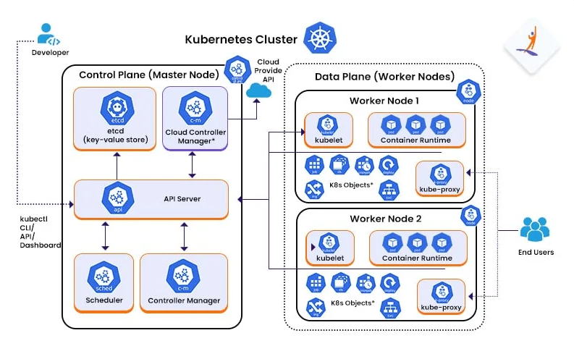
Cloud-Native Applications
Not just "running on cloud" — designed specifically FOR the cloud
Four pillars:
1. Microservices — application broken into small, independent services
Each service has its own responsibility, communicates via APIs
2. Containers — lightweight, isolated, reproducible environments
Docker for packaging, Kubernetes for orchestration
3. DevOps & CI/CD — frequent, automated, repeatable deployments
Infrastructure as Code, integrated testing and security
4. Resilience & Observability — assume components will fail
Retry logic, circuit breakers, graceful degradation
Centralized logging, metrics, distributed tracing
Notes:
A cloud-native application is designed from the ground up for the cloud, resting on four pillars. First: microservices — small, independent services communicating via APIs. Second: containers — lightweight, isolated, reproducible environments with Docker and Kubernetes. Third: DevOps and CI/CD — frequent, automated deployments with Infrastructure as Code. Fourth: resilience and observability — assume components will fail, with retry logic, circuit breakers, centralized logging and distributed tracing.
Examples: Netflix, Spotify, Uber — they couldn't exist without cloud-native architectures.

Slide 23
Section 8
Real-World Case Studies
How industry leaders use cloud computing
Notes:
Let's see how industry leaders actually use cloud computing in practice. These case studies show the power of cloud-native architectures at global scale.

Slide 24
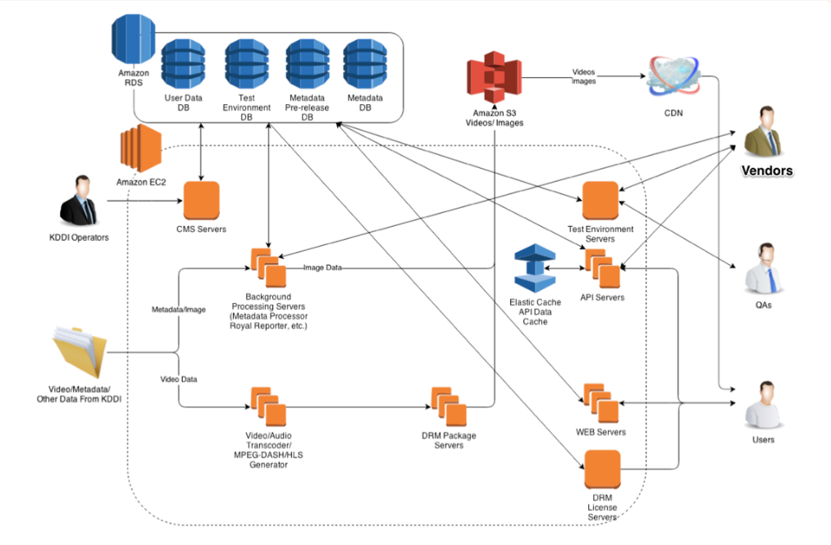
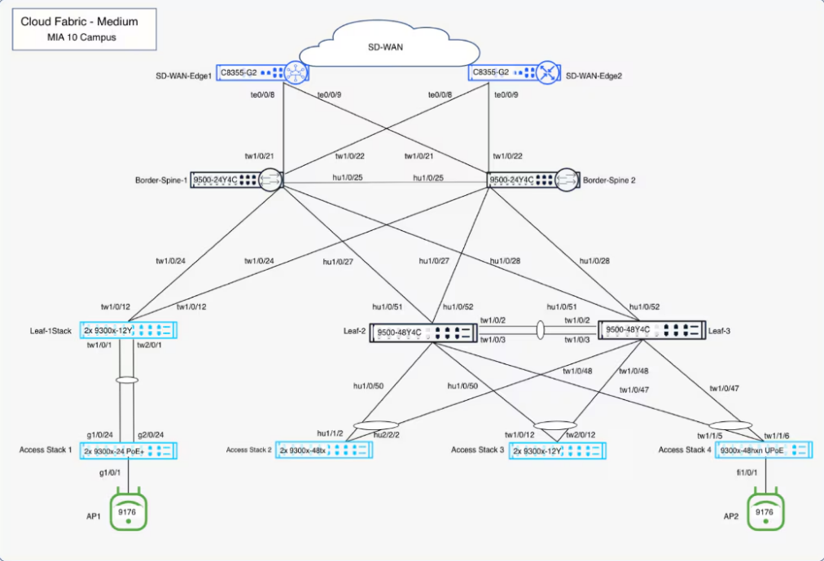
Real-World Case Studies
Netflix
Spotify
Migrated from physical data centers to AWS.
Uses microservices, autoscaling, and global
CDN for 200M+ subscribers worldwide.
Built on Google Cloud Platform.
Leverages big data analytics and ML for
personalized music recommendations.
Uber
Healthcare
Cloud-native from day one.
Uses microservices + Kubernetes to handle
millions of rides across 70+ countries.
Cloud platforms enable:
• Secure medical record storage
• Telemedicine and remote diagnostics
• AI-powered imaging analysis
Notes:
Netflix migrated from physical data centres to AWS, using microservices and autoscaling to serve 200M+ subscribers worldwide. Spotify was built on Google Cloud Platform, leveraging big data analytics and ML for personalized recommendations. Uber was cloud-native from day one, using microservices and Kubernetes across 70+ countries. And in healthcare, cloud platforms enable secure record storage, telemedicine, and AI-powered imaging analysis.

Slide 25
Summary
Cloud computing = on-demand access to computing resources over the internet
Three service models: IaaS (infrastructure), PaaS (platform), SaaS (software)
Four deployment models: Public, Private, Hybrid, Multi-Cloud
Key benefits: elasticity, no CapEx, global reach, faster innovation
Key challenges: cost unpredictability, vendor lock-in, compliance, latency
Modern frontiers:
• Edge Computing — processing near the data source for low latency
• Serverless — run code without managing servers, pay per execution
• Cloud-Native — microservices, containers, CI/CD, resilience
Notes:
To summarize: cloud computing is on-demand access to computing resources over the internet. Three service models: IaaS, PaaS, SaaS. Four deployment models: Public, Private, Hybrid, Multi-Cloud. Key benefits: elasticity, no CapEx, global reach. Key challenges: cost unpredictability, vendor lock-in, compliance. And the frontiers: Edge Computing, Serverless, and Cloud-Native.

Slide 26
The cloud is not a destination — it's a journey.
Companies don't "finish" migrating to the cloud — they continuously evolve.
Understanding these fundamentals gives you the tools
to participate in this evolution.
Thank you — Questions?
Notes:
The final message: the cloud is not a destination — it's a journey. Companies don't 'finish' migrating to the cloud — they continuously evolve how they use it. Understanding these fundamentals gives you the tools to be part of that evolution. Thank you.

Slide 27
Thank You
Any questions?
Notes:
Thank you for your attention. I'm happy to take any questions you may have.

