Slide 1
Cloud Computing Fundamentals
A Technical Presentation
Evolution • Service Models • Deployment Models
Serverless • Edge Computing • Cloud-Native
Cloud Specialist Course — ITS ICT Piemonte

Slide 2
Agenda
1. Introduction — What is Cloud Computing?
2. Evolution: From Data Centers to the Cloud
3. Service Models: IaaS, PaaS, SaaS
4. Deployment Models: Public, Private, Hybrid, Multi-Cloud
5. Advantages & Disadvantages
6. Edge Computing vs Cloud Computing
7. Serverless Computing
8. Cloud-Native Applications
9. Real-World Case Studies
10. Summary & Conclusions

Slide 3
Section 1
What is Cloud Computing?
Definition, characteristics, and how it works

Slide 4
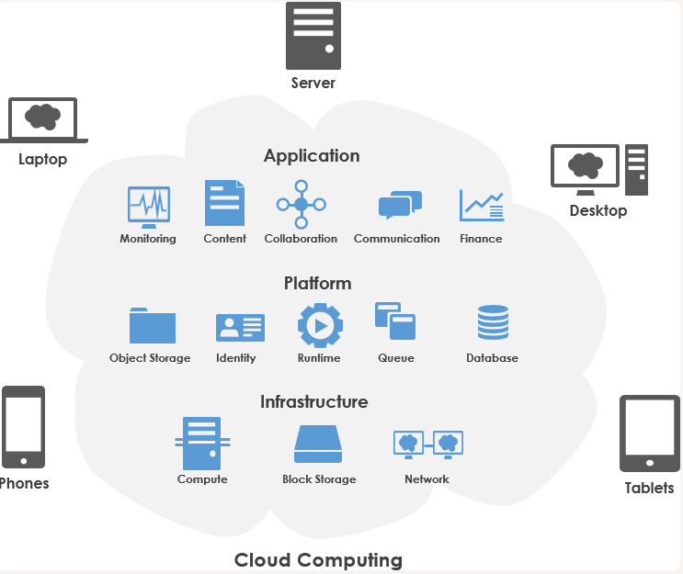
What is Cloud Computing?
Delivery of computing services over the internet
Servers, storage, databases, networking, analytics, software
Key characteristics:
• On-demand self-service — provision via API/click
• Broad network access — from any device
• Resource pooling — economies of scale
• Rapid elasticity — scale with demand
• Measured service — pay-as-you-go
Instead of owning hardware,
you rent what you need and pay for what you use.

Slide 5
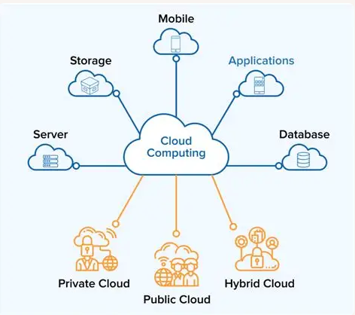
Evolution: Data Centers → Cloud
Traditional Data Centers:
• Physical servers, high CapEx, weeks to provision
• Fixed capacity — over-provision or crash
• On-premise maintenance, limited DR
Cloud Computing:
• Virtualized resources, OpEx, minutes to provision
• Elastic — scales with demand automatically
• Provider handles infra, geo-redundant DR

Slide 6
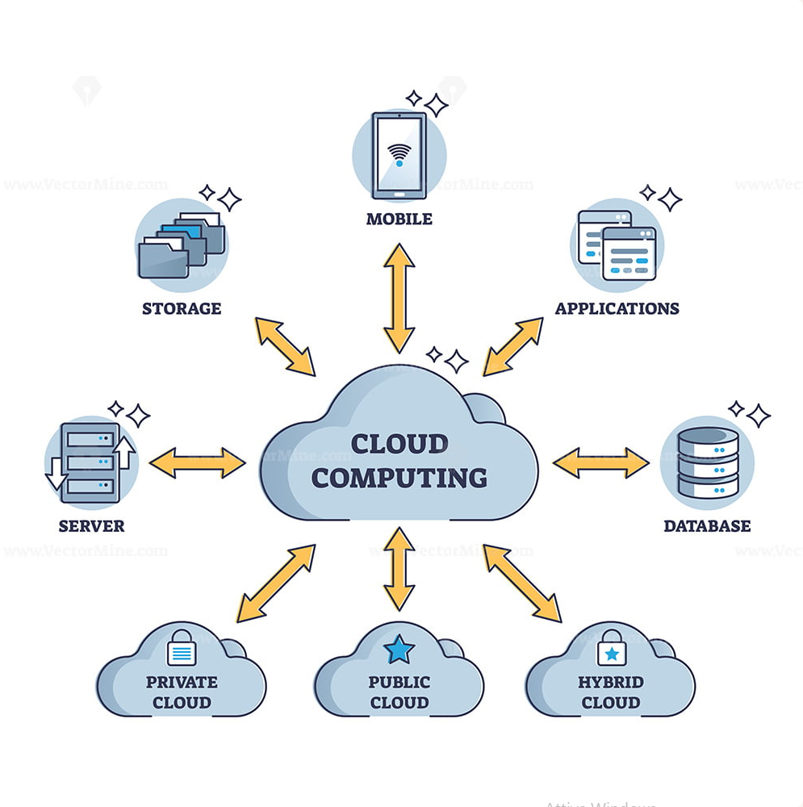
Key Milestones
2006: Amazon launches AWS (S3 + EC2) — public cloud born
2008: Google App Engine — first PaaS
2010: Microsoft Azure commercially available
2014: AWS Lambda — serverless computing
2015: Kubernetes 1.0 — container orchestration standard
2020s: Multi-cloud, hybrid, edge become mainstream
Infrastructure shifted from capital asset to programmable service.
Infrastructure as Code (IaC) via Terraform, CloudFormation.

Slide 7
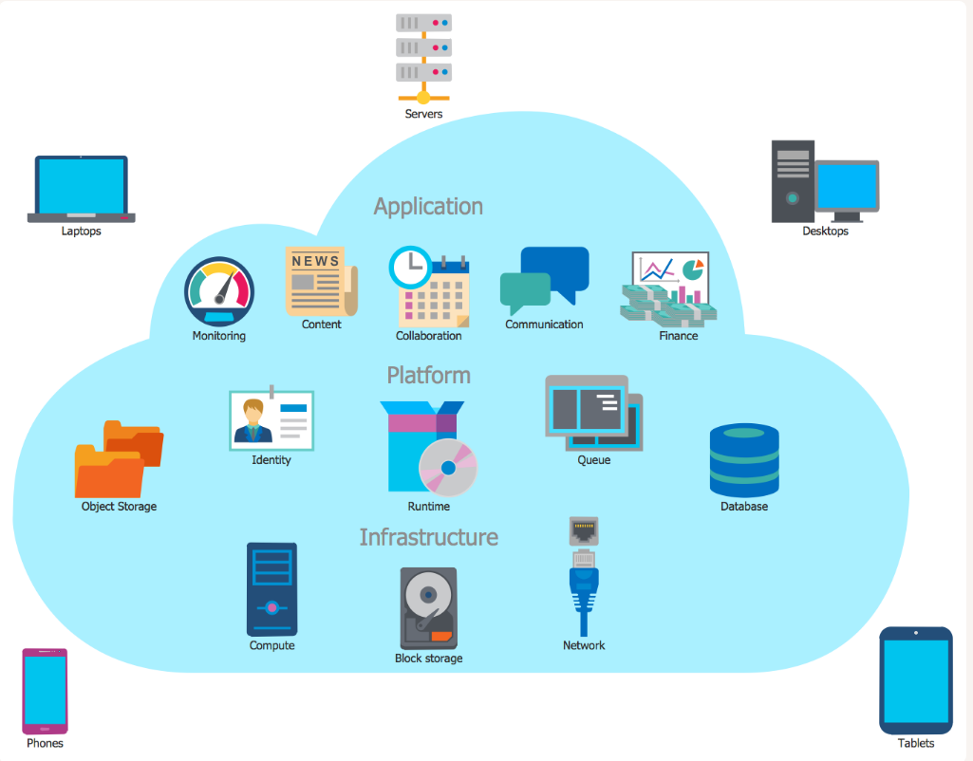
Traditional vs Cloud — Comparison
Traditional: buy servers, wait weeks, fixed capacity, manual ops, limited DR
Cloud: rent resources, instant provisioning, elastic, automated, geo-redundant

Slide 8
Section 2
Cloud Service Models
IaaS • PaaS • SaaS

Slide 9
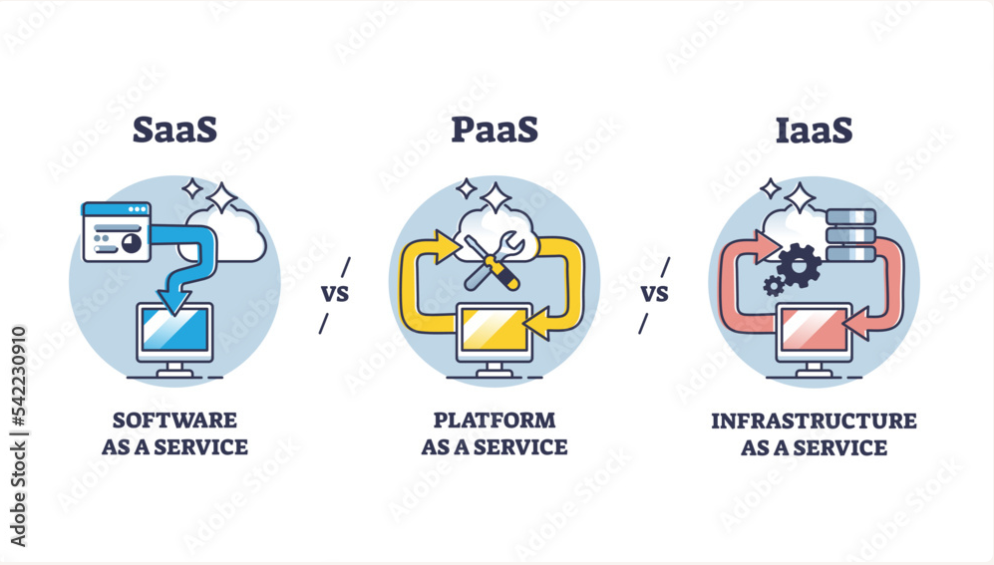
IaaS — Infrastructure as a Service
Provider offers: VMs, storage, network, load balancers
You manage: OS, middleware, runtime, apps, data
Maximum control, maximum responsibility
Use cases:
• Migrating existing workloads without changes
• Full control over the software stack
Examples: AWS EC2, GCE, Azure VMs

Slide 10
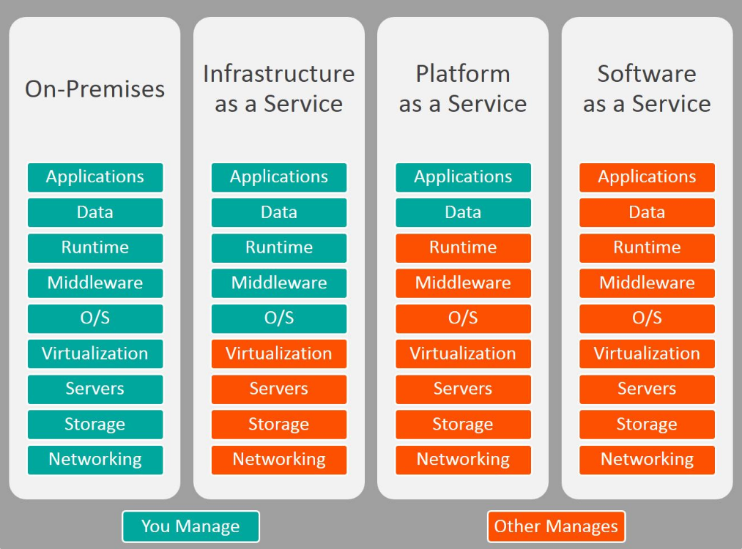
PaaS — Platform as a Service
Provider manages: OS, runtime, middleware, scaling, patching
You manage: code and data only
Focus on development, not infrastructure
Use cases:
• Web apps and APIs
• Rapid prototyping and MVPs
Examples: Google App Engine, Heroku, Azure App Services

Slide 11
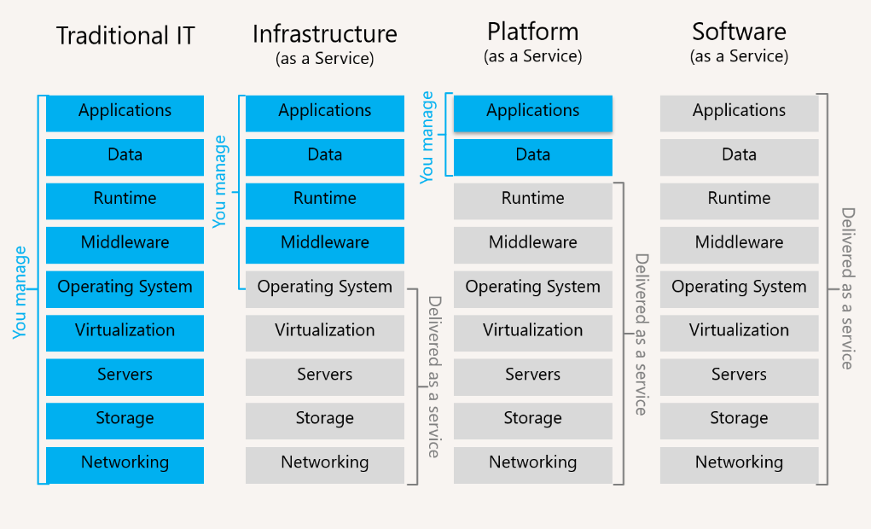
SaaS — Software as a Service
Provider manages everything: hardware, platform, app, data
You just use it — open a browser and log in
Zero installation, zero maintenance
Examples:
• Gmail, Microsoft 365, Salesforce
• Dropbox, Slack, Zoom
The most common cloud model for end users

Slide 12
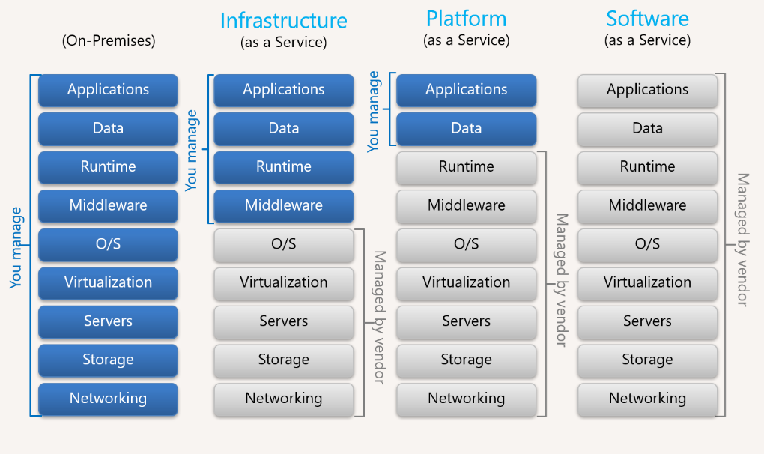
Service Models Comparison
IaaS (You manage more):
Apps | Data | Runtime | Middleware | OS
Provider: VMs | Storage | Network
PaaS (Balance):
Apps | Data
Provider: Runtime | Middleware | OS | Infra
SaaS (Provider manages everything):
Everything managed by provider
You just use the application

Slide 13
Section 3
Cloud Deployment Models
Public • Private • Hybrid • Multi-Cloud

Slide 14
Cloud Deployment Models
Public Cloud
Private Cloud
Shared infrastructure
AWS, Azure, GCP
No CapEx, elastic
Less control
Dedicated infra
VMware, OpenStack
Full control, secure
High cost
Hybrid Cloud
Multi-Cloud
Mix on-prem + cloud
Flexibility, compliance
Operational complexity
Multiple providers
No vendor lock-in
Multi-platform expertise

Slide 15
Section 4
Advantages & Disadvantages
A balanced look at cloud computing pros and cons

Slide 16
Cloud Computing: Pros & Cons
Advantages
Disadvantages
No upfront CapEx — pay-as-you-go OpEx
Elasticity — scale instantly with demand
Faster time-to-market — infra in minutes
Global reach — deploy in regions worldwide
Enterprise-grade security
Built-in disaster recovery
Automatic updates and patching
Unpredictable costs without monitoring
Internet dependency
Vendor lock-in — expensive migration
Limited control during provider outages
Compliance constraints (healthcare, finance)
Data sovereignty regulations
Latency for real-time applications

Slide 17
Section 5
Edge Computing vs Cloud Computing
Centralized vs distributed processing

Slide 18
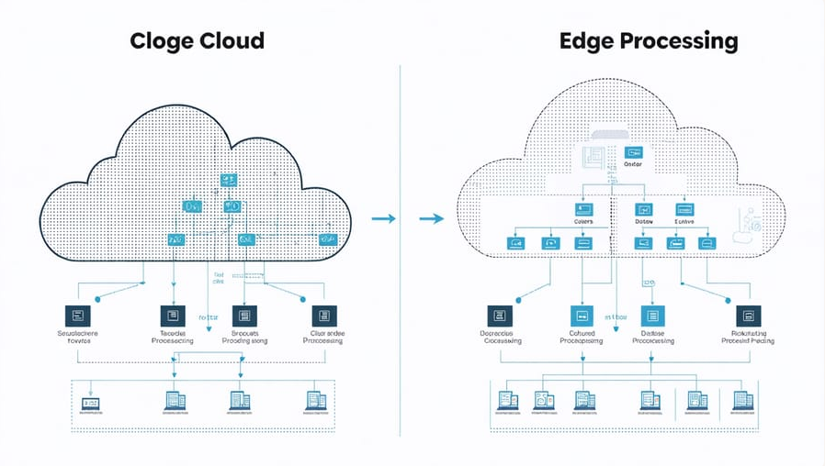
Edge vs Cloud Computing
Cloud Computing:
• Centralized data centers
• High computing power
• Higher latency (50-500ms)
• Analytics, ML training, storage
Edge Computing:
• Processing near data source
• Ultra-low latency (<10ms)
• Real-time decisions, IoT
• Autonomous vehicles, smart cities

Slide 19
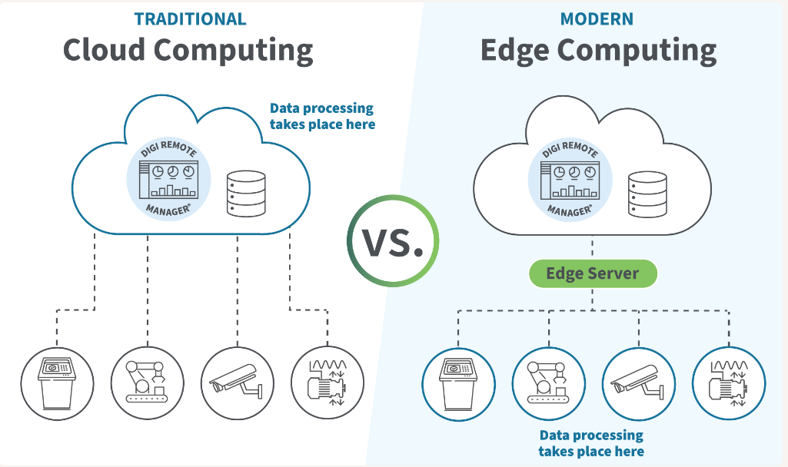
Edge Computing — Use Cases
Autonomous vehicles, industrial IoT, smart cities, healthcare, retail
Complementary: Edge handles real-time, Cloud handles complex analytics
Gartner: 75% of enterprise data processed at edge by 2028

Slide 20
Section 6
Serverless Computing
Run code without managing servers

Slide 21
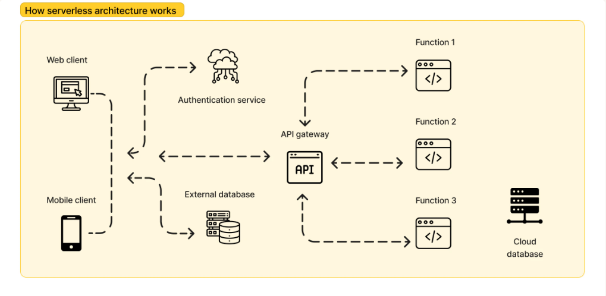
Serverless Computing
Write functions — cloud handles everything else
No server provisioning, no OS management
How it works:
• Upload function code
• Connect to event (HTTP, upload, DB change)
• Cloud runs only when triggered
• Pay per execution (millisecond billing)
Providers: AWS Lambda, Azure Functions, GCP Functions
Ideal for: intermittent workloads, webhooks, mobile backends

Slide 22
Section 7
Cloud-Native Applications
Designed for the cloud from day one

Slide 23
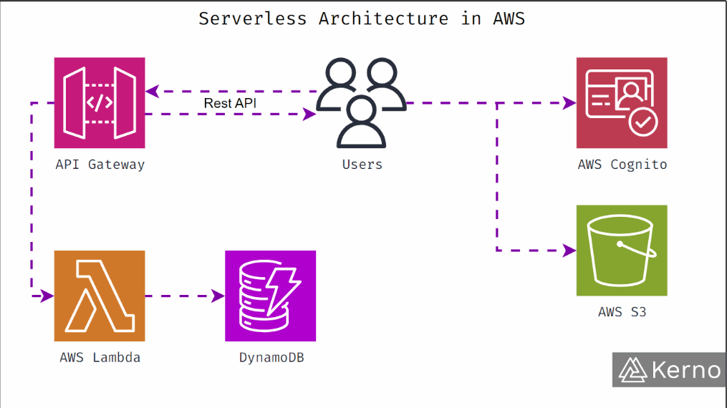
Cloud-Native Applications
Not just "running on cloud" — designed FOR the cloud
Four pillars:
1. Microservices — small, independent services
2. Containers — Docker + Kubernetes
3. DevOps & CI/CD — automated deployments
4. Resilience & Observability
(retries, circuit breakers, tracing)
Examples: Netflix, Spotify, Uber
Scale and speed impossible without cloud-native design

Slide 24
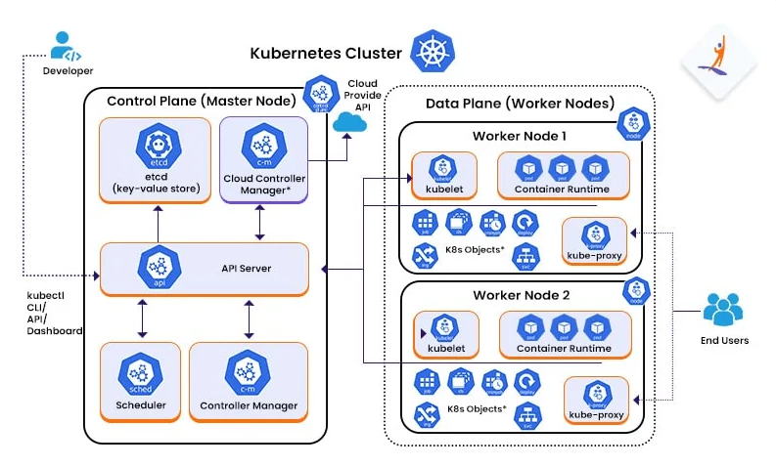
Cloud-Native Architecture
Microservices packaged in containers, orchestrated by Kubernetes, deployed via CI/CD pipelines
Observability: centralized logging, metrics, distributed tracing

Slide 25
Section 8
Real-World Case Studies
How industry leaders use cloud computing

Slide 26
Real-World Case Studies
Netflix
Spotify
Migrated from data centers to AWS
200M+ subscribers, microservices,
autoscaling, global CDN
Built on Google Cloud
Big data analytics, ML for
personalized recommendations
Uber
Healthcare
Cloud-native from day one
Microservices + Kubernetes
70+ countries, millions of rides
Secure medical record storage
Telemedicine, remote diagnostics
AI-powered imaging analysis

Slide 27
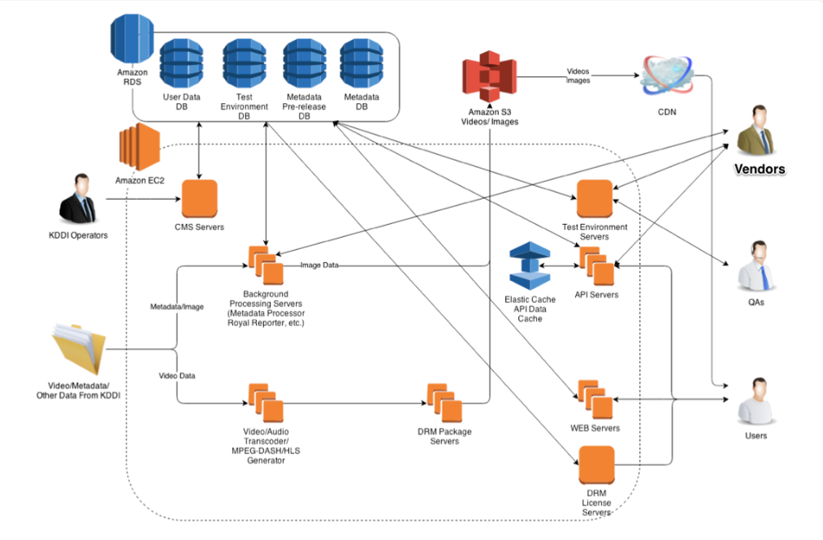
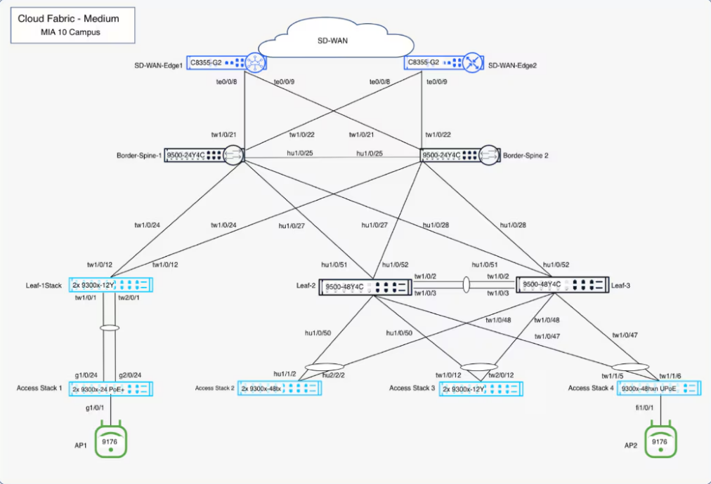
Cloud Architecture Examples

Slide 28
Summary
Cloud computing = on-demand access to computing resources over the internet
Three service models: IaaS (infrastructure), PaaS (platform), SaaS (software)
Four deployment models: Public, Private, Hybrid, Multi-Cloud
Key benefits: elasticity, no CapEx, global reach, faster innovation
Key challenges: cost unpredictability, vendor lock-in, compliance, latency
Modern frontiers:
• Edge Computing — low-latency processing near data source
• Serverless — run code without managing servers, pay per execution
• Cloud-Native — microservices, containers, CI/CD, resilience

Slide 29
The cloud is not a destination — it’s a journey.
Companies continuously evolve how they use the cloud.
Understanding these fundamentals gives you the tools
to participate in this evolution.
Thank you — Questions?

Slide 30
Thank You
Any questions?

