Slide 1
Amazon EC2 Modeling
Pricing Example

Slide 2
EC2 Numbers
8 Regions (Each with different prices. Some Instances are not available In some regions)
18 different instance types (3 have the option to choose the EBS-optimized service)
Standard Instances Model
Reserved Instances Model
Light Utilization
Medium Utilization
Heavy Utilization
Spot Instances Model (The prices change every 5 min based on offer/Demand)
Other Services
Amazon EBS
Elastic IP
Amazon CloudWatch
Elastic Load Balancing
1Year and 3Year Contracts
Each has a different price for the 18 types of instances with Linux and for the 18 types with Windows (total of 36)

Slide 3
EC2 Numbers
Each Instance has several metrics:
Main Memory
Local Storage
Platform (32bit or 64bit)
EC2 Compute Unit
Number of Cores
EBS Storage
Ethernet
SSD-based Storage
Hard Disk
I/O Performance
Operating System (this only makes the price change. However, the above metrics are the same for the different operating systems)

Slide 4
EC2 Numbers
Each Instance is linked to at least two variables:
The Instance Price (Constant)
The Number of usage hours (Usage)
Note that we can have many instances, the only metric is the hour. E.g.: 2 instances for one hour is the same as 1 instance for 2 hours.
However more variables may be needed
For the Reserved Instance for example there is an Upfront price (Constant).
Since all the instance characteristics are the same between Linux and Windows, a new variable was added: OperatingSystem
This new variable allows the reduction of ServiceOfferings which only differ in the operating system characteristic. We can now calculate the price of an instance depending on the Operating System.

Slide 5
Amazon EC2 Service
NOTE: For the purpose of this example not all the EC2 instances were considered, and only the essential services were included to explain the model example. The Amazon EC2 Example includes:
1 Region (Europe, Ireland Dublin)
1 Type of instance (EC2 Small Instance)
2 Instance Models (Standard and Reserved)
It was also included the Data Transfer service since it is an essential part for the Amazon EC2 Service

Slide 6
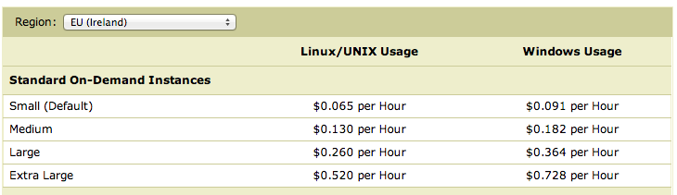
Amazon EC2 Service
From the Amazon EC2 website we can extract the price information for the selected region. For this example we are interested in the Small Instance.
If we wanted to model the entire Amazon EC2 we could define the Region as our ServiceModel and each different instance (row in table) as a particular Service of that ServiceModel.
The table refers to the Standard
On Demand Instance Model. Each Instance model has its own table
Small Instance Prices
Europe Region

Slide 7
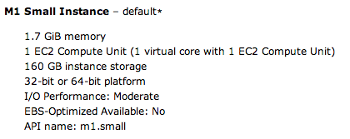
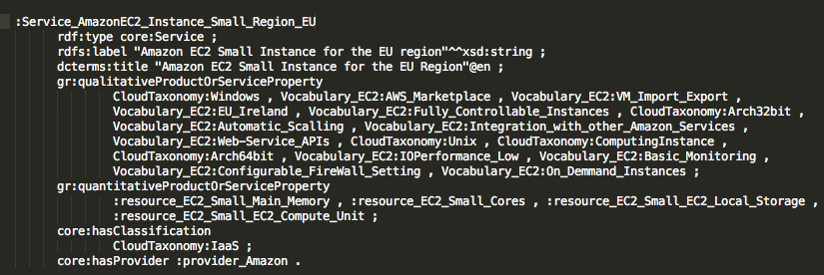
Amazon EC2 Service
Small Instance Service
Service Features
These are GoodRelations Qualitative and Quantitative Values defined in an external vocabulary.
The service features include everything the
Amazon EC2 Small instance provides. Eg: Basic monitoring, Web-service API …

Slide 8
Amazon EC2 Service Offering
For each Instance Service we have 2 Modeled Instance Models (The Spot Instance Model was left outside this example):
On-Demand Instance
Reserved Instance
Low Utilization (1 or 3 Year contract)
Medium Utilization (1 or 3 Year contract)
Heavy Utilization (1 or 3 Year contract)
We will have 7 different ServiceOfferings:
1 for the On-Demand Instance
6 for the Reserved Instance
2 for the Low Utilization (1 for the 1 Year contract and 1 for the 3 Year contract)
2 for the Medium Utilization (1 for the 1 Year contract and 1 for the 3 Year contract)
2 for the Heavy Utilization (1 for the 1 Year contract and 1 for the 3 Year contract)

Slide 9
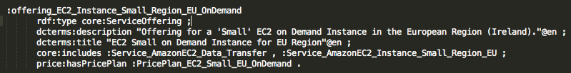
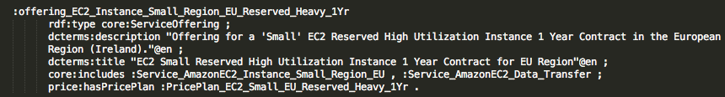
Amazon EC2 Service Offering
On-Demand Small Instance Service Offering
All the 7 offering import the Small Instance Service
1 Year contract Heavy Utilization Reserved Small Instance Service Offering
Besides the Small Instance Service all the offering import the DataTransfer Service. This service includes all the Data transfer related features such has transfer ratio, internal and external transferring,…
Other Services such as Amazon CloudWatch can be included if the offering applies for its features

Slide 10

Amazon EC2 PricePlan
Each Service Offering has one, and only one PricePlan
Each PricePlan as at least 4 PriceComponents:
3 for the Data Transfer prices
These are the same for all the PricePlan, since all use the same Pricing Table for Data Transfer
Depends mainly on the number of Gb transferred per month
1 for the instance general price
Depends on the chosen Operating System and the hours of usage per instance per month
On-Demand Small Instance Price Plan

Slide 11
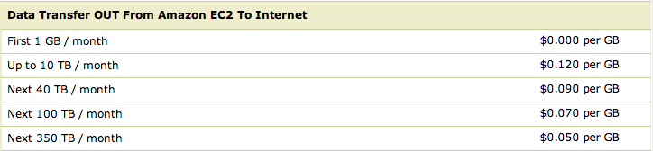
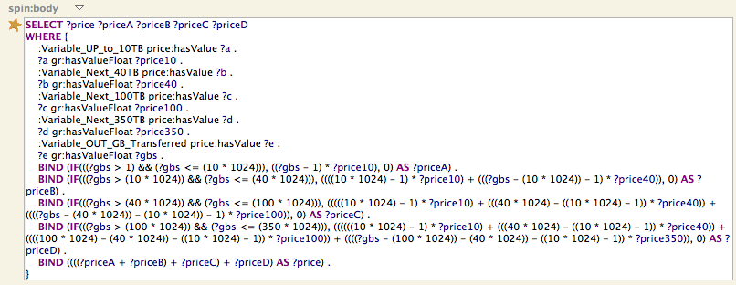
Amazon EC2 Data Transfer PriceComponent
PriceComponent
PriceFunction (SPIN)
PriceVariable (Usage)
PriceVariable (Constant)
The final price is calculated depending on several values

Slide 12
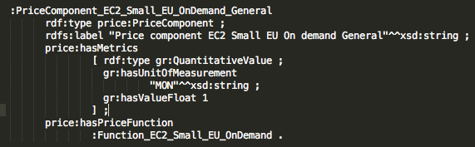
Amazon EC2 General PriceComponent
The final price is only known after knowing the amount of hours used in a month
A price function must be used for the dynamic price calculation
Different operating system different price
On Demand Instance
On-Demand Small Instance Price Plan
This PriceComponent is linked to a PriceFunction for dynamically calculate the price
This PriceComponent for 1 Month cycles

Slide 13

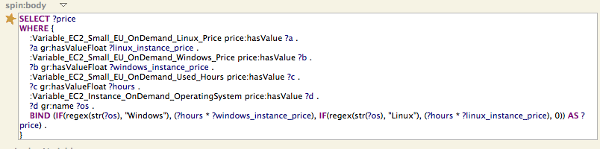
Amazon EC2 General PriceComponent
Linux Price
Windows Price
PriceComponent
PriceFunction (SPIN)
Hours Used (Usage)
PriceVariable (Constant)
Operating System
(Usage)
Price Calculation: multiplies the used hours by the instance price of the operating system being used

Slide 14
Amazon EC2 Model
Simplified Diagram of the Amazon EC2 Example

