Slide 1
Heroku Modeling
Pricing Example

Slide 2
Heroku Service
The Heroku Service can be divided into two distinct services:
Database Service
Application Platform Service (Dynos Service)
Each service has its own set of features, offerings and pricing schemas.
For the purpose of this modeling exercise not all the Heroku features were included in the model

Slide 3
Heroku Database Service
There are a total of 8 production databases in the Heroku Database Service
All of them share the same set of features they only differ in Price and Cache Size
We should group the shared features in one top level service: Service Model
A different service is created for each of the different database type. All these services include the features from the top level service model

Slide 4
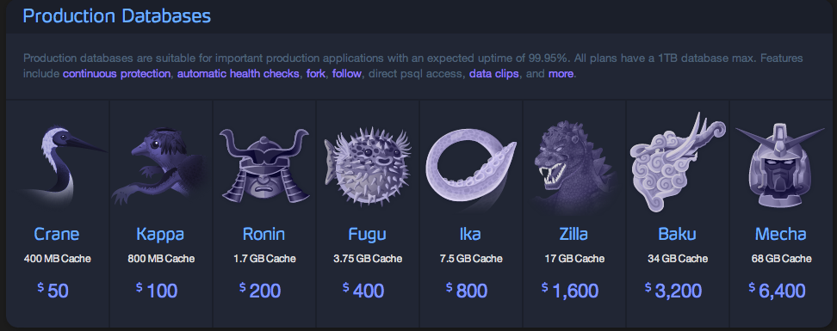
Heroku Database Service
Shared Service Model
Features
Services
Cache Size
Database price

Slide 5
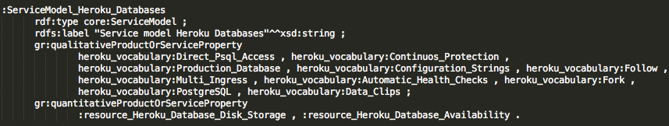

Database Service Model
Disk Storage resource is also defined in the model
List of features included in this ServiceModel
Can be any kind of concept defined in other ontologies if that concept is either a GoodRelations Quantitative or Qualitative value
All the services grouped by this ServiceModel have exactly 1024 Gb of Disk Storage

Slide 6
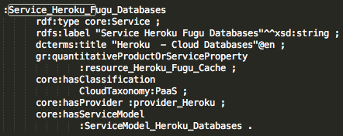
Database Service
Each Service only has to include the extra features
And link to the previously defined ServiceModel to inherit all its features
This process goes for all the 8 different Heroku production databases.
If one more database type were to be created it could also be grouped in the ServiceModel, if it shares the same set of features.
The service does not yet include the price we need a ServiceOffering for that purpose
Note that a ServiceModel is a subclass of Service and therefore they share the same properties.

Slide 7
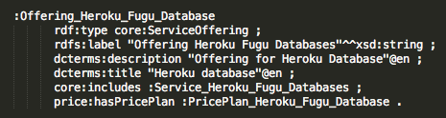
Database Service Offering
A ServiceOffering is created whenever a price is assigned to a particular set of services
Different prices different ServiceOfferings
It can include more than one Service or ServiceModel
It has only one PricePlan which will hold the final price for the offering
For the Heroku Databases one Offering for each different database type was the chosen approach
Includes the specific Database type
Links to the PricePlan for this offering

Slide 8
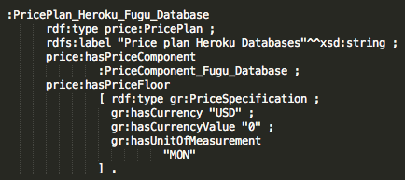
Database Price Plan
There is one PricePlan for each ServiceOffering
The final price for a PricePlan is a sum of all the PriceComponents subtracted with the Deductions
Each Database PricePlan only has one PriceComponent
We have a fixed price
List of PriceComponents linked to this PricePlan (only one in this case)
The price cannot be less than 0$

Slide 9
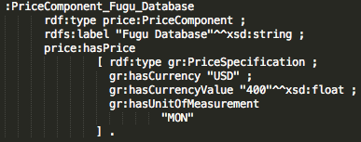
Database Price Component
Each database has a fixed price
No need for a PriceFunction
The property price:hasPrice is how we can specify a specific price for a PriceComponent
The price for the “Fugu Database” is 400 USD
The price is defined using GoodRelations gr:PriceSpecification.
This Price is paid per month
Note that this is the simplest way to define a PriceComponent. The other option is to define a PriceFuntion which would be unnecessary in this case (this option will be later explained).

Slide 10
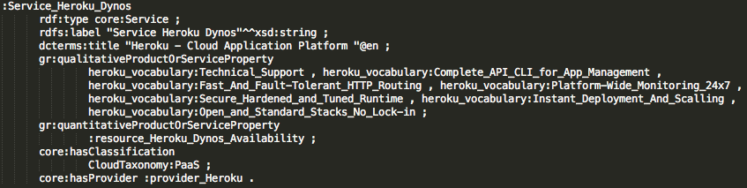
Heroku Dynos Service
Only a single service
The only service variations are parameterization of the service (ex: number of dynos)
No need for a Service Model to group only one Service
All the features are included with the GoodRelations gr:QualitativeProductOrServiceProperty and gr:QuantitativeProductOrServiceProperty
The service is defined as previously explained for the Databases

Slide 11
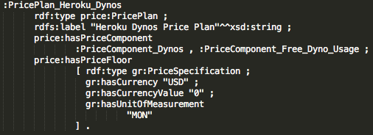
Heroku Dynos Service
There is only one ServiceOffering linked to the Dynos Service
This ServiceOffering includes only the Dynos Service
There is only one PricePlan for the ServiceOffering
The PricePlan groups one PriceComponents and one Deduction
The Deduction reflects the Heroku 750 hours of free usage policy
2 PriceComponents defined in this PricePlan. One is a deduction (PriceComponent_Free_Dynos_Usage)

Slide 12

Dynos Price Components
Two PriceComponents:
PriceComponent_Free_Dyno_Usage (Deduction)
Holds the PriceFunction for generating the deduction price based on the free hours assigned to a user
The price is a factor of 2 PriceVariables (hour cost and number of free hours):
PriceComponent_Dynos (PriceComponent):
holds the PriceFunction for dynamically generate the price based on the usage of the service
The price is a factor of 3 PriceVariables: Hour cost, number of hours used of Web Dynos, number of hours used of Worker Dynos
Dynamic price
Makes use of the Spin functionality
Note that this is the second option when defining a Price for a PriceComponent. The Price is based on a function, therefor is dynamic.

Slide 13

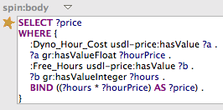
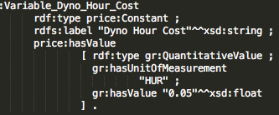
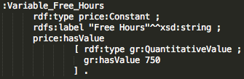

Dynos Price Components: Free_Dyno_Usage
Function =
( Free_Hours * Dyno_Hour_Cost )
Constant (PriceVariable),
750 hours of free usage
Constant (PriceVariable),
Price/hour of one worker
0.05$
The body of the Spin:function
The function is linked to the variables it uses
0.05/hour
750 hours of free usage

Slide 14
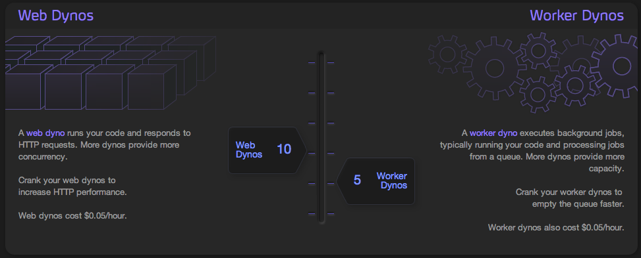
Dynos (PriceComponent)
Constant PriceVariable
Usage PriceVariable

Slide 15
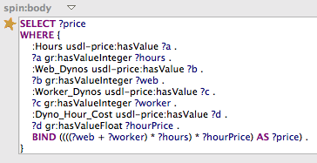

Dynos (PriceComponent)
Function =
(#Web_Dyno + #Worker_Dyno) * #Hours) * Dyno_Hour_Cost
Usage (PriceVariable)
Constant (PriceVariable),
Price/hour of one worker
The four Variables used in the function

Slide 16
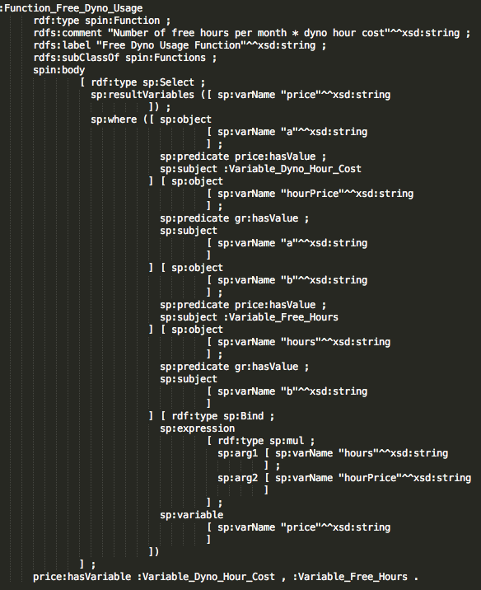
Other Topics
Spin:Funtion for the Free_Dyno_Usage
Consider to use the new spin:Text option

