Slide 1
Cyclistic trends in ridership
A study of the biking habits of members and non-members
Last updated: July 20, 2021
Ed Ocansey

Slide 2
Table of contents
Cyclistic trends in ridership
Business Statement
Data Overview
The Data Story
Conclusion
Suggestions
Appendix

Slide 3
Business Statement
Objective:
Identify trends which may provide insight into how members and casual riders use Cyclistic bikes differently.
Discuss potential areas for further exploration

Slide 4
Data Overview
Data source:
Original first party data from Cyclistic’s own database was used as a source for this analysis. The data is comprised of historical trips from May 2020 through May 2021.
Modifications to data:
The data sample in this analysis includes ride times from 10 minutes to 24 hours in an effort to minimize erroneous records. Examination of the data revealed that virtually the entire distribution of ride times are concentrated within a 1 minute to 3 hour timeframe in peak months and approximately 1 minute to 1.5 hours in slow months. A 10 minute to 2 hour sample was used for this analysis in an effort to cover the timeframe most representative of the greatest distribution of riders.
Bias:
Potential bias may exist where rides having a start time and end time in excess of 24 hours were omitted from this analysis. However in an analysis of ride times within a 24 hour period over 13 months, the distribution of ride times rarely moved beyond 3 hours in peak months and 1.5 hours in slow months.

Slide 5
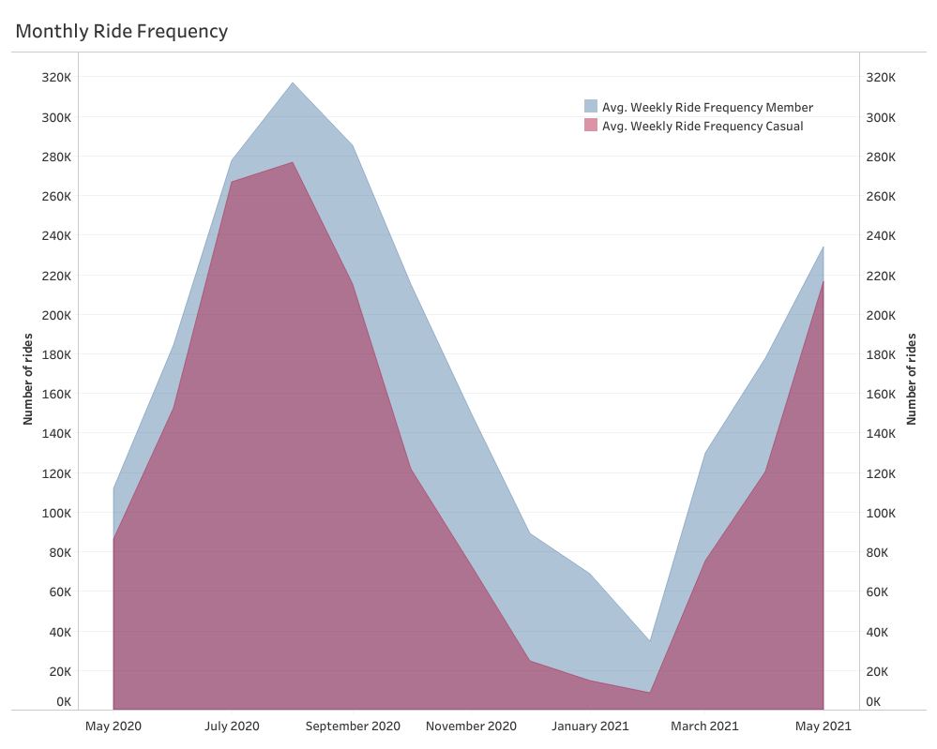
Member bikers rode more frequently than casual bikers year round
Key Points:
By comparing ridership trends month over month, we identified that member bikers consistently rode more frequently on average than casual bikers
The average ridership of member bikers declined 23x less than that of casual bikers from the highest to the lowest peak averages
Ridership for both member and casual bikers peaked during the summer and reached a low point during the winter months
Notes:
The data indicates a 916% decline in average ridership (from peak average to low average) among Member bikers, while Casual bikers showed a 3244% decline in average ridership (from peak average to low average). The average ride frequency of members exceeded the average ride frequency of casual bikers month over month from May 2020 - May 2021.

Slide 6
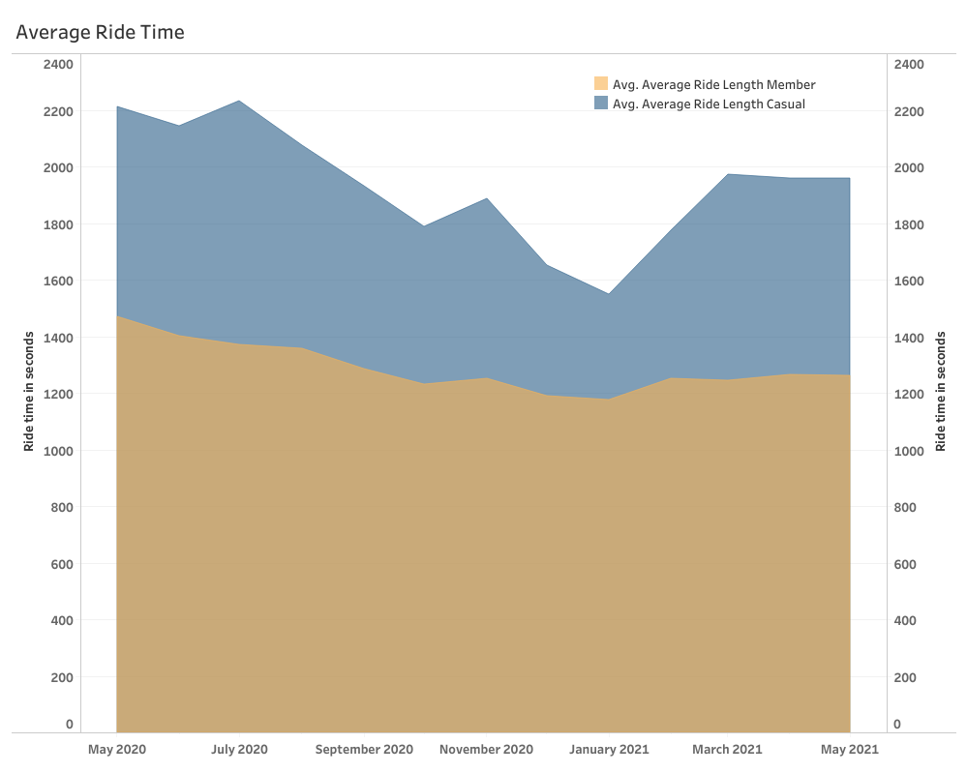
Casual bikers averaged longer ride times than members
Key Points:
Casual bikers rode 10 minutes and 35 seconds longer on average than member bikers
Casual bikers showed a 20% greater decrease in average ride time [from peak average to low average] than member bikers
The average ride time of casual bikers was more varied month over month in contrast to member bikers and declined significantly during the winter months, while member ride lengths remained more stable
Notes:
The average ride time of casual bikers consistently exceeded the average ride time of member bikers from May 2020 - May 2021. Member bikers showed a 145% decrease in average ride length (from peak average to low average) in contrast to a 125% decrease in average ride length (from peak average to low average) for casual bikers.

Slide 7
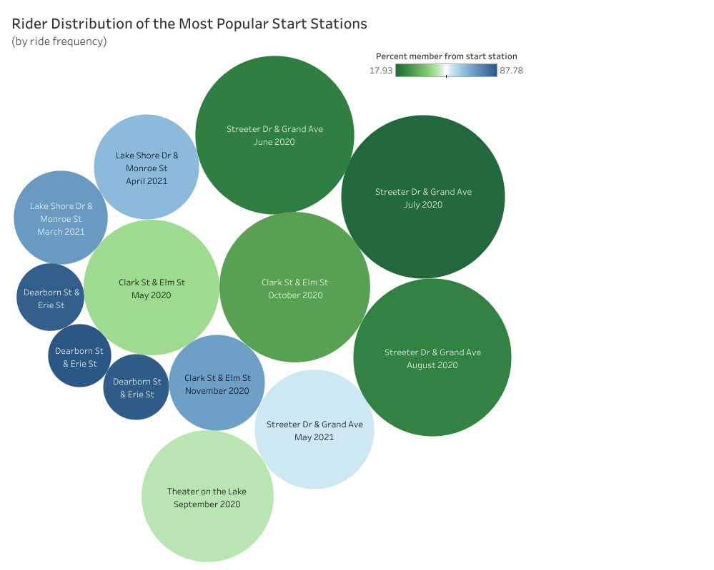
Casual bikers accounted for the majority of rides taken from the most popular start stations during peak ridership months
Key Points:
The distribution of casual bikers traveling from the most popular start stations exceeded 50% reaching as high as 82% on average during peak months
By contrast, the distribution of member bikers traveling from the most popular stations exceeded 50% reaching as high as 88% on average during the months of lowest average ridership overall
Though the overall trend showed member ridership to exceed casual ridership month over month, during the peak months the majority of rides from the most popular start stations were by casual bikers.
Notes:
Start station refers to the station where the bike ride started from. The bluer the circle, the greater the percentage of member bikers traveling from that station. The greener the circle, the greater the number of casual bikers traveling from that station. The size of the circle reflects the overall ridership numbers for the month

Slide 8
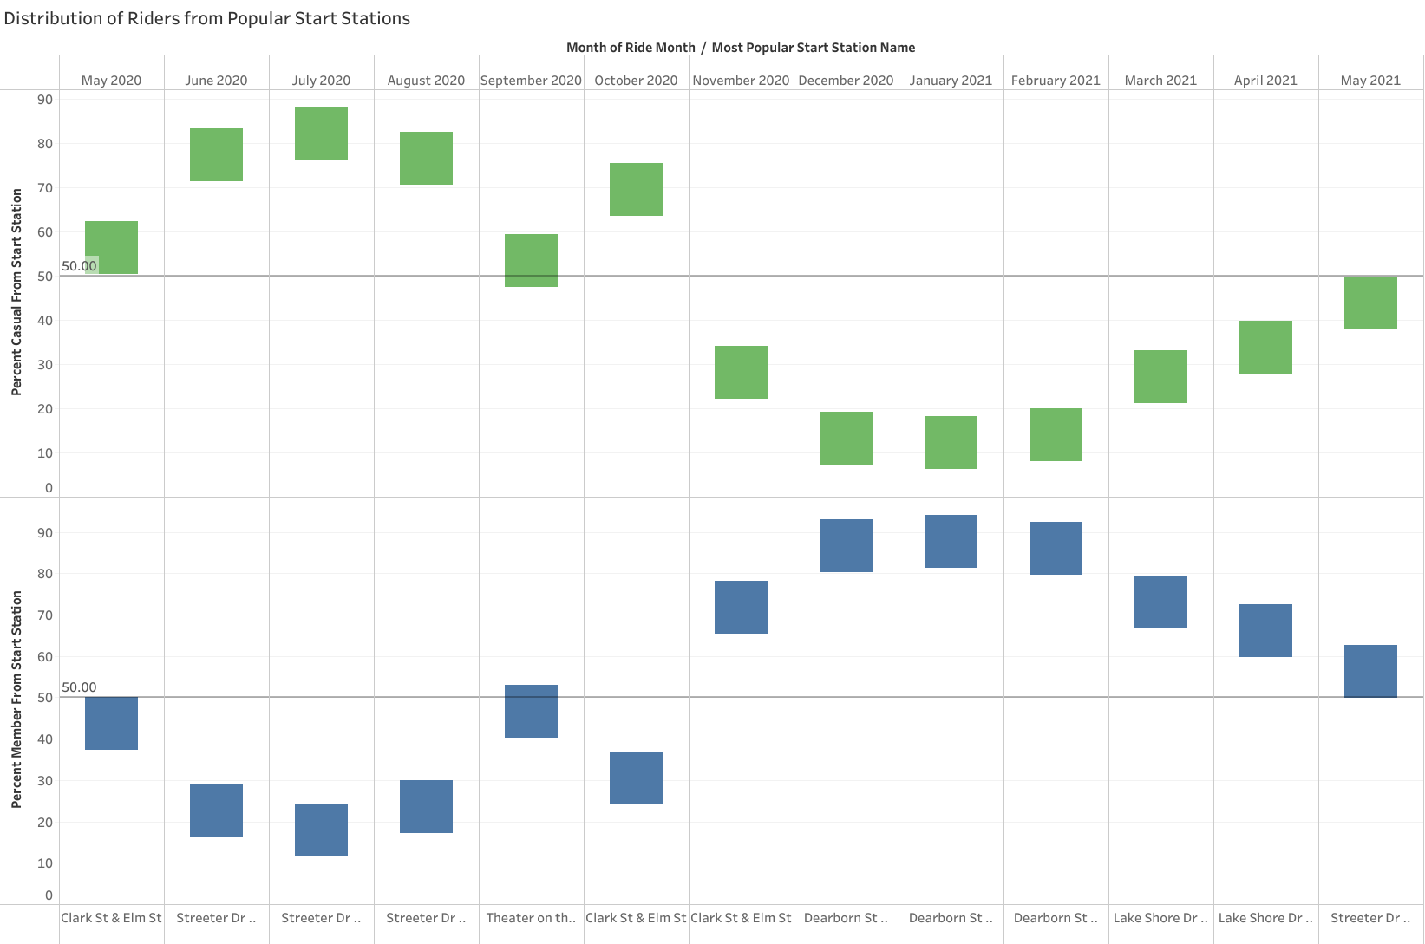
Ridership distribution of members at the most popular start stations showed an inverse relationship to average overall ridership
Key Points:
Casual biker distribution in the most popular start stations followed the overall ridership trend, where it was highest in summer months and lowest in winter months
The fewer people riding bikes overall, the higher the member biker distribution at the most popular start stations
Notes:
The data indicated a sustained above-50% member distribution in the most popular start stations during the months of the steepest overall decline in average ridership, while casual bikers sustained an above-50% distribution in months of peak average ridership.

Slide 9
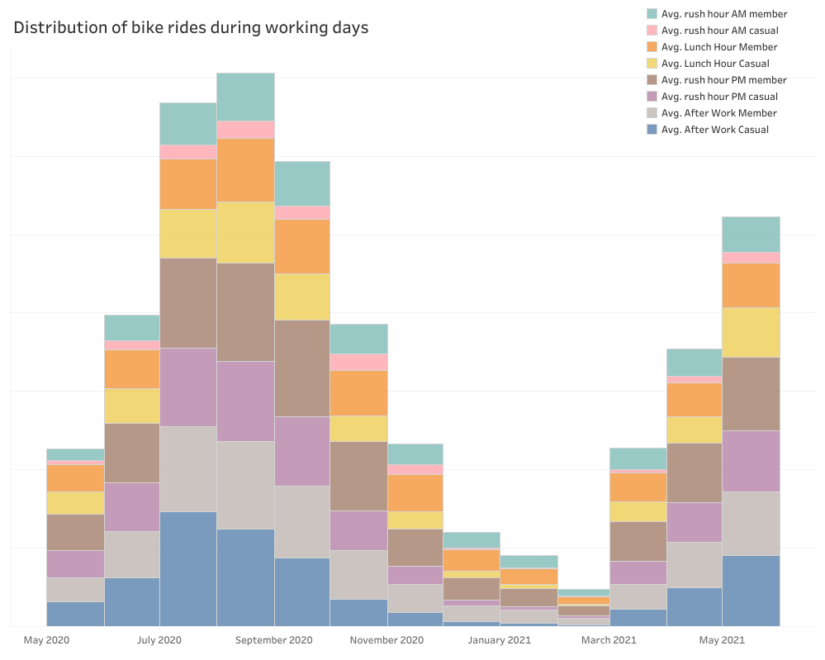
Member bikers rode most frequently during morning and evening rush hour while casual bikers rode most frequently after work hours
Key Points:
Month over month, member bikers rode during rush hour AM [7:00-9:00am] over 3x more than casual bikers on average
Member bikers showed an average ridership 28% and 43% greater than that of casual bikers during lunch hour [12:00-2:00pm] and rush hour PM [5:00-7:00pm] respectively
The ride frequency of member bikers peaked during rush hour PM, while the ride frequency of casual bikers peaked after work hours [7:00-11:59pm]
Notes:
The data showed a positive correlation between peak work commute times and member biker ride frequency. Member bikers ride frequency peaks during the PM rush hour, while casual biker ride frequency peaks after work hours.
On average from May 2020-May 2021, members showed an average bike ridership during rush hour AM of 310% more than casual bike riders. Additionally, members showed 128% and 143% more average ridership during the lunch and rush hour PM time segments respectively.

Slide 10
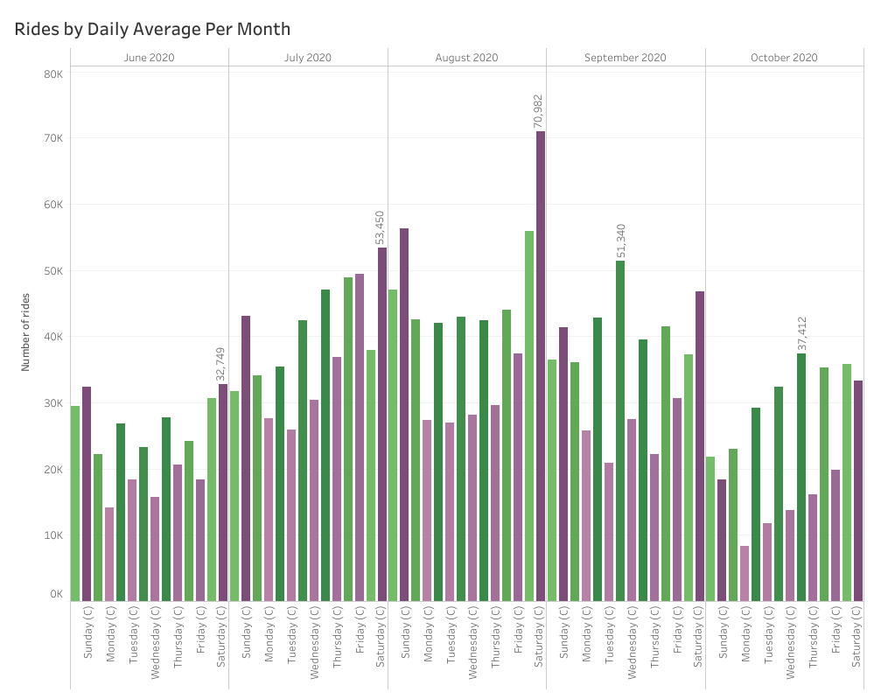
Member bikers rode more frequently on weekdays while casual bikers rode more frequently on weekends during peak months
Key Points:
Ridership of casual bikers consistently peaked on Saturdays and was 9.4% higher on weekends compared to that of member bikers during peak months
Member biker ride frequency from Monday through Friday was 42% higher on average than casual bikers, and peaked on several different days
Member ridership day over day was consistent, indicating only a 0.5% higher ride frequency on weekends versus weekdays
By contrast, casual riders showed a 47% greater ride frequency on weekends as compared to weekdays
Notes:
Member bikers (M) average ride frequency regularly exceeded casual biker average frequency during weekdays within peak months, and on all days of the week during months of low overall average ridership.
Members peak days of average ride frequency varied, in contrast to casual bikers whose peak days were generally isolated to Saturday and Sunday.
Casual bikers (C) average ride frequency consistently peaked during Saturday and Sunday, regularly exceeding member biker average ride frequency in the months of peak overall ridership. This trend reversed during months of low overall ridership.

Slide 11
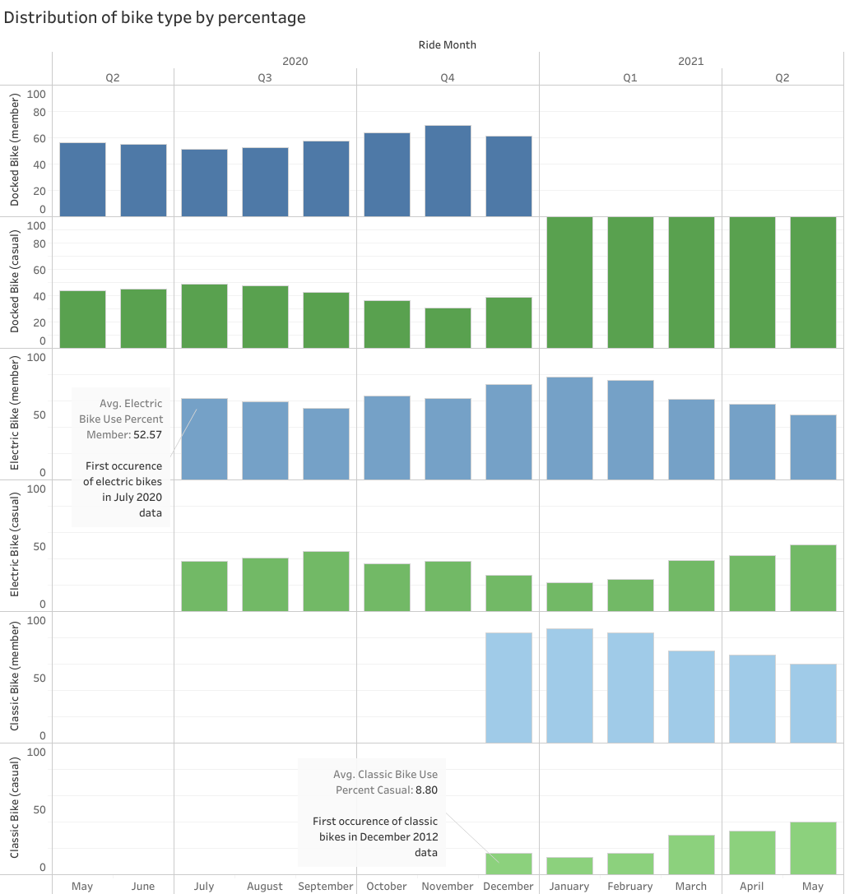
Casual riders used docked bikes more than any other bike type in the 1st and 2nd quarter 2021
Key Points:
Prior to December 2020, member bikers regularly used the greater percentage of docked bikes as compared to casual bikers.
Following a steep decline of docked bike use in December, members as of January 2021 used virtually zero docked bikes as their classic bike usage skyrocketed
As of January 2021, casual bikers made up virtually 100% of the docked bike distribution

Slide 12
Conclusion
1
2
3
Casual riders are more likely to ride for recreation, while annual members are more likely to use bikes to commute to and from work.
Annual members sustain ridership during the winter months while casual riders dominate weekend ridership during the Summer months.
Annual members tend to ride more often than casual riders, while casual riders tend to ride for longer times.
The data suggests that casual riders are seasonal-weekend riders who usually ride for recreation, while annual members are daily riders who ride for recreation but may also commute to work.

Slide 13
Suggestions
Prepare for a weekend surge in casual ridership in June, July and August. The anticipated high distribution of casual riders at the most popular stations may present an ideal marketing opportunity.
1
Potential areas for further exploration
An analysis into the expenditures of repeat casual riders who purchase daily passes during peak months, compared to the cost of an annual pass
An analysis of the cost and convenience of commuting to work by bike versus other methods of travel
An analysis into the feasibility of splitting the cost of an annual pass over the months of June, July and August and a comparison between that and the average cost of casual riders who frequently buy daily passes during this time period
Additional note:
The data revealed that members in Q1 and Q2 rode 0% of total docked bikes used, while casual riders rode 100%. Was the change due to preference or access? An exploration into this may provide valuable insight.

Slide 14
Appendix
Data cleaning log
A data cleaning log is attached as an addendum to this presentation under the file name “work_log.txt”
Data license:
The data license is accessible at the following link: https://www.divvybikes.com/data-license-agreement

