Slide 1
Social Movie Platform
Website/App Structure • Technology Stack • APIs
Core Experience
Discover → Track → Rate → Review → Discuss → Get Recommendations
1

Slide 2
1. What Are We Building?
An all-in-one platform for movie discovery, reviews, watchlists, collections and community discussions.
Users give an overall 1–10 rating and can optionally rate story, acting, cinematography, direction, pacing, music and VFX.
Social features include profiles, likes, comments, follows and movie-related discussions.
Recommendations initially use simple rule-based logic; ML can be added later.
2

Slide 3
2. Overall Website / App Structure
DISCOVER
Home • Trending • Upcoming
Search & filters
MOVIE PAGES
Metadata • Cast • Ratings
Reviews • Related discussions
PERSONAL
Watchlist • Watched
Custom collections
SOCIAL
Profiles • Follows
Likes • Comments
COMMUNITY
Create discussions
Trending conversations
RECOMMEND
Genre + ratings + history
Future ML personalization
3

Slide 4
3. Recommended Technology Stack
Frontend
Next.js + React
Tailwind CSS
Backend
NestJS + TypeScript
REST APIs + JWT Authentication
Database
PostgreSQL
Structured relational data
Why TypeScript?
Using TypeScript on both frontend and backend reduces context switching and makes the project easier for a student team to maintain.
Optional later: Redis for caching/rate limiting • WebSockets for real-time features • background jobs • ML recommendation service.
4

Slide 5
4. High-Level Architecture
USER
Web / Responsive App / PWA
FRONTEND
Next.js + React
BACKEND
NestJS API • Auth • Business Logic • Recommendation Logic
DATABASE
PostgreSQL
EXTERNAL SERVICES
TMDB • News API • YouTube API • Email/OTP
Important: sensitive external API calls should go through the backend so secret keys are not exposed in the browser.
5

Slide 6
5. Main Features & Logic
Structured Reviews
Overall score + aspect-wise ratings
Store individual reviews and aggregate community scores
Trending Discussions
Rank using likes + comments + recent activity − age decay
Recommendations
Use genres, user ratings, watchlist, watched history, directors and actors
Core Data
Users • Movies • Reviews • Ratings • Watchlists • Collections • Discussions • Comments • Follows • Likes
6

Slide 7
6. APIs & API-Key Strategy
TMDB API
Primary movie metadata: search, titles, cast, genres, images and release information.
News / GNews API
Optional: movie announcements and events that can become suggested discussion topics.
YouTube Data API
Optional: official trailers and teasers.
Email / OTP Provider
Resend/SendGrid for email; choose a suitable provider if phone OTP is needed.
7

Slide 8
7. Final Recommendation & Development Approach
MVP: Next.js frontend, NestJS backend, PostgreSQL, and TMDB as the main external movie-data API.
Build in order: Foundation → Movie discovery & profiles → Reviews & collections → Social/discussions → Trending & recommendations → Testing/deployment.
We won’t add ML, Redis, WebSockets or complex infrastructure until the core platform works reliably.
Future upgrades: ML recommendations, sentiment analysis, real-time discussions, notifications and caching.
Best approach
First build a complete and usable product; then add advanced technologies only when a specific feature or performance need justifies them.
8

Slide 9
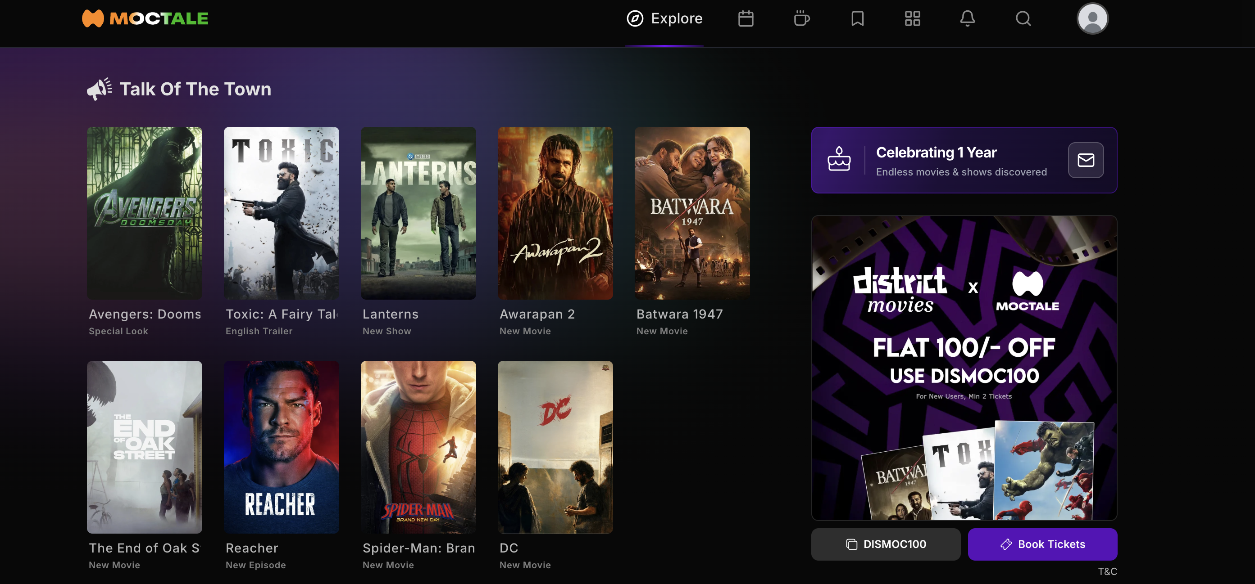
BASIC LAYOUT AND STRUCTURE OF WEBSITE
Home page icon
Profile
Posters of the latest releases and popular movies.
The top right icons include calendar, notifications, collection, search bar, etc.

