Slide 1
L4 Bone Mineral Density & Microarchitecture
Clinician-facing pipeline v16 · YOLO26-seg, AP + LA
An analyst's review: what the numbers actually support
Measuring spinal bone architecture after hip surgery from plain radiographs
L4_AP_segmentation_v16.ipynb · BUU-LSPINE-2000 (n=4,000) + DICOM test set (n=42)

Slide 2
EXECUTIVE SUMMARY
The physics is sound. The statistics are driven by one study.
The physics and the segmentation are sound; every clinical number on top of them is not. Findings 2–4 and 6 are all one contaminated reference fit. Finding 1 is a labelling rule. Finding 5 is real.
1
Segmentation works; L4 naming does not. Matched Dice 0.757 vs deployed 0.302. 27 of 42 test images name the wrong vertebra.
2
The reference cohort is contaminated. It was fitted on 38 studies including QC-WARN. One study (BAR = 12.24) inflates σ by 8.5×.
3
The z-score can never flag anyone. With σ = 1.949, z ≤ −1 requires BAR ≤ −1.33 — impossible. Hence 38/38 “Within reference”.
4
Learned texture polarity is a leverage artifact. Drop that one study and fractal dimension's sign flips (+0.845 → −0.275). It carries 15% of BHI.
5
Precision, not the outlier, blocks follow-up use. The QC gate cuts LSC from 96.8% to 36.8% — still 12× worse than DXA. This one is not an artifact.
6
BAR is right-skewed; a Gaussian z is misspecified. skew = +5.80 raw, +0.33 on log(BAR). The reference should be fitted in log space.
Every finding below is recomputed directly from the notebook's own metrics/ CSVs.

Slide 3
CONTEXT
What the pipeline measures, and why BAR is the right primitive
The chain
Segment — YOLO26-seg finds L1–L5 as instances (AP + LA).
Isolate — Erode the cortical rim (10% of body height) and strip the endplate bands (18% each) → a pure trabecular ROI.
Linearise — Map pixels to attenuation A using the DICOM PixelIntensityRelationship tag: LOG → A = I, LIN → A = −ln(1 − I).
Reduce — A_trab = 10–90% trimmed mean; A_soft = median of paraspinal bands; A_air = Otsu background.
Report — BAR, microarchitecture, BHI, QC verdict, LSC.
BAR — Bone Attenuation Ratio
BAR = (A_trab − A_soft) / (A_soft − A_air)
“L4 trabecular bone absorbs BAR× as much extra X-ray as the patient's own soft tissue.” Dimensionless, and provably invariant to exposure, gain and window/level — both numerator and denominator are differences, so any affine A → aA + b cancels.
Why this matters analytically
BAR is the one quantity in the notebook whose correctness rests on physics rather than on the cohort. Everything downstream — the z-score, the category, the BHI, the LSC — is a statistical construct fitted to 38 studies, and that is where this review concentrates.
Beer–Lambert: attenuations add along a ray, so the soft-tissue correction must be a subtraction — v15 divided, and drifted.

Slide 4
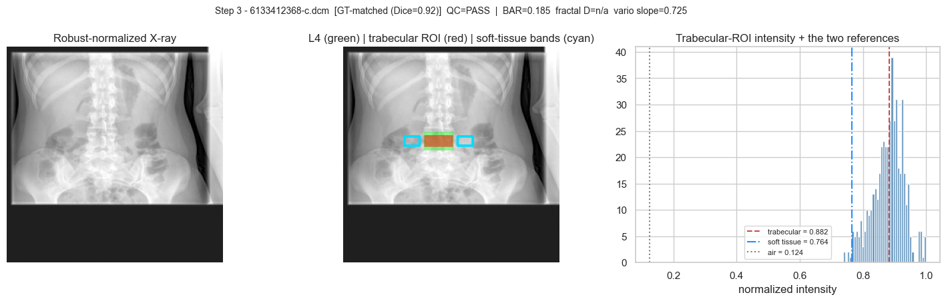
WHAT IS SOLID
The invariance claim holds — verified numerically
Applying an exposure/gain/window change A → 2.30·A − 0.11
BAR 1.005193 → 1.005192 invariant bmd_rel (v15) 1.837660 → 1.996527 drifts +8.6%
Step 3 demo. This property is what makes BAR comparable across visits and machines — it is the pipeline's strongest result.

Slide 5
DATA
What we are actually fitting on
4,000
training X-rays
BUU-LSPINE-2000 2,000 AP + 2,000 LA, classes L1–L5
42
DICOM test studies
all 42 carry an L4 ground-truth mask out-of-domain field of view
38
studies in the reference
PASS (27) + WARN (11) FAIL (4) excluded — WARN is not
26
studies with all four vertebrae
n_vert = 4. Seven studies contribute only a single vertebra
QC verdicts across the 42 test studies
Verdict | n | Used to fit the reference? | Consequence
PASS | 27 | yes | correct
WARN | 11 | yes | admits the BAR = 12.24 outlier
FAIL | 4 | no | correct
The QC gate exists and works — it is simply not applied upstream of the statistics. fit_reference() takes every study with a non-null BAR.

Slide 6
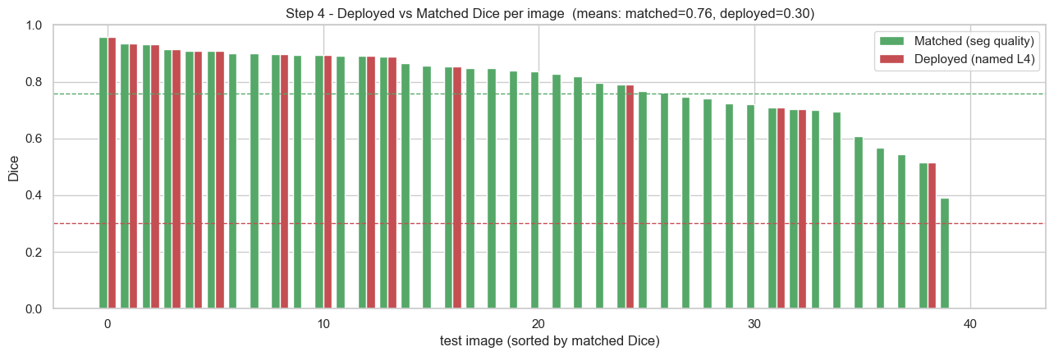
FINDING 1
The masks are good. The labels on them are wrong.
Matched Dice 0.757 — the best-overlap vertebra against the true L4. Segmentation quality is fine. Deployed Dice 0.302 — the mask the pipeline actually calls “L4”.
27 of 42 images have deployed Dice ≈ 0 while their best-overlap vertebra reaches mean Dice 0.707 on those same images. This is an off-by-one indexing failure on the out-of-domain DICOM field of view, not a segmentation failure — and it means most reported BAR values are measured on the wrong bone.
The “4th-from-top” fallback selector breaks when the DICOM crop does not start at L1. Three studies detect no L4 at all.

Slide 7
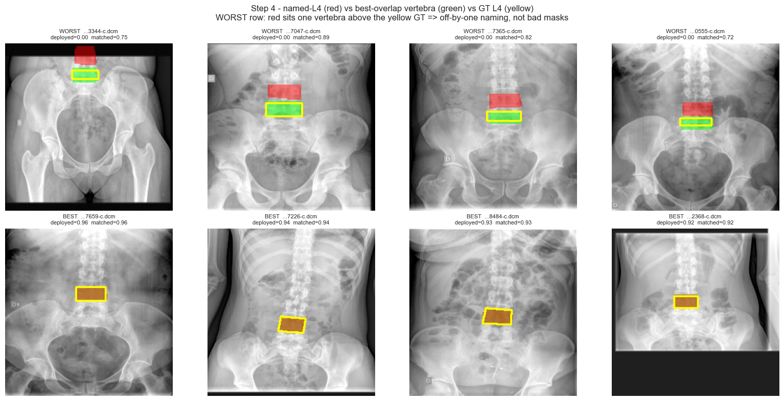
FINDING 1 · EVIDENCE
Red = the vertebra named “L4”. Green = the true best match.
Yellow contour = ground-truth L4. Where red and green diverge, the pipeline measured a neighbouring vertebra and reported it as L4.
Fix: anchor the ordering on the sacrum / L5 rather than counting from the top of a cropped frame. The segmentation head already gives you what you need — this is a labelling rule, not a model problem.

Slide 8
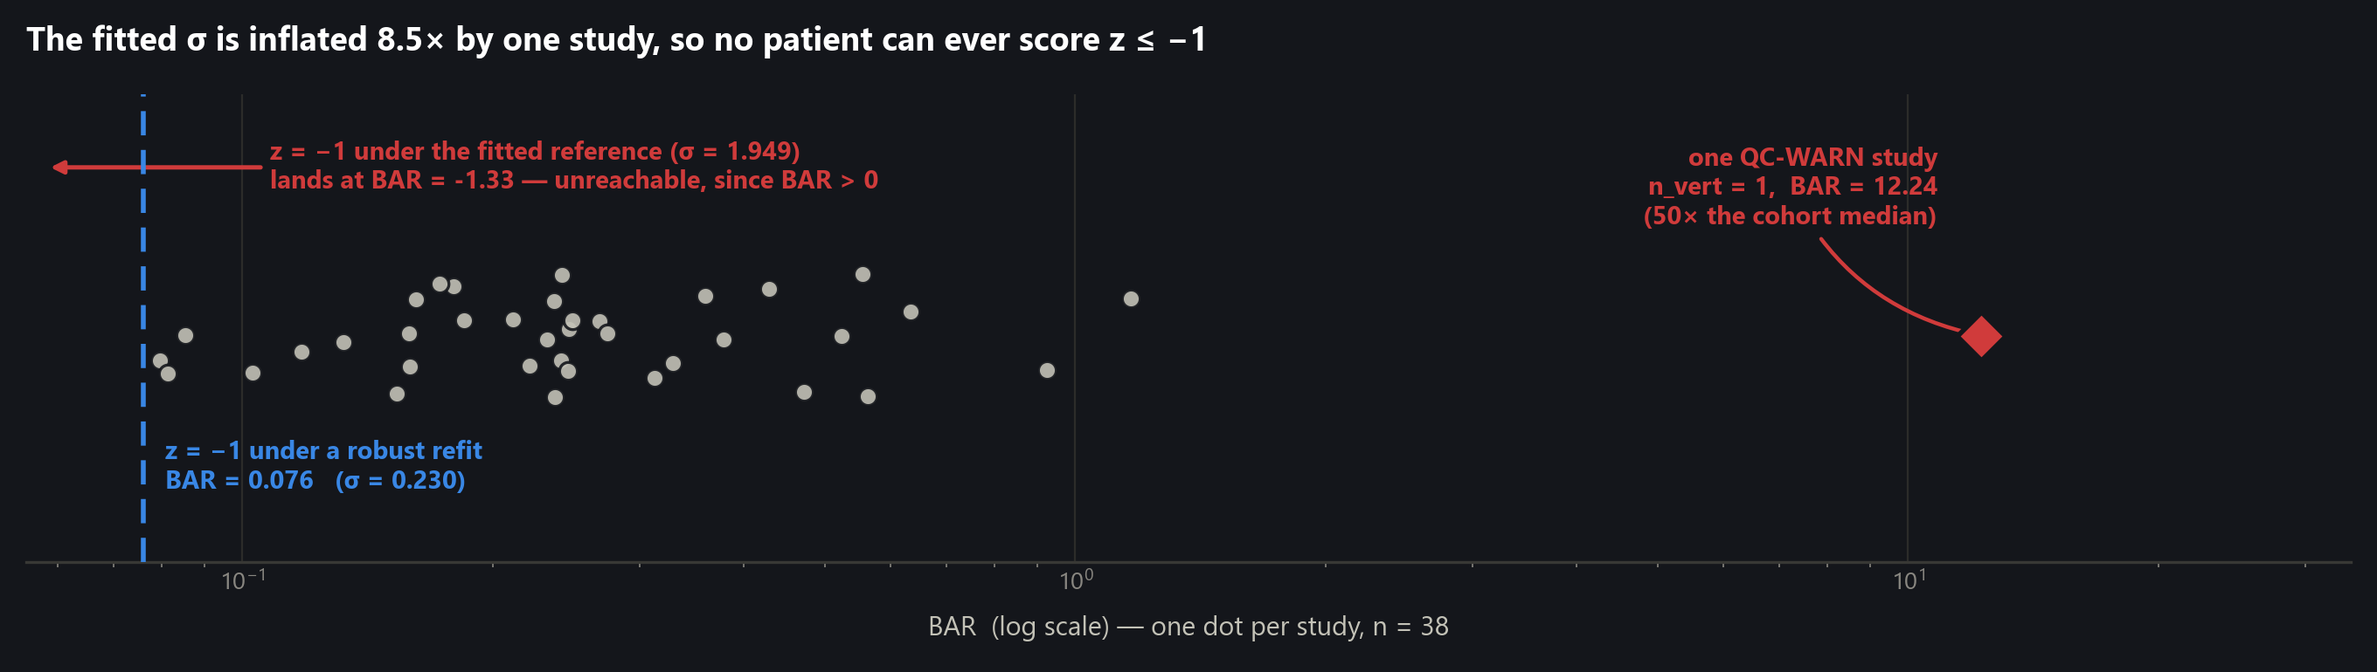
FINDING 2
One QC-WARN study owns the entire reference distribution
Reference statistic | As fitted (n = 38) | Excluding that one study (n = 37) | Change
mean BAR | 0.620 | 0.306 | −51%
σ (BAR) | 1.949 | 0.230 | 8.5× inflation
BAR at the z = −1 cut-point | −1.329 (unreachable) | 0.076 | becomes reachable
The outlier: n_vert = 1, ROI area 574 px, soft-tissue−air margin 0.025. It is a failed measurement, not dense bone — and QC caught it as WARN.

Slide 9
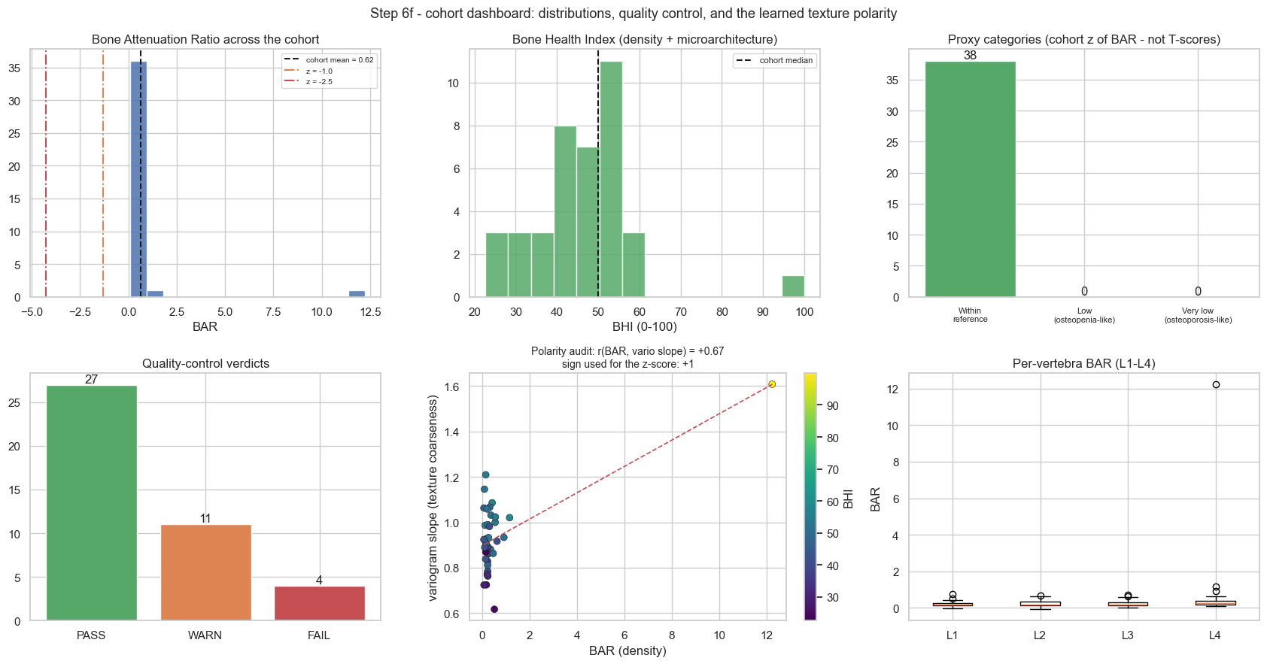
FINDING 3
So the category system has zero sensitivity — by construction
38 / 38 “Within reference range”
Not because the cohort is healthy. Because BAR ≥ 0 by construction and the z = −1 cut-point sits at BAR = −1.33. No study, however osteoporotic, can cross it.
The polarity audit panel is the tell
Centre-bottom: r(BAR, variogram slope) = +0.67 is a straight line from a dense cloud at BAR ≈ 0.2 to a single point at BAR = 12.24. That is leverage, not correlation.
Step 6f cohort dashboard, reproduced unmodified from the notebook.

Slide 10
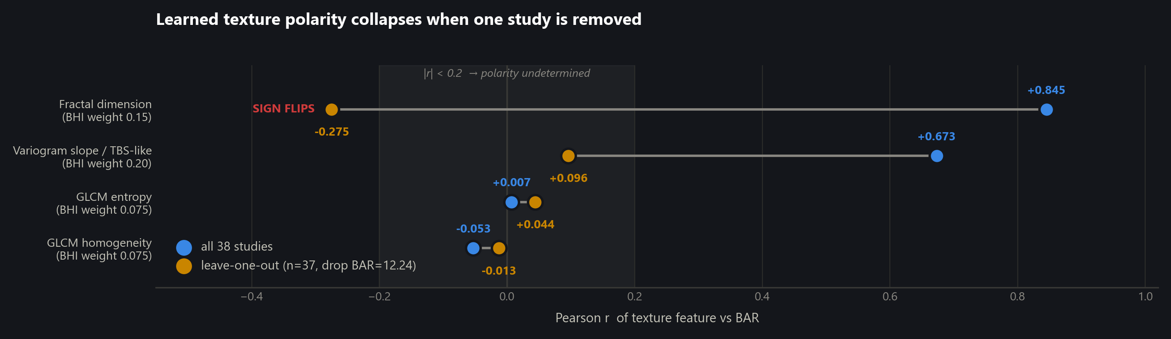
FINDING 4
Remove that study and a feature's sign flips
The notebook's §1.4 warns that “a wrong sign would silently invert the index.” It has happened.
Fractal dimension is entered into the BHI with sign +1 on the strength of r = +0.845. Recomputed without the single leverage point, r = −0.275 — the opposite direction. The |r| < 0.2 guard did not catch it, because the outlier is exactly what pushes r past the guard. Worse, fractal dimension is only defined on 11 of 38 studies (71% missing), and those NaNs still carry 15% of the BHI weight.
Leave-one-out is the right diagnostic here: with n = 38, a single point at 50× the median has enormous leverage on Pearson r.

Slide 11
FINDING 4 · CONSEQUENCE
Auditing the BHI: only one term is defensible
Feature | BHI weight | r with BAR (n=38) | r leave-one-out | Verdict
BAR | 0.500 | +1.000 (anchor) | +1.000 | keep — physical anchor
Variogram slope (TBS-like) | 0.200 | +0.673 | +0.096 | weight → 0
Fractal dimension | 0.150 | +0.845 | −0.275 sign flips | drop — 71% missing
GLCM homogeneity | 0.075 | −0.053 | −0.013 | drop — |r| ≈ 0
GLCM entropy | 0.075 | +0.007 | +0.044 | drop — |r| ≈ 0
50% of the BHI weight rests on features whose polarity is either undetermined or wrong.
The notebook already flagged homogeneity and entropy as weakly determined and kept them anyway. Once the leverage point is removed, the variogram slope joins them and fractal dimension inverts. Until DXA labels arrive, the BHI is a noisy monotone transform of BAR — and should simply be reported as BAR.
The 0.5/0.2/0.15/0.075/0.075 weights are hard-coded placeholders, not fitted — the notebook is explicit about this.

Slide 12
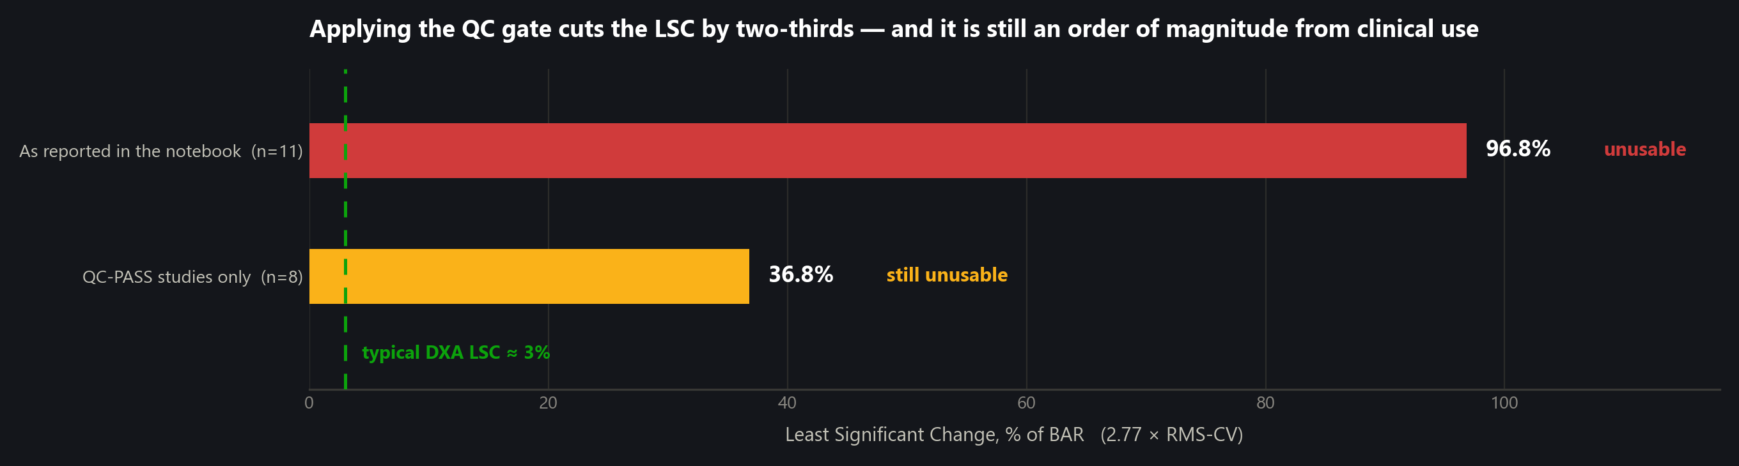
FINDING 5
The only problem the outlier does not explain
The reported RMS-CV is dominated by the same failed study — its repeats read BAR = 5.53 ± 6.06 (CV = 110%). Excluding QC-WARN studies, as ISCD would, brings LSC down to 36.8%. But two studies that passed QC still show CV = 32.6% and 14.7%. Repositioning alone moves BAR by a third.
This is the one finding a data fix cannot rescue. And it is a lower bound: the perturbations model repositioning, not a true test–retest with re-exposure. Until the ROI is stable under small geometric changes, BAR cannot support longitudinal follow-up — which is the whole clinical premise of measuring bone after hip surgery.

Slide 13
FINDING 6
A Gaussian z-score is the wrong model for a positive ratio
BAR is a ratio bounded below by zero and heavily right-skewed. fit_reference() assumes normality.
Distribution of BAR | Skewness | Reading
raw BAR, all 38 studies | +5.80 | dominated by the outlier
raw BAR, excluding the outlier | +2.04 | still strongly right-skewed
log(BAR), all 38 studies | +2.05 | outlier still visible
log(BAR), excluding the outlier | +0.33 | near-symmetric — fit here
Two consequences
1. A symmetric ±1σ band on a skewed variable mislabels both tails — which is where osteoporosis lives.
2. Even after removing the outlier the minimum observed z is −0.985, so a robust refit alone still flags nobody. Fitting in log space, with median/MAD rather than mean/σ, is the minimum viable change — and a real normative cohort is the actual fix.

Slide 14
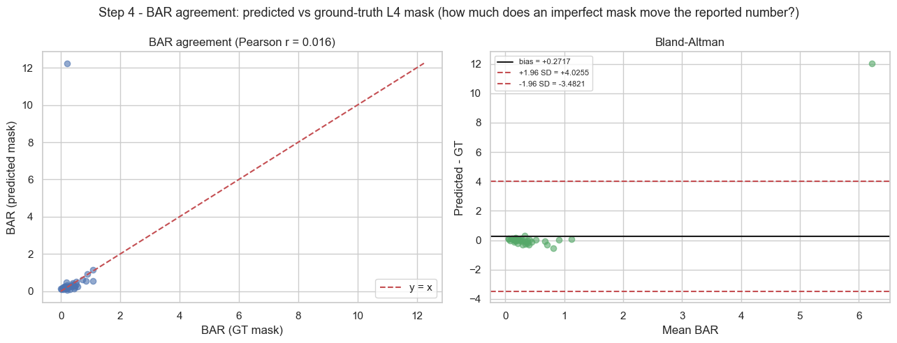
DOWNSTREAM COST
An imperfect mask moves BAR further than the signal itself
Segmentation-induced BAR bias = +0.272, with 95% limits of agreement [−3.48, +4.03]. Against a cohort median BAR of 0.242, the limits of agreement span roughly 30× the typical value. Part of this is the same outlier; part is real. Until Finding 1 is fixed, the mask error and the biological signal are the same order of magnitude.
Bland–Altman, predicted mask vs ground-truth mask, on the primary index. Step 4.

Slide 15
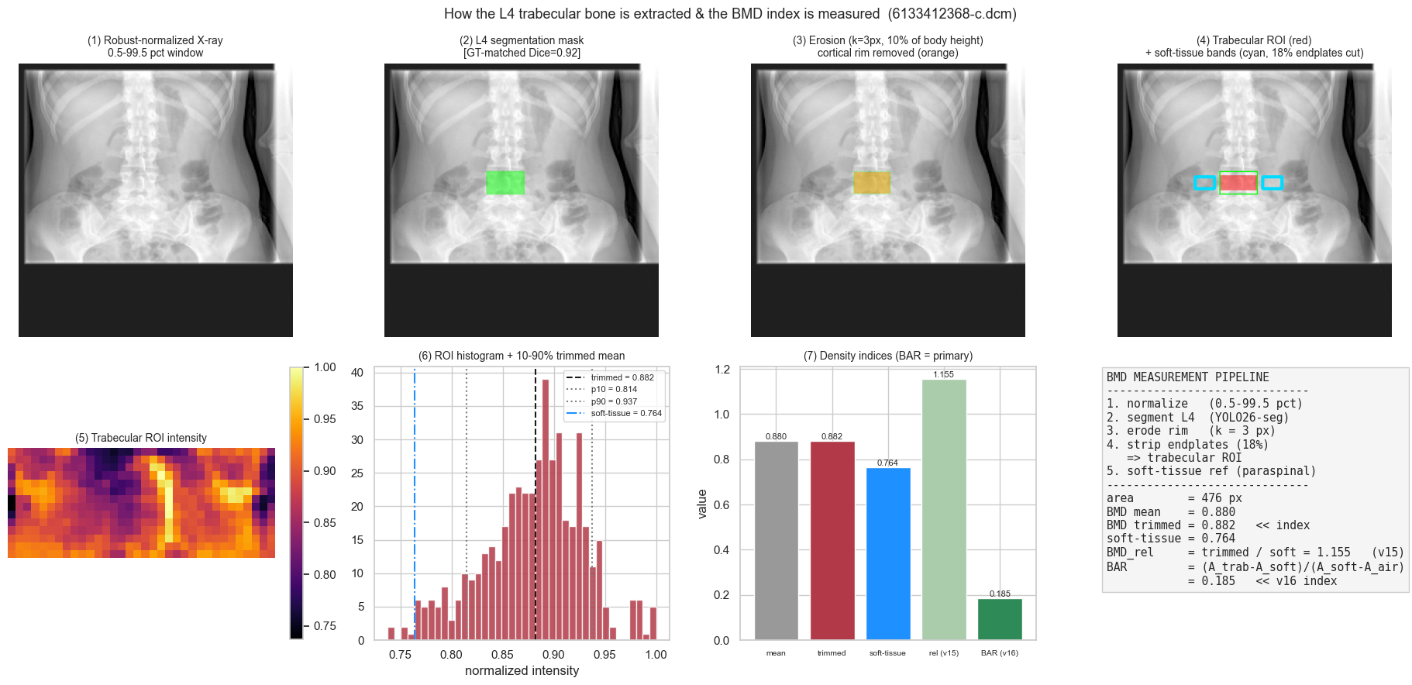
WHAT IS SOLID
The engineering is ahead of the statistics
Physics
BAR's affine invariance is proved and numerically verified. The attenuation domain is chosen from the DICOM tag rather than assumed.
Traceability
One entry point, measure_l4(), feeds the CSV, the report card, the web JSON and the precision experiment. A figure cannot disagree with a number.
Honesty
The QC gate, the “not a T-score” caveats and the limitations section are all correct. The notebook diagnoses most of what this review confirms.
Deployment
best.pt → ONNX opset 12, with a PyTorch-vs-ONNX parity check and a versioned report schema.
XAI 2b: the measurement pipeline, stage by stage. Seg-Grad-CAM over L1–L5 puts >90% of its evidence on the spine.

Slide 16
RECOMMENDATIONS
Ordered by how much they change the reported numbers
# | Action | Where | Expected effect
1 | Anchor vertebra ordering on the sacrum/L5, not “4th from top” | yolo_l4() | deployed Dice 0.30 → ~0.76
2 | Fit the reference on QC-PASS studies only (n = 27) | fit_reference() | removes the leverage point
3 | Fit in log space, with median/MAD instead of mean/σ | fit_reference() | z-score becomes well-posed
4 | Re-derive polarity under leave-one-out; drop any feature whose sign flips | fit_reference() | kills fractal_dim, vario_slope
5 | Set BHI weights to zero for all unstable features → BHI = BAR | BHI_WEIGHTS | removes a false composite
6 | Re-estimate LSC on QC-PASS studies; state it as a lower bound | precision_lsc() | 96.8% → 36.8%, still unusable
7 | Stabilise the ROI under small rotations — the real precision fix | trabecular_roi() | the only non-data problem
8 | Rebuild the BUU val split so Step 2b reports in-domain metrics | Step 2b | currently silently skipped
Items 2–6 are edits to a single function and its weights; item 1 is a labelling rule. None require retraining. Item 7 is the only one that needs new engineering.

Slide 17
THE ONE EXPERIMENT THAT MATTERS
Everything above is a proxy until DXA labels exist
What we need
≥ 50 studies
with paired DXA T-scores or continuous BMD
The CSVs are already shaped for it. L4_clinical_scores.csv carries bar, bhi and every texture feature per study; attaching a label column is the whole data task.
What it settles
corr(BAR, T-score) — does the physics survive contact with the reference standard?
ROC(BHI → osteoporosis) — does texture add anything over density alone?
If BAR alone reaches adequate AUC — drop the texture terms entirely.
If it does not — re-fit BHI_WEIGHTS by logistic regression on the labels.
That single experiment converts every “-like” in this notebook into a defensible clinical claim.
Until then: report BAR with its QC verdict, and say nothing about osteopenia.
Recommendations 1–4 should land before the labels arrive, so the correlation is computed on the right vertebra.

