Slide 1
AUTOMATED IMAGING · BONE HEALTH
Measuring Spinal Bone Density
from Routine Hip / Spine X-rays
An automatic, explainable pipeline that finds the L4 vertebra and measures its bone density and texture.
Presented by: Edward Choi · Data Analyst
Audience: Dr. Brent Lanting / Orthopaedic / Hip Surgery
July 09, 2026
1/15
Notes:
'I built an automatic tool that measures bone quality of the L4 spine vertebra directly from the X-rays you already take.
No extra scan, no extra dose.
I'll show what it does, how accurate it is, and what we still need to fix before clinical use.'

Slide 2
THE GOAL
Why measure L4 bone from an X-ray?
Bone quality of the lumbar spine matters for surgical planning and follow-up.
AP hip / spine X-rays are already taken in routine care.
Goal: a fast, repeatable bone-quality number for the L4 vertebra — fully automatic.
L4 is the standard lumbar reference level for bone assessment (as in DXA).
IMPORTANT CAVEAT
This is a relative, X-ray-based proxy of bone density — not a calibrated DXA result (g/cm²).
It is for method demonstration. True BMD needs DXA / QCT or an in-image calibration phantom.
WHAT WE MEASURE ON L4
1) Bone density proxy (image brightness)
2) Bone texture (trabecular pattern, GLCM)
L4 Spinal Bone Measurement · Data Analytics
2/15
Notes:
‘This is not replacing DXA. I’m extracting a consistent, automatic bone signal from images you already have.
Two things: density (how bright/dense the bone looks) and texture (the internal bone pattern).
But it is a proxy, not calibrated g/cm-squared.'

Slide 3
OVERVIEW
The pipeline in four steps
1
2
3
4
Input X-ray
Find L4
Measure
Report + Explain
Routine AP spine / hip radiograph
AI outlines vertebrae L1-L5 and selects L4
Density proxy + bone texture on L4
Numbers + heatmaps showing the 'why'
Built on a single AI detector (YOLOv26) trained on 5,000 public spine X-rays; the measurement and explanation code is independent of the detector.
L4 Spinal Bone Measurement · Data Analytics
3/15
Notes:
'The pipeline in four steps:
take the X-ray,
the AI finds and outlines L4,
we measure bone on that region, and we report the numbers with a heatmap that shows where the AI looked.
Everything after the detector is standard, transparent image math.'

Slide 4
THE GOAL
AI in osteoporosis diagnosis 1
Imaging modalities
Clinical tasks
DXA
X-ray
CT
MRI
Osteoporosis
classification
Fracture
detection
Risk
detection
Normal
BMD
estimation
Bone
detection
Bone
density
Osteopenia
T-score
classification
Opportunistic
screnning
Bone structure
analysis
Osteoporosis
L4 Spinal Bone Measurement · Data Analytics
4/15

Slide 5
THE GOAL
AI in osteoporosis diagnosis 2
AI methodologies
Classical
Machine Learning
CNN-based
Explainable AI
Transformer-based
Self-supervised
learning
GLCM
YOLO26-seg
Seg-Grad-Cam
(Feature Extraction)
(L4 vertebral split)
ONNX
Web export
Attention
heatmaps
L4 Spinal Bone Measurement · Data Analytics
5/15

Slide 6
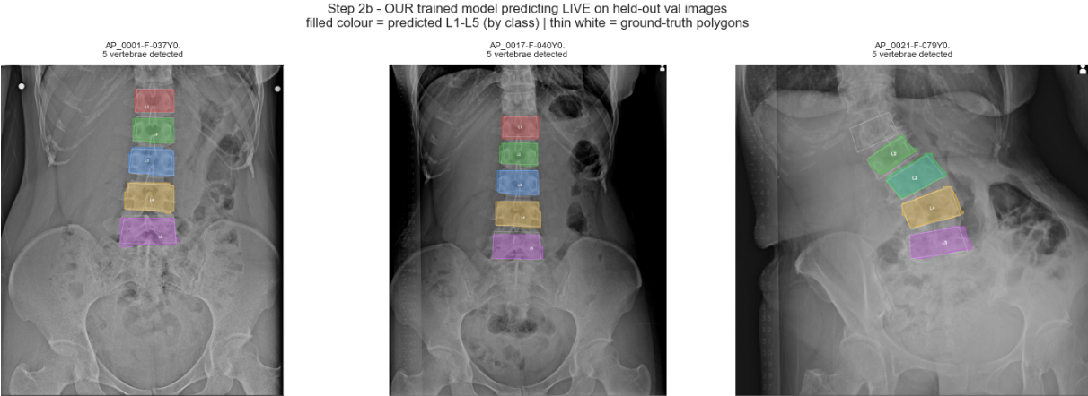
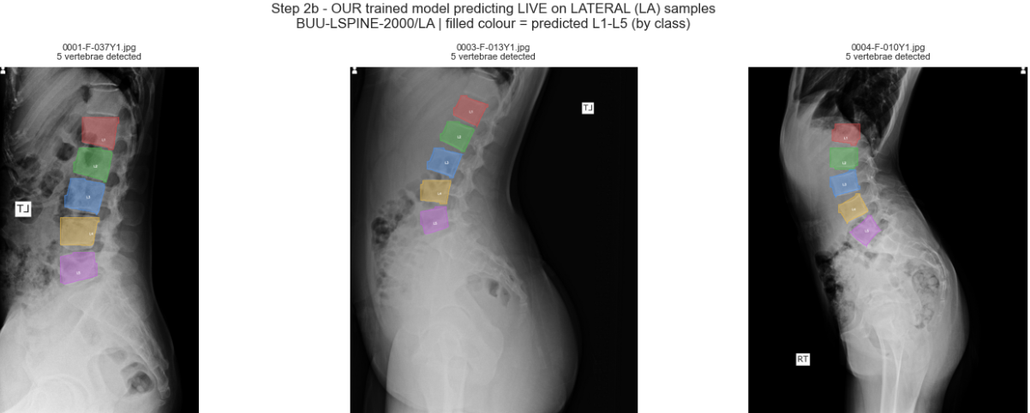
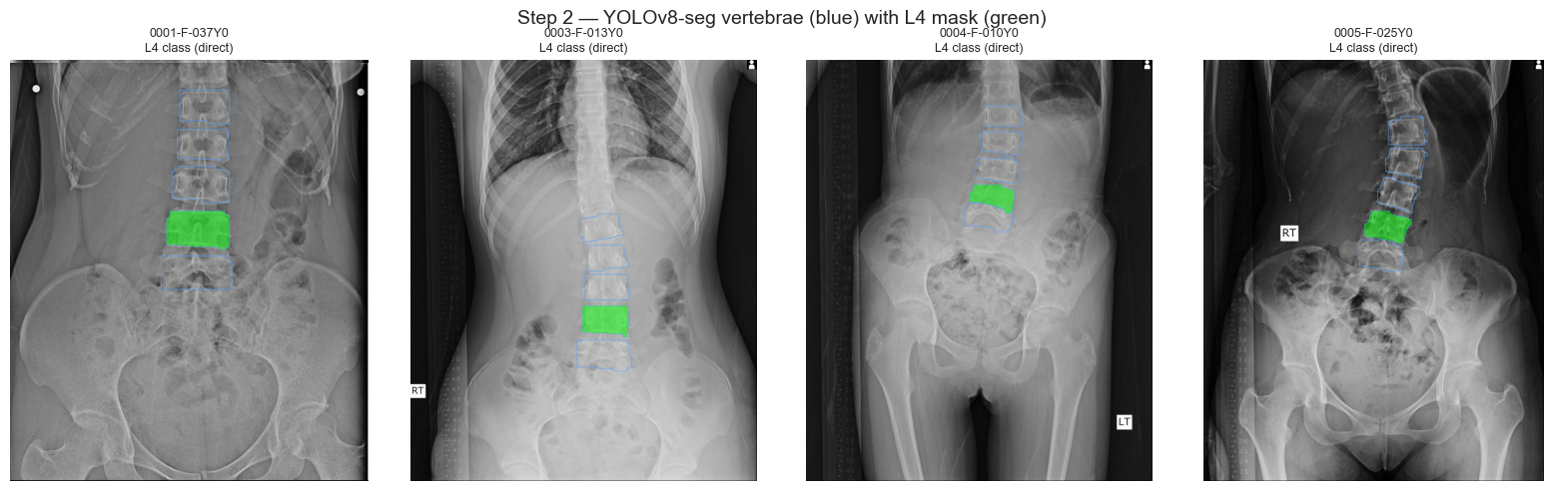
STEP 1
Finding the L4 vertebra
AI segmentation (YOLOv8-seg)
It outlines each vertebra L1-L5 as a separate object.
L4 is selected by its label, with a 4th-from-top backup rule.
Output: a clean L4 outline at full image resolution.
Blue = all vertebrae · Green = selected L4
L4 Spinal Bone Measurement · Data Analytics
7/15
Notes:
'The AI does instance segmentation - it separates each vertebra.
and then pick L4.
Green is the L4 it chose.
This is the core building block;
the bone measurement sits on top.'

Slide 7
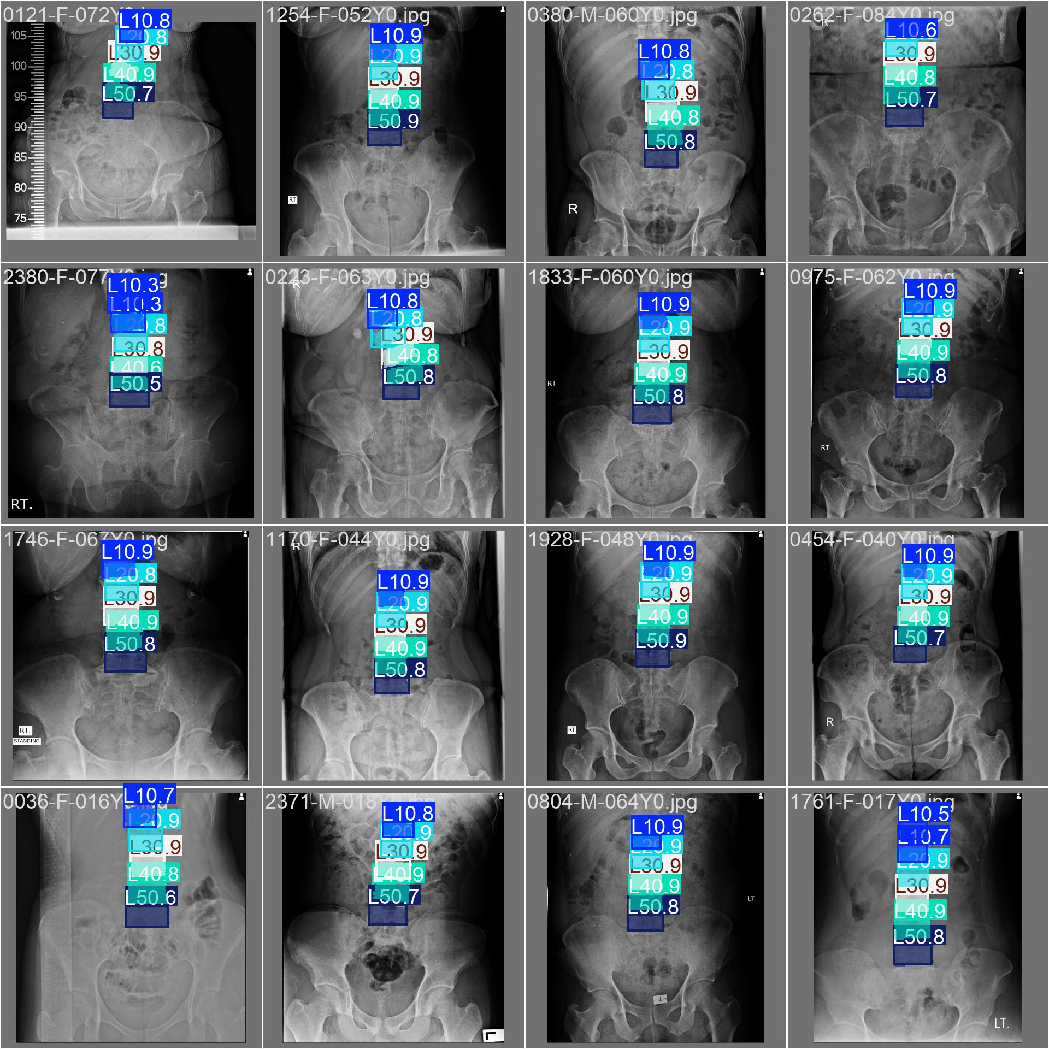
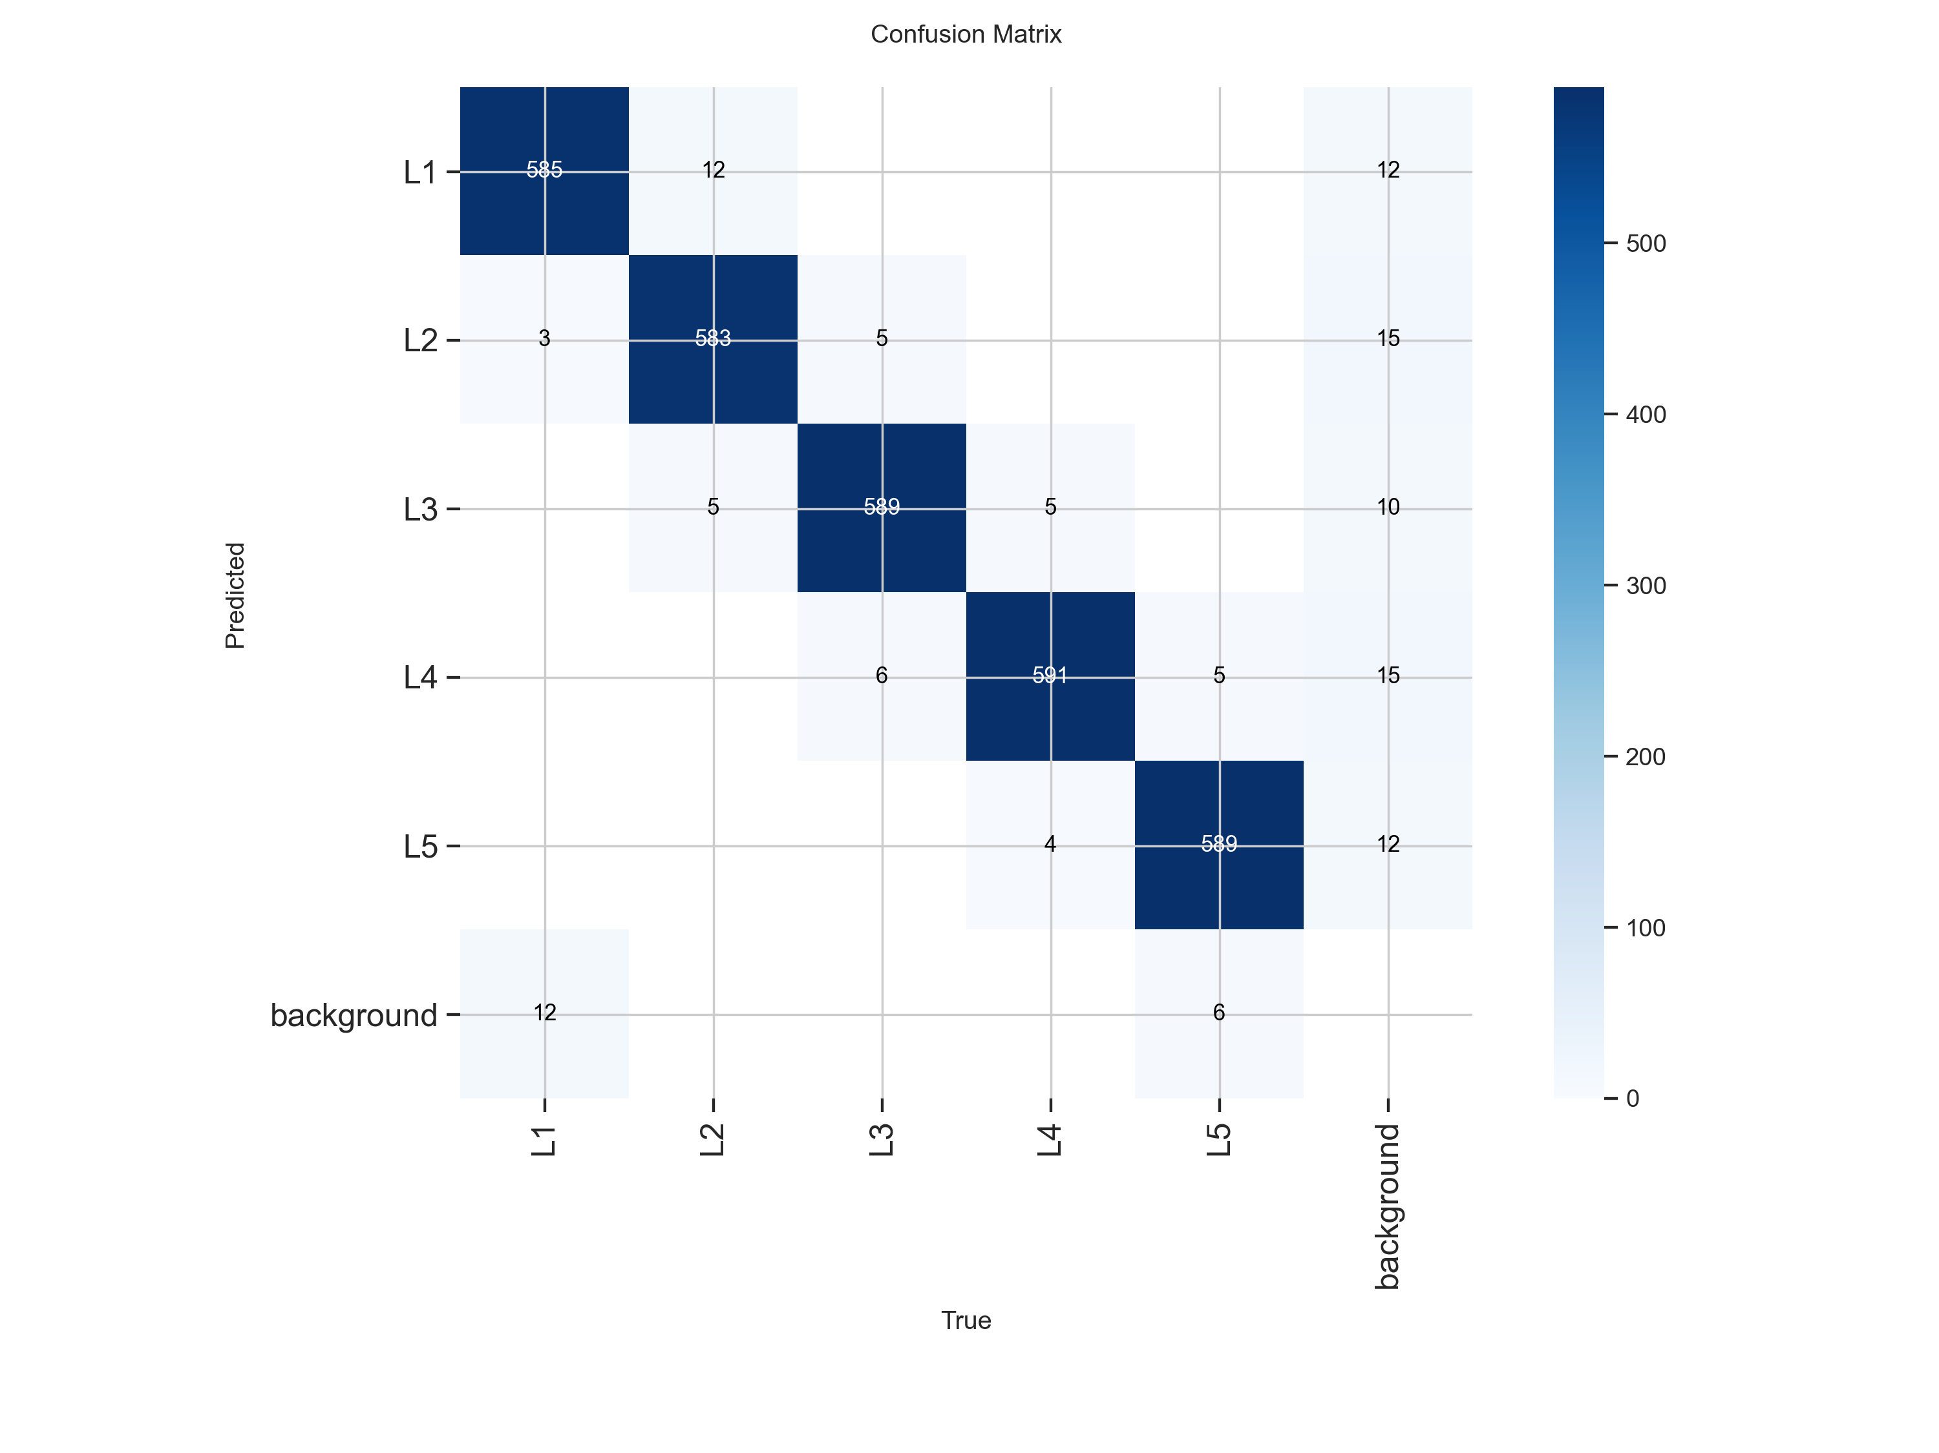
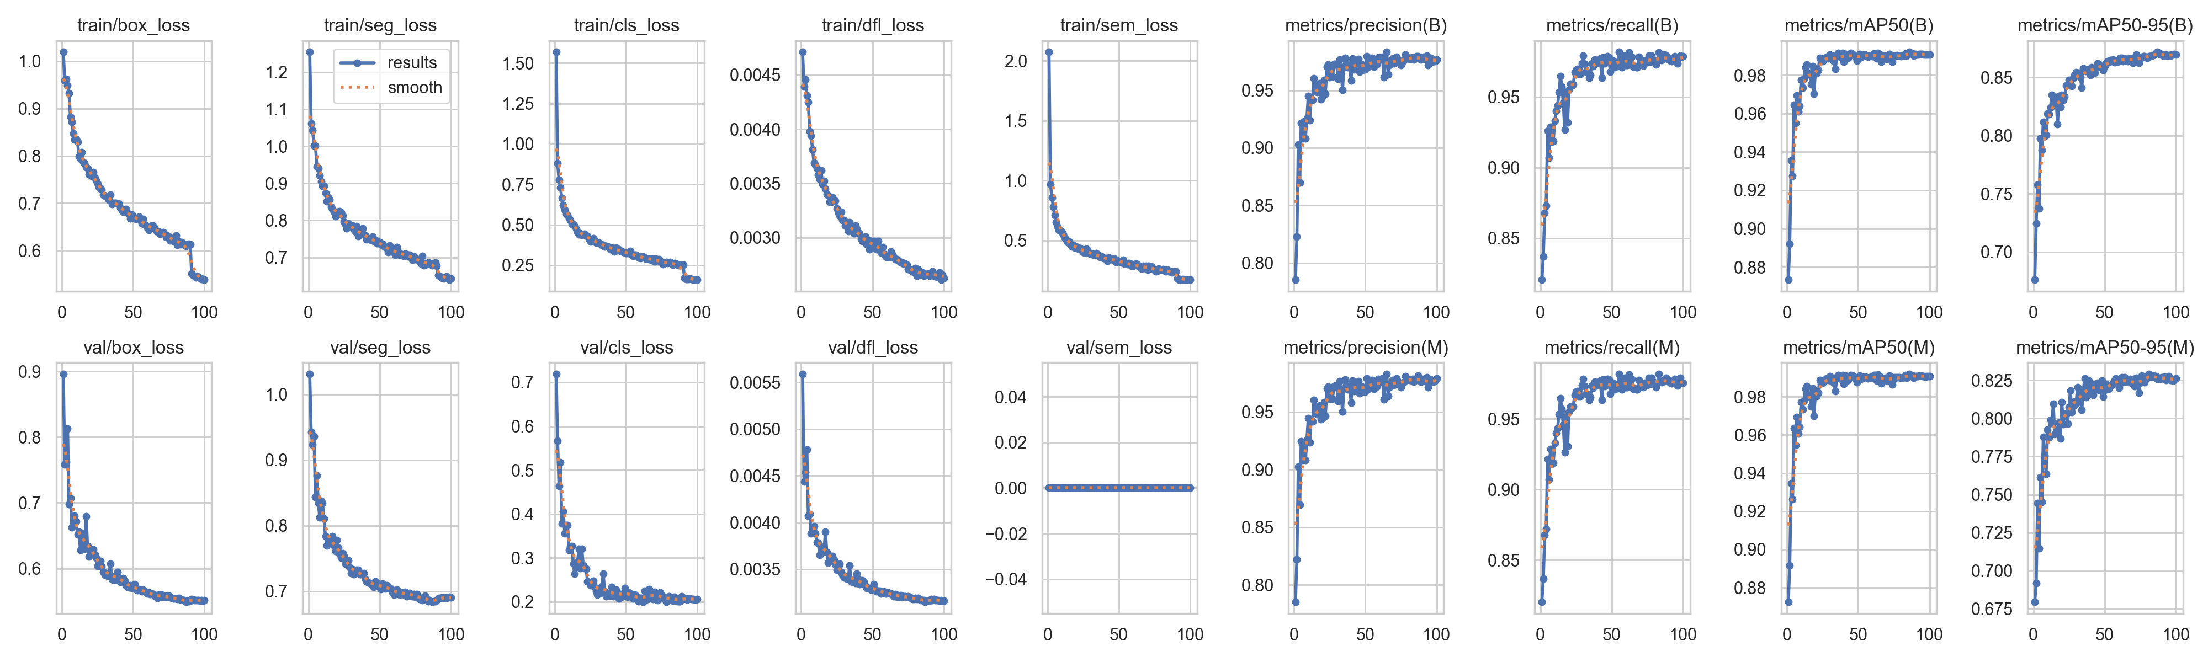
VALIDATION
The detector is accurate (in-domain)
0.97
0.95
0.96
0.76
Mask mAP@50
Precision
Recall
mAP@50-95
On held-out validation X-rays, the model finds and outlines vertebrae very reliably.
mAP@50 = 0.97 means near-complete agreement with the human labels at a standard overlap threshold.
Right: model predictions on a validation batch.
L4 Spinal Bone Measurement · Data Analytics
8/15
Notes:
'On images from the same source it trained on, accuracy is high - 0.97 mAP (mean Average Precision). The maximum value is 1
So the detector itself is strong.
The next slide is the honest part: what happens on our real clinical X-rays, which look different.'

Slide 8
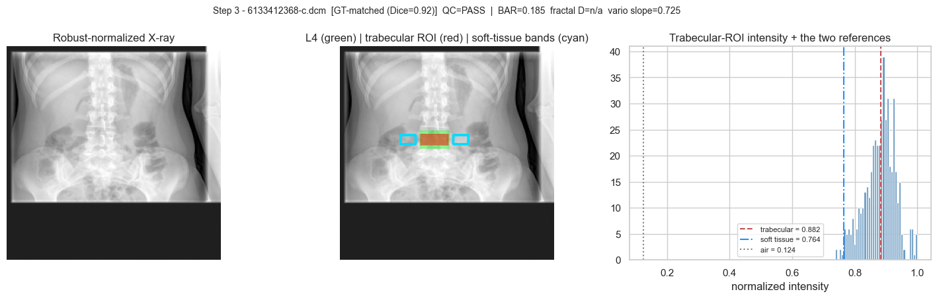
STEP 2
Measuring bone on L4
Two bone read-outs
Density proxy: average brightness inside the L4 region. Denser bone tends to look brighter.
Texture (GLCM): the trabecular bone pattern — contrast, energy, homogeneity.
We use the inner 'cancellous' core of L4 (red ROI) where bone change shows first.
Green = L4 · Red = measurement ROI
L4 Spinal Bone Measurement · Data Analytics
9/15
Notes:
'From the L4 outline I measure two things:
density (brightness) and texture (the internal bone pattern).
I focus on the inner core, where osteoporotic change appears earliest.
density here is a relative index, not calibrated BMD.'

Slide 9
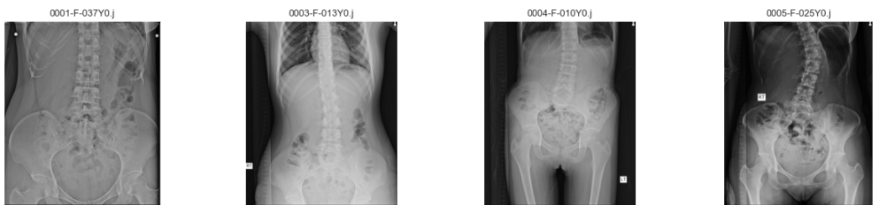
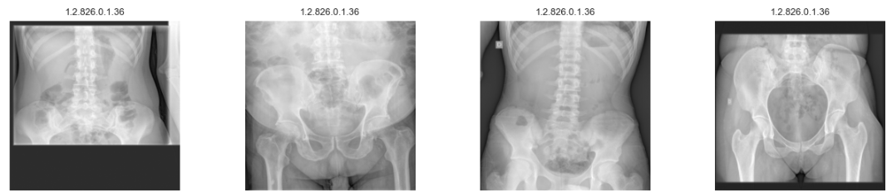
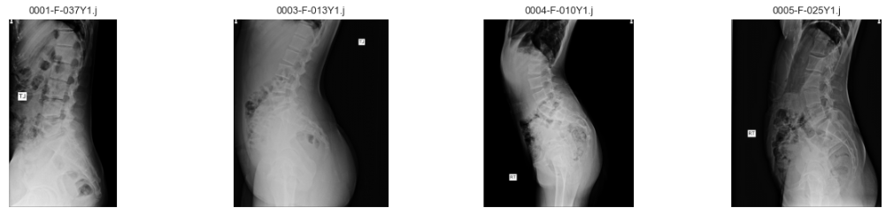
dataset
Dataset
Training/Validation Dataset (BUU dataset)
Test Dataset (DICOM dataset)
2000(train 1700/val 300) AP Dataset
42 AP Dataset
2000(train 1700/val 300) LA Dataset
0 LA Dataset
L4 Spinal Bone Measurement · Data Analytics
6/15

Slide 10
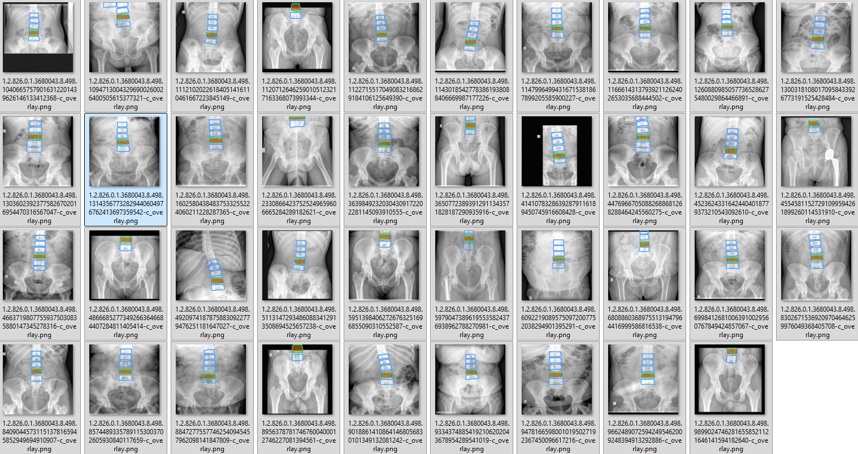

Slide 11
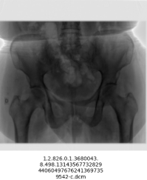
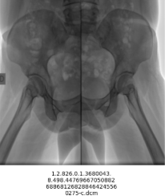
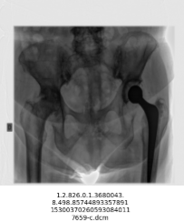

Slide 12
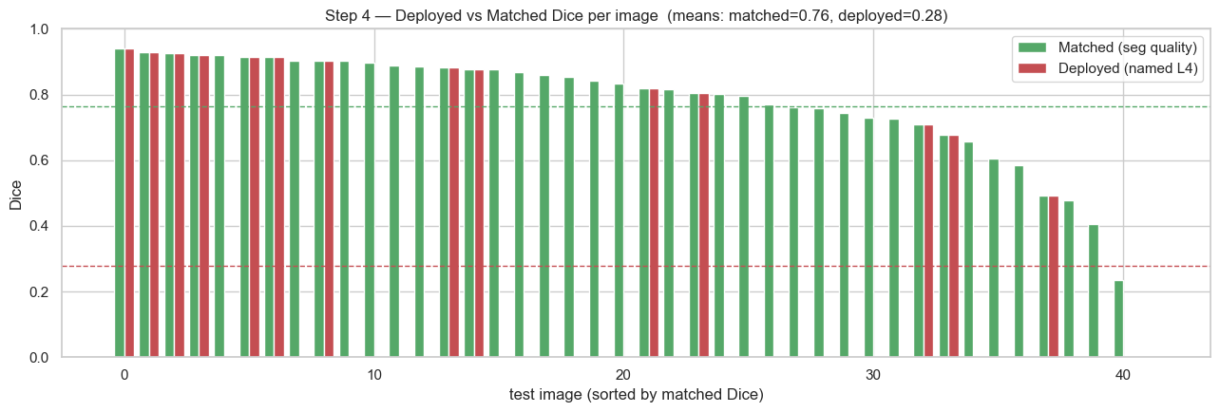
REALITY CHECK
Honest test on 42 real clinical X-rays
0.76
0.28
THE ONE ISSUE: 'OFF-BY-ONE'
The AI draws a correct vertebra shape, but on these different-looking clinical images it sometimes labels the neighbour as 'L4'.
Right shape, wrong name — on 28 of 42 images.
Shape quality (Dice)
When it labels L4, the outline is good.
As-labeled (Dice)
Sometimes it names the wrong vertebra.
Why report two numbers?
Separating 'shape quality' from 'naming' tells us exactly what to fix. The segmentation is good (0.76). The gap to 0.28 is purely a labeling problem we can target directly.
L4 Spinal Bone Measurement · Data Analytics
10/15
Notes:
MOST IMPORTANT SLIDE.
I am being transparent. Two numbers on purpose.
The outline quality is good - 0.76. But the as-labeled score is 0.28 because of an anatomical demarcation issue during ground-truth labeling.
Due to my own difficulty in precisely differentiating the L4 boundaries on real clinical X-rays, the vertebra above or below L4 may have been incorrectly designated as L4.
So Right shape, wrong name.
The value of splitting the metric: it proves the segmentation works and isolates a single, fixable labeling issue

Slide 13
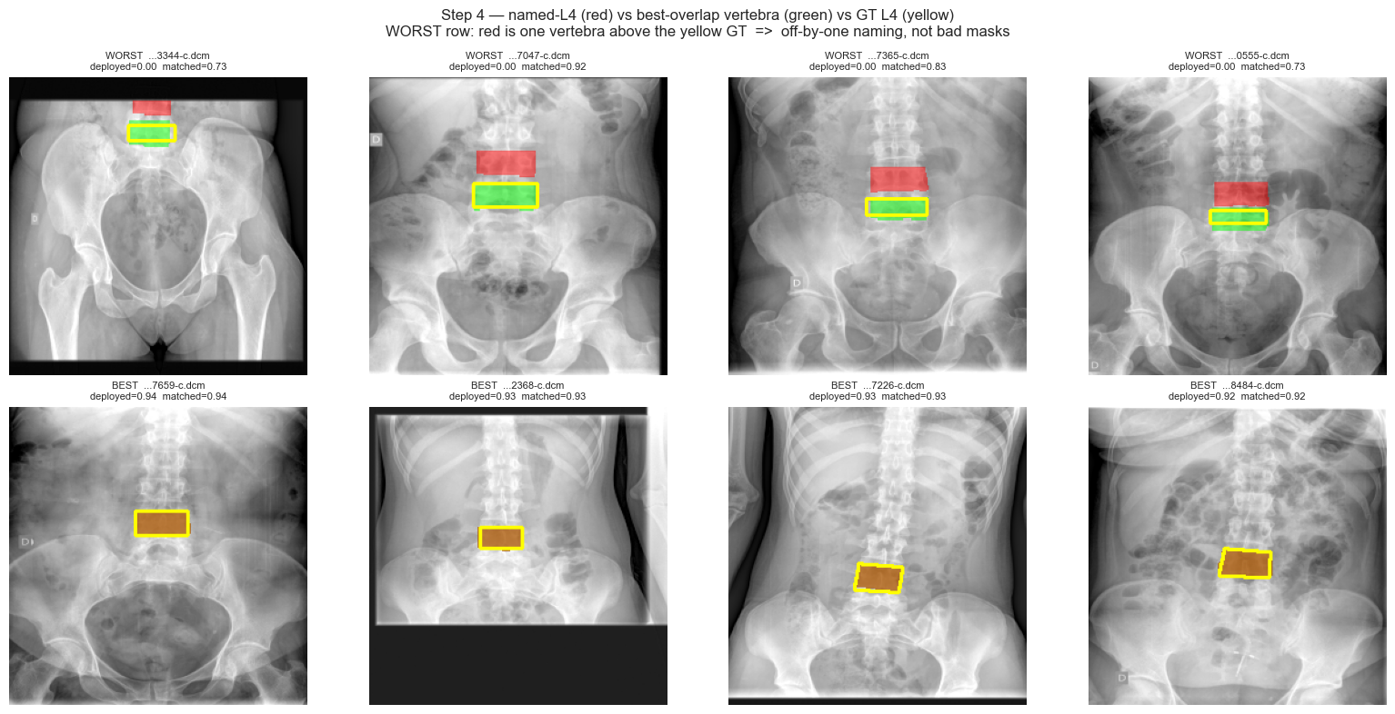
DIAGNOSIS
Seeing the 'off-by-one' clearly
How to read this
Yellow = true L4 (Edward)
Red = what the AI named L4
Green = best-matching vertebra
Top row (worst): red sits one vertebra above the yellow — the off-by-one shift.
Bottom row (best): red, green and yellow line up.
Cause: I am having difficulty naming the L4 bone. I think it's a labeling issue.
L4 Spinal Bone Measurement · Data Analytics
11/15
Notes:
'This shows the problem visually.
Yellow is the true L4 , I marked it.
Red is the AI's L4. In the worst cases the red is one level too high.
The shapes are right - it is a counting / field-of-view problem, not a segmentation failure.’
I am having difficulty naming the L4 bone.
It is often difficult to distinguish bones in X-ray images.

Slide 14
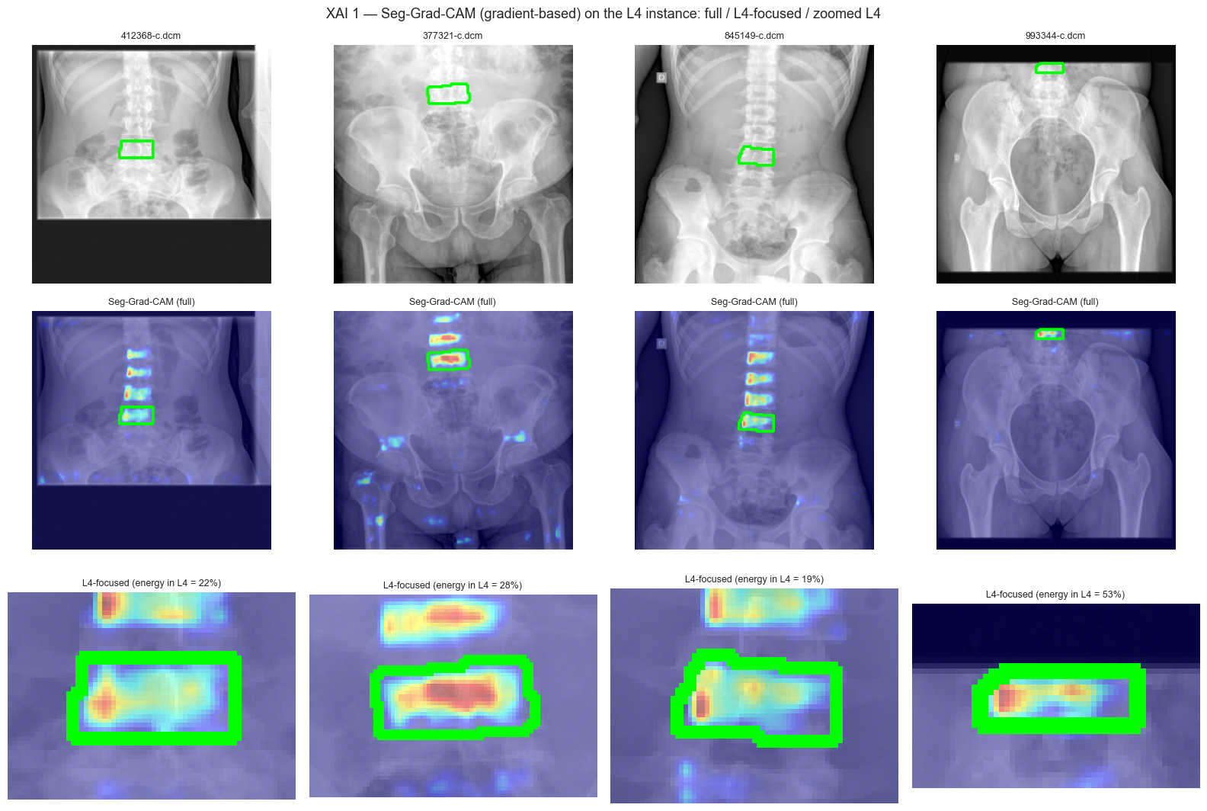
EXPLAINABILITY
Can we trust where the AI looks?
Grad-CAM (gradient-based)
A heatmap of the pixels the model used to decide 'this is L4'.
Red / warm = most important.
The attention lands on the L4 body and its internal bone structure — not on background, implants, or soft tissue.
Why it matters: a clinician can verify the AI is reading the right anatomy before trusting the number.
L4 Spinal Bone Measurement · Data Analytics
12/15
Notes:
'Trust matters in medicine.
This heatmap shows the pixels the AI used.
It focuses on the L4 bone itself and its trabecular pattern - the same thing a radiologist would look at.
So when it does pick the right level, it is looking at the right structure for the right reason.'

Slide 15
WHERE WE STAND
What works, and what's next
WORKING TODAY
Accurate vertebra detector (mAP@50 = 0.97 in-domain).
Good L4 outline quality on clinical images (Dice = 0.76).
Fully automatic density + texture read-out.
Explainable: heatmaps confirm correct anatomy.
Honest, two-number evaluation.
NEXT STEPS
1) Fix L4 labeling: fine-tune on a small set of labeled clinical X-rays (removes off-by-one).
2) Calibrate density to real units using a phantom or paired DXA.
3) Validate against DXA on the same patients.
4) Package as a one-click report for routine use.
L4 Spinal Bone Measurement · Data Analytics
13/15
Notes:
'The engine works and is explainable.
One fixable gap remains - the L4 labeling on clinical images.
The fix is straightforward: fine-tune on a small number of labeled clinical X-rays.
I would need a small set of labeled clinical cases from your team to do step one.'
However, I plan to receive the dataset and label it first. I will ask for your help later.
And I would like to compare this with the DXA test results. It would be helpful to know how actual bone density can be measured.
For now, 2 and 3 numbers are outside the scope of the research, so they have been marked this way.

Slide 16
Takeaways
We can measure L4 bone density and texture automatically from X-rays you already take.
The detector is accurate and explainable; the L4 outline quality on clinical images is good (0.76). ( 0.97 on the training dataset )
One clear, fixable gap remains: correctly labeling L4 on out-of-domain clinical images.
With a small labeled clinical set + calibration, this can become a routine bone-quality readout.
Thank you — questions & discussion welcome.
Edward · Data Analyst
14/15
Notes:
'In short:
I can get an automatic, explainable bone-quality signal from routine X-rays.
The method is sound;
one labeling gap is left and it is fixable with a small amount of labeled clinical data.
My ask: help me get a few labeled clinical cases so I can close that gap.

Slide 17
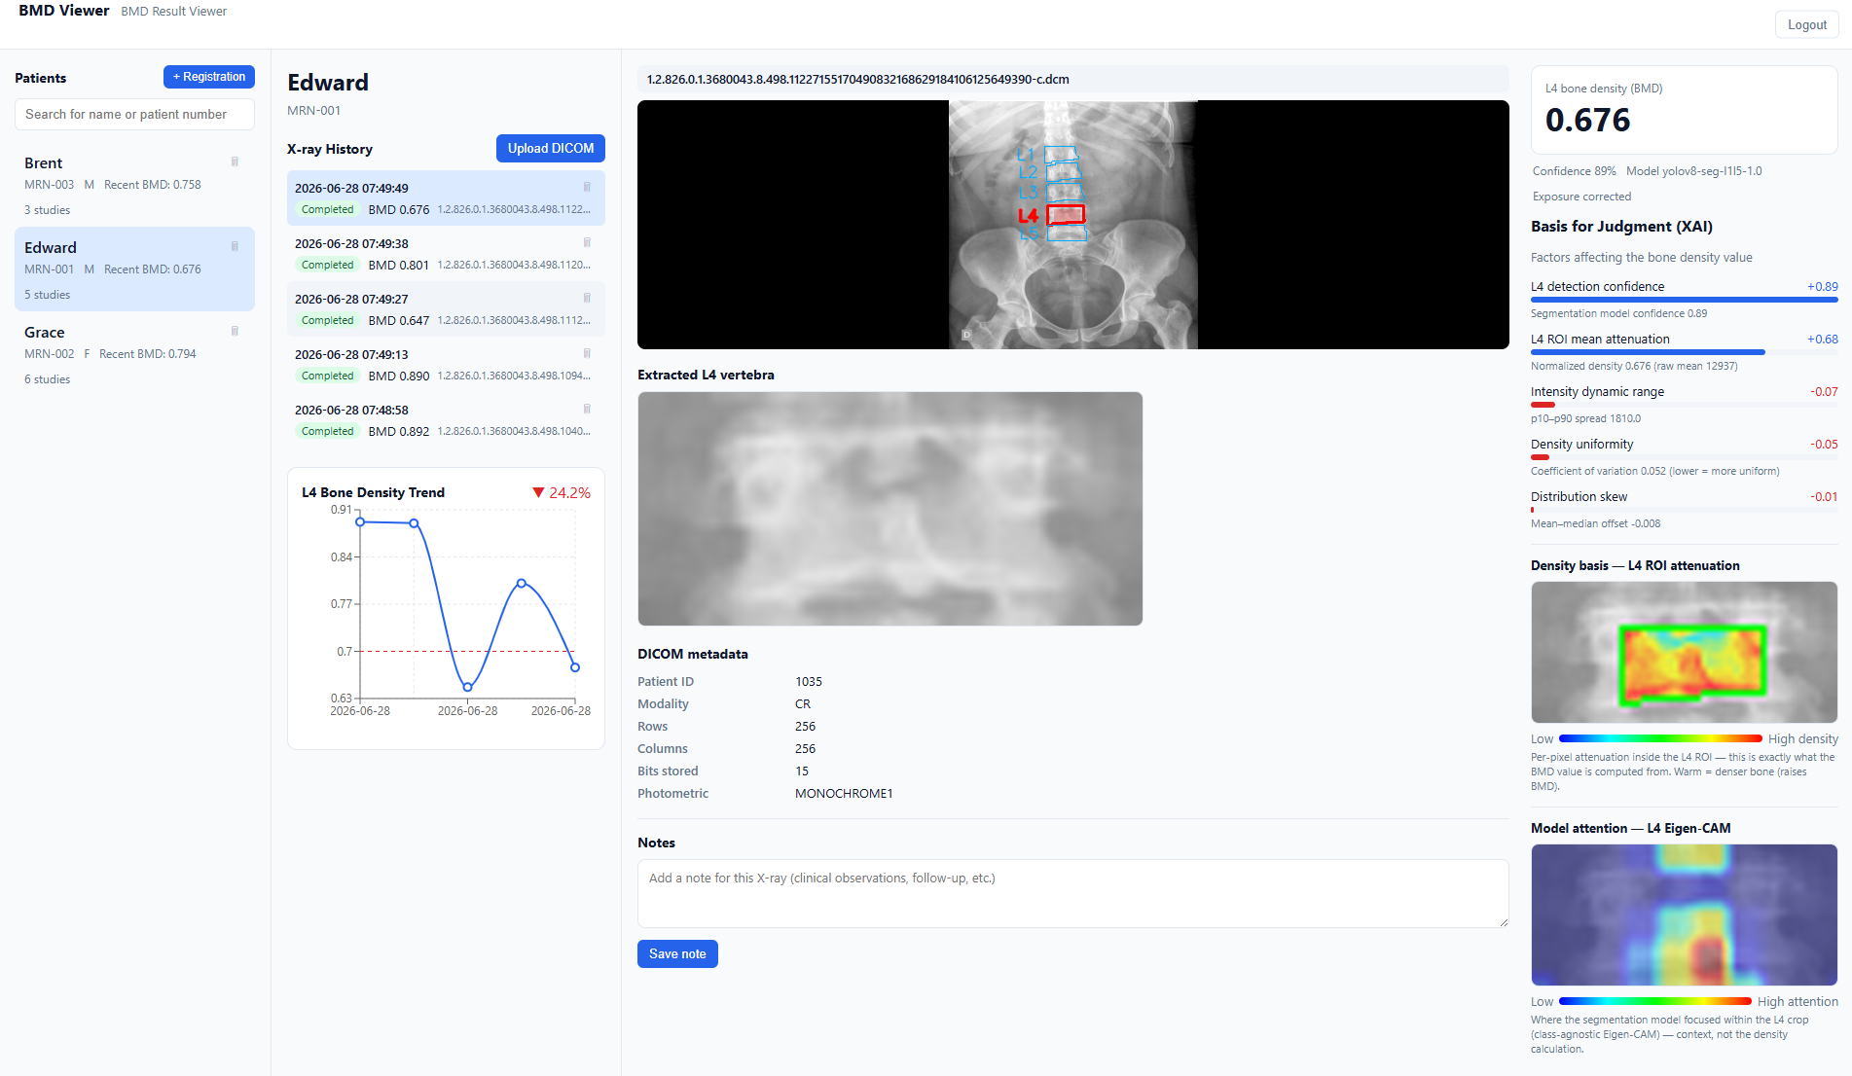
Sample Application Description version
Patients Area
Patient X-ray upload history
Original X-ray image and extracted vertebrae and L4 marking
Bone tissue value based on brightness (0 - 1)
Explainable
AI values
Extracted L4 vertebra
Graph of bone density changes according to X-ray upload date
Areas
affecting
BMD
X-ray Metadata
Areas
affecting
L4
Extraction
L4 Spinal Bone Measurement · Data Analytics
10
15/15

