Slide 1
AUTOMATED IMAGING · BONE HEALTH
Measuring Spinal Bone Density
from Routine Hip / Spine X-rays
An automatic, explainable pipeline that finds the L4 vertebra and measures its bone density and texture.
Presented by: Edward Choi · Data Analyst
Audience: Dr. Brent Lanting / Orthopaedic / Hip Surgery
July 09, 2026
1/15
Notes:
'I built an automatic tool that measures bone quality of the L4 spine vertebra directly from the X-rays you already take.
No extra scan, no extra radiation dose.
I'll show what it does, how accurate it is, and what we still need to fix before clinical use.'

Slide 2
THE GOAL
Why measure L4 bone from an X-ray?
Bone quality of the lumbar spine matters for surgical planning and follow-up.
AP hip / spine X-rays are already taken in routine care.
Goal: a fast, repeatable bone-quality number for the L4 vertebra — fully automatic.
L4 is the standard lumbar reference level for bone assessment (as in DXA).
IMPORTANT CAVEAT
This is a relative, X-ray-based proxy of bone density — not a calibrated DXA result (g/cm²).
It is for method demonstration. True BMD needs DXA / QCT or an in-image calibration phantom.
WHAT WE MEASURE ON L4
1) Bone density proxy (image brightness)
2) Bone texture (trabecular pattern, GLCM)
L4 Spinal Bone Measurement · Data Analytics
2/15
Notes:
‘This is not replacing DXA.
It extracts consistent and automated bone structures from images you already have.
It extracts two things: density (how bright and dense the bones appear) and texture (the patterns within the bones).
However, this is only an approximation and is not corrected to actual bone density units.

Slide 3
OVERVIEW
The pipeline in four steps
1
2
3
4
Input X-ray
Find L4
Measure
Report + Explain
Routine spine / hip radiograph
AI outlines vertebrae L1-L5 and selects L4
Density proxy + bone texture on L4
Numbers + heatmaps showing the 'why'
Built on an AI detector (YOLOv26) trained on 4,000 public spine X-rays; the measurement and explanation code is independent of the detector.
L4 Spinal Bone Measurement · Data Analytics
3/15
Notes:
The pipeline consists of four stages.
It takes an X-ray image, has the AI ​​locate the L4 vertebra and outline it,
measures the L4 Bone structure in that area, and reports the values ​​along with a heatmap showing where the AI ​​found it.
I upgraded the model from Yolo 8 to Yolo 26 last week.

Slide 4
THE GOAL
AI in osteoporosis diagnosis 1
Imaging modalities
Clinical tasks
DXA
X-ray
CT
MRI
Osteoporosis
classification
Fracture
detection
Risk
detection
Normal
BMD
estimation
Bone
detection
Bone
density
Osteopenia
T-score
classification
Opportunistic
screnning
Bone structure
analysis
Osteoporosis
L4 Spinal Bone Measurement · Data Analytics
4/15
Notes:
I will show you the overall scope and specific methodology of this research.
If you look at Imaging modalities, there are various options ranging from standard diagnostic equipment like DXA to CT and MRI. Among these, what we focused on is X-ray.
The purpose of this project is to establish an 'Opportunistic screening' pipeline for osteoporosis risk.

Slide 5
THE GOAL
AI in osteoporosis diagnosis 2
AI methodologies
Classical
Machine Learning
CNN-based
Explainable AI
Transformer-based
Self-supervised
learning
GLCM
YOLO26-seg
Seg-Grad-Cam
(Feature Extraction)
(L4 vertebral split)
ONNX
Web export
Attention
heatmaps
L4 Spinal Bone Measurement · Data Analytics
5/15
Notes:
Our AI architecture is a pipeline that fuses Statistical Texture Analysis (GLCM), Deep Learning-based Segmentation (YOLO), and Explainable AI (Seg-Grad-CAM).

Slide 6
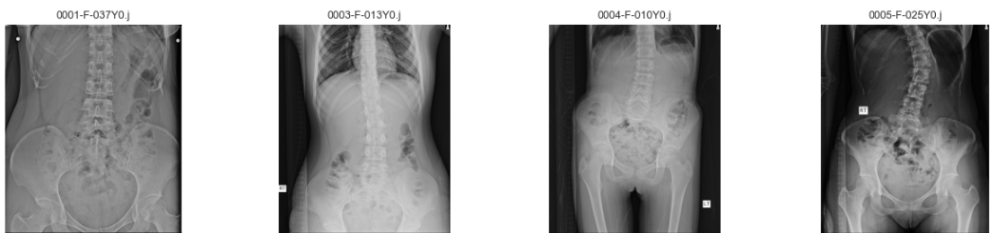
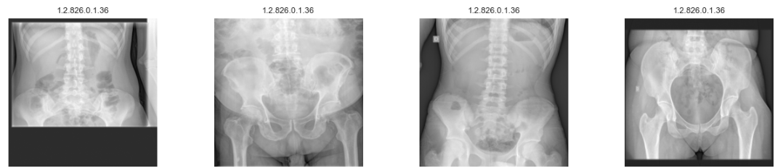
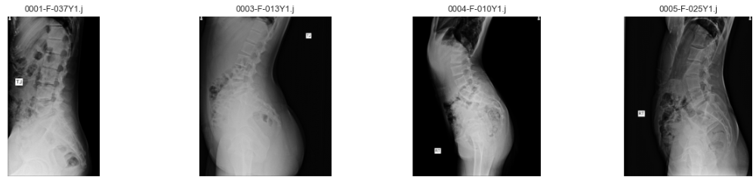
dataset
Dataset
Training/Validation Dataset (BUU dataset)
Test Dataset (DICOM dataset)
2000(train 1700/val 300) AP Dataset
42 AP Dataset
2000(train 1700/val 300) LA Dataset
0 LA Dataset
L4 Spinal Bone Measurement · Data Analytics
6/15
Notes:
For the training and validation datasets, 4,000 samples were used from the AP (Anteroposterior) and LA (Lateral) BUU datasets, and 42 DICOM files were used for the test dataset.

Slide 7
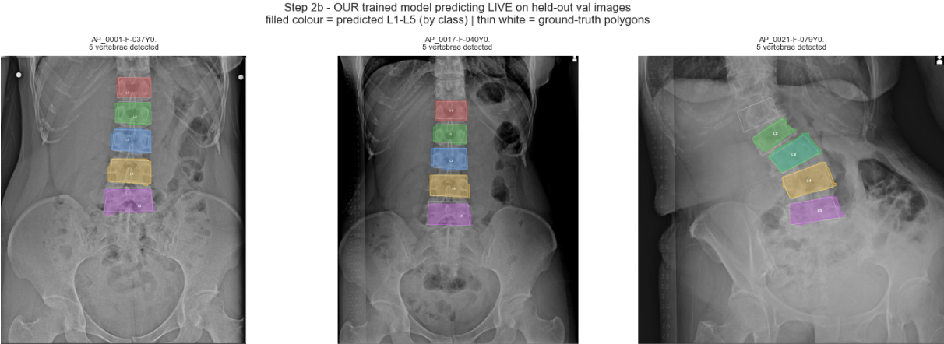
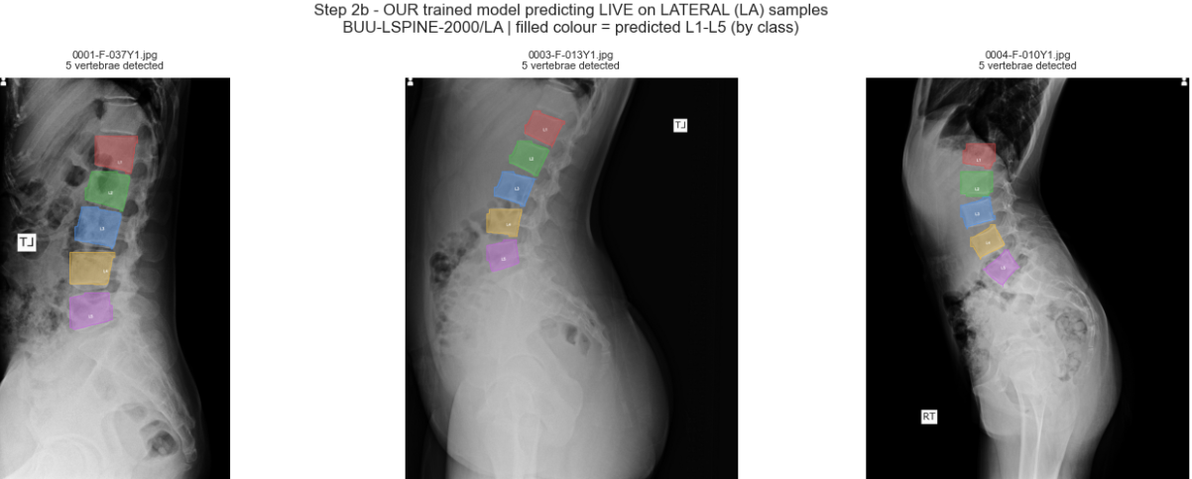
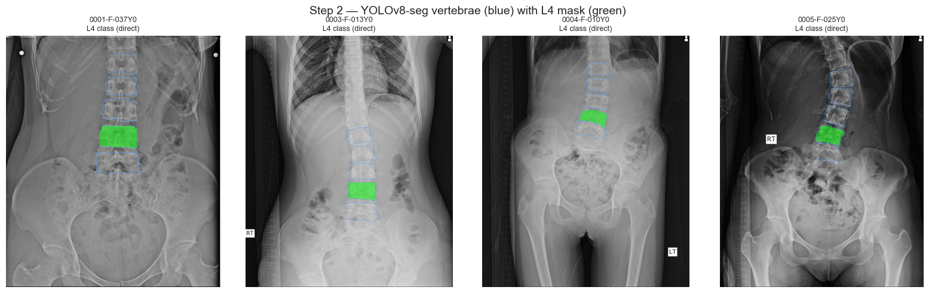
STEP 1
Finding the L4 vertebra
AI segmentation (YOLOv8-seg)
It outlines each vertebra L1-L5 as a separate object.
L4 is selected by its label, with a 4th-from-top backup rule.
Output: a clean L4 outline at full image resolution.
Blue = all vertebrae · Green = selected L4
L4 Spinal Bone Measurement · Data Analytics
7/15
Notes:
This is AI segmentation (YOLOv8-seg).
Draws the outlines of each vertebra (L1–L5).
L4 is selected based on the label, and primarily the fourth vertebra from the top is selected as the object.
This is a frontal and side training photo, and on the right is the L4 extracted from an actual X-ray DICOM file.

Slide 8
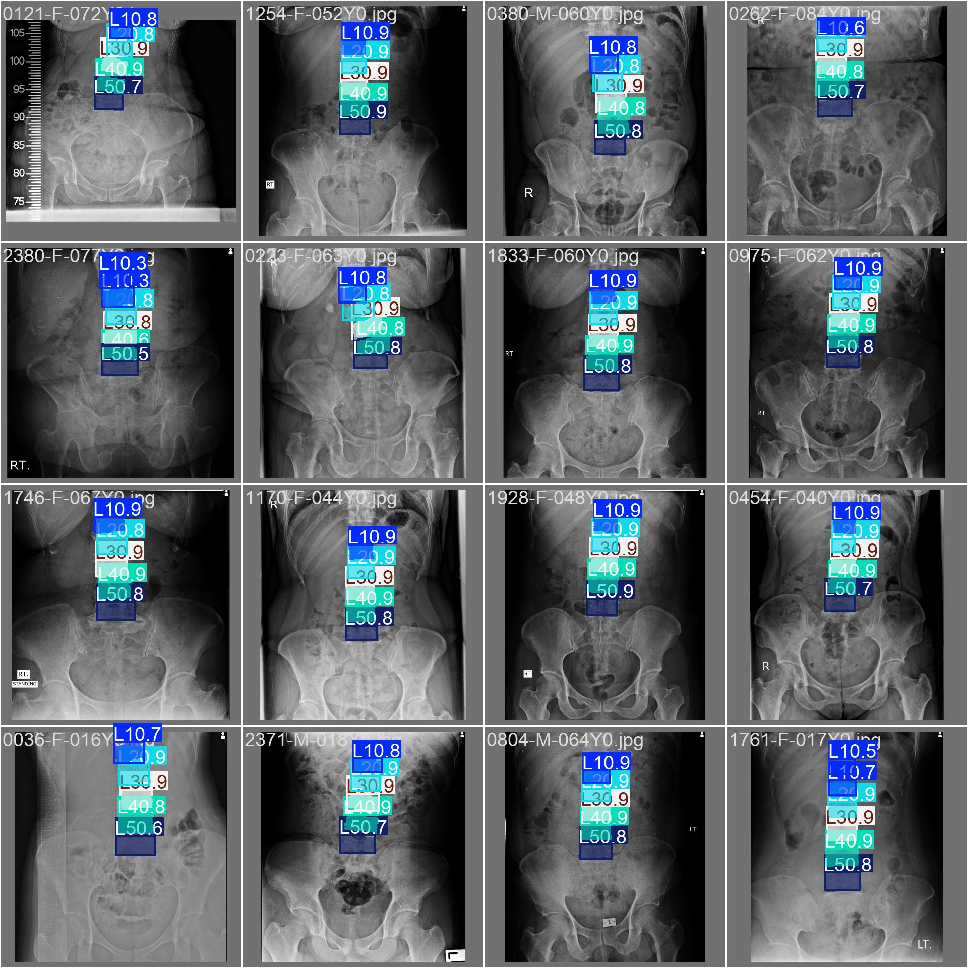
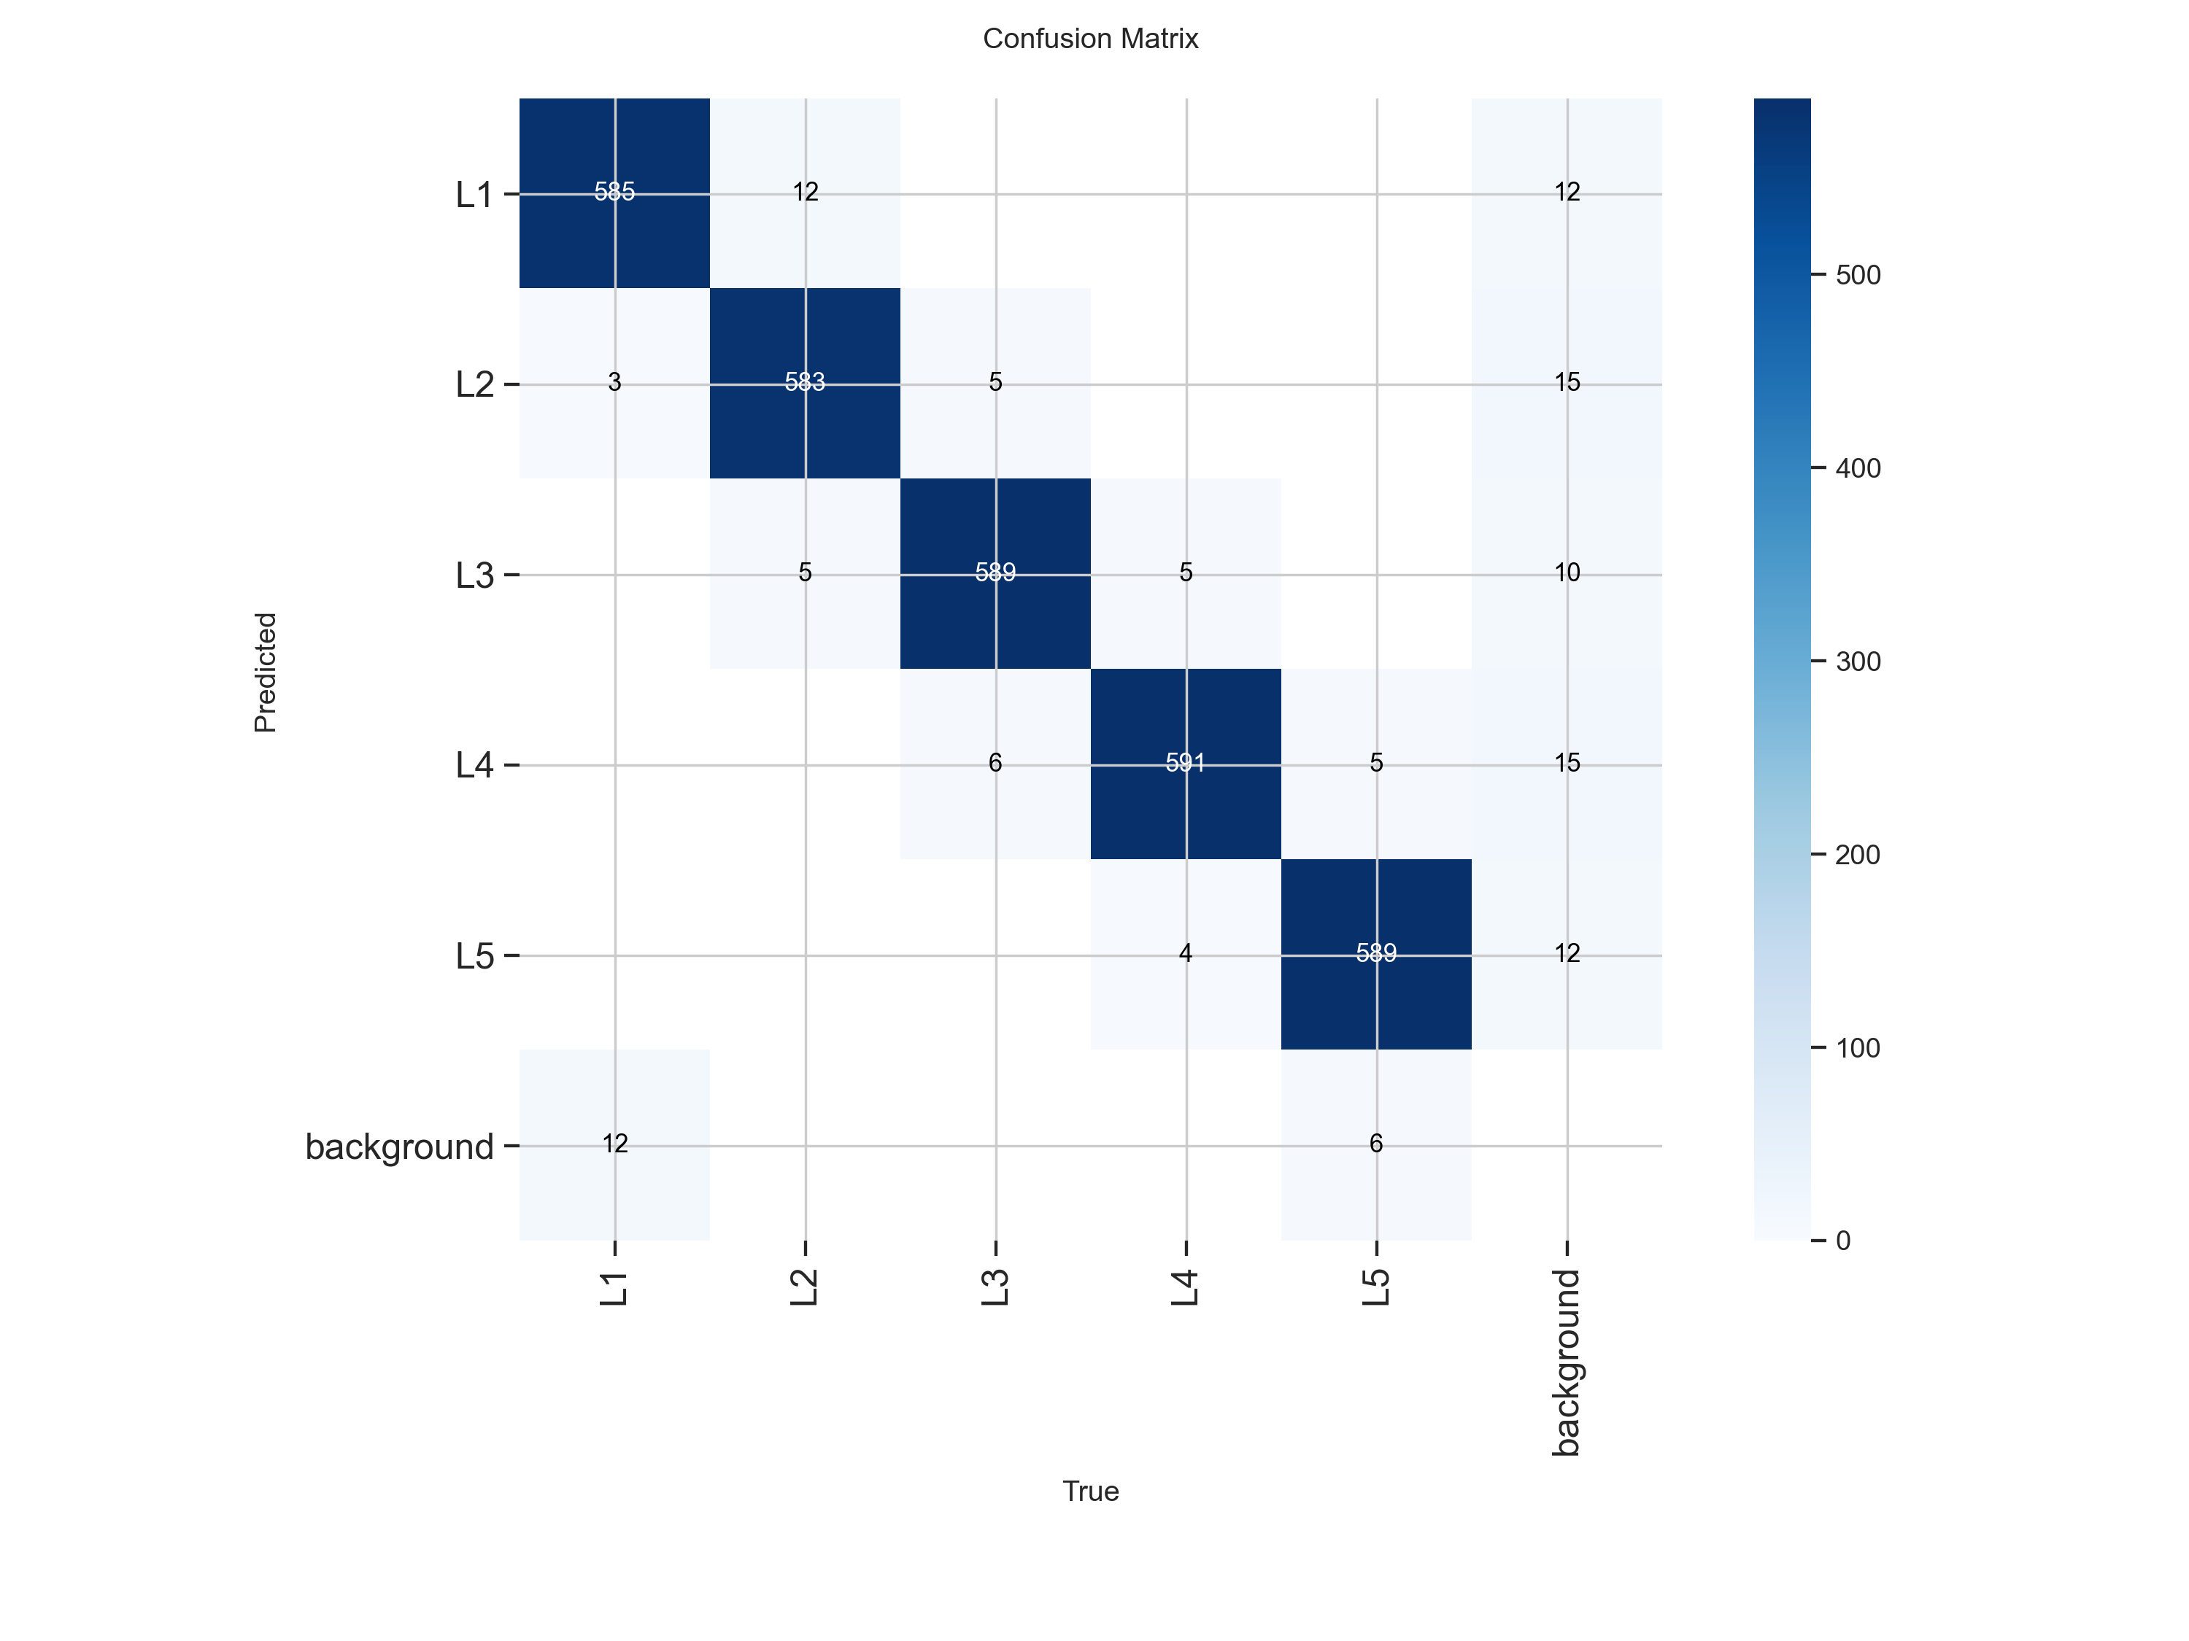
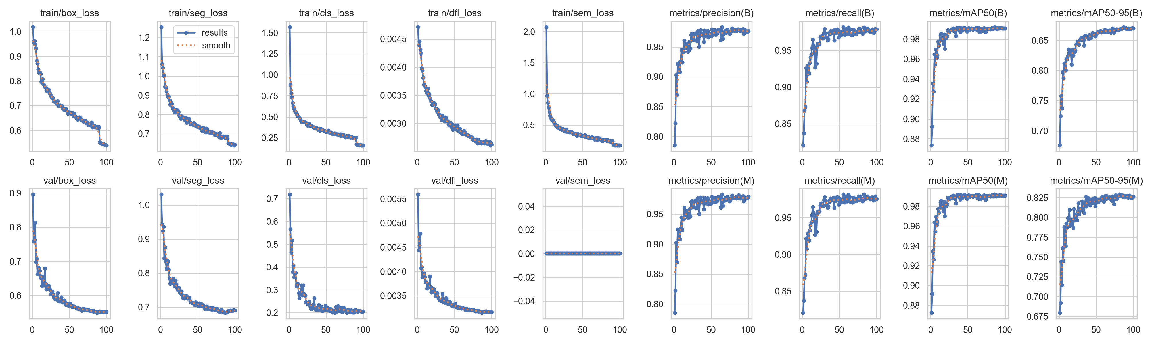
VALIDATION
The detector is accurate (in-domain)
0.97
0.95
0.96
0.76
Mask mAP@50
Precision
Recall
mAP@50-95
On held-out validation X-rays, the model finds and outlines vertebrae very reliably.
mAP@50 = 0.97 means near-complete agreement with the human labels at a standard overlap threshold.
Right: model predictions on a validation batch.
L4 Spinal Bone Measurement · Data Analytics
8/15
Notes:
The accuracy of the training data is high at 0.97 mAP (mean Average precision). The maximum value is 1.
Therefore, the detector itself is strong.
This is called the confusion matrix, which shows how well it locates the bones of L1 through L5.
All core losses sloped downward and converged stably across both the train and validation sets, and a robust model was built without overfitting.
Analysis of performance metrics revealed excellent convergence in both Box (location detection) and Mask (contour segmentation) metrics.
Combining the stable decrease in the loss graph with the upward trend of the metrics, this model has achieved high reliability in accurately detecting spinal locations and precisely segmenting the contours of bone structures.

Slide 9
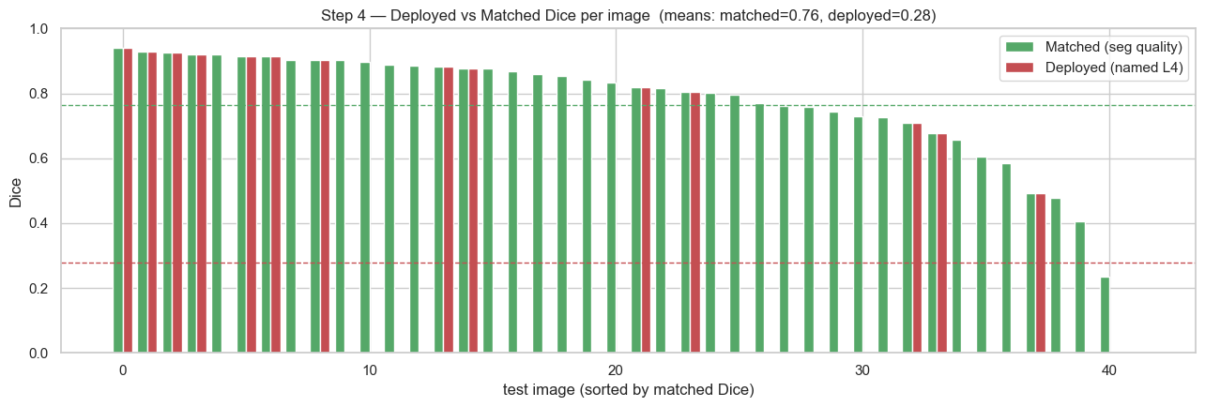
REALITY CHECK
Honest test on 42 real clinical X-rays
0.93 (39/42)
0.38(15/39)
THE ONE ISSUE: ‘Label mismatch'
The AI draws the correct vertebra and usually picks the right one. On 27 of 42 images its 'L4' didn't match my mask — but on 23 of those, my mask was drawn on L5, not the model's error.
Right bone, mismatched label
– fixable by re-labeling
Found an L4
The model produced an L4 mask on 39 of 42 X-rays
Same vertebra as my label
Of those 39, only 15 matched the bone I marked
Why report two numbers?
Separating 'does it find the bone' from 'is it the right one' tells us exactly what to fix.
The model finds an L4 on 93% of images and its outlines are good.
Most of the gap to 38% is my labeling — 23 of the 27 mismatches are my mask on L5 — so it's fixable by re-labeling, not retraining.
L4 Spinal Bone Measurement · Data Analytics
10/15
Notes:
This is an important point.
I found 39 out of 42 L4s.
However, only 15 matched my labels.
Since I am not a doctor and lack experience, it was difficult for me to draw the correct L4s by looking at the X-ray images when writing the labels.
I will show you the actual data.

Slide 10
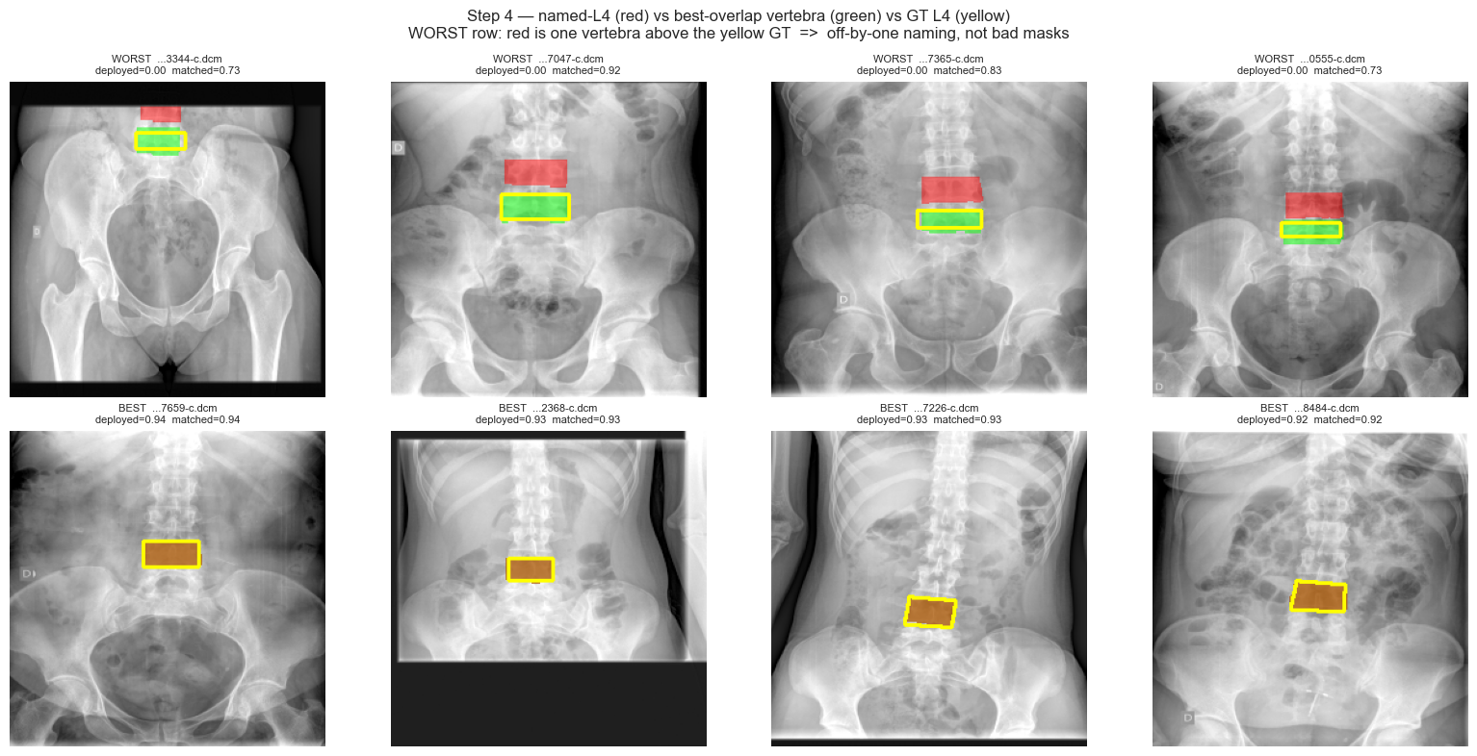
DIAGNOSIS
Seeing the ‘Mismatch'
How to read this
Yellow = true L4 (Edward)
Red = what the AI named L4
Green = best-matching vertebra
Top row (bad): red sits one vertebra above the yellow — the off-by-one shift.
Bottom row (best): red, green and yellow line up.
Cause: I am having difficulty naming the L4 bone. I think it's a labeling issue.
L4 Spinal Bone Measurement · Data Analytics
11/15
Notes:
'This shows the problem visually.
Yellow is the true L4 , I marked it.
Red is the AI's L4. In the bad cases the red is one level too high.
The shapes are right - it is a counting / field-of-view problem, not a segmentation failure.’
I am having difficulty naming the L4 bone.
It is difficult to distinguish bones in X-ray images.
From what I could see, the sacrum and L5 were indistinguishable.

Slide 11
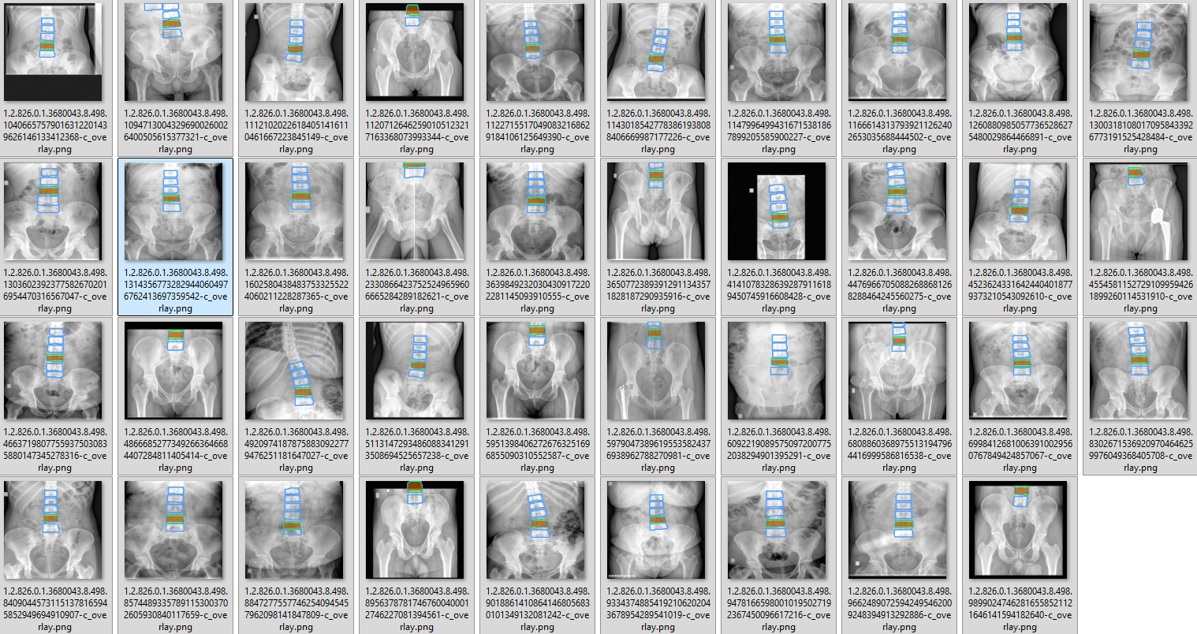
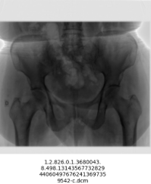
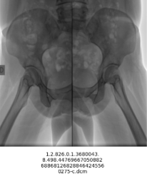
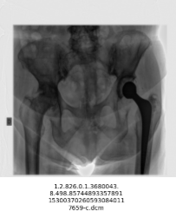
0.93 (39/42)
Found an L4
The model produced an L4 mask on 39 of 42 X-rays
Notes:
These are the 39 images from which the lumbar spine was extracted.
and
These are the 3 images from which the lumbar spine was not extracted.

Slide 12
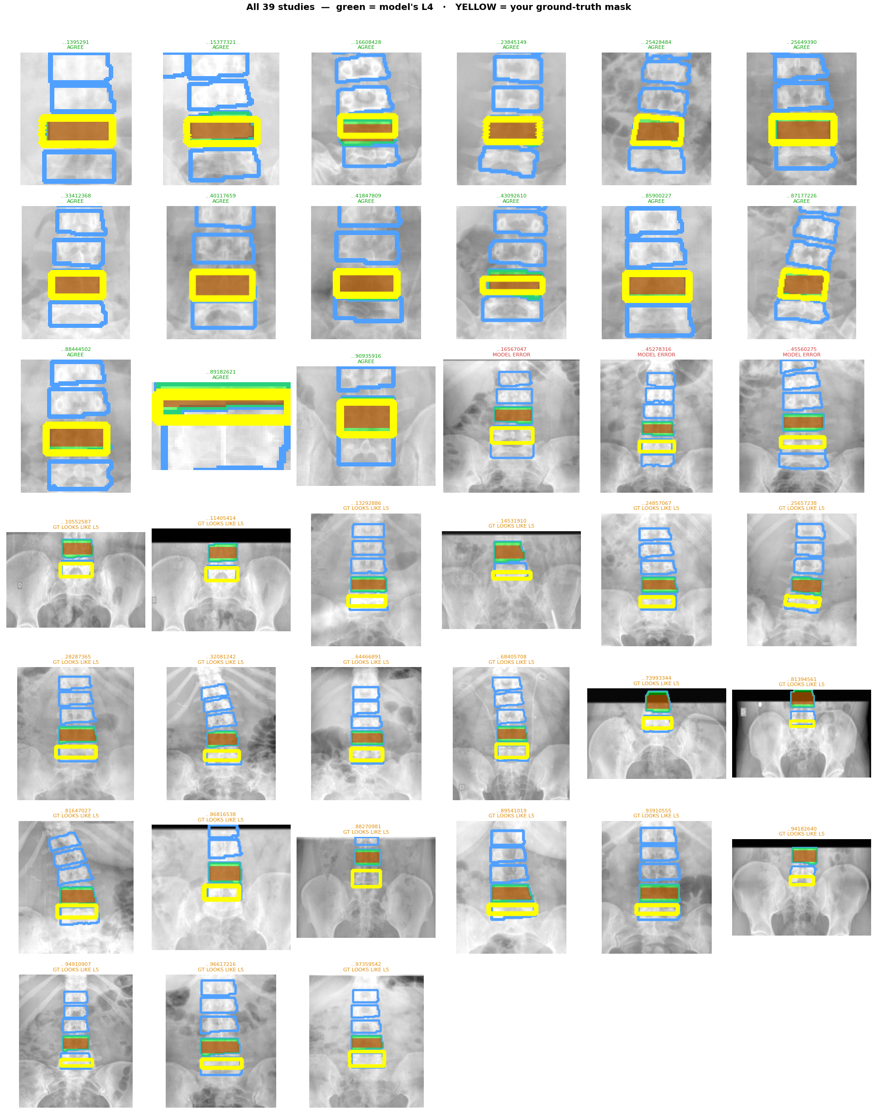
0.38(15/39)
Same vertebra as my label
Of those 39, only 15 matched the bone I marked
AI labeling
My masking
Notes:
Out of 39, these are the yellow parts I masked and the green L4 area found by AI.
Looking at the red area, it seems like the AI ​​found it is correct compared to what I masked.

Slide 13
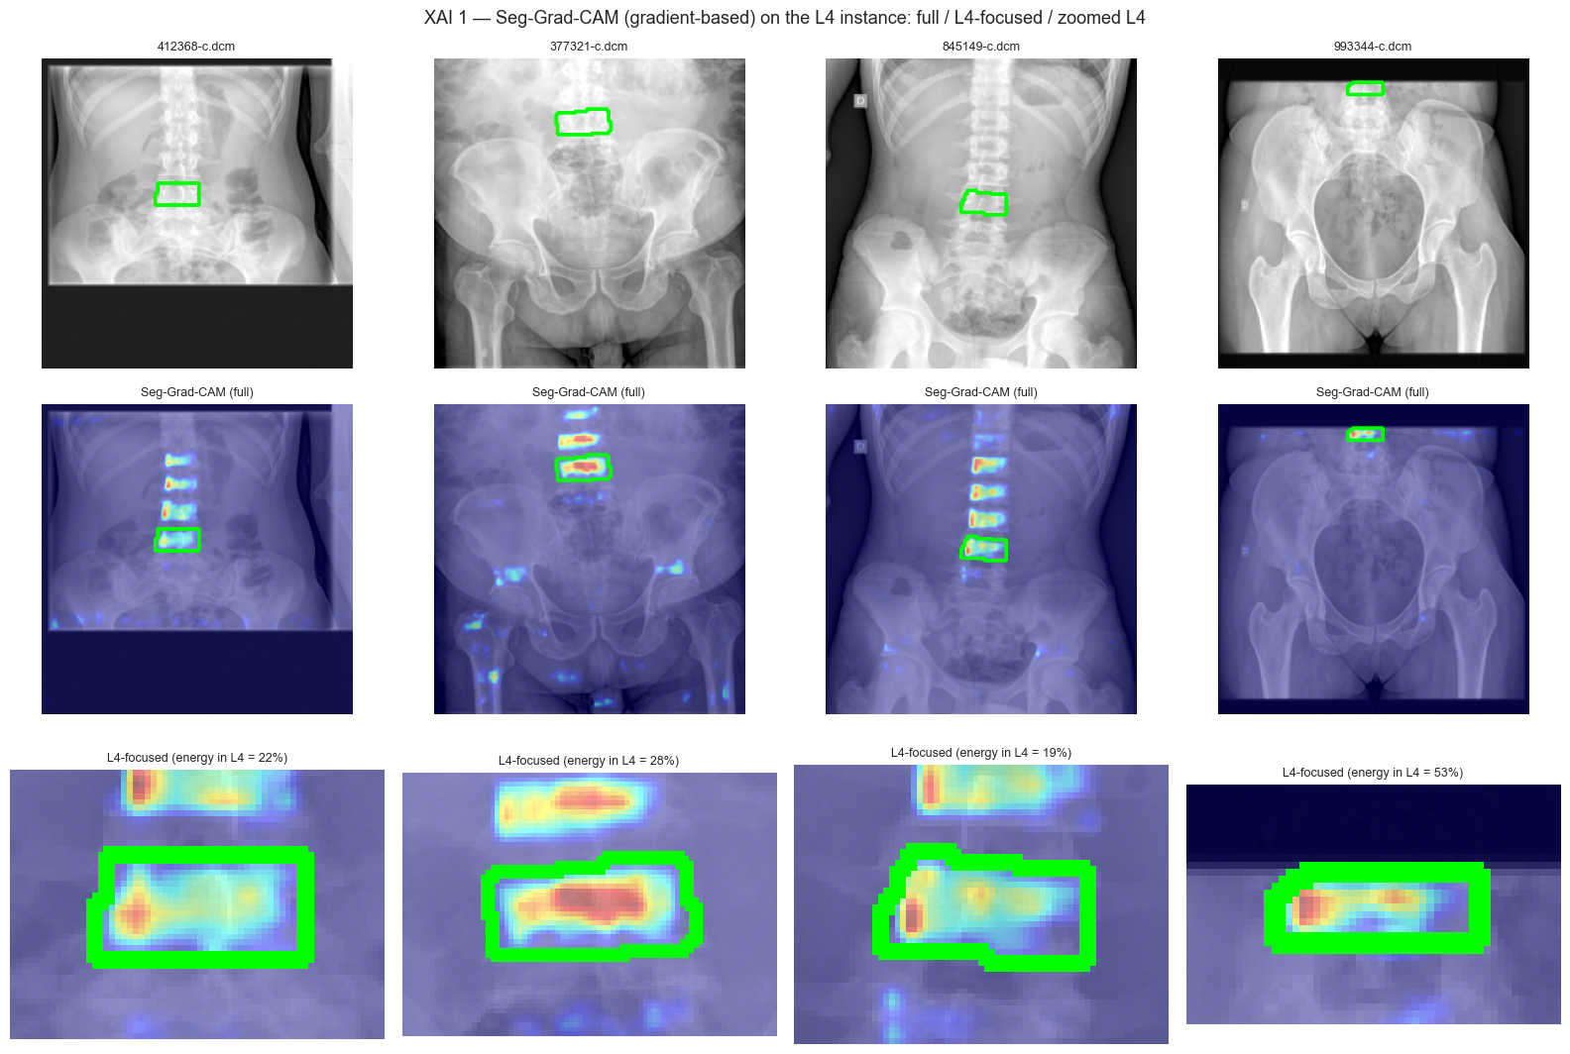
EXPLAINABILITY
Can we trust where the AI looks?
Grad-CAM (gradient-based)
A heatmap of the pixels the model used to decide 'this is L4'.
Red / warm = most important.
The attention lands on the L4 body and its internal bone structure — not on background, implants, or soft tissue.
Why it matters: a clinician can verify the AI is reading the right anatomy before trusting the number.
L4 Spinal Bone Measurement · Data Analytics
12/15
Notes:
'Trust matters in medicine.
This heatmap shows the pixels the AI used.
It focuses on the L4 bone itself and its trabecular pattern which is the same thing a radiologist would look at.
Therefore, you can visually see the reasons why the labels were selected from an AI perspective.

Slide 14
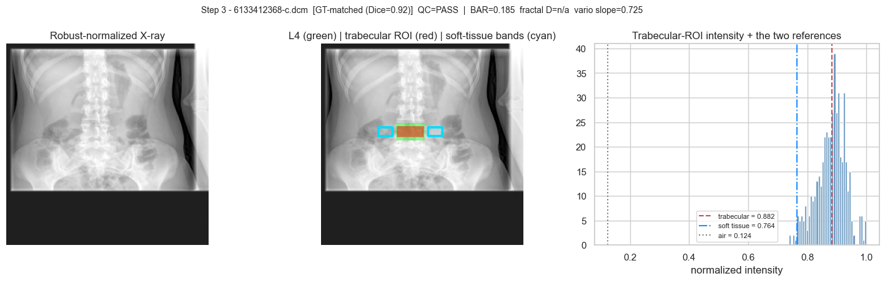
STEP 2
Measuring bone on L4
Bone density measurement procedure
1. Extract Trabecular Bone ROI - Remove cortical bone and endplates (top and bottom surfaces) to leave only cancellous bone
2. Attenuation Domain Transformation - Since pixel values ​​are not density, the calculation is based on light attenuation and soft tissue.
4. BAR( Bone Attenuation Ratio ) calculation - BAR = (A_trabecular − A_soft_tissue) / (A_soft_tissue − A_air)
5. Micro structure - GLCM 5, Variation slope , fractal dimension
6. QC (Quality Control) Gate = Checkpoint
7. I’ll measure the average value of L1~L4 is bone density.
Green = L4 · Red = measurement ROI
L4 Spinal Bone Measurement · Data Analytics
9/15
Notes:
"Next, Our Bone Density and Structure Measurement Procedure.
This pipeline is currently under active research and is subject to continuous changes and updates
First, Region of Interest (ROI) Isolation: To focus purely on the microarchitecture that reflects bone loss, I remove the cortical bone and the top and bottom endplates.
This isolation process allows us to extract and analyze the cancellous bone exclusively.
Second, Feature Extraction: From this isolated cancellous region, I compute the Bone Attenuation Ratio to capture overall density. Concurrently, to deeply analyze the bone’s structural patterns, i extract three categories of texture features: the GLCM5 metrics for local homogeneity and complexity, the Variation Slope, and the Fractal Dimension for structural self-similarity.
Future Scope: Currently, this pipeline is optimized to calculate the density and texture of the L4 vertebra specifically.
As a next step to enhance diagnostic robustment, I plan to expand this scope to calculate and utilize the average bone mineral density across the L1 to L4 vertebrae.

Slide 15
WHERE WE STAND
What works, and what's next
WORKING TODAY
Accurate vertebra detector (mAP@50 = 0.97 in-domain).
Good L4 outline quality on clinical images (Dice = 0.76).
Fully automatic density + texture read-out.
Explainable: heatmaps confirm correct anatomy.
number evaluation.
NEXT STEPS
1) Fix L4 labeling: fine-tune on a small set of labeled clinical X-rays (removes off-by-one).
2) Calibrate density to real units using a phantom or paired DXA.
3) Validate against DXA on the same patients.
4) Package as a one-click report for routine use.
L4 Spinal Bone Measurement · Data Analytics
13/15
Notes:
The core engine is functioning well, and the results are explainable.
As mentioned last time, I have difficulties with L4 labeling.
I have created a sample application, so you can upload an actual X-ray file to verify the labeling results.
If the results differ significantly from expectations, I will request labeling support.
In the future, I would like to improve accuracy by comparing AI results with actual DEXA data.
However, this is not current project stage, items 2 and 3 have been excluded from the scope of research.
Therefore, those items are struck through.

Slide 16
Takeaways
We can measure L4 bone density and texture automatically from X-rays you already take.
The detector is accurate and explainable; the L4 outline quality on clinical images is good (0.76). ( 0.97 for the extracted vertebrae)
One clear, fixable gap remains: correctly labeling L4 on out-of-domain clinical images.
With a small labeled clinical set + calibration, this can become a routine bone-quality readout.
Thank you — questions & discussion welcome.
Edward · Data Analyst
14/15
Notes:
In short,
You can automatically obtain explainable bone density and texture signals from routine X-ray images.
This method is valid,
although there is one missing labeling step remaining.
For now, I think you just need to try using the software and check the results.
If the results are satisfactory, I think we don't need to perform the labeling.

Slide 17
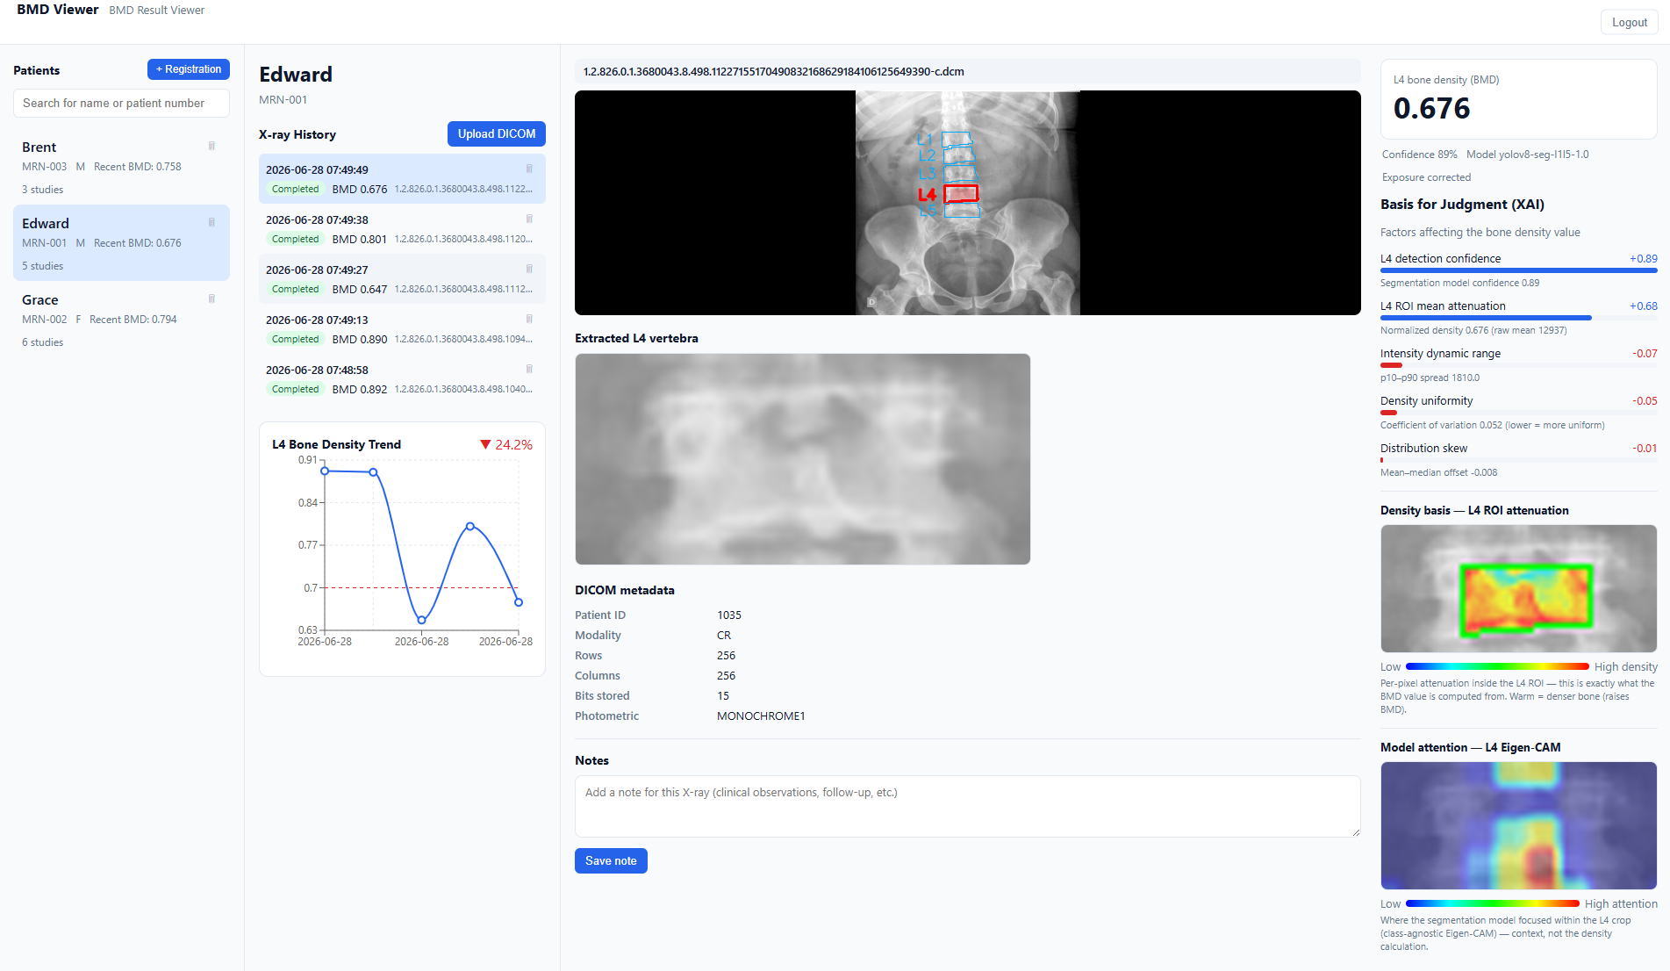
Sample Application Description version
Patients Area
Patient X-ray upload history
Original X-ray image and extracted vertebrae and L4 marking
Bone tissue value based on brightness (0 - 1)
Explainable
AI values
Extracted L4 vertebra
Graph of bone density changes according to X-ray upload date
Areas
affecting
BMD
X-ray Metadata
Areas
affecting
L4
Extraction
L4 Spinal Bone Measurement · Data Analytics
10
15/15
Notes:
I’ll show you sample software
According to the schedule, building the infrastructure and designing and developing the software begins in September.
However, to make it easier for you to understand, I have created a simple version.
And even if I cannot answer your question properly, I will write an answer and provide feedback later.
Could you please wait a moment?

Slide 18
Notes:
First, this is log in page.
On the left is the patient list, where you can register or delete patients.
The next screen is the X-ray list, where you can view the X-ray images in chronological order.
At the top, you can see the changes in bone density values ​​for the uploaded X-ray files in sequence.
Please note that the samples I have are not X-ray files from a single person, but from multiple people.
When looking at the registered X-ray files, the vertebrae is displayed, L4 is extracted, and the ROI is indicated.
This is the metadata of the X-ray file.
This is the part where the AI ​​looks at the density.
Blue indicates low-density areas, and red indicates high-density areas.
Air and metallic materials are excluded from the calculation.
Since this is not a DEXA measurement method, the values ​​may vary from patient to patient.
On the right, the status and values ​​based on the AI's judgment are displayed,
and at the bottom, the view of L4 as seen by the AI ​​is shown.
In case of failure, you can check the reason for the failure.
In addition, you can select a pre-operative X-ray image and choose an image to compare with the post-operative X-ray image.
I added a loss grid because I thought visual recognition might not be fast enough.
The red area indicates the region that was strong before surgery. In other words, the larger the red area, the weaker it becomes.
This is all I have prepared.
Thank you.

