Slide 1
AUTOMATED IMAGING · BONE HEALTH
Measuring Spinal Bone Density
from Routine Hip / Spine X-rays
An automatic, explainable pipeline that finds the L4 vertebra and measures its bone density and texture.
Presented by: Edward Choi · Data Analyst
Aug 19, 2026
1/15
Notes:
I built an automatic tool that measures bone quality from the L4 vertebra on a regular X-ray.
It doesn’t need an extra scan or extra radiation.
Today, I'll show you how it works, how accurate it is, and what still needs to be improved before clinical use.

Slide 2
THE GOAL
Why measure L4 bone from an X-ray?
IMPORTANT CAVEAT
This is a relative, X-ray-based proxy of bone density — not a calibrated DXA result (g/cm²).
It is for method demonstration. True BMD needs DXA / QCT or an in-image calibration phantom.
Bone quality of the lumbar spine matters for surgical planning and follow-up.
AP hip / spine X-rays are already taken in routine care.
Goal: a fast, repeatable bone-quality number for the L4 vertebra — fully automatic.
L4 is the standard lumbar reference level for bone assessment (as in DXA).
WHAT WE MEASURE ON L4
1) Bone density proxy (image brightness)
2) Bone texture (trabecular pattern, GLCM)
L4 Spinal Bone Measurement · Data Analytics
2/15
Notes:
This is not replacing DXA.
It uses X-ray images you already have and automatically analyzes the bone.
It measures two things:
density, which is how bright the bone looks,
and texture, which is the pattern inside the bone.
But this is only an estimate. It is not converted to real bone density units.

Slide 3
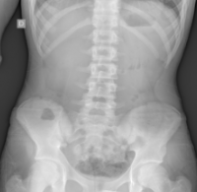
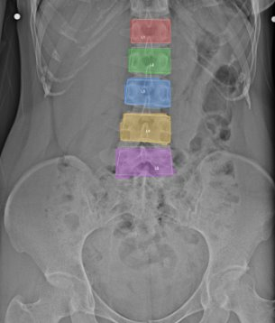
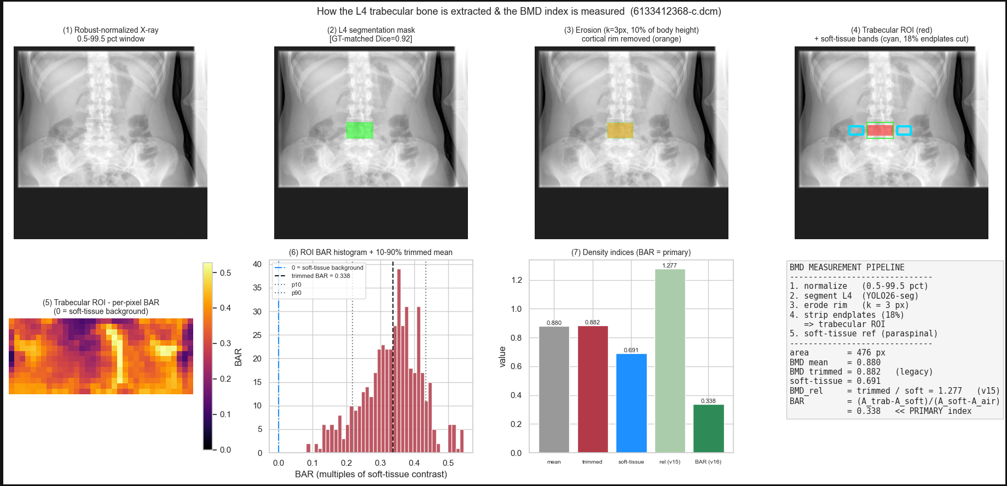
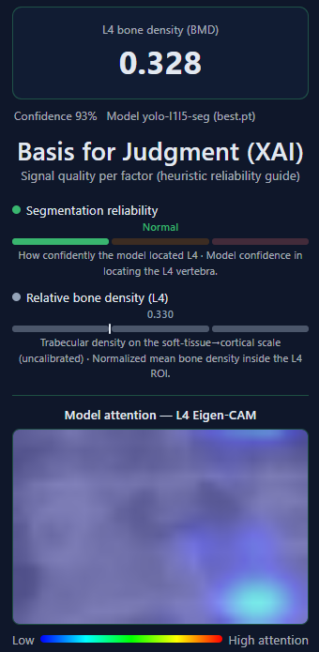
OVERVIEW
The pipeline in four steps
1
2
3
4
Input X-ray
Find L4
Measure
Report + Explain
Routine spine / hip radiograph
AI outlines vertebrae L1-L5 and selects L4
Density proxy + bone texture on L4
Numbers + heatmaps showing the 'why'
Built on an AI detector (YOLOv26-seg) trained on 4,000 public spine X-rays; the measurement and explanation code is independent of the detector.
L4 Spinal Bone Measurement · Data Analytics
3/15
Notes:
Here is the whole system in four steps. >
First, we take an X-ray, either a front view or a side view. > Next, a deep-learning model finds five vertebrae. > Then, we clean the image to keep only the inner bone. After that, we calculate our bone-density score, called BAR.
> Finally, we perform a quality check to make sure the result is reliable.
For segmentation, I used the YOLO-26-segmentation model.
Getting the dataset was one of the biggest challenges
because X-rays contain personal information.

Slide 4
THE GOAL
Imaging modalities – why X-ray
Imaging modalities
Clinical tasks
DXA
X-ray
CT
MRI
Osteoporosis
classification
Fracture
detection
Risk
detection
Normal
BMD
estimation
Bone
detection
Bone
density
Osteopenia
T-score
classification
Opportunistic
screnning
Bone structure
analysis
Osteoporosis
L4 Spinal Bone Measurement · Data Analytics
4/15
Notes:
Let's look at the imaging options.
There are many choices — DXA, CT, and MRI.
Among these, we focused on reusing X-rays that have already been taken.
There are many clinical tasks we can do with X-rays.
We focused on bone density measurement to identify the risk of osteoporosis early.

Slide 5
THE GOAL
AI methodologies – three parts together
AI methodologies
Classical
Machine Learning
CNN-based
Explainable AI
Transformer-based
Self-supervised
learning
GLCM
YOLO26-seg
Seg-Grad-Cam
(Feature Extraction)
(L4 vertebral split)
ONNX
Web export
Attention
heatmaps
L4 Spinal Bone Measurement · Data Analytics
5/15
Notes:
I used three AI techniques.
First, texture analysis, using GLCM.
Second, deep-learning segmentation, using YOLO.
Third, explainable AI, using Seg-Grad-CAM.
This is still experimental.
We are building an Autoencoder model to validate the BMD values.

Slide 6
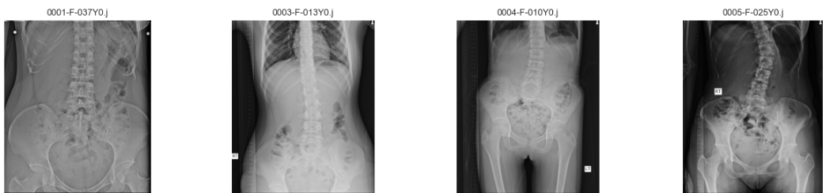
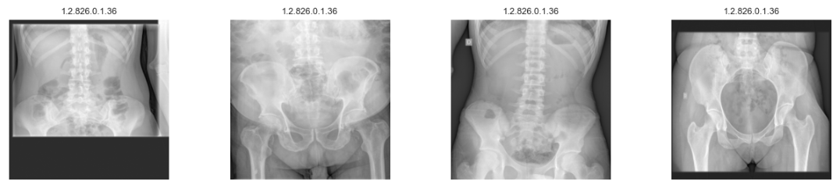
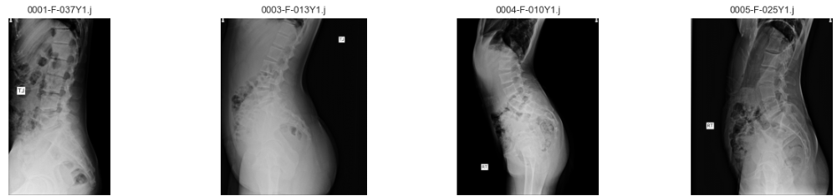
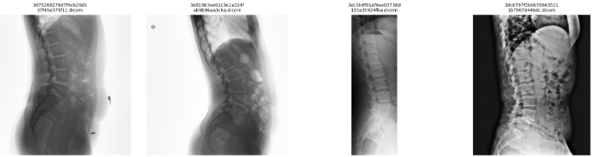
dataset
Dataset
Training/Validation Dataset (BUU dataset)
Test Dataset (DICOM dataset)
2000(train 1700/val 300) AP Dataset
42 AP Dataset
2000(train 1700/val 300) LA Dataset
175 LA Dataset
L4 Spinal Bone Measurement · Data Analytics
6/15
Notes:
We used 4,000 X-ray images from Burapha University for training and validation.
The dataset includes both front and side views.
For testing, we used a separate Kaggle dataset.

Slide 7
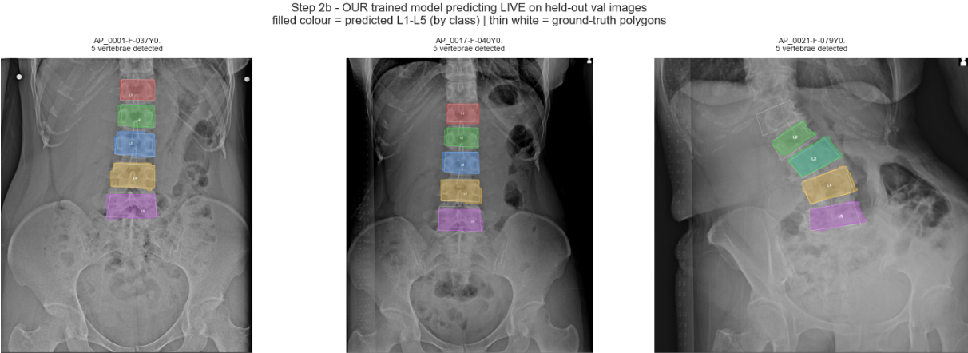
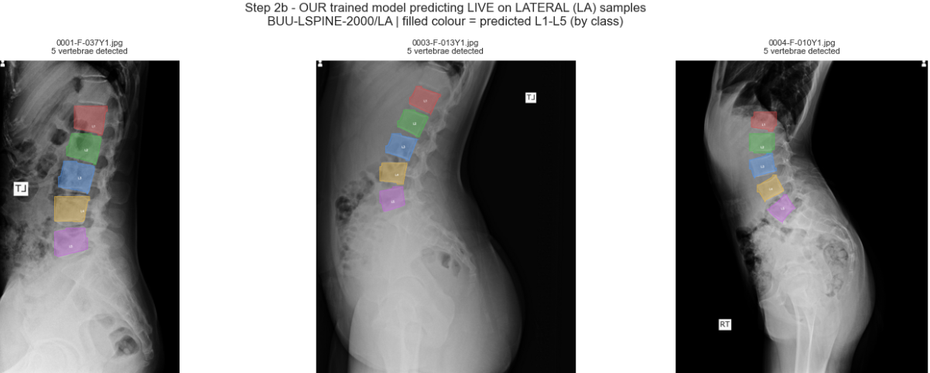
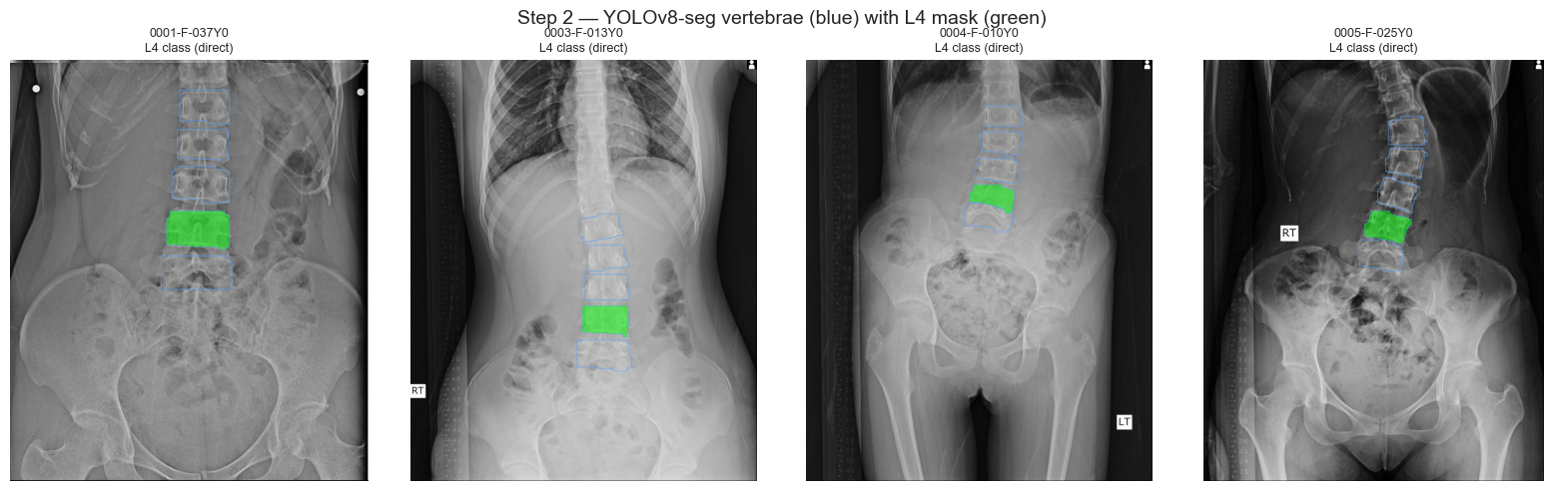
STEP 1
Finding the L4 vertebra
AI segmentation (YOLOv26-seg)
It outlines each vertebra L1-L5 as a separate object.
L4 is selected by its label, with a 4th-from-top backup rule.
Output: a clean L4 outline at full image resolution.
Blue = all vertebrae · Green = selected L4
L4 Spinal Bone Measurement · Data Analytics
7/15
Notes:
This is AI segmentation
We used the YOLO-26 segmentation model.
It detects five labels, from L1 to L5.
We can count the vertebrae from top to bottom, or from bottom to top.
So, the model identifies each vertebra as a separate shape.
Using this approach, the model automatically selects L4.

Slide 8
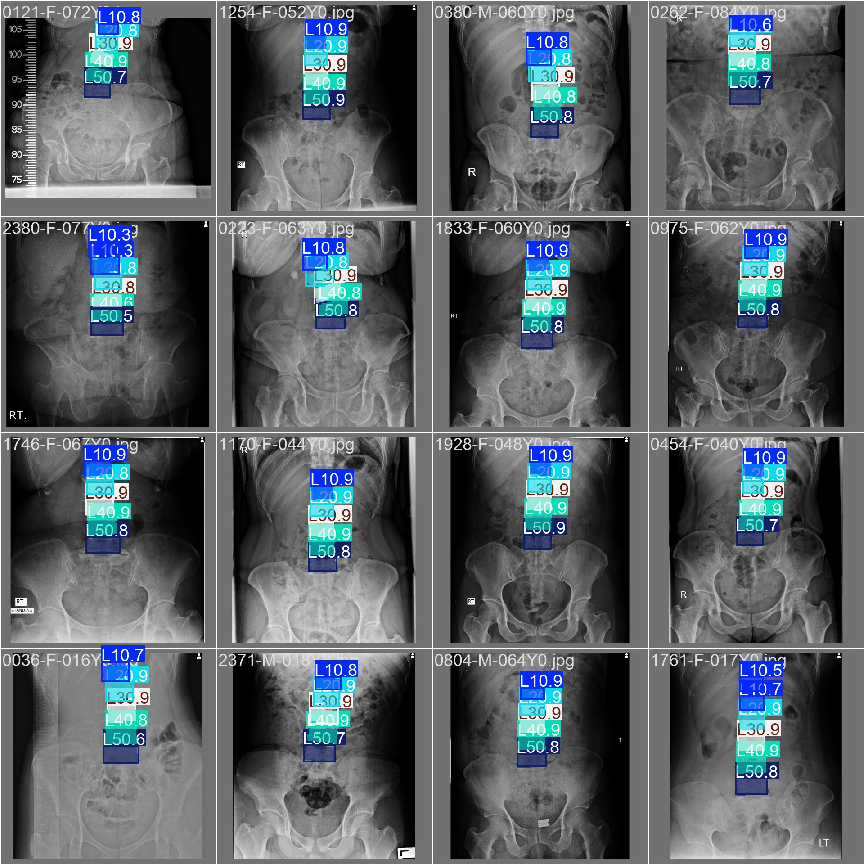
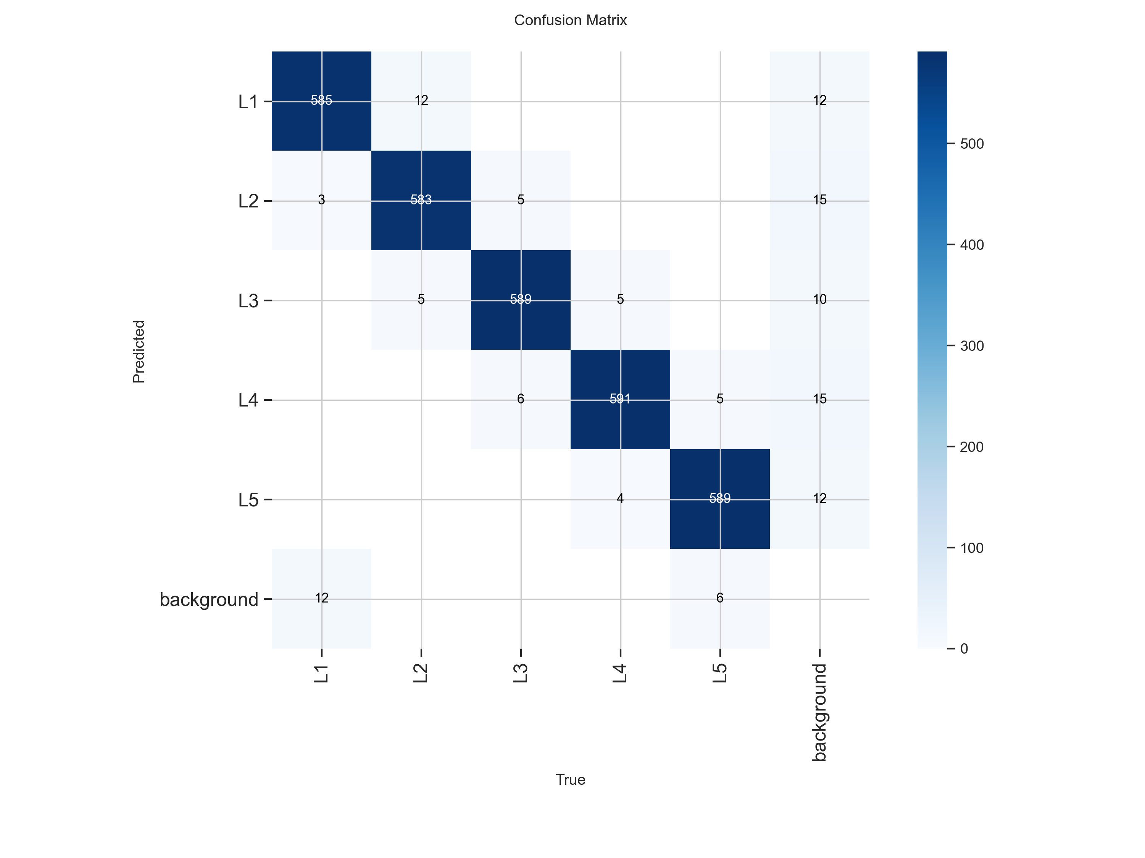
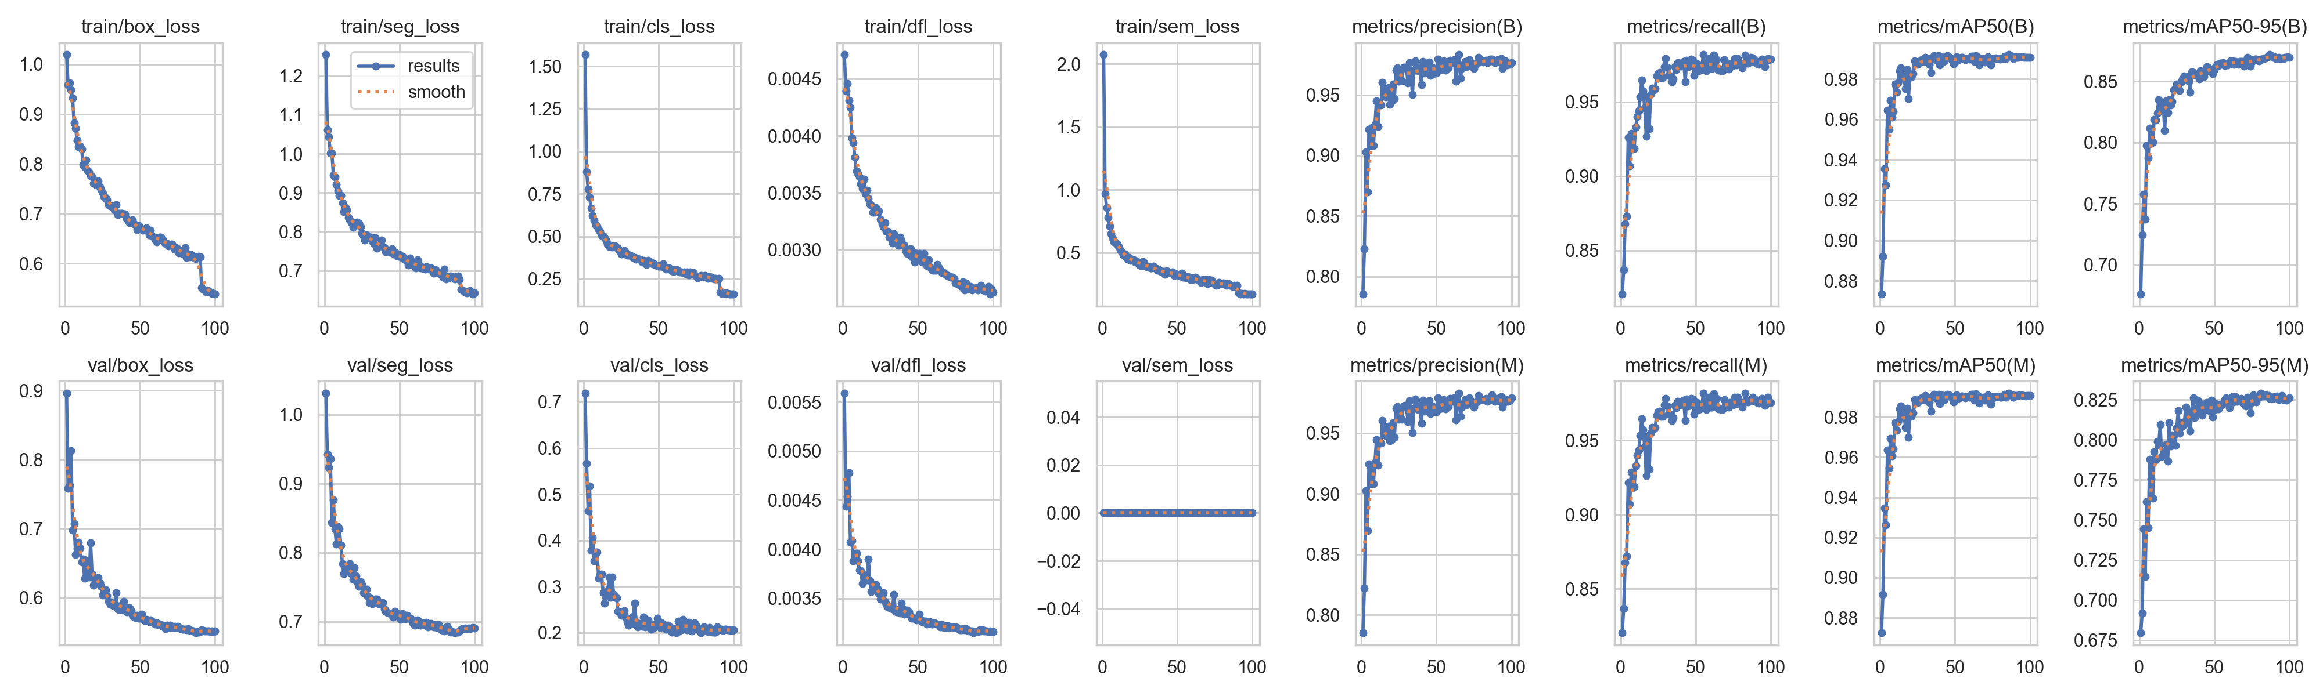
VALIDATION
The detector is accurate (in-domain)
0.97
0.95
0.96
0.76
Mask mAP@50
Precision
Recall
mAP@50-95
On held-out validation X-rays, the model finds and outlines vertebrae very reliably.
mAP@50 = 0.97 means near-complete agreement with the human labels at a standard overlap threshold.
Right: model predictions on a validation batch.
L4 Spinal Bone Measurement · Data Analytics
13/18
Notes:
The mAP-50 score is 97 percent.
Therefore, the detector itself is strong.
Precision is 95 percent, and recall is 96 percent.
So, the model finds and outlines the vertebrae very reliably.
> Click
This is the confusion matrix.
Most predictions are on the diagonal,
which means the model correctly identifies each vertebra.
> Click
These are the loss and performance graphs.
The top row shows the training results.
The bottom row shows the validation results.
On the left, we have the loss.
On the right, we have the performance metrics.
We trained the model for 100 epochs.
The training took about two days.

Slide 9
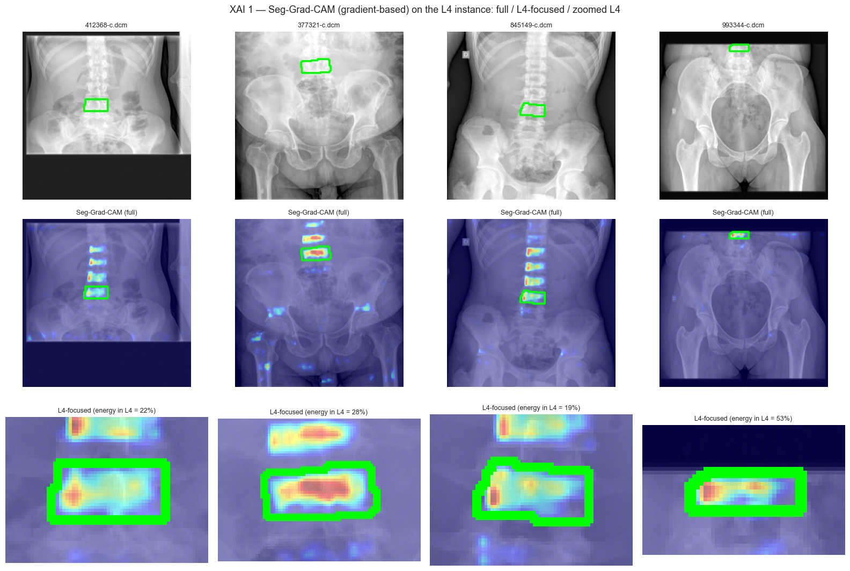
EXPLAINABILITY
Can we trust where the AI looks?
Grad-CAM (gradient-based)
A heatmap of the pixels the model used to decide 'this is L4'.
Red / warm = most important.
The attention lands on the L4 body and its internal bone structure — not on background, implants, or soft tissue.
Why it matters: a clinician can verify the AI is reading the right anatomy before trusting the number.
L4 Spinal Bone Measurement · Data Analytics
9/15
Notes:
This heatmap shows which pixels the AI focused on.
It focuses on the L4 bone and its inner pattern.
This is similar to the area a radiologist looks at.
So, we can see what the AI is looking at.

Slide 10
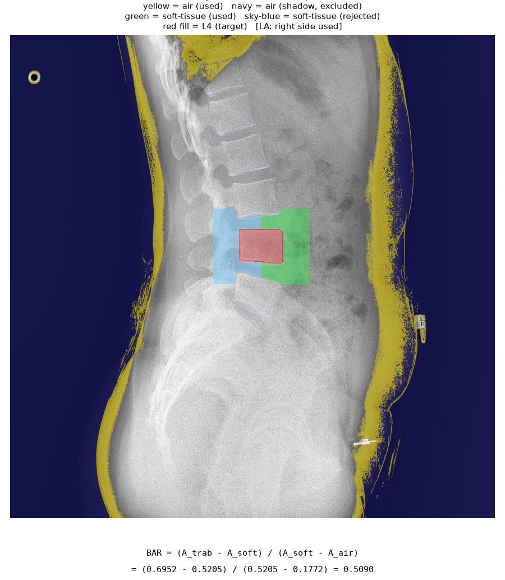
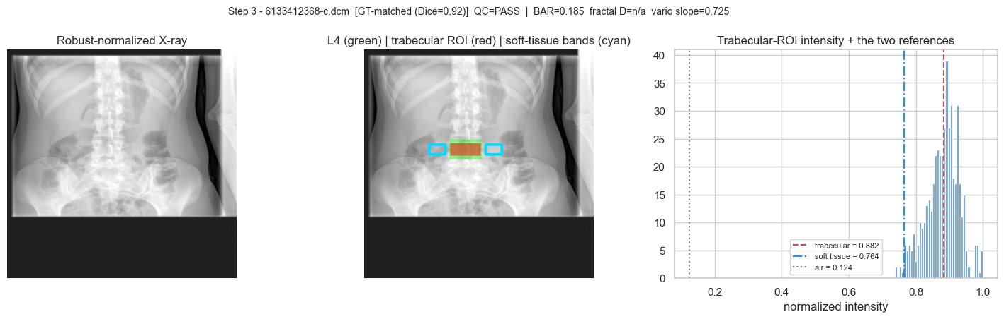
STEP 2
Measuring bone on L4
Bone density measurement procedure
1. Extract Trabecular Bone ROI - Remove cortical bone and endplates (top and bottom surfaces) to leave only cancellous bone
2. Attenuation Domain Transformation - Since pixel values ​​are not density, the calculation is based on light attenuation and soft tissue.
4. BAR( Bone Attenuation Ratio ) calculation - BAR = (A_trabecular − A_soft_tissue) / (A_soft_tissue − A_air)
5. Micro structure - GLCM 5, Variation slope , fractal dimension
6. QC (Quality Control) Gate = Checkpoint
7. We’ll measure the BAR value of The L4 bone density.
L4 Spinal Bone Measurement · Data Analytics
10/15
Notes:
I’ll explain the process in three simple steps.
> Click
First, we normalized the x-ray image.
> Click
Second,
We remove the cortical(피질) bone and the endplates,
so we keep only the cancellous bone(해면골).
> Click
Third, we calculate the BAR value.
We use a normalized brightness histogram to measure the bone signal against the surrounding tissue.
> Click
BAR stands for Bone Attenuation Ratio.
It compares the attenuation of the trabecular bone with the patient’s own soft tissue.
After this calculation,
we get the BAR value for L4.
This value is used for bone density measurement.

Slide 11
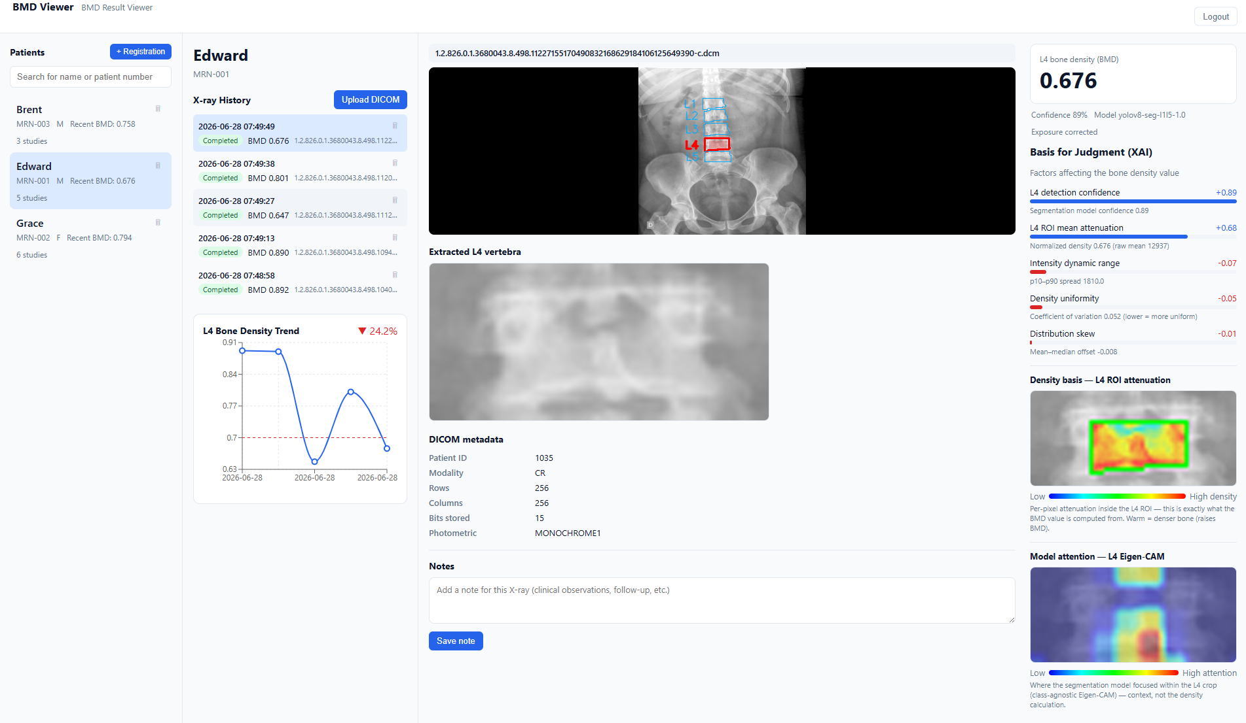
Sample Application Description version
Patients Area
Patient X-ray upload history
Original X-ray image and extracted vertebrae and L4 marking
Bone tissue value based on brightness (0 - 1)
Explainable
AI values
Extracted L4 vertebra
Graph of bone density changes according to X-ray upload date
Areas
affecting
BMD
X-ray Metadata
Areas
affecting
L4
Extraction
L4 Spinal Bone Measurement · Data Analytics
10
15/15

