Slide 1
DATA ANALYTICS PROJECT
Telco Customer Churn
Prediction & Analysis
Using IBM Telco Dataset • Machine Learning Pipeline • SHAP Explainability
Rakesh
Edward (Seongmin Choi)
Mawuko
EDA & Data Cleaning
Preprocessing & Modeling
SHAP & Dashboard

Slide 2
What Are We Solving?
The Problem
Our Dataset
Customer churn = when a customer stops using a service.
For telecom companies, losing customers is expensive — it costs
5–10x more to acquire a new customer than to retain an existing one.
IBM Telco Customer Churn Dataset
• 7,043 customers • 21 features
• Demographics, services & billing info
• Target: Churn (Yes / No)
OUR WORKFLOW PIPELINE
EDA
Preprocessing
& Modeling
SHAP
Explainability
Streamlit
Dashboard
▶
▶
▶

Slide 3
Step 1: Understanding the Raw Data
7,043
21
11
20
Total Customers
Features / Columns
Rows with Missing Data
Features After Cleaning
What We Found in the Raw Data
Feature Categories
• TotalCharges stored as text (object) instead of number
• 11 rows had blank TotalCharges (new customers, tenure=0)
• No actual duplicate customer IDs found
• Churn column: 'Yes'/'No' strings → converted to 1/0
• customerID removed (not useful for modeling)
Demographics
gender, SeniorCitizen, Partner, Dependents
Services
PhoneService, InternetService, OnlineSecurity, TechSupport...
Account Info
Contract, PaymentMethod, PaperlessBilling
Charges
tenure, MonthlyCharges, TotalCharges

Slide 4
Key Finding #1: Churn Rate Overview
💡 What This Means
26.5%
~1 in 4
customers leave
This is significant. Industry avg is around 15–25%.
The class imbalance (73% vs 27%) must be handled carefully in modeling.
Overall
Churn Rate
1,869 out of 7,032 customers
Data: IBM Telco Customer Churn Dataset | After Cleaning: 7,032 rows

Slide 5
Key Finding #2: Contract Type is the Strongest Predictor
42.7%
Month-to-Month
11.3%
One Year
2.8%
Two Year
Month-to-month customers churn
15× more than 2-year contract customers!
🔑 Insight for Modeling:
Contract type should be the top feature in the model. Month-to-month contracts are the highest-risk segment — targeting these customers for retention offers could drastically reduce churn.

Slide 6
Key Finding #3: Tenure & Monthly Charges
📅 Avg Tenure
Retained
37.6 mo
Churned
17.9 mo
💰 Avg Monthly
Retained
$61.27
Churned
$74.44
🔑 The first 12 months are critical — nearly 50% churn! AND churners pay $13/month more on average.

Slide 7
Key Finding #4: Internet Service & Payment Method
⚠️ Surprising!
💡 Key Pattern:
Fiber Optic is the PREMIUM service yet has the HIGHEST churn (42%). This suggests pricing dissatisfaction or service quality issues — not just usage patterns.
Electronic check users churn 3× more than credit card users. Auto-pay methods (bank transfer, credit card) = lower churn — these customers are more committed.

Slide 8
EDA Summary & What's Next
🤝 Passing to
Edward
1
Overall churn rate: 26.5% (~1 in 4 customers leave)
2
Month-to-month contracts: 42.7% churn vs 2.8% for 2-year
✓ cleaned_telco_churn.csv
3
New customers (0-12 months) are at highest risk: ~48% churn
✓ Churn encoded as 0/1
4
✓ Top 5 features identified
Fiber optic users churn most despite being premium service
✓ Recommend: handle class
imbalance (73/27 split)
5
Electronic check → highest churn; auto-pay methods → lowest
✓ Focus metric: Recall
Clean data is the foundation. Without solid EDA, the model has no reliable base to learn from.

Slide 9
Feature Engineering
Label Encoding
One-Hot Encoding
Standard Scaling
Gender
Female
MultipleLines
No
Tenure
Min : 0
0
MultipleLines_No
Min : -1.280248
1
Max : 1.612573
Male
Yes
Max : 72
MultipleLines_Yes
No Phone Service
MultipleLines_Nophone service
Partner
0
Min : -1.547283
No
InternetService
DSL
MonthlyCharges
Min : 18.25
InternetService_DSL
1
InternetService_No
Max : 1.793381
Yes
No
Max : 118.75
Fiber optic
InternetService_Fiber
Churn
0
No
Contract
Month-to-month
TotalCharges
Min : 18.8
Contract_Month-to-month
Min : -0.999069
Yes
One year
Max : 8684.8
1
Contract_One year
Max : 2.824261
Contract_Two year
Two year
Notes:
Hello, I am Edward, in charge of the Data Preprocessing and Modeling part.
First, we will cover the 'Data Preprocessing and Feature Engineering' process.
First, to enable algorithms to perform calculations,
We converted binary fields such as gender, partner or churn status into 0s and 1s using label encoding.
For data with three or more categories, such as multiple lines, internet services or contract,
We dummy-coded them using one-hot encoding to ensure the independence of each item.
Finally, for numerical data like Tenure, MonthlyChargs and TotalCharges, which exhibit significant variance,
We applied a Standard Scaler to scale them into a standard normal distribution to prevent the model from becoming overly biased toward specific variables.

Slide 10
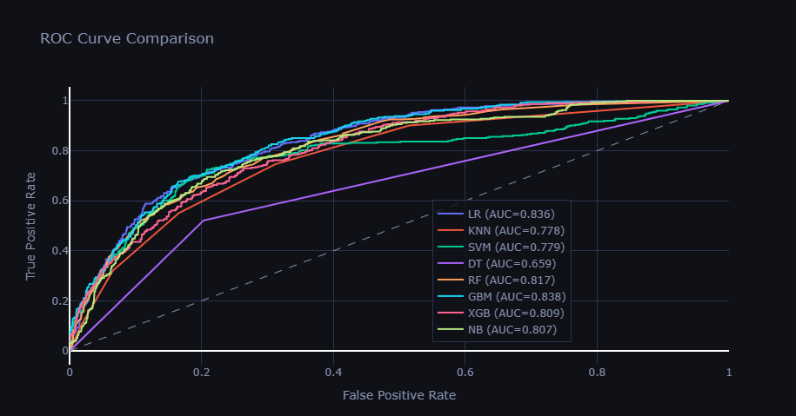
Dataset Splitting and Training Strategy
Comparison of 8 Classification Algorithms
Data Splitting
Train
80%
Test
20%
LogisticRegression
KNeighborsClassifier
SVM
DecisionTreeClassifier
RandomForestClassifier
GradientBoostingClassifier
Naïve Bayes
XGBClassifier
Notes:
This is Dataset Splitting and Model Training Strategy.
We verified the model's generalization performance by splitting the dataset into 80% training data and 20% test data.
In particular, to avoid bias in specific algorithms,
We conducted comparative experiments using a total of eight classification models, ranging from logistic regression to the latest technique, XGBoost(Extreme Gradient Boosting)
Here, we used AUC as the metric for model performance. We determined that AUC is the most suitable metric for evaluating the ability to classify churners,
which is the core of our project, because it best represents a model's discriminative power regardless of the classification threshold.

Slide 11
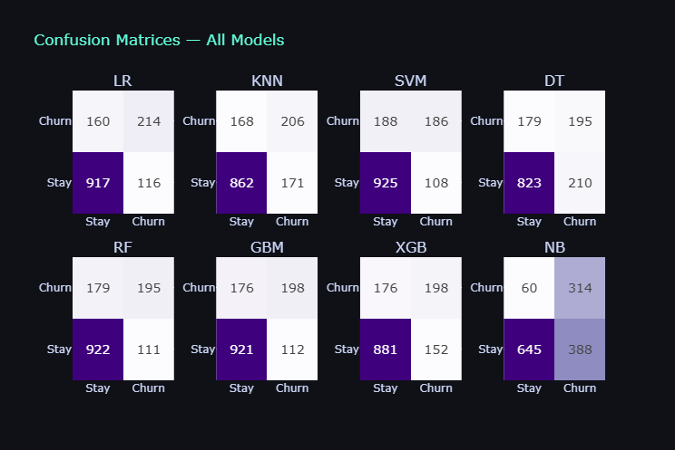
Model Performance Evaluation and Selection
0.84
0.83
Evaluation Metric
CM ROC Recall Confusion Matrix Roc Curve Core Metric Key Indicator
Notes:
I will now present the experimental results.
Among the eight models, the Gradient Boosting model, demonstrated the highest performance with an AUC of 0.84,
followed by Logistic Regression at 0.83.
We did not view these results merely as numerical values
but examined them in detail using the Confusion Matrix and ROC curve.
In particular, to achieve the business goal of preventing customer churn,
We tuned the final model by focusing on improving Recall to minimize errors where actual churners are misidentified as regular customers.

Slide 12
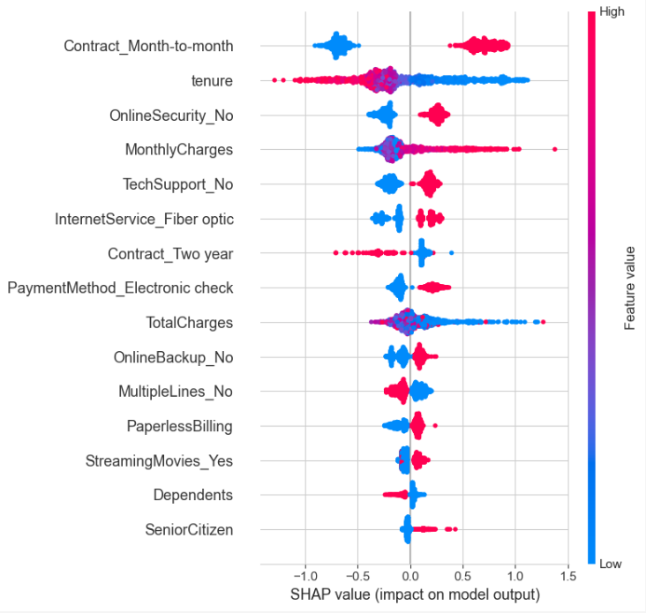
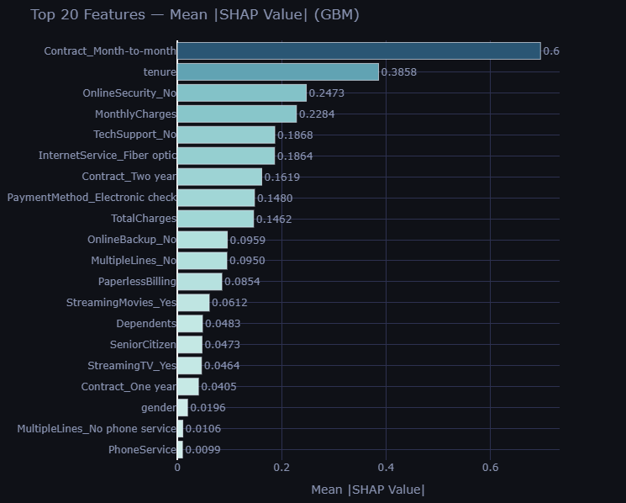
Model analysis - SHAP
Notes:
Deep learning or complex ensemble models have the disadvantage of being "black boxes,"
where it is difficult to understand the basis for their internal decisions.
To overcome this, we introduced explainable AI techniques:
SHAP for global interpretation and LIME for individual case interpretation.
Looking at the SHAP summary chart,
For example, You can see that 'Month-to-month' is the most critical variable determining churn.
The people who sign monthly contracts have a higher probability of cancellation,
whereas those who do not have a lower probability.
Based on this chart, The top 2 to 3 features had a significant impact.
Let's take a closer look at the values?

Slide 13
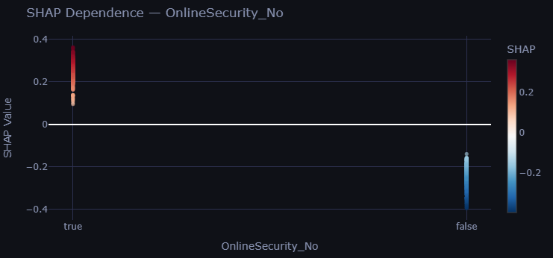
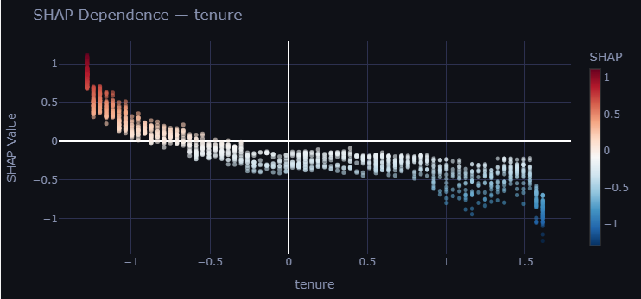
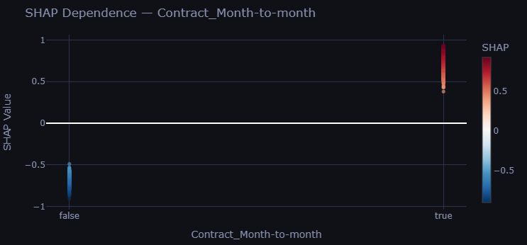
Model analysis – SHAP Dependence Plot
Notes:
The red color indicates a positive SHAP value,
meaning a Month-to-month contract significantly increases the probability of churn.
Conversely, blue indicates a negative SHAP value,
showing that other contract types correlate with a lower churn risk.
For shorter tenure (left side of the x-axis),
the SHAP values are mostly positive (red), contributing to a higher churn probability.
As tenure increases (moving right), the values turn negative (blue),
indicating that longer-term customers are less likely to churn
The same principle applies to not having a security subscription

Slide 14
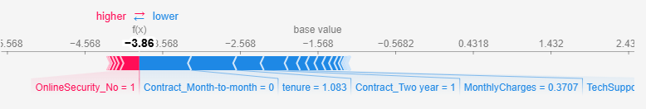
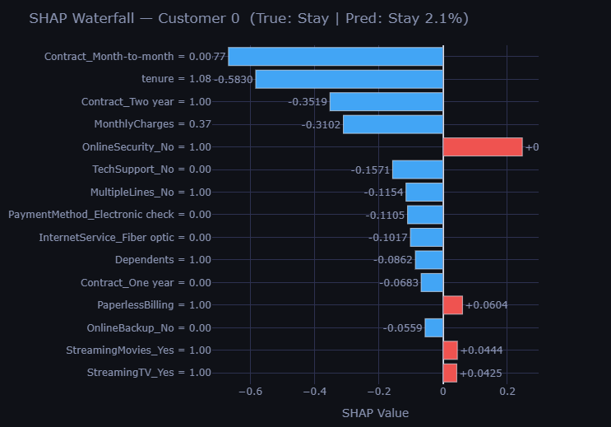
Model analysis - SHAP
Notes:
To understand the model's specific logic,
we analyzed an individual case (Customer 0) using SHAP values.
Key Retention Drivers are represented by the blue bars.
The primary reasons for the low churn prediction are not being on a Month-to-month contract and having a Two-year contract significantly reduce the churn risk.
Their high tenure further reinforces this stability.
On the other hand, the lack of an Online Security subscription acts as a push factor, slightly increasing the probability of churn.
Consequently, the model predicts a very high probability of this customer staying with the service.

Slide 15
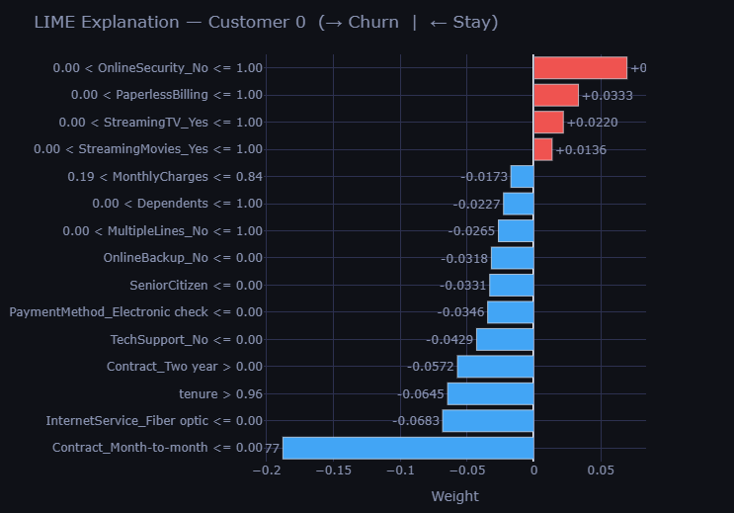
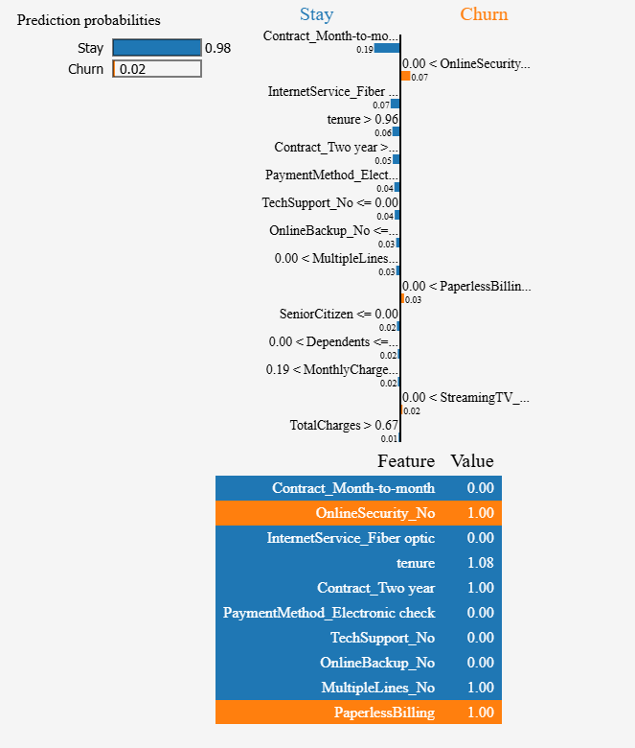
Model analysis - LIME
Notes:
Furthermore, through LIME analysis,
we can now provide specific reasons why individual customers are flagged as high-risk.
This interpretability provides marketing managers with evidence-based insights,
allowing them to make more effective and personalized churn prevention strategies.

Slide 16
DASH ANALYTICS
CHURN RATE
26.5%
RECALL SCORE
0.78
Target Customer​
1,869
KEY POINT
Recall-centric design to avoid losing potential churn customers,
rather than precision for cost reduction in churn prevention.
Notes:
From a business perspective, missing a potential churner is a much costlier mistake than misidentifying a loyal one.
That is why our model prioritizes Recall over Precision.
With this dashboard, companies can pinpoint 1,869 high-risk customers and
immediately launch personalized promotions tailored to each individual's specific reason for churn.
MawuKo, could you please explain the dashboard?

