Slide 1
Large-Scale and Multi-Structured Databases Project Design <PokeMongo>
<authors: Edoardo Fazzari, Mirco Ramo, Olgerti Xhanej>

Slide 2
Application Highlights
PokeMongo is a gaming application in which users compete each other to build up the best Team choosing from the set of Pokemon available in the environment.
Features:
Consult pokedex (encyclopedia of pokemons)
Catch pokemon for building team up
Consult ranking of teams
Make friend relationships with other trainers
An admin can:
Add/remove pokemon
Remove users
Checks analytic information about application usage (daily login…)

Slide 3
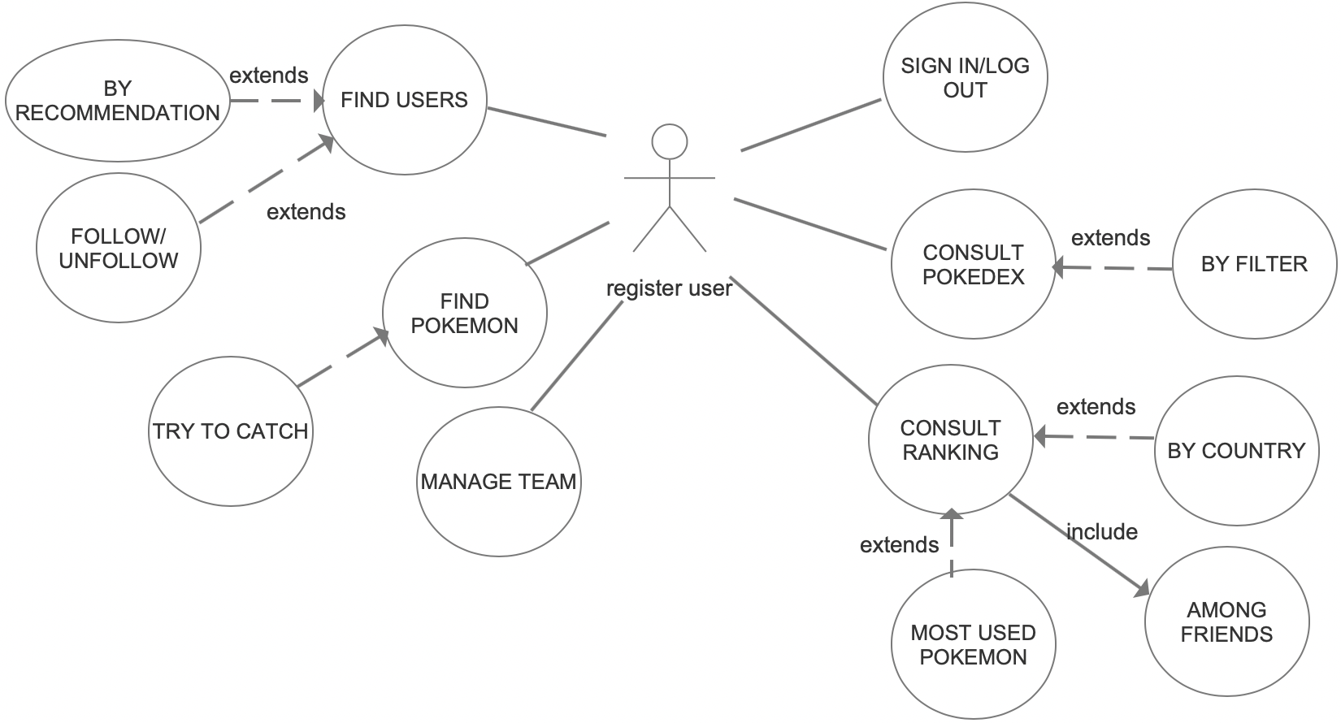
Actors and main supported functionalities
extends

Slide 4
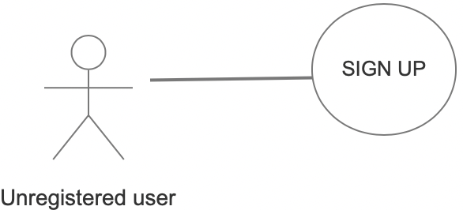
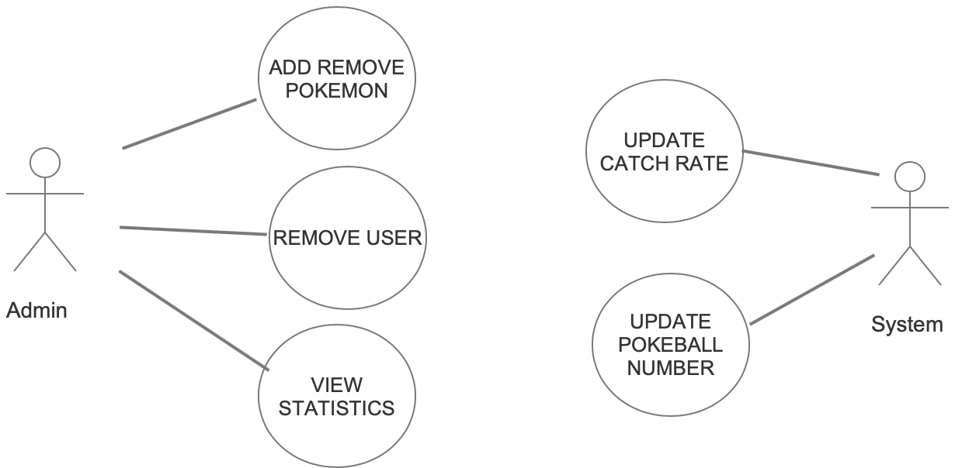

Slide 5
Dataset Description
Source: PokeAPI (https://pokeapi.co), https://gist.github.com/kalinchernev/486393efcca01623b18d, https://github.com/smashew/NameDatabases/blob/master/NamesDatabases/surnames/all.txt, https://bulbapedia.bulbagarden.net/wiki/Main_Page
Description: Information about pokemons, user anagraphic data
Volume: ~80MB
Variety: Information about pokemon retrieved by different sites
Velocity/Variability: Dynamic catch rate, team composition, user’s team points. Points of a user loses importance after a certain lap of time (negative feedback loop).

Slide 6
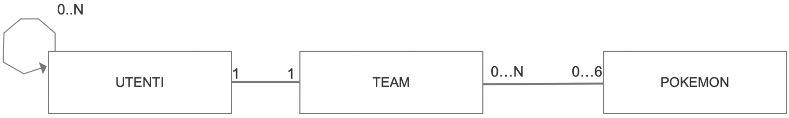
Preliminary UML Class Diagram

Slide 7
Requirements and Entities handled by Document DB
ENTITIES:
User (surname, name, username, password, teamName, points…)
Pokemon (id, name, capture_rate, biology, types, portrait,…)
CRUD:
Create/Remove/Modify a user
Create/Remove a pokemon
Retrieve user information
Retrieve Pokemon using several filters
Retrieve a user by username
ANALYTICS (3 AGGREGATIONS):
best ranked teams [among friends/by country]
evolution on time of catchRates, users, logins per day
Country ranking based on the number of user online

Slide 8
Requirements and Entities handled by Graph DB
ENTITIES:
User (username)
Team
CRUD:
APPLICATION QUERY | GRAPH QUERY
Follow/unfollow a user | Add/remove an edge between users
Add/remove pokemon to the team | Add/remove an edge between a user and a pokemon
Create/remove a user/pokemon | Create/remove a user/pokemon’s node
Recommend a friend | From given user node (A) find all user nodes that are connected to the user nodes connected to A
Find most used pokemon | Find pokemon nodes with the highest number of incoming edges

Slide 9
Software Architecture Preliminary Idea
Include also the frameworks and tools that the group would like to use (programming languages, DBMSs, etc..)
Programming language: Java
Front-end: javafx
Libraries: caffeine (cache), Mockito, JUnit, gson, Apache commons-codec (data encryption)
DBMSs: mongoDB, Neo4j
POKEMON:
{ "id": 1, "name": "bulbasaur", "weight": 69, "height": 7, "capture_rate": 45, "biology": "", "types": [ "", "" ], "portrait": "", "sprite": "" }
POKEMON:
{ "id": 1, "name": "bulbasaur", "weight": 69, "height": 7, "capture_rate": 45, "biology": "", "types": [ "", "" ], "portrait": "", "sprite": "" }

