Slide 1
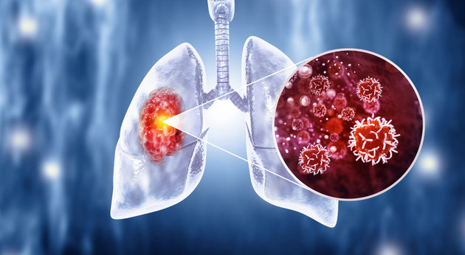
Survival Analysis of Lung Cancer Patients in Sweden
Group 11: Liang-Jen Huang, Hadeel Elhassan
Department of Statistics, Uppsala University

Slide 2
Introduction
Focus on lung cancer patients in Sweden and investigate factors associated with survival time.
Main interest: whether different treatment types are associated with different survival experiences over time
Notes:
Our study focuses on lung cancer patients in Sweden and looks at factors related to how long patients survive.
Our main question is whether patients receiving different types of treatment have different survival experiences over time.

Slide 3
Data Description
A random sample of 500 lung cancer patients from Sweden was selected from the Kaggle Lung Cancer Dataset (33,161 patients in total).
During treatment, 386 patients died, while 114 were still alive when the observation period ended.
Notes:
Our data comes from a lung cancer dataset from Kaggle.
We extract the patient from Sweden, and there are 33161 people in total. We further random sample 500 people for our dataset
And there are 386 patients died and 114 alive when the treatment end

Slide 4
Data Description
Age
Gender (Female/Male)
BMI
Cholesterol level
Treatment (radiation / Chemotherapy / Surgery / Combined)
Cancer stage (I - IV)
Smoking status (Never / Passive / Former / Current)
Hypertension (No / Yes)
Asthma (No / Yes)
Cirrhosis (No / Yes)
Other cancer (No / Yes)
Family history of cancer (No / Yes)
Event
Censored
  Survival (Death / Alive)
  Treatment Days
Time
Notes:
In this analysis, we count time in treatment days.
We follow each patient from the start of treatment to the end of the treatment, and see whether they die or not.
If a patient dies, we record that.
If the patient is still alive when the treatment ends, we simply stop following them at that point.
These are the other variables in the dataset. treatment is our main focus, but we also examine other factors that may be related to survival time.

Slide 5
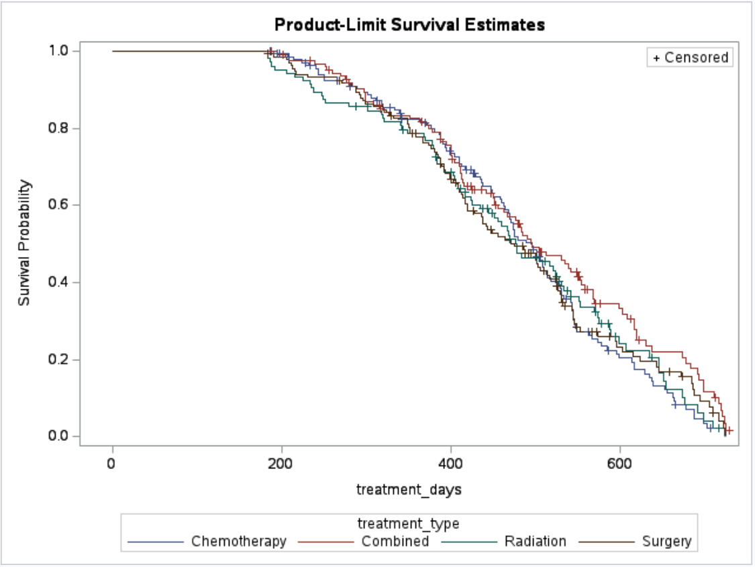
Survival Curves by Treatment Type
No clear treatment differences are observed early in time.
Combined treatment shows higher survival at later times.
Notes:
Here are the survival curves for our main variable of interest, which is treatment type. At the beginning, the treatments look quite similar.
Later on, combined treatment seems to perform a bit better.

Slide 6
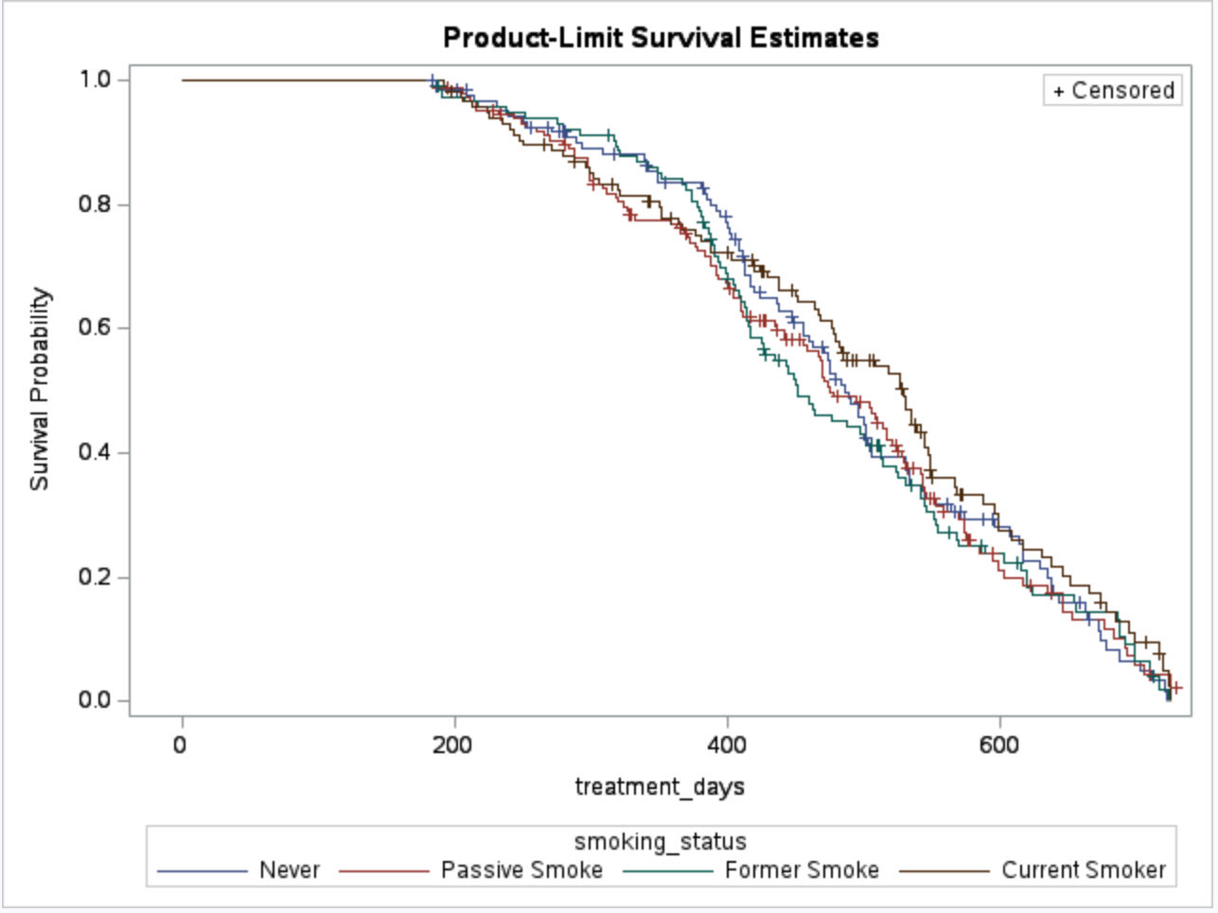
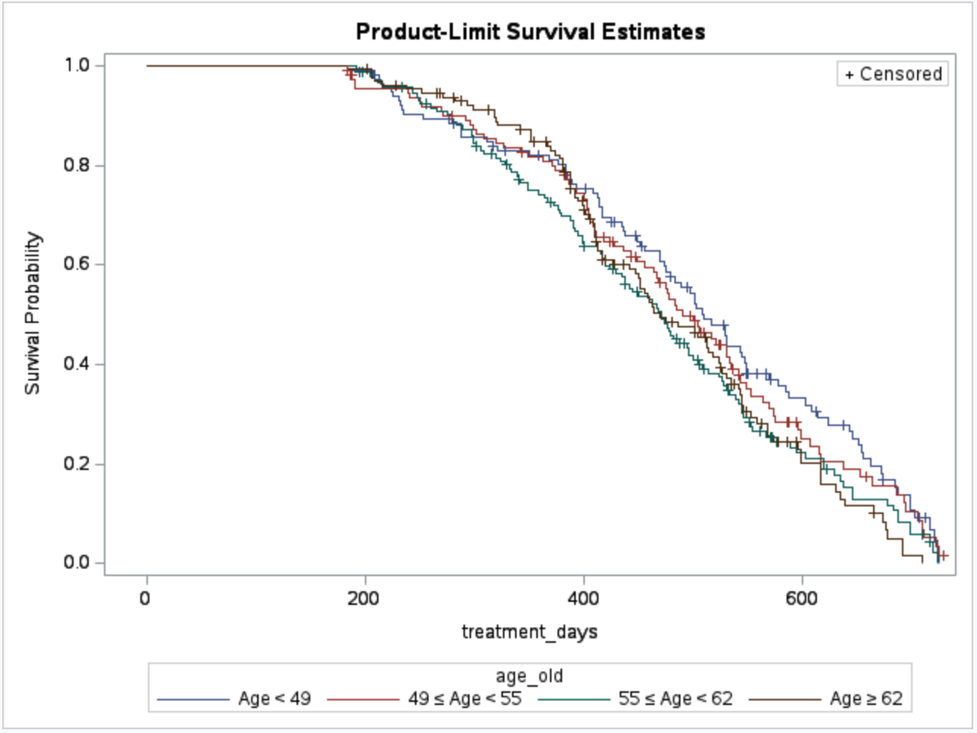
Survival Curves by Patient Characteristics
Smoking status: No clear survival differences
Age: Younger patients (<49) show higher survival.
Notes:
Next, we look at a few variables that we think might also influence survival.
For smoking status, the survival curves are pretty close, so we don’t see a clear difference in survival.
For age, we divided patients into four groups based on percentiles. Patients younger than 49 tend to survive longer, but for the older groups, the curves overlap a lot and don’t separate clearly.

Slide 7
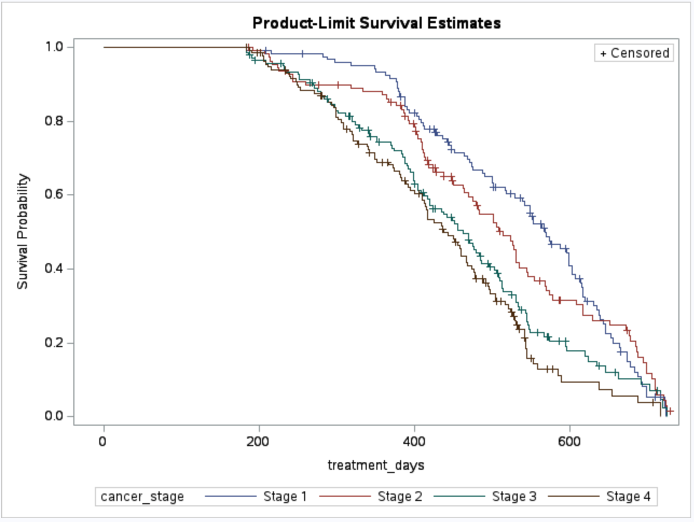
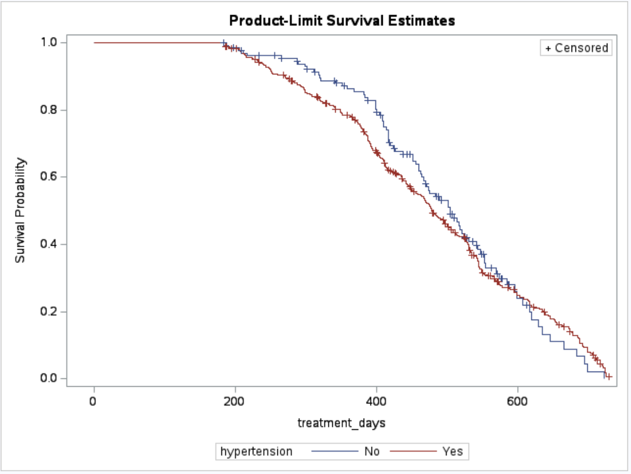
Survival Curves by Patient Characteristics
Cancer stage: Clear survival differences
Hypertension: Survival rates cross over time
Notes:
For cancer stage, we see clear survival differences, with earlier stages showing higher survival, which really makes sense
For hypertension, the survival curves cross over time. Patients with hypertension appear to have lower survival early on, but higher survival later, which is somewhat unexpected.
So far, we’ve been looking at one thing at a time. But in real life, patient characteristics are connected and affect survival together.
Next, we’ll look at survival by considering several characteristicsat the same time.

Slide 8
Analysis Result
This analysis was based on comparing patients within the same cancer stage.
Parameter | P-value | Hazard ratio
Age | 0.03 | 1.01
Cirrhosis | 0.23 | 1.16
Chemotherapy v.s Radiation | 0.88 | 1.02
Surgery v.s Radiation | 0.84 | 1.03
Combined v.s Radiation | 0.13 | 0.79
Hypertension | <0.01 | Strong time-dependent effect

Slide 9
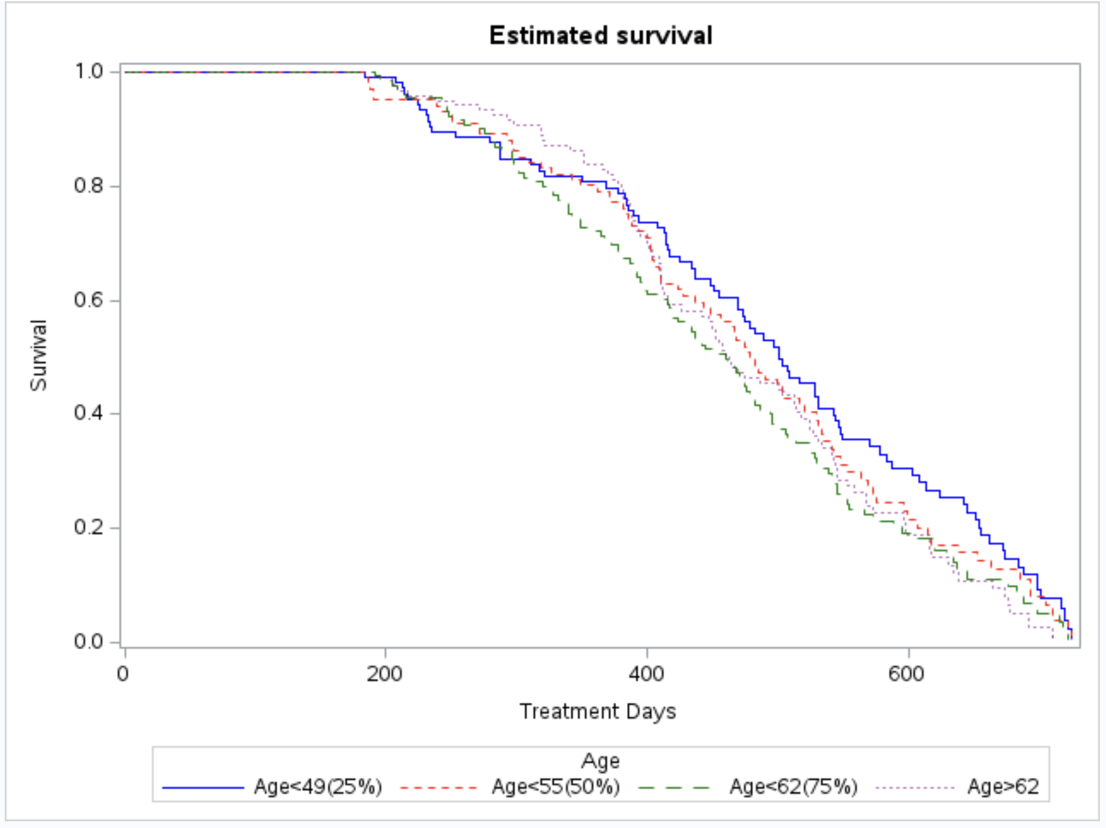
Estimated Survival by Age
Older patients are associated with a slightly higher risk.
Each additional year of age increases the risk by around 1.2%.
(Fix age at 55, with no cirrhosis and Radiation treatment)

Slide 10
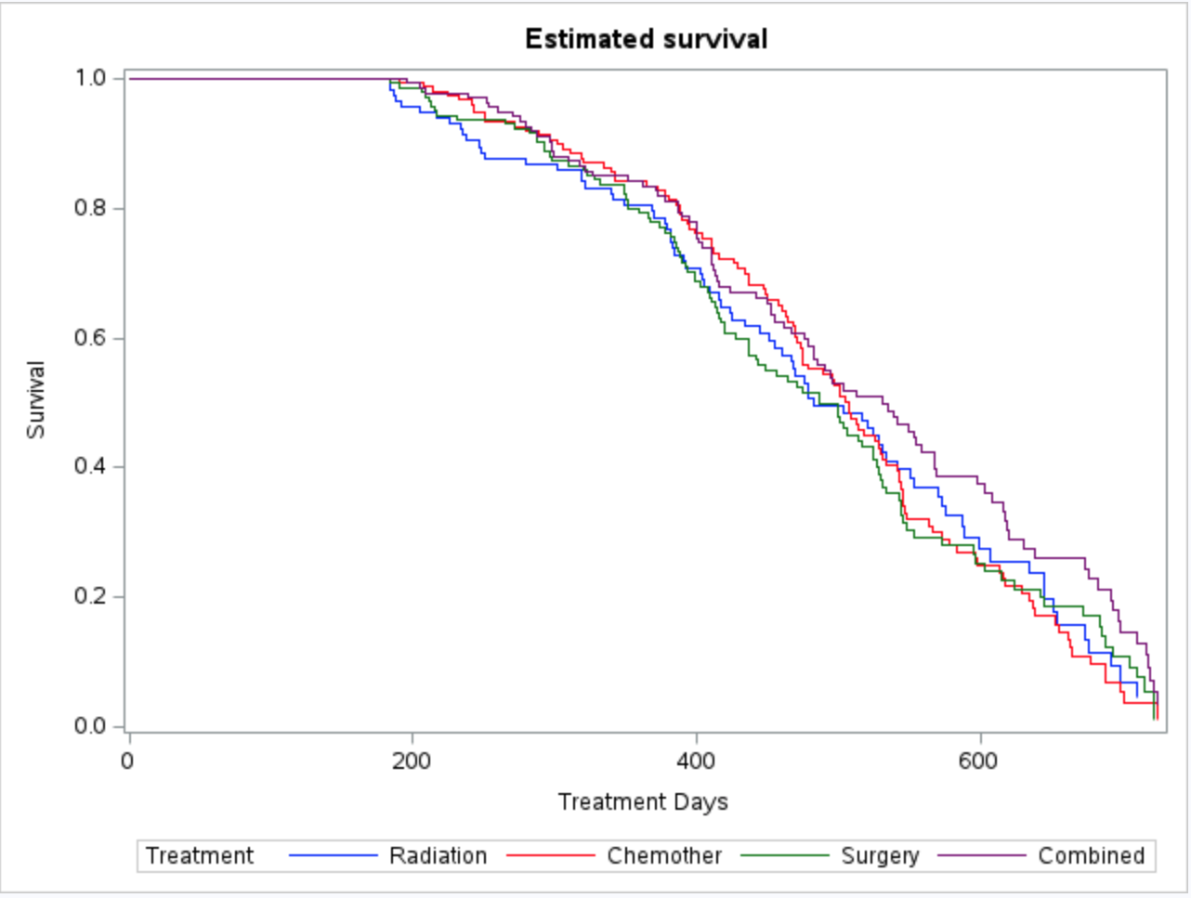
Estimated Survival by Treatment Type
After accounting for patient differences, survival is similar across treatments groups.

Slide 11
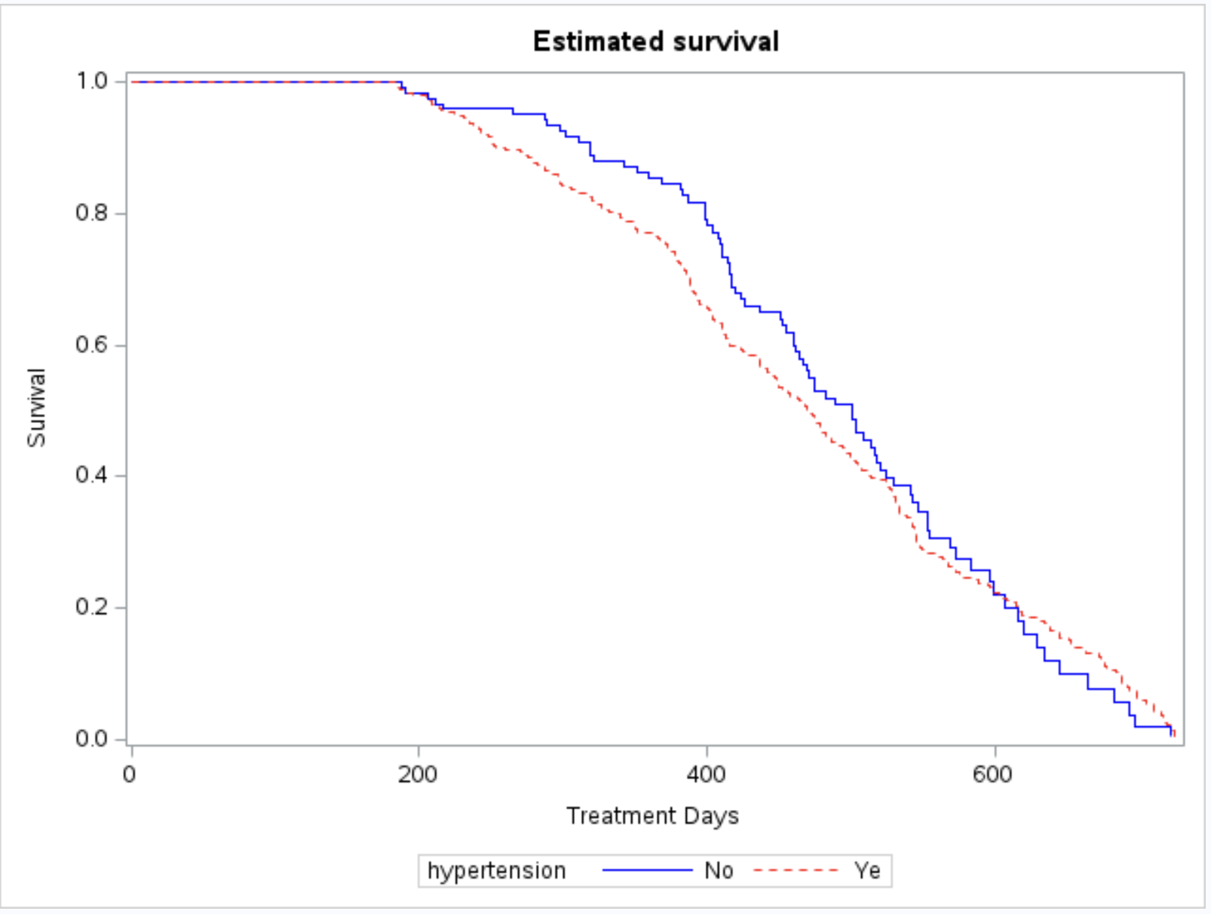
Estimated Survival by Hypertension Status
Higher risk early on, weaker effect later.
Hypertension is strongly associated with survival.

Slide 12
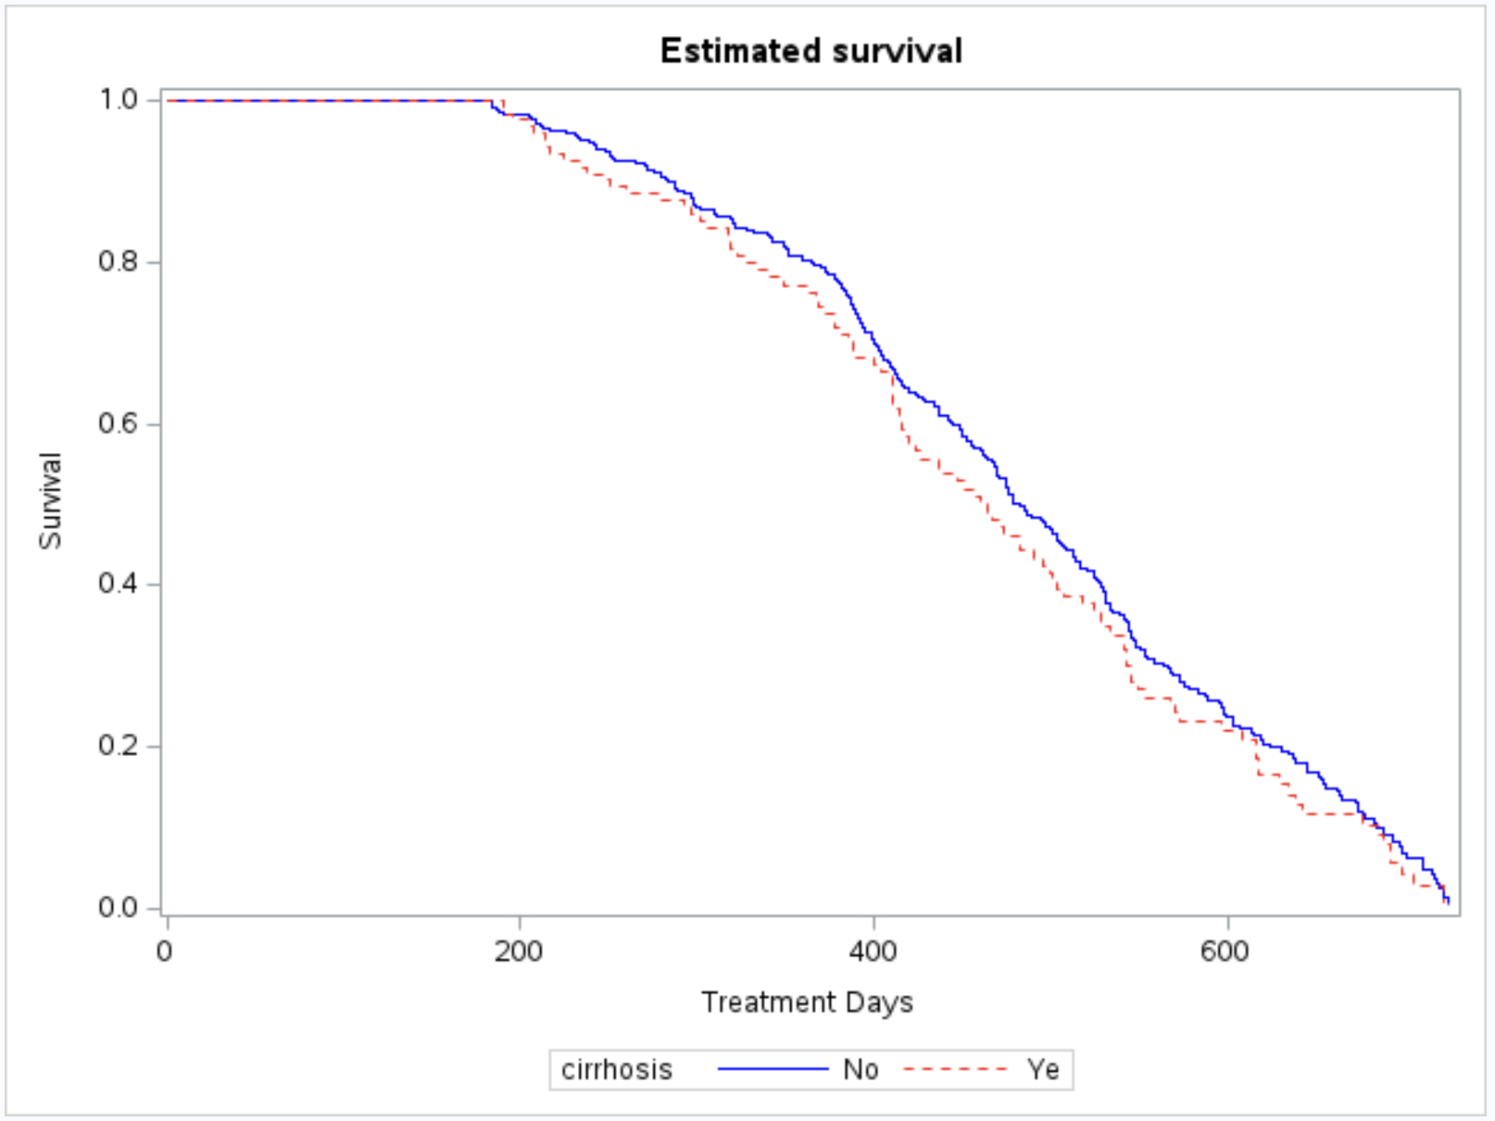
Estimated survival by Cirrhosis
Although patients with cirrhosis appeared to have higher risk, the evidence was weak.
(Fix age at 55, with no cirrhosis and Radiation treatment)

Slide 13
Conclusion
After accounting for patient characteristics and cancer stage, no strong evidence of meaningful survival differences between treatments was found.
Patient characteristics played a more key role in survival outcomes.
In particular:
  Age was associated with higher risk.
  High blood pressure showed a clear effect that changed over time.

Slide 14
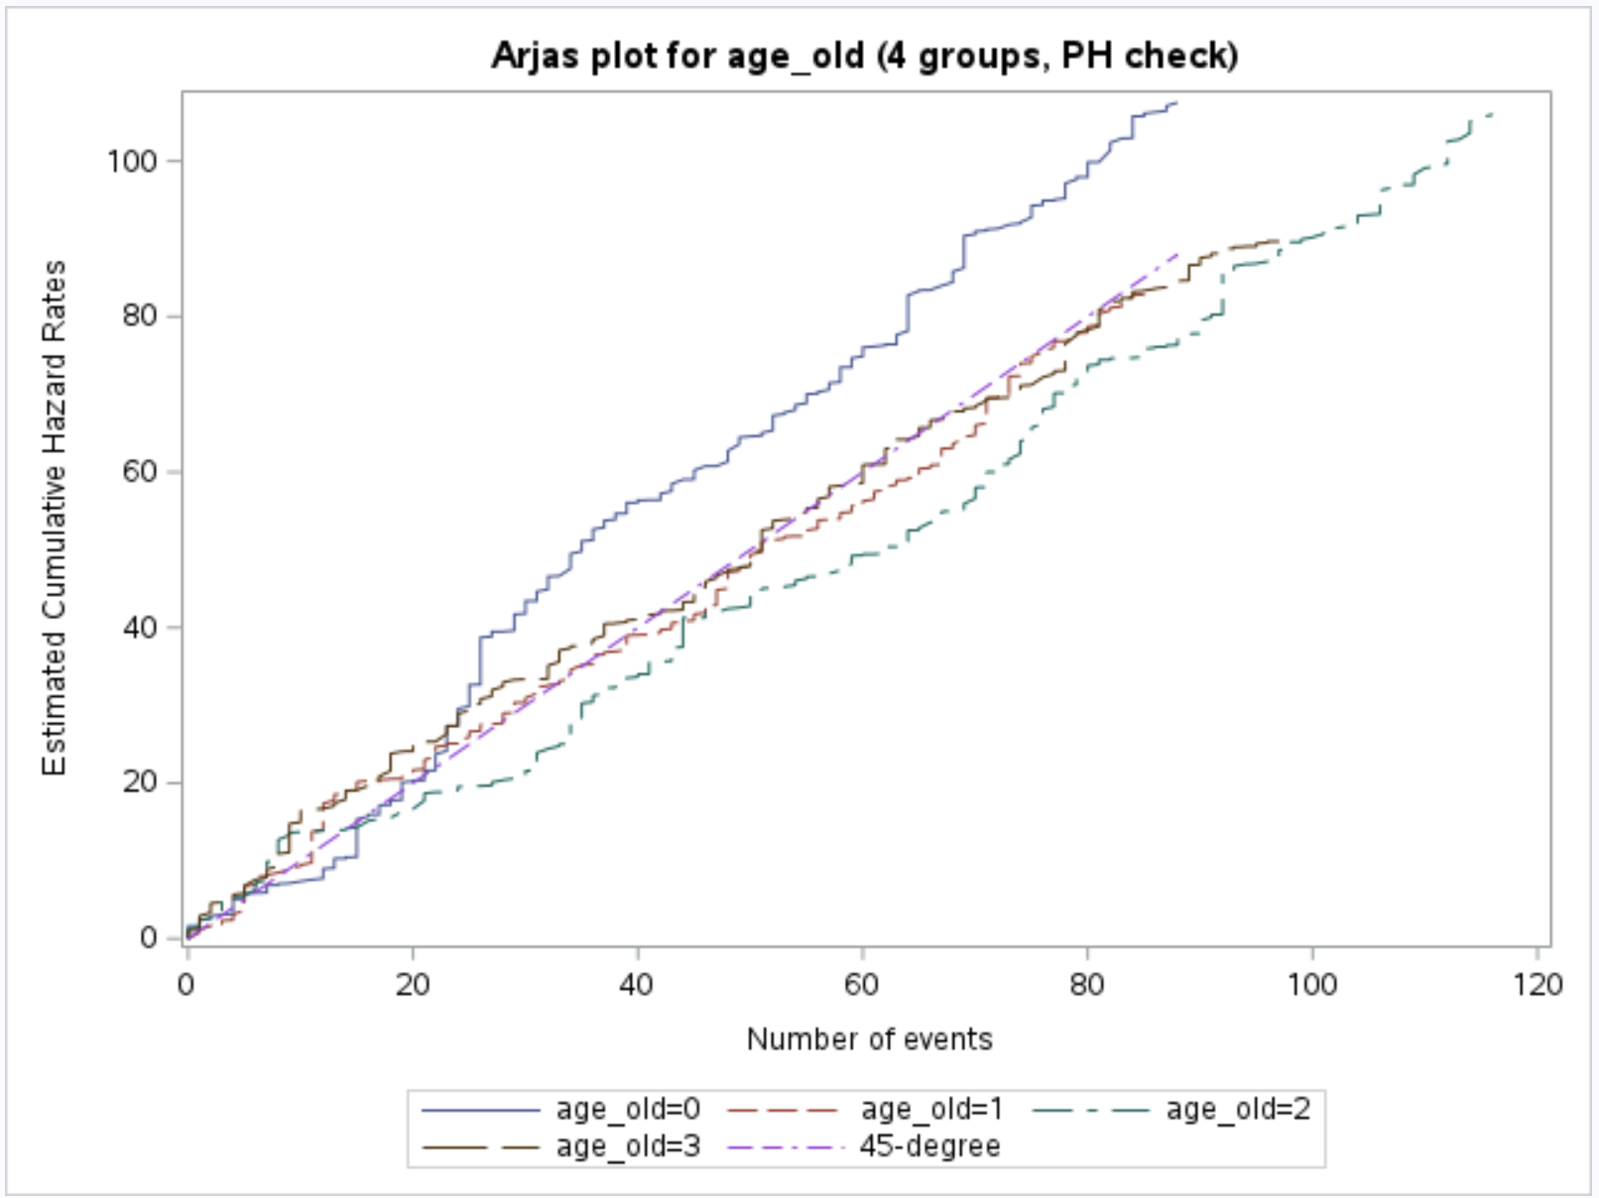
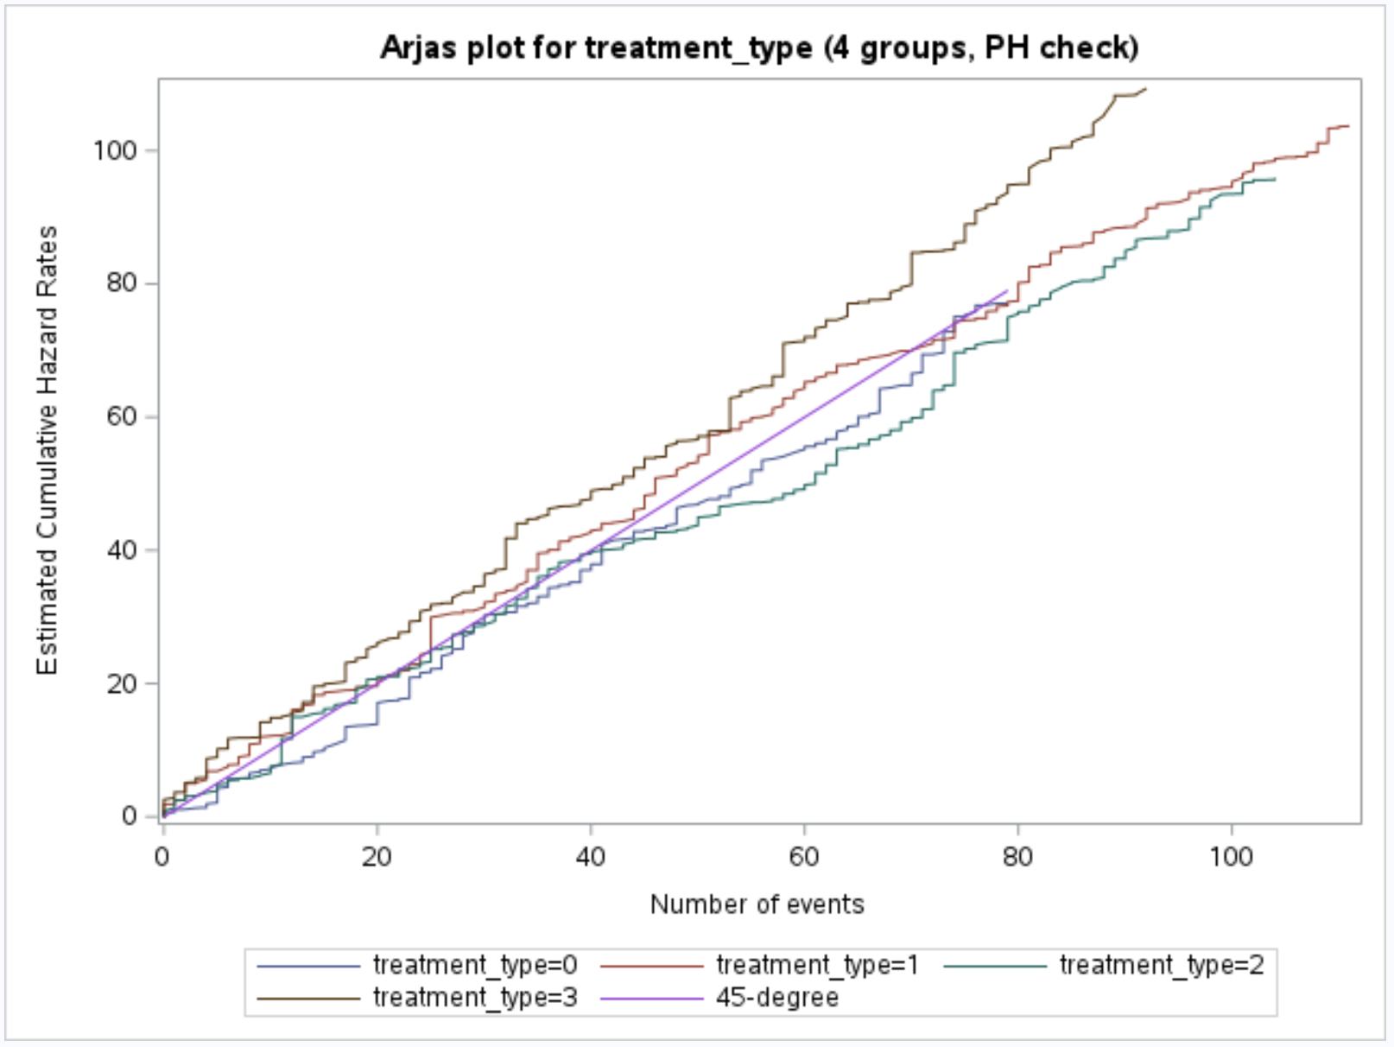
Appendix- Arjas Plot

