Slide 1
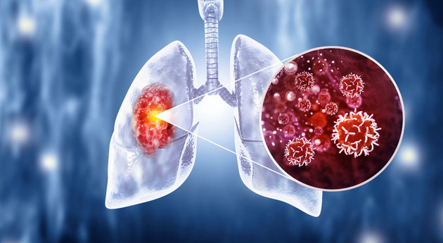
Survival Analysis of Lung Cancer Patients in Sweden
Group 11: Liang-Jen Huang, Hadeel Elhassan
Department of Statistics, Uppsala University

Slide 2
Introduction
Focus on lung cancer patients in Sweden and investigate factors associated with survival time.
Main interest: whether different treatment types are associated with different survival experiences over time.
Not all patients experience the event during follow-up, so survival analysis methods are required.
Notes:
Our study focuses on lung cancer patients in Sweden and looks at factors related to how long patients survive.
Our main question is whether patients receiving different types of treatment have different survival experiences over time.
But not all patients experience the event during follow-up and some are still alive when the study ends, so we use survival analysis methods to properly handle this type of data.

Slide 3
Data Description
A random sample of 500 lung cancer patients from Sweden was selected from the Kaggle Lung Cancer Dataset (33,161 patients in total).
During treatment, 386 patients died, while 114 were still alive when the observation period ended.
Notes:
Our data comes from a lung cancer dataset from Kaggle.
We extract the patient from Sweden, and there are 33161 people in total. We further random sample 500 people for our dataset
And there are 386 patients died and 114 alive when the treatment end

Slide 4
Data Description
Age
Gender (Female/Male)
BMI
Cholesterol level
Treatment (radiation / Chemotherapy / Surgery / Combined)
Cancer stage (I - IV)
Smoking status (Never / Passive / Former / Current)
Hypertension (No / Yes)
Asthma (No / Yes)
Cirrhosis (No / Yes)
Other cancer (No / Yes)
Family history of cancer (No / Yes)
Event
Censored
  Survival (Death / Alive)
  Treatment Days
Time
Notes:
In this analysis, we count time in treatment days.
We follow each patient from the start of treatment to the end of the treatment, and see whether they die or not.
If a patient dies, we record that.
If the patient is still alive when the treatment ends, we simply stop following them at that point.
These are the other variables in the dataset. treatment is our main focus, but we also examine other factors that may be related to survival time.

Slide 5
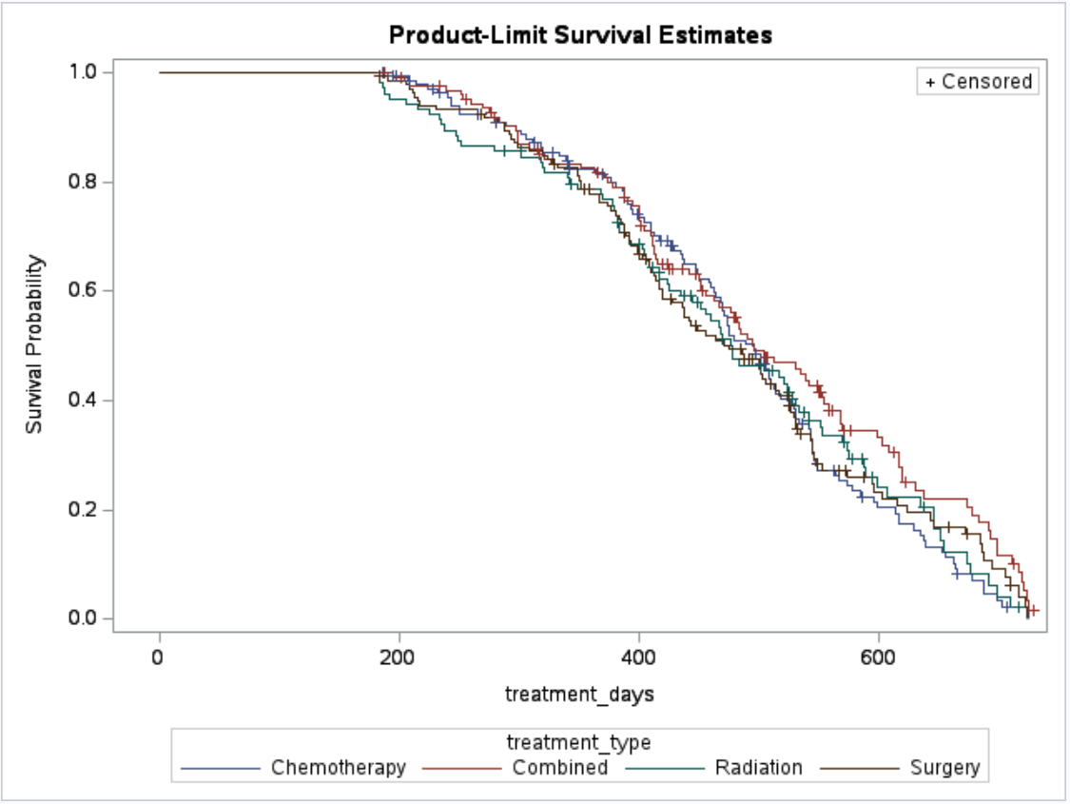
Survival Curves by Treatment Type
No clear treatment differences are observed early in time.
Combined treatment shows higher survival at later times.
Notes:
Here are the survival curves for our main variable of interest, which is treatment type. At the beginning, the treatments look quite similar.
Later on, combined treatment seems to perform a bit better.

Slide 6
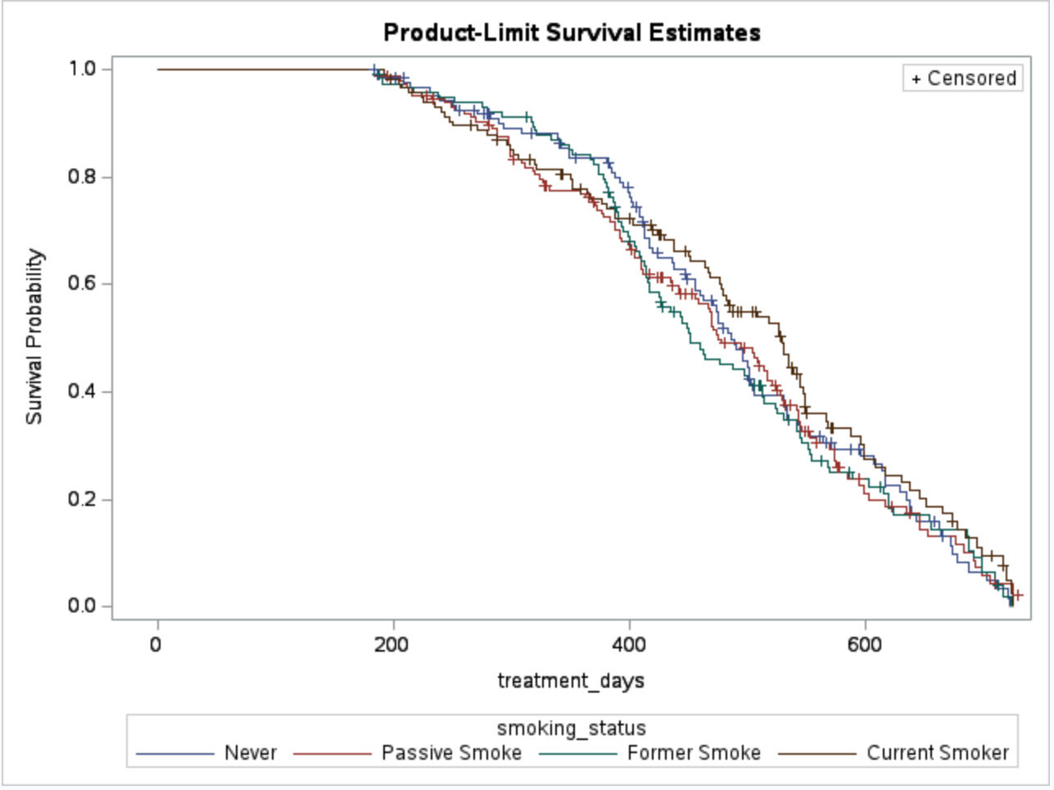
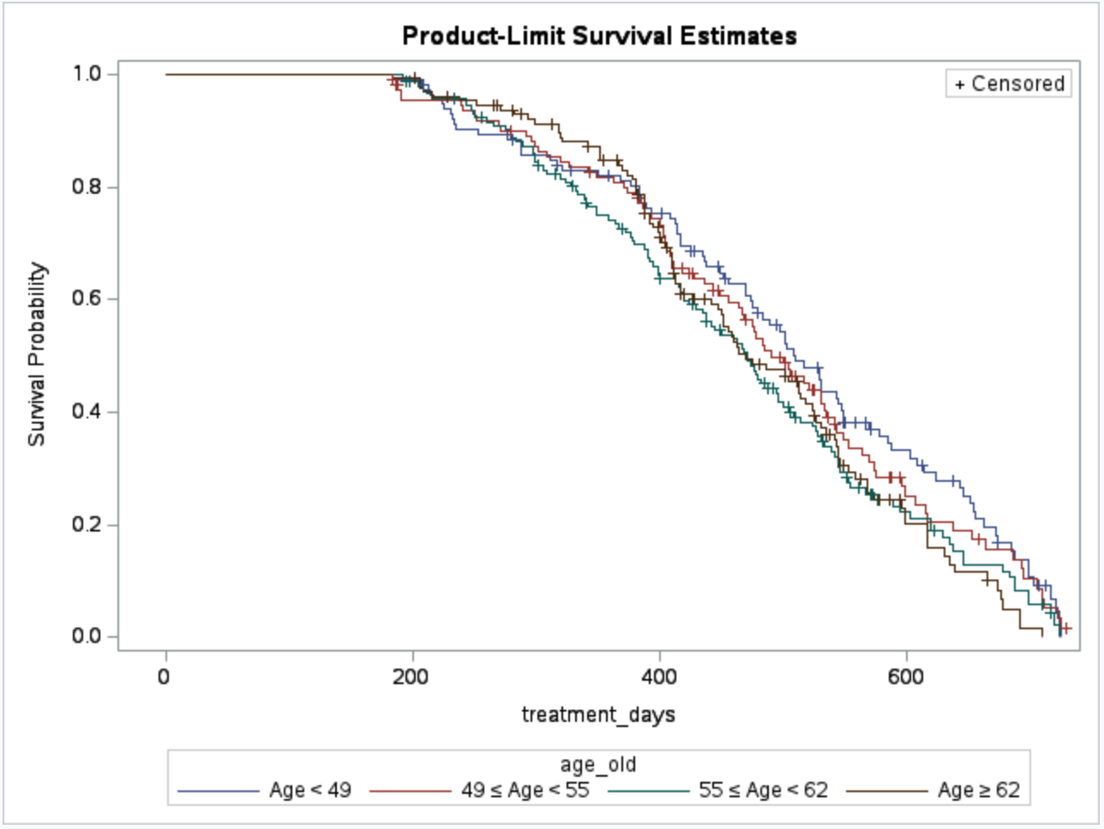
Survival Curves by Patient Characteristics
Smoking status: No clear survival differences
Age: Younger patients (<49) show higher survival.
Notes:
Next, we look at a few variables that we think might also influence survival.
For smoking status, the survival curves are pretty close, so we don’t see a clear difference in survival.
For age, we divided patients into four groups based on percentiles. Patients younger than 49 tend to survive longer, but for the older groups, the curves overlap a lot and don’t separate clearly.

Slide 7
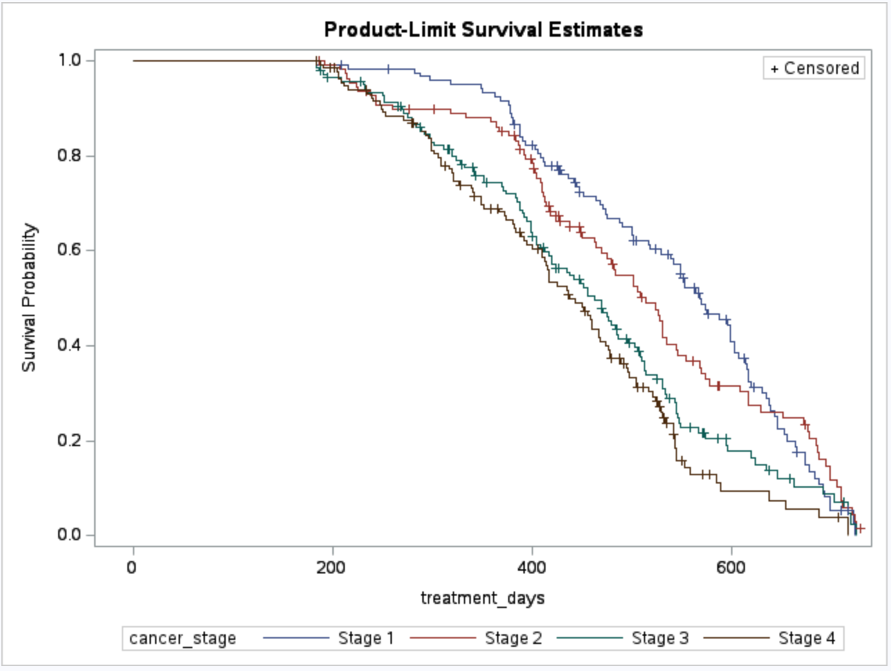
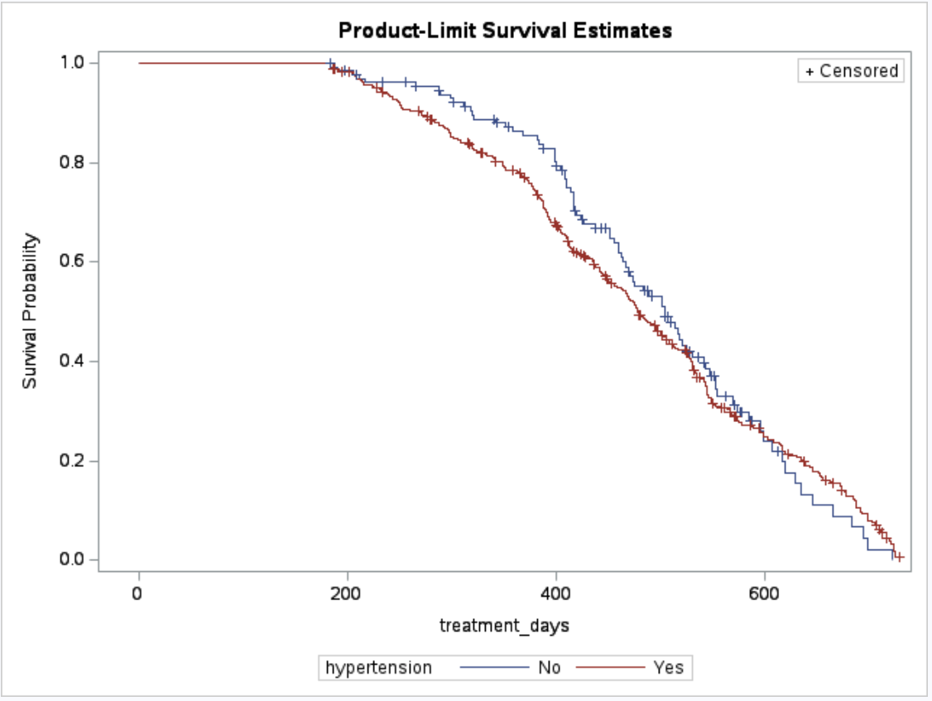
Survival Curves by Patient Characteristics
Cancer stage: Clear survival differences
Hypertension: Survival rates cross over time
Notes:
For cancer stage, we see clear survival differences, with earlier stages showing higher survival, which really makes sense
For hypertension, the survival curves cross over time. Patients with hypertension appear to have lower survival early on, but higher survival later, which is somewhat unexpected.

Slide 8
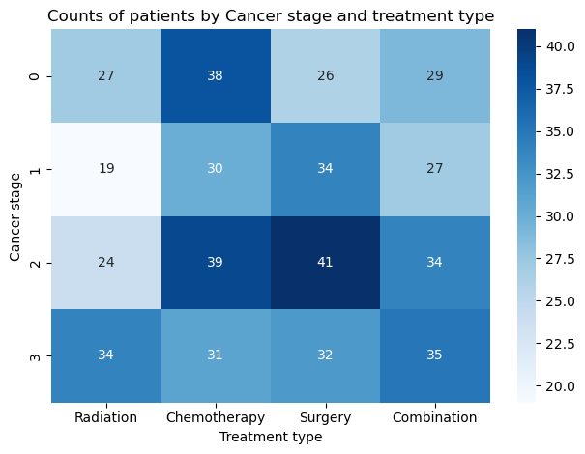
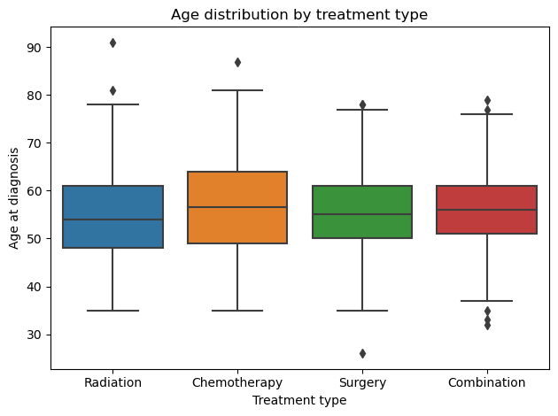
Descriptive Analysis of Patient Characteristics
Treatment groups differ in patient characteristics, so patient characteristics must be considered together when analyzing survival.
Notes:
Here we look at how treatment is related to other patient characteristics.
We can see that patients at different cancer stages tend to receive different types of treatment.
We also see that older patients are more likely to receive chemotherapy.
This tells us that when we talk about the effect of treatment on survival, we cannot look at treatment alone.
For example, patients with more advanced cancer, such as stage III, often receive specific treatments and also tend to die easily
So if a treatment seems to be associated with lower survival, it may be because the patients receiving that treatment are more severe to begin with, not because the treatment itself is worse.
So later we will consider treatment together with other patient characteristics at the same time when analyzing survival.

Slide 9
Analysis Result
This analysis was based on comparing patients within the same cancer stage.
Parameter | P-value | Hazard ratio
Age | 0.03 | 1.01
Cirrhosis | 0.23 | 1.16
Chemotherapy v.s Radiation | 0.88 | 1.02
Surgery v.s Radiation | 0.84 | 1.03
Combined v.s Radiation | 0.13 | 0.79
Hypertension | <0.01 | Strong time-dependent effect

Slide 10
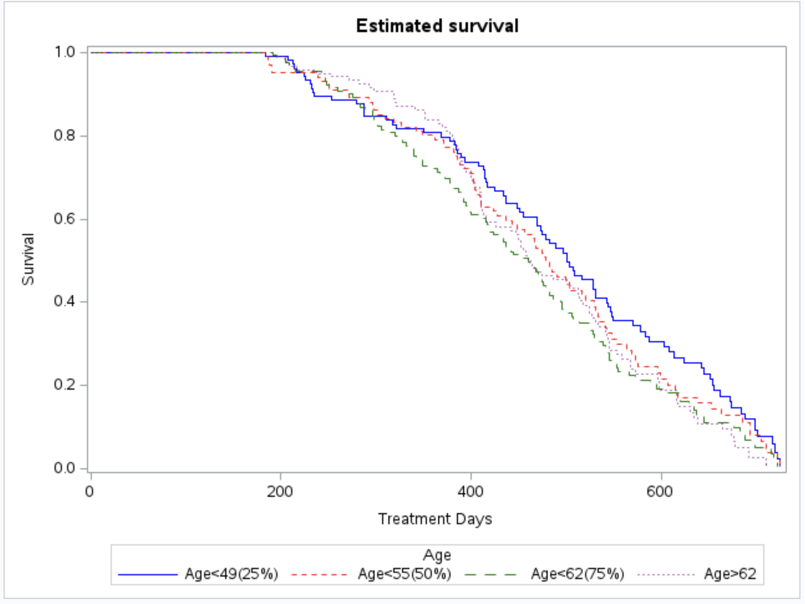
Estimated Survival by Age
Older patients are associated with a slightly higher risk.
Each additional year of age increases the risk by around 1.2%.
(Fix age at 55, with no cirrhosis and Radiation treatment)

Slide 11
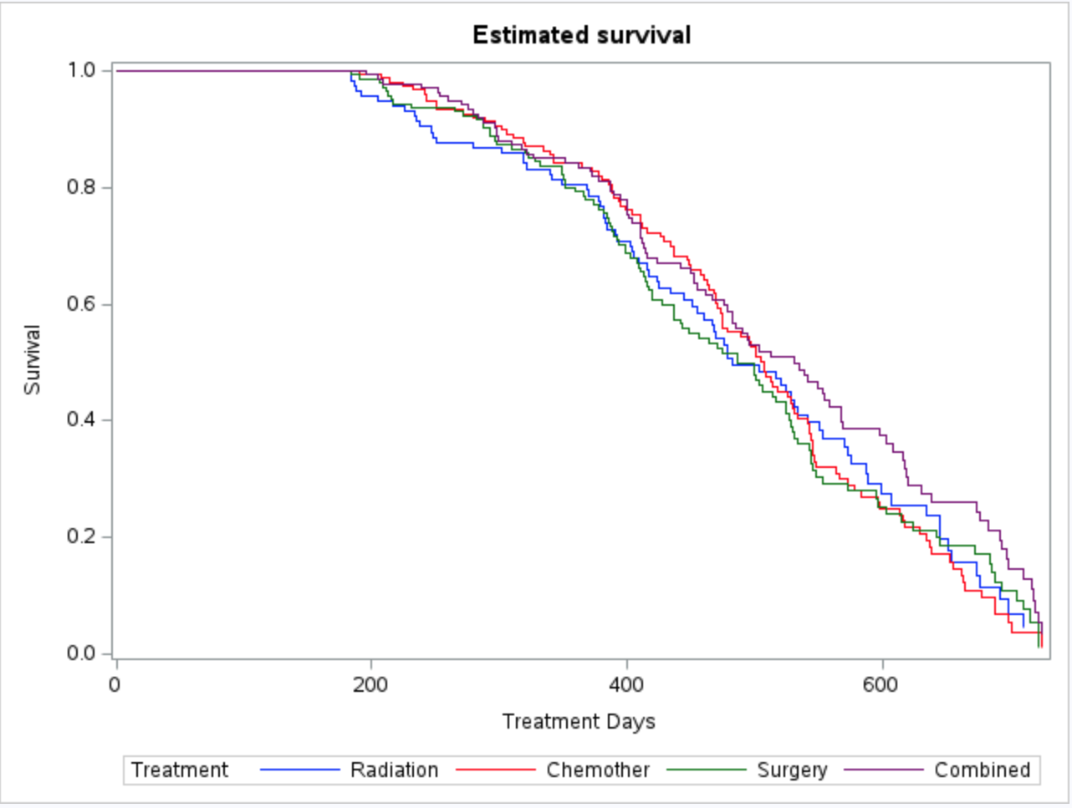
Estimated Survival by Treatment Type
After accounting for patient differences, survival is similar across treatments groups.

Slide 12
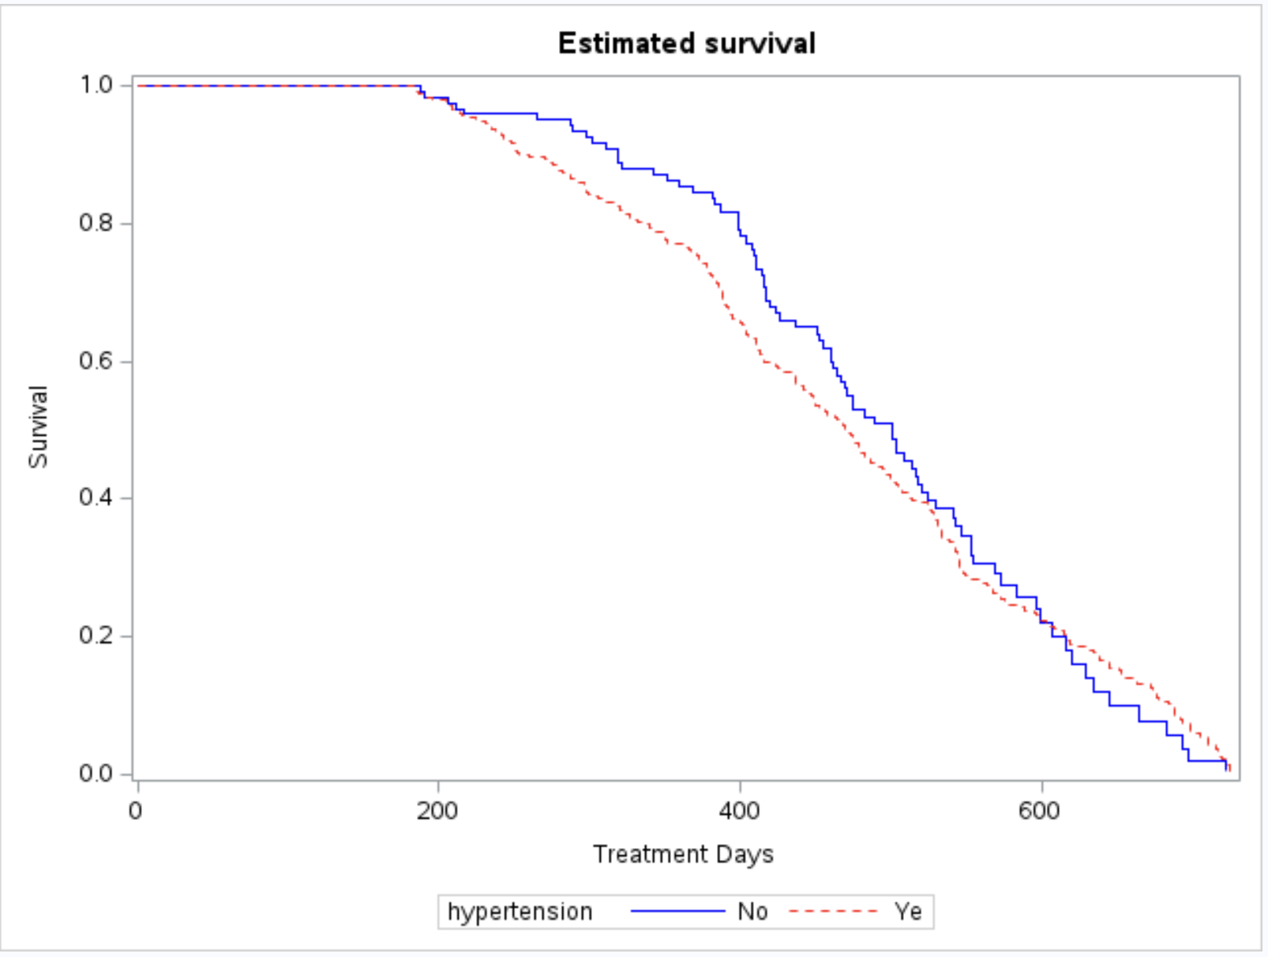
Estimated Survival by Hypertension Status
Higher risk early on, weaker effect later.
Hypertension is strongly associated with survival.

Slide 13
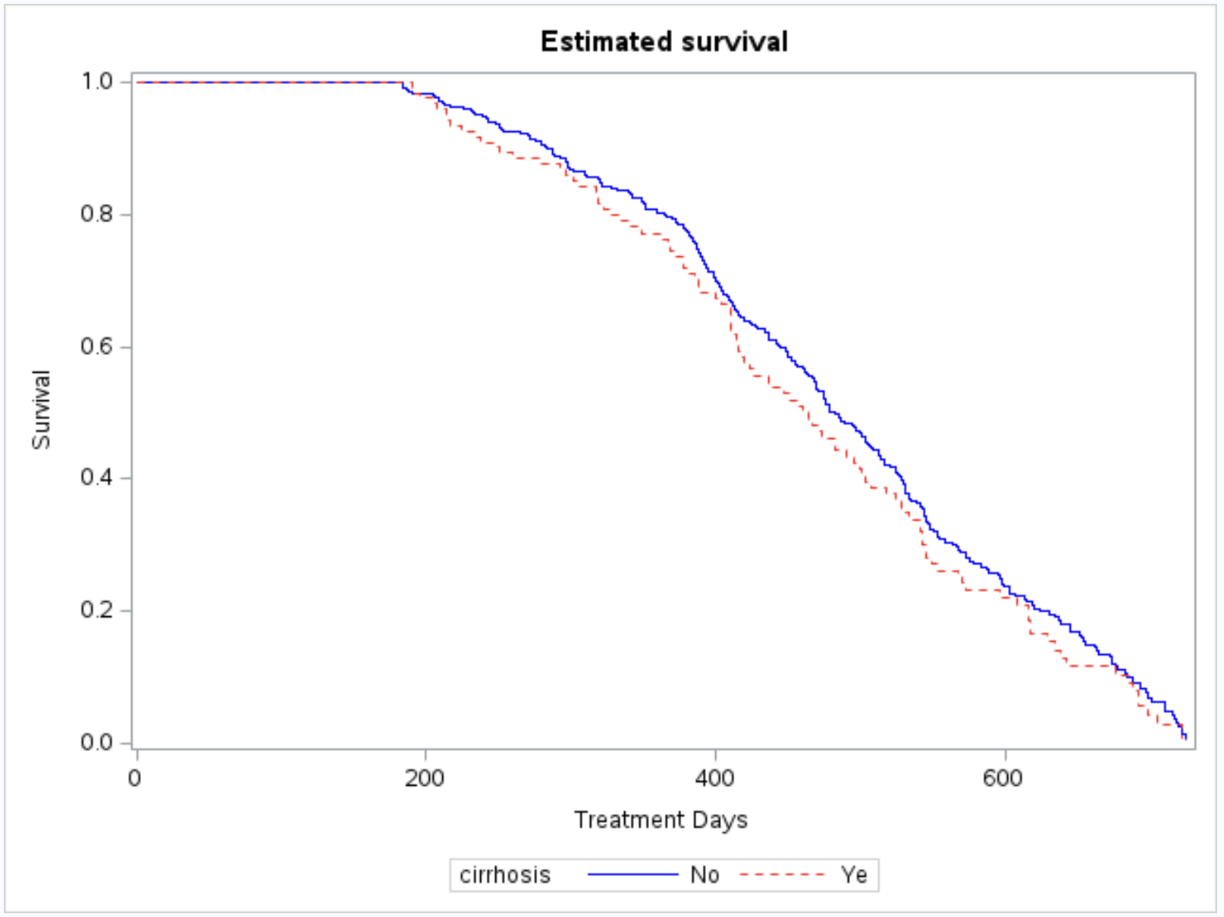
Estimated survival by Cirrhosis
Although patients with cirrhosis appeared to have higher risk, the evidence was weak.
(Fix age at 55, with no cirrhosis and Radiation treatment)

Slide 14
Conclusion
After accounting for patient characteristics and cancer stage, no strong evidence of meaningful survival differences between treatments was found.
Patient characteristics played a more key role in survival outcomes.
In particular:
  Age was associated with higher risk.
  High blood pressure showed a clear effect that changed over time.

Slide 15
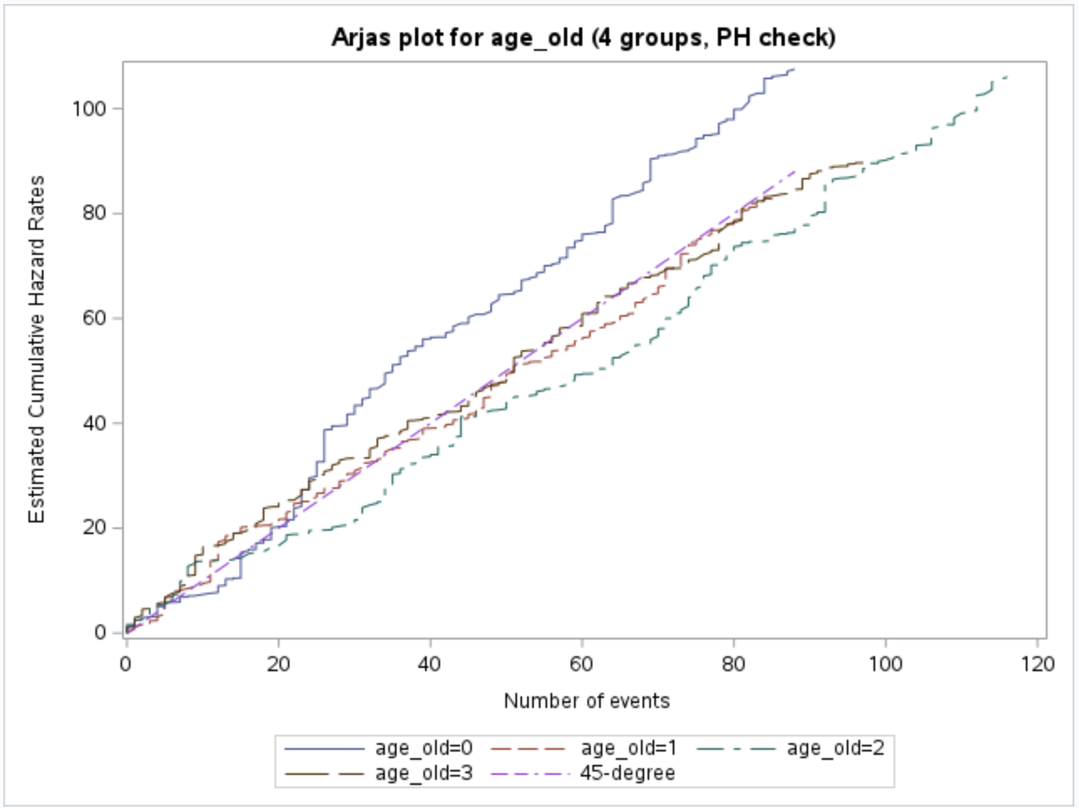
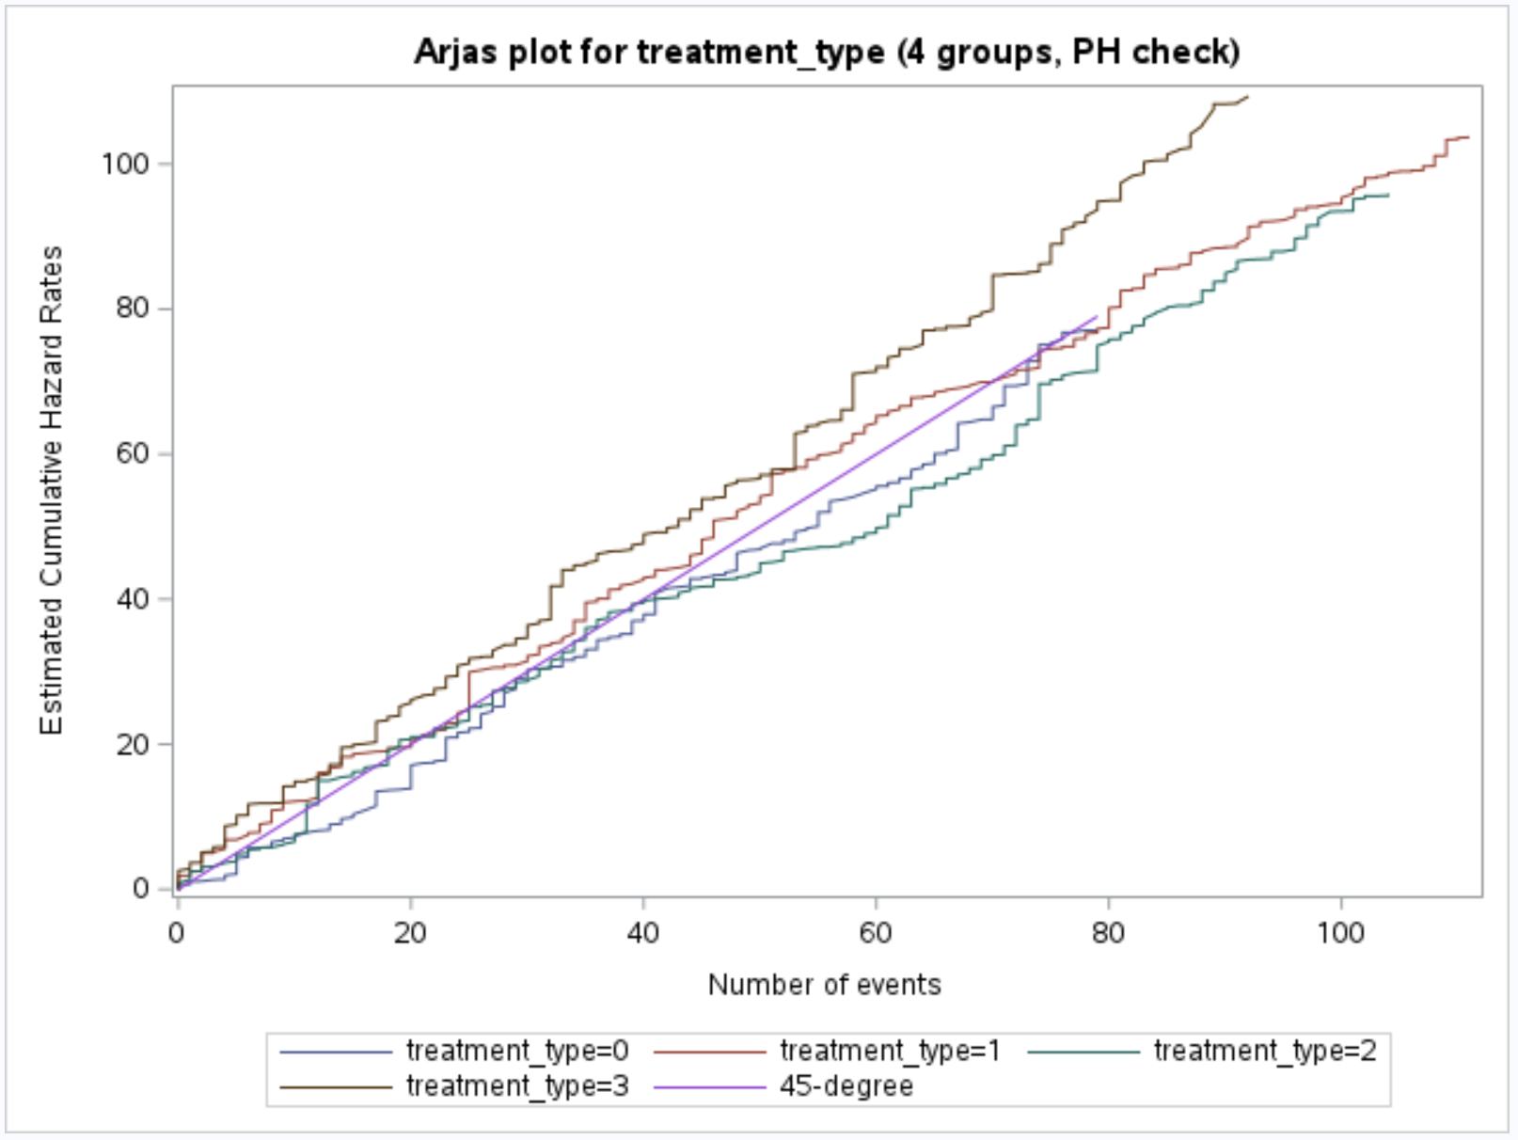
Appendix- Arjas Plot

