Slide 1
TETRIS
Roy Joseph
Anju Krishna
Athish jobin
Theophilus edoja

Slide 2
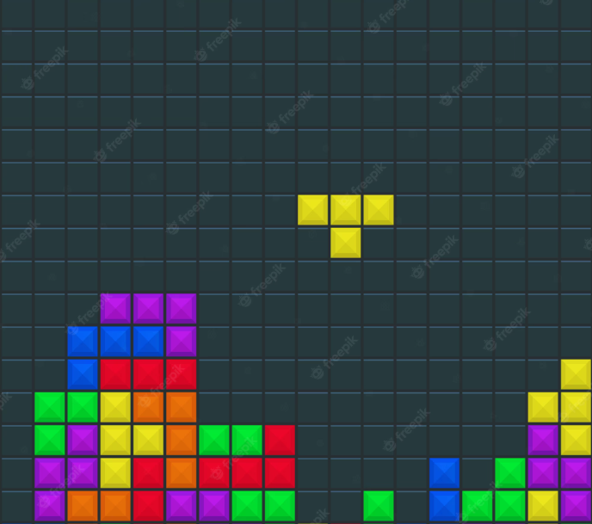
Tetris is a video game developed in 1984 by Alexey Pajitnov
Shapes in Tetris is called as tetrominoes which moves downwards to make horizontal lines.
The game window mainly made of grids of 10 x 20
The game ends when the stack of tetrominoes reaches the top.

Slide 3
TOOLS USED
Pygame
Tkinter
Python
SQL

Slide 4
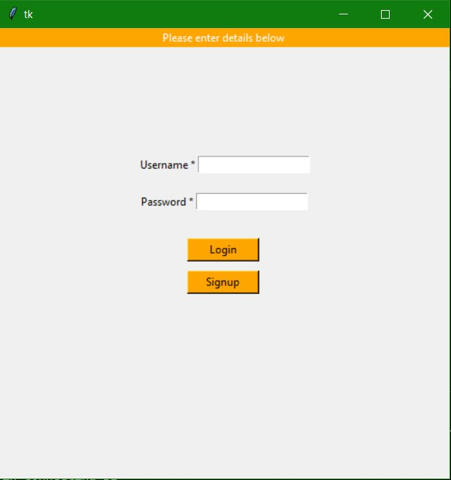
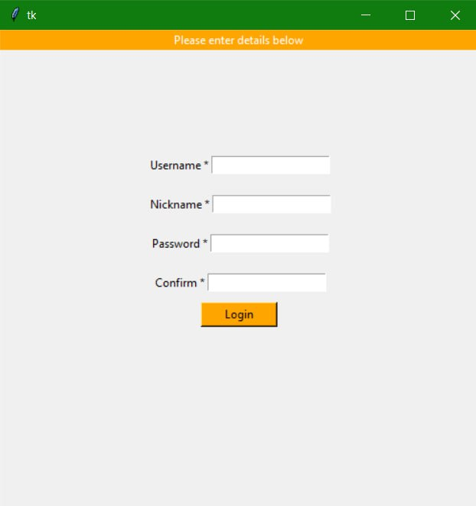
LOGIN / SIGN UP

Slide 5
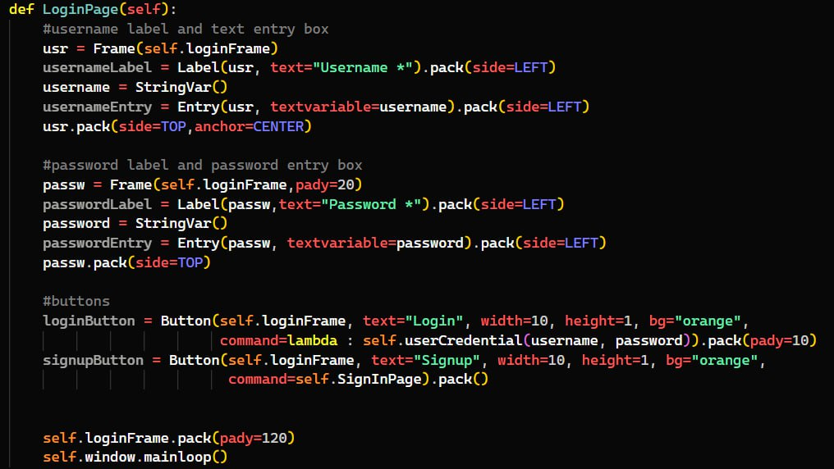

Slide 6
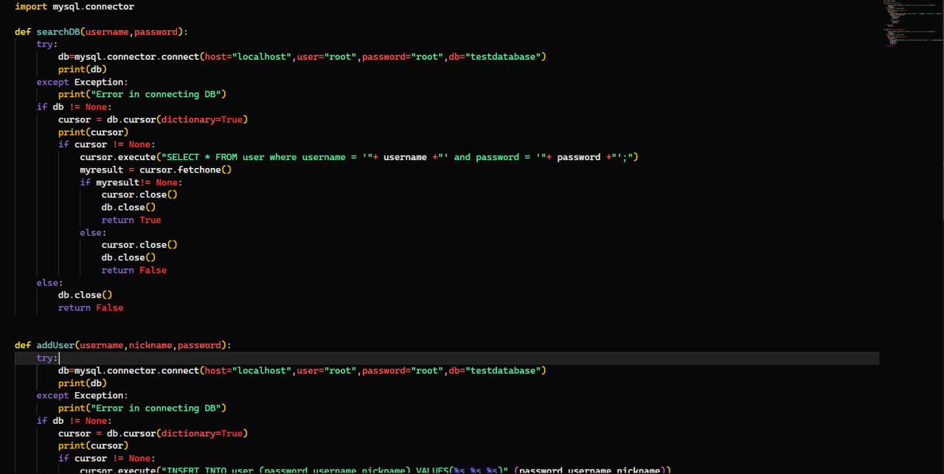

Slide 7
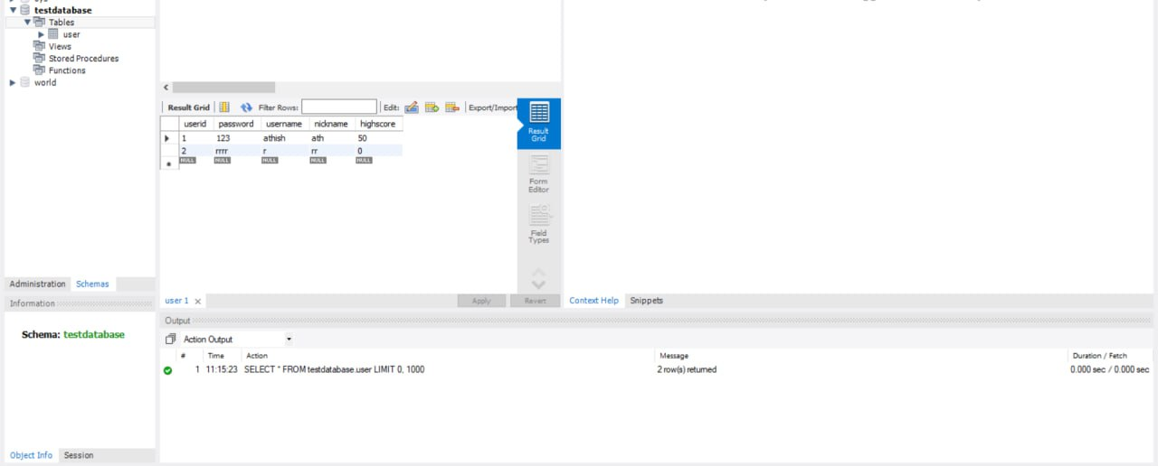

Slide 8
USER INTERFACE FUNCTIONS
Checks if the user credential is in the Data Base.
Sign up allows to register for a new user.

Slide 9
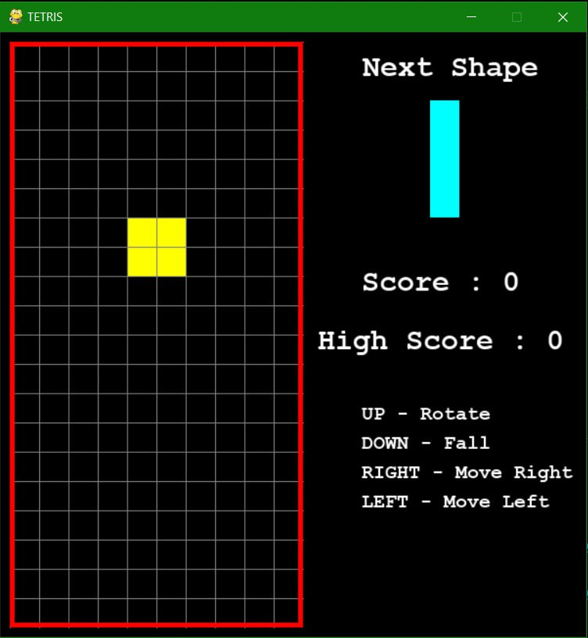
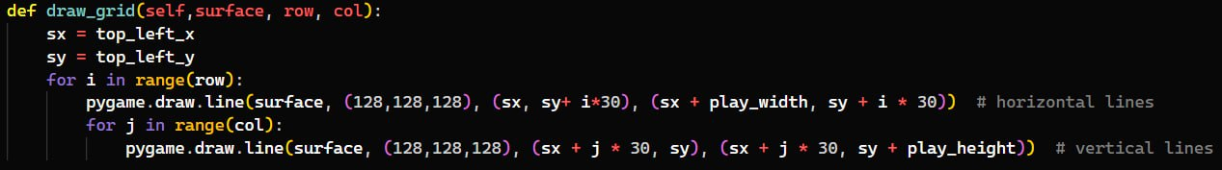

Slide 10
MAIN FUNCTIONS
convert_shape_format – rotate the shape
valid_space – check the space in grid is empty or not
clear_rows – clear the fully filled rows
draw_next_shape – displays the next shape in game window
main – call the function in a specific sequence

Slide 11
REFERENCES
Python Pygame Tetris Tutorial #1 - techwithtim.net

Slide 12
THANK YOU

