Slide 1
What brings people to parks?
Using social media, amenities and park accessibility to predict park visitation rates

Slide 2

What brings people to parks?
Why do park users choose one over the other?
Hypothesis: Park usage (i.e. the number of geolocated tweets within a park boundary) can be predicted through park size, the number and types of amenities in the park, and the number of people living with a 10-minute walk of the park.

Slide 3

What brings people to parks?
Who cares and why?
City officials
Park professionals
Community members
Conservation organizations
Landscape architects
Social equity organizations

Slide 4



What brings people to parks?
Data Sources
NYC Parks and Recreation Department
Park locations
General park attributes (e.g. park size, park type)
Park amenities
The Trust for Public Land’s ParkServe® database
10-minute walk park statistics
Twitter Streaming API
Image source: Friends of the High Line

Slide 5
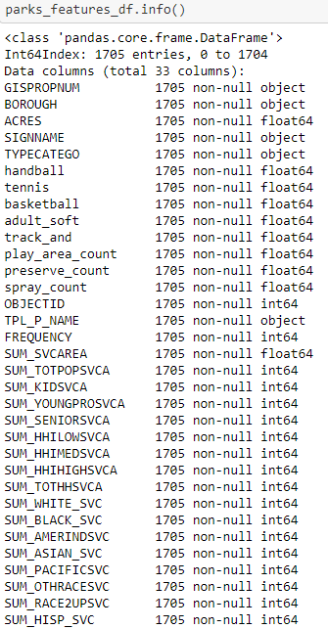
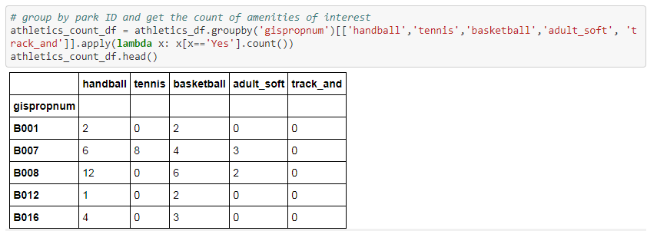
What brings people to parks?
Data Wrangling
Get amenity count for each park (total and for each amenity)
Join 10-minute walk statistics

Slide 6
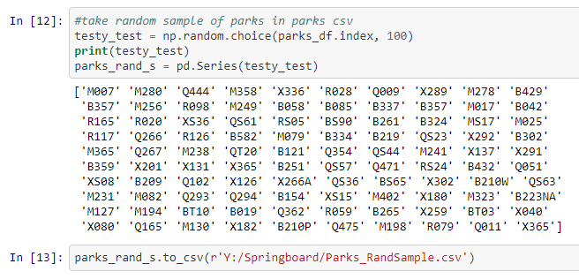
What brings people to parks?
Data Wrangling
Choose random sample of 1,705 NYC parks
Collect geolocated tweets in JSON and parse to CSV
Above code snippet originally obtained from Natural Capital Project and modified for use in this project

Slide 7
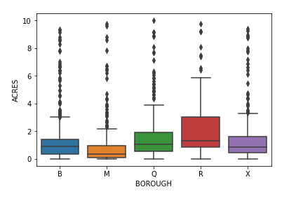
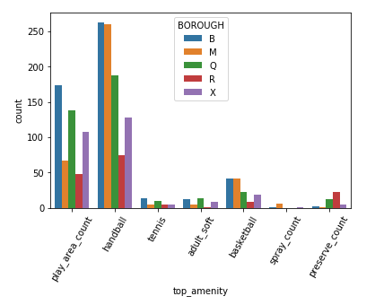
What brings people to parks?
Park size by borough
Initial Findings – Park attributes
Amenity count does not appear to be strongly correlated with park size
Manhattan has the lowest median # of park amenities and Queens has the highest.
Staten Island has the largest parks on average
No strong correlation between # of people within a 10-minute walk and park size, or # of people within a 10-minute walk and amenity count.
Handball courts are the most popular amenities in NYC parks.
Amenity count by borough

Slide 8
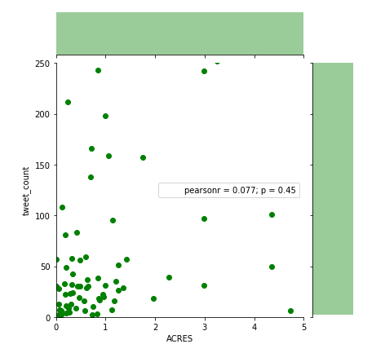
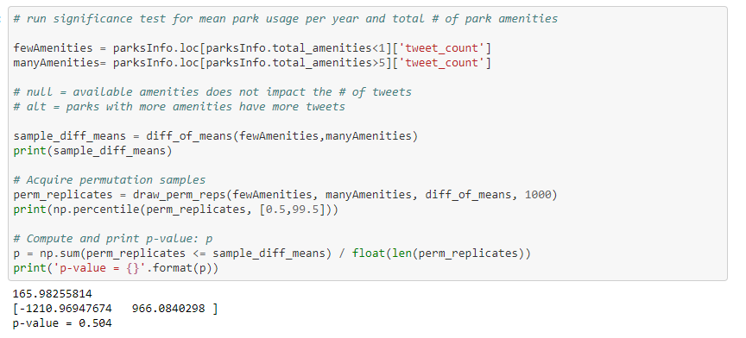
What brings people to parks?
Park size vs. # of tweets
Initial Findings – Park attributes and tweets
The number of tweets within a park boundary is not linearly correlated with park size, total number of park amenities, or number of people living within a 10-minute walk of a park.
I did not find any significant difference in means for small vs. large parks and # of tweets, parks with many amenities vs parks with few amenities and # of tweets, or parks with many people living within a 10-minute walk vs. parks with few people living within a 10-minute walk and # of tweets.

Slide 9
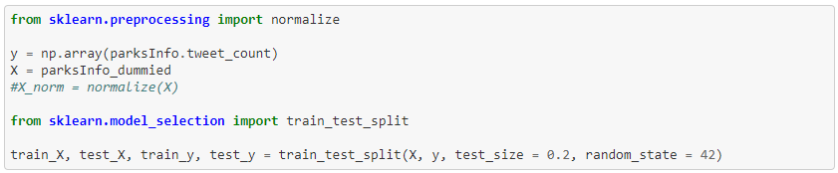
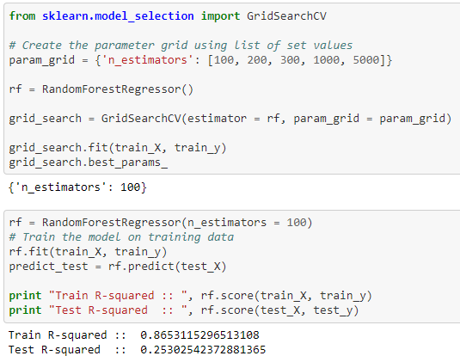
Predicting park visitation
Machine Learning – Random Forest Regressor
Results are not too great. Let’s try to do better than this!

Slide 10
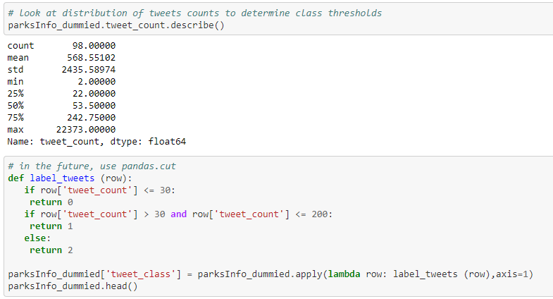
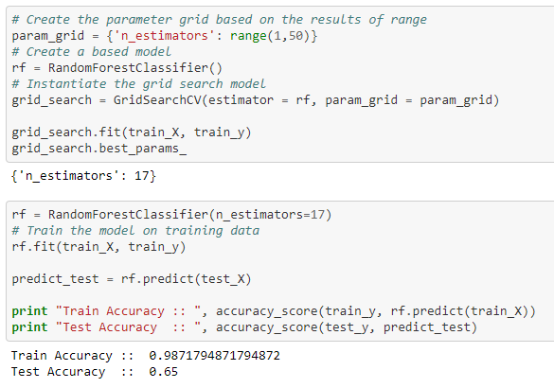
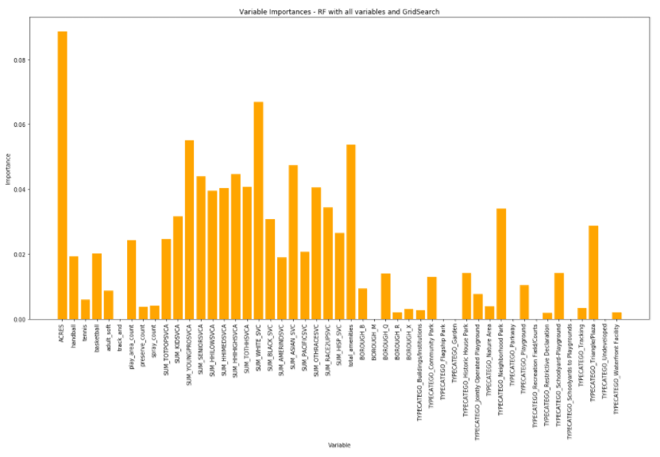
Predicting park visitation
Machine Learning – Random Forest Classifier
ACRES
OK, but not good enough!
White Population within a 10-minute walk

Slide 11
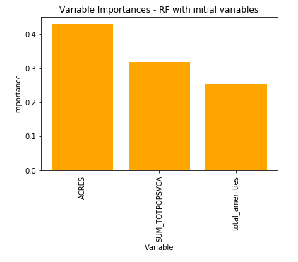
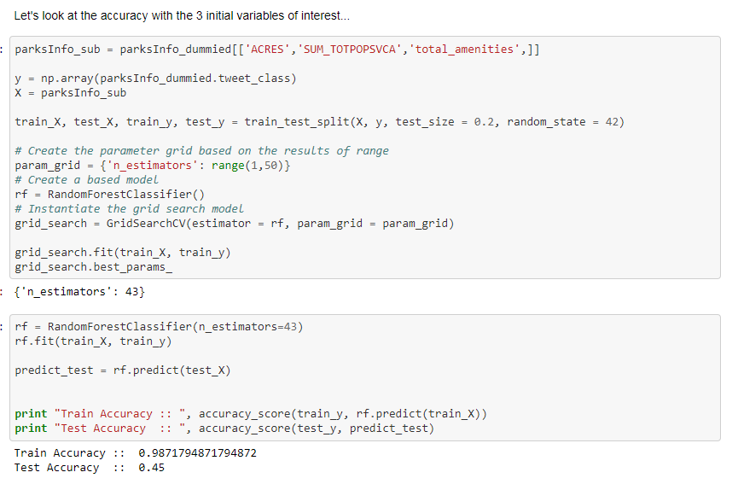
Predicting park visitation
Machine Learning – Random Forest Classifier
Definitely not good enough!

Slide 12
Predicting park visitation
Datasets for further investigation:
Public transportation
More amenities
Crime statistics
Park programming/rental facilities
Conclusions and Next Steps
Using the data at hand, park size, the number and type of amenities, and the number of people living within a 10-minute walk of the park are not reliable predictors of park usage, yet bringing more variables into the analysis strengthens the model.
Questions for further consideration:
Is the number of tweets within a park truly representative of park usage/visitation?
Define local perception of a high-quality park. Are high quality parks more likely to have a higher number of tweets?
Can the number of tweets predict park attributes, such as park type (e.g. community, pocket, regional) and park size?

Slide 13
Emmalee Dolfi
GIS Sr. Project Manager
emmalee.dolfi@tpl.org

