Slide 1
Pregnancy Hypertension Prediction
Edo Lior
June, 2025

Slide 2

Chapters Overview
1. Data Analysis
2. Preprocessing: Tabular Data
3. Preprocessing: Clinical Text
4. Models
5. Experiments
6. Results
7. Future Work

Slide 3
Data Analysis
Data: Hypertensive disorders of pregnancy - arising after 20 weeks of gestation:
1. Gestational - Hypertension – Without Proteinuria
2. Preeclampsia - Hypertension – With Proteinuria
3. Eclampsia – Seizure – With Preeclampsia
Task: Prediction of early detection – to enable preventive interventions:
1. Week target number: 15
Goal: Group of women to be referred for expensive blood testing treatments
Cohort: Hypertensive pregnancy risk grades:
1. Low
2. Moderate
3. High – Automatically referred patients for testing and are excluded from the dataset

Slide 4
Data Analysis
Data Shape: 10,000 female patient records with 157 column features
Data Formats: float64: 95, int64: 61, object: 1 (clinical sheet)
Data Size: 26.2MB
Data Memory: 12MB

Slide 5
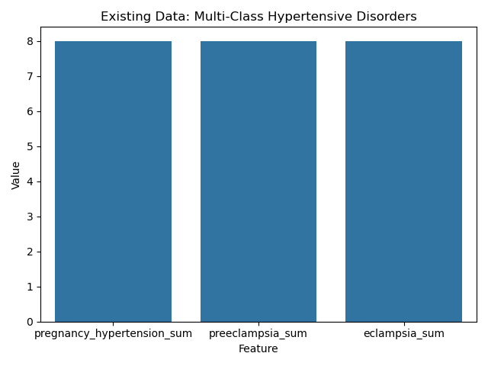
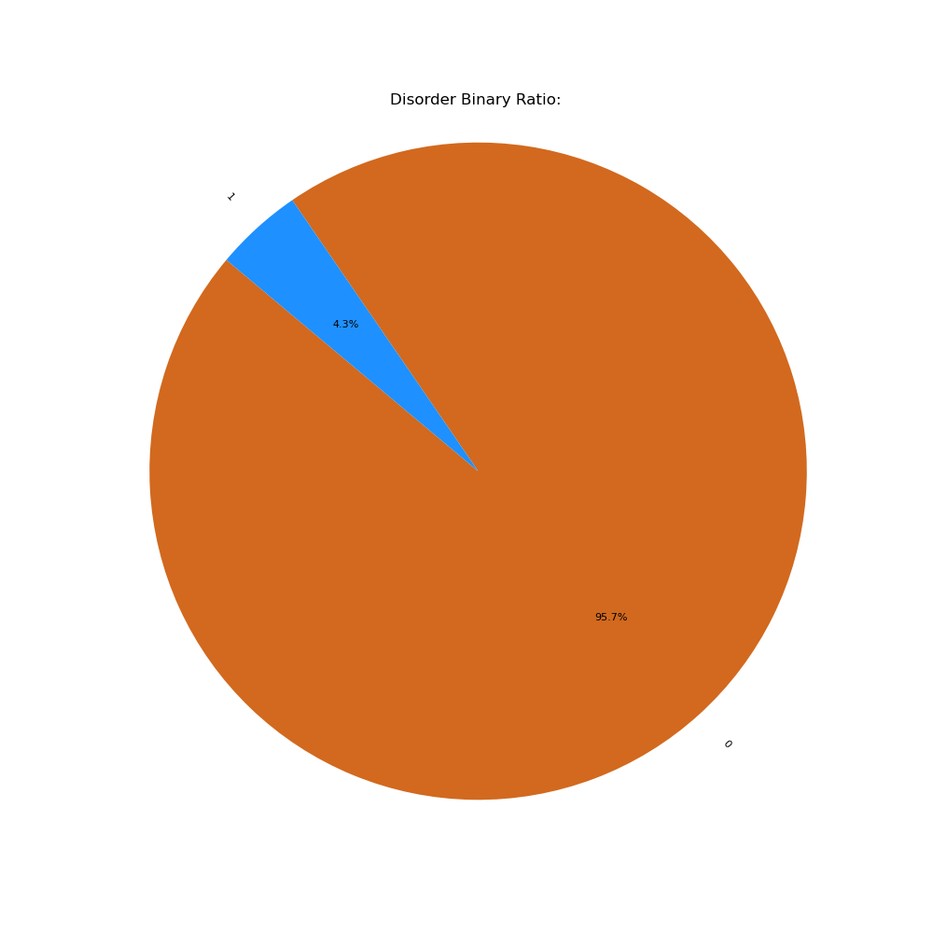
Data Analysis – Multi-Class and Binary Classes Ratio

Slide 6
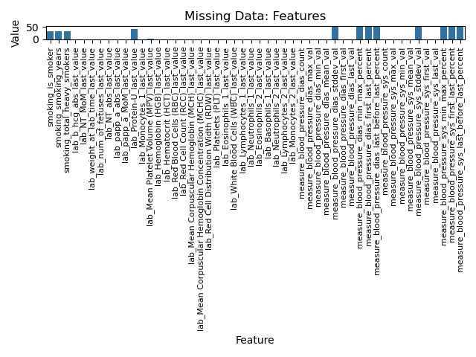
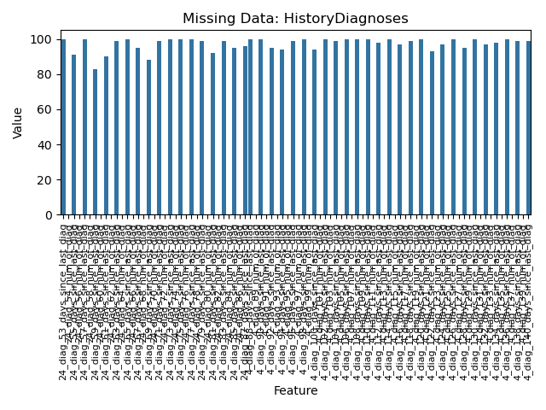
Data Analysis – Missing Data

Slide 7
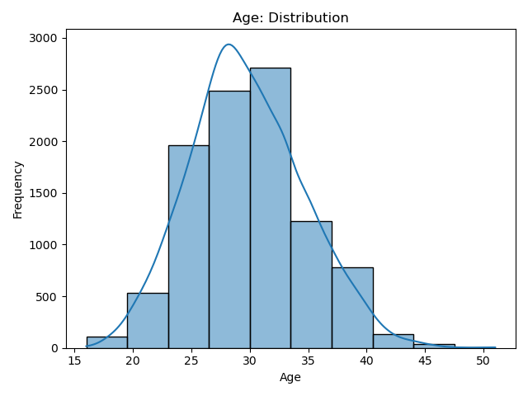
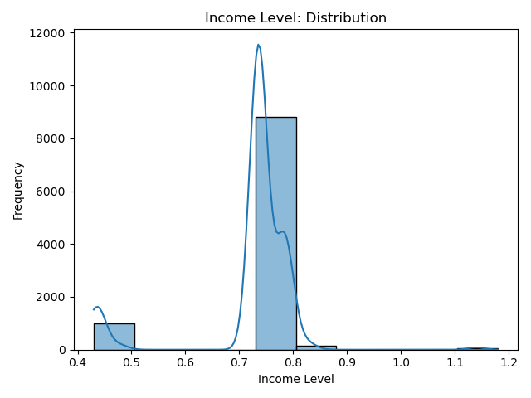
Data Analysis – Distribution Histograms

Slide 8
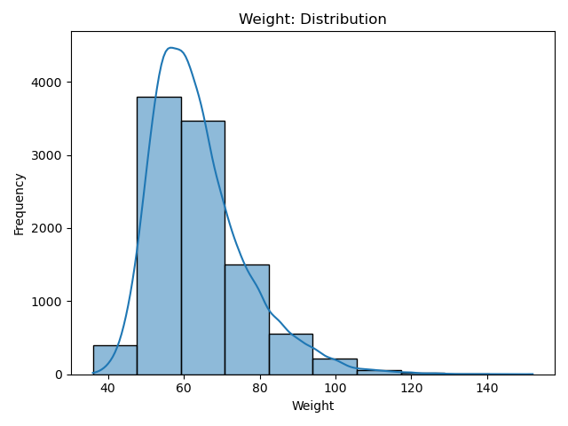
Data Analysis – Distribution Histograms

Slide 9
Preprocessing Data: Tabular
Additional tabular data features:
Extracted from the clinical notes text data
Imputation:
Filling missing data features relative to the input dataset characteristics
Simple Mean Imputer / KNN Imputer
Standardization:
Ensures all features contribute equally during model evaluation
Applied for continues numeric features (e.g., mmHg, mg/dL, age in years)

Slide 10
Feature Engineering – Tabular Data
1. Mean Arterial Pressure (MAP):
Main indicator for pregnancy toxicity of Preeclampsia
Formula:
MAP = (2 * diastolic_blood_pressure + systolic_blood_pressure) / 3
MAP thresholds for disorder:
MAP ≥ 100 mmHg → high risk
2. Pulse Pressure (PP):
Indicator for pregnancy low blood pressure disorder
Formula:
PP = systolic – diastolic
PP thresholds for disorder:
PP > 50 mmHg → high risk
3. WBC to Lymphocyte Ratio (WLR)
Common inflammation indicator of toxicity levels
Formula:
WLR = WBC / Lymphocytes
WLR thresholds for disorder:
WLR > 5 → high risk

Slide 11
Preprocessing Data: Text
Segmentation: By a specific medical report format
Parser: Extracting additional medical features for both tabular and text datasets
Normalization: Hebrew stop-words, punctuations, lower-case transformation for English terms
TF-IDF: n-grams, max features

Slide 12
Preprocessing Data: Text Features
Main Text Feature Parsing Pipeline:
For each data record additional medical features are parsed and extracted
Each week of diagnosis of a patient is added and contains multiple new features
All features from a certain week are added as column labels
For example, “Week 8”:
Tabular Column Features: 8_diastolic, 8_systolic, 8_pulse, …
Text Column Features: 8_תלונות, 8_המלצות, 8_מעבדה, 8_סיכום, …
TODO:
1. In addition, adding clinical note text features also by rows: by aggregated report information of previous weeks
For example, Patient_A which has diagnoses medical reports for weeks 6 and 8:
 | 6_systolic | 6_summary | 8_dystolic | 8_complaints
Patient_A | 120 | ‘text1’ | 80 | ‘text2’
Patient_A_6 | 120 | ‘text1’ | N/A | N/A
Patient_A_8 | N/A | N/A | 80 | ‘text2’

Slide 13
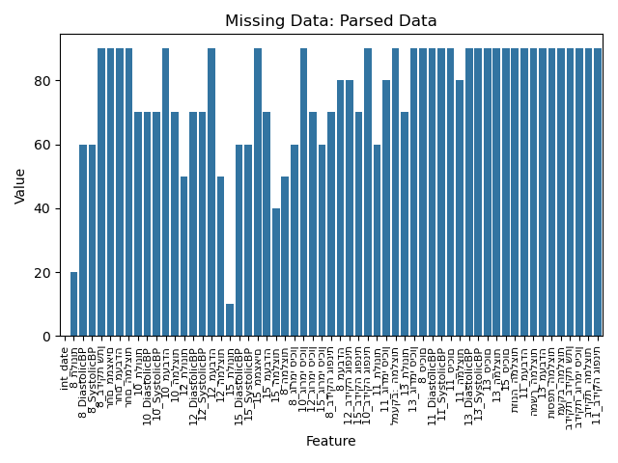
Preprocessing Data: Text Features
Example of parsed text medical features:

Slide 14
Preparing Data & Data Leakage Considerations
Target: Same train-test record cases are together in a set
Temporal: Same past-future cases are together in set for repetitive diagnoses
Preprocessing and Feature Selection: Performed on training sets only (TF-IDF, Imputation, Standardization, …)
Data Split Propensity Score Matching: Implementing KNN to match patients by similar features (Demographics, Tabular and Text)
Data Split Ratio: Balanced and by similar ratio to real-world pregnancy hypertension disorder settings
Stratified and Shuffled Data: datasets are stratified and randomly shuffled

Slide 15
Experimental Setup
Models: XGBoost, CatBoost and LightGBM
Loss Function: Binary Cross-Entropy
Fixed Percentage Threshold: 0.05
Evaluation Performance Metrics and True Cases (weighted for imbalanced data):
1. Accuracy = (𝑇𝑃+𝑇𝑁)/(𝑇𝑃+𝑇𝑁+𝐹𝑃+𝐹𝑁)
2. Precision = 𝑇𝑃/(𝑇𝑃+𝐹𝑃)
3. Recall = 𝑇𝑃/(𝑇𝑃+𝐹𝑁)
4. F1 = 2∗(𝑃𝑟𝑒𝑐𝑖𝑠𝑖𝑜𝑛∗𝑅𝑒𝑐𝑎𝑙𝑙)/(𝑃𝑟𝑒𝑐𝑖𝑠𝑖𝑜𝑛+𝑅𝑒𝑐𝑎𝑙𝑙)
5. AUC = 𝐴𝑟𝑒𝑎 𝑢𝑛𝑑𝑒𝑟 𝑡ℎ𝑒 𝑅𝑂𝐶 𝑐𝑢𝑟𝑣𝑒 (𝑇𝑃𝑅−𝑅𝑒𝑐𝑎𝑙𝑙 𝑎𝑛𝑑 𝐹𝑃𝑅 𝑡ℎ𝑟𝑒𝑠ℎ𝑜𝑙𝑑𝑠)
6. Precision−Recall AUC = 𝐴𝑟𝑒𝑎 𝑢𝑛𝑑𝑒𝑟 𝑡ℎ𝑒 𝑝𝑟𝑒𝑐𝑖𝑠𝑖𝑜𝑛−𝑟𝑒𝑐𝑎𝑙𝑙 𝑐𝑢𝑟𝑣𝑒

Slide 16
Results
Results are preliminary and incomplete due to the time limitation of the home assignment
I will further explain the model pipeline strategy in the upcoming meeting

Slide 17
Future Work
Finish the following code tasks (TODO):
Imputation of features containing missing values
Standardization of continuous features
Feature engineering: MAP, PP and WLR
Shap local force plot
Calibration plot for features age and income level
Adding clinical note text features also by rows by aggregated report information of weeks –> better model learning stability
Additional experiments:
K-fold cross validation: [3, 5, 10]
Text parser expanding Hebrew stop-words
N-grams: [(1,2 ), (1, 3)]
Max-features: [100, 1000, 5000, 10000, None (all)]
Stratified data split: By a balanced ratio of hypertensive disorder records and by the ratio of the disorders in real-world settings
Text augmentations sets: Implementing sequence augmentation sets using DL and transformer-based techniques
Model hyperoptimization: Bayesian optimization

Slide 18
Future Work
Implementing a transformer-based pre-trained model architecture: BERT, roBERTa, GPT and T5
Explainability methods:
Additional local methods: Local Interpretable Model-Agnostic Explanations (LIME), Individual Conditional Expectation (ICE) and Anchors
Additional global methods: Partial Dependence Plot (PDP), Accumulated Local Effects (ALE) and Global Surrogate Models (Decision Tree/Logistic Regression)
Imputation methods: Mice
Fine-tuning model: Incorporating additional text sources of Gestational hypertension, Preeclampsia hypertension and Eclampsia disorders

