Slide 1
Evaluating Anopheles stephensi's Impact on Malaria Distribution in Ethiopia Using Epidemiological Data
Edom Seyoum

Slide 2
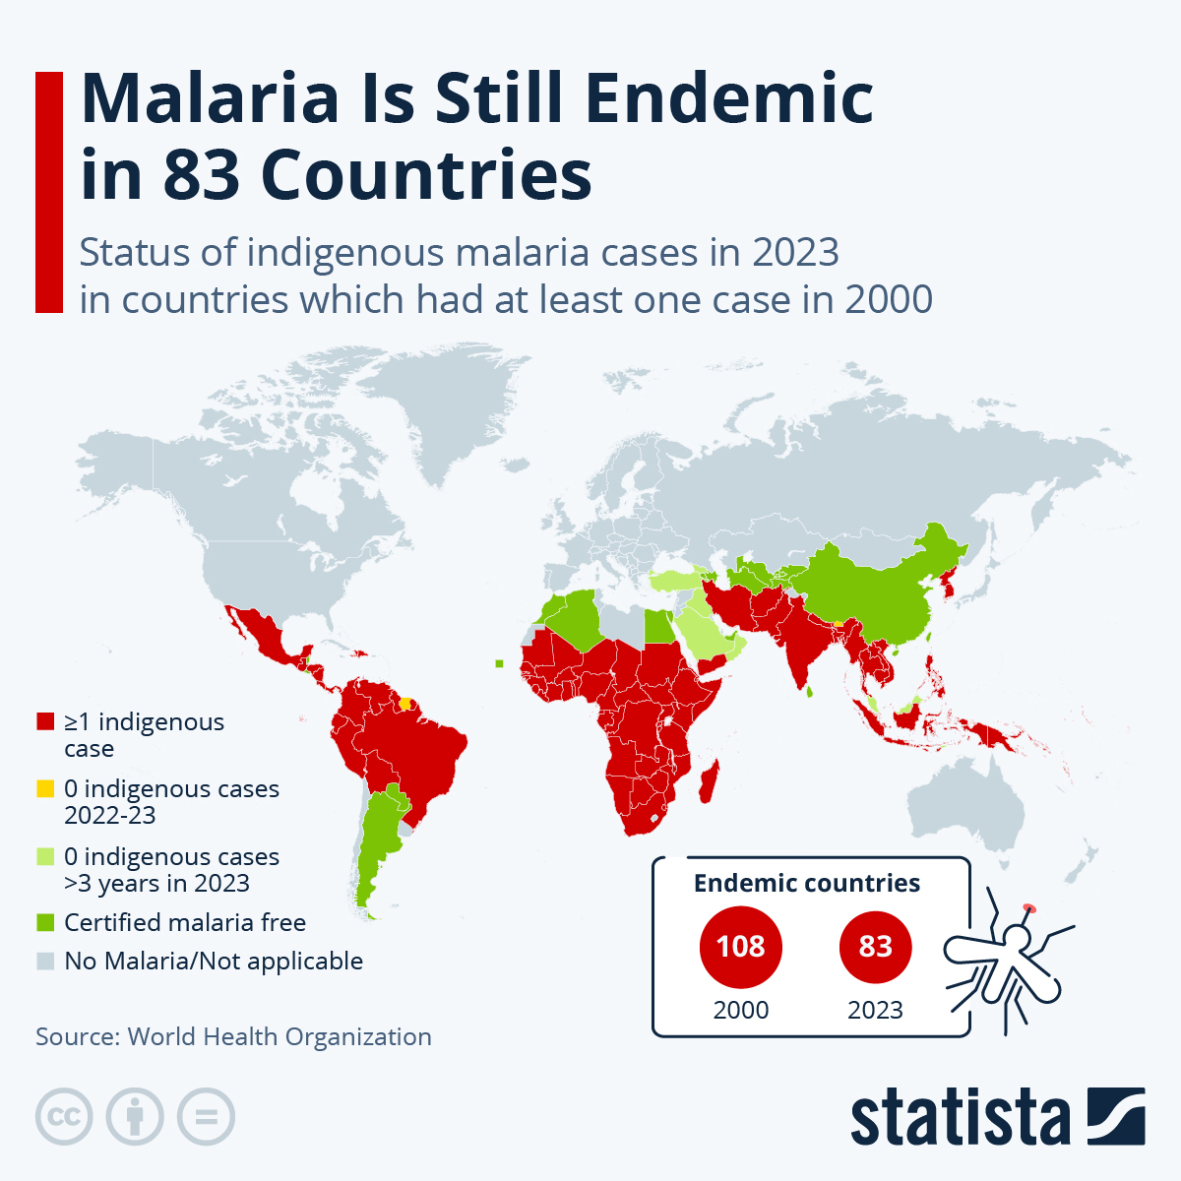
Malaria
Caused by infected female Anopheles mosquitoes
In 2023
  263 million malaria cases
  597,000 deaths
  Children under 5 accounted for about 76% of all malaria deaths
Malaria control strategies
  adaptive evolution of species
  Region specific

Slide 3
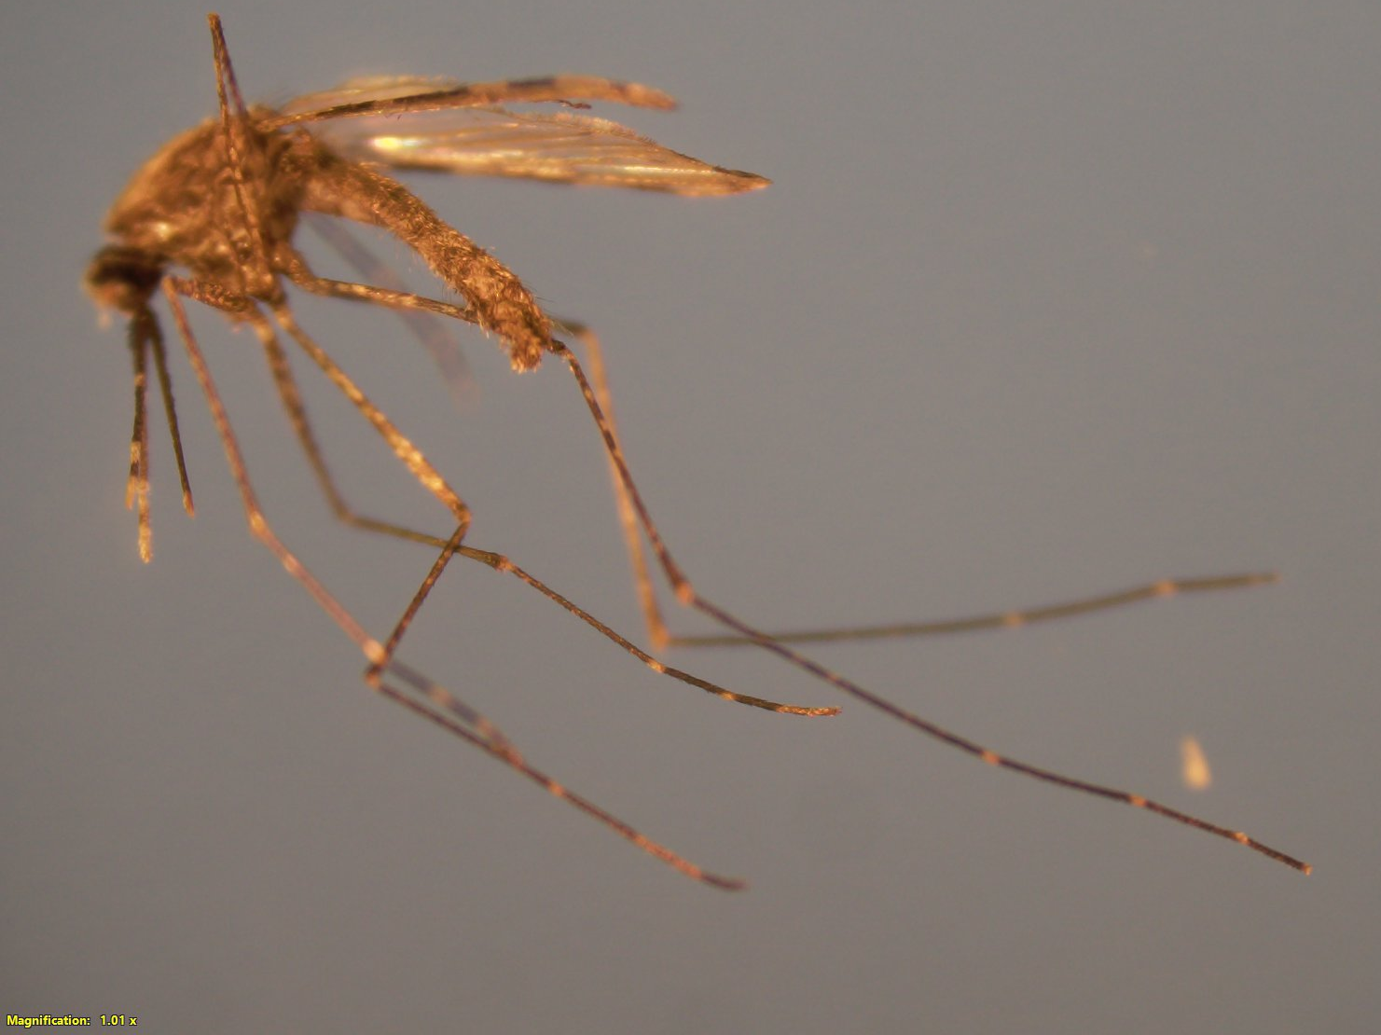
Anopheles stephensi
Invasive malaria vector that can transmit the two major forms of human malaria (Plasmodium Falciparum and P. Vivax)
Originally confined to South Asia and Arabian Peninsula
Detected in Djibouti in 2012 then Ethiopia in 2016
An. stephensi responsible for recent malaria outbreaks in HoA
Knowledge gaps on impact that An. stephensi is having on local malaria epidemiology

Slide 4
Why is this important?
Raises concern about increased malaria transmission and effectiveness of current control strategies
An. stephensi thrives in urban environments, which could potentially shift malaria epidemiology
Endures high temperatures
Insecticide resistant

Slide 5
Research Question
How has the presence of Anopheles stephensi influenced malaria transmission in Ethiopia?
What trends in malaria cases can be observed before and after Anopheles stephensi was detected?
How can we develop a tool for visualizing the transmission pattern of this invasive species?

Slide 6
Objectives
Develop a distribution map to visualize malaria case trends over time in Ethiopia
Integrate epidemiological data to assess occurrence of An. stephensi and its potential links to malaria case trends and transmission patterns
Use statistical and spatial analysis tools to identify high risk areas and support malaria control efforts

Slide 7
Epidemiological Data collected from Febrile patients
Two Health Centers
Erer Health Center
Hurso Health Center
Participated in a study
Blood spots
Survey

Slide 8
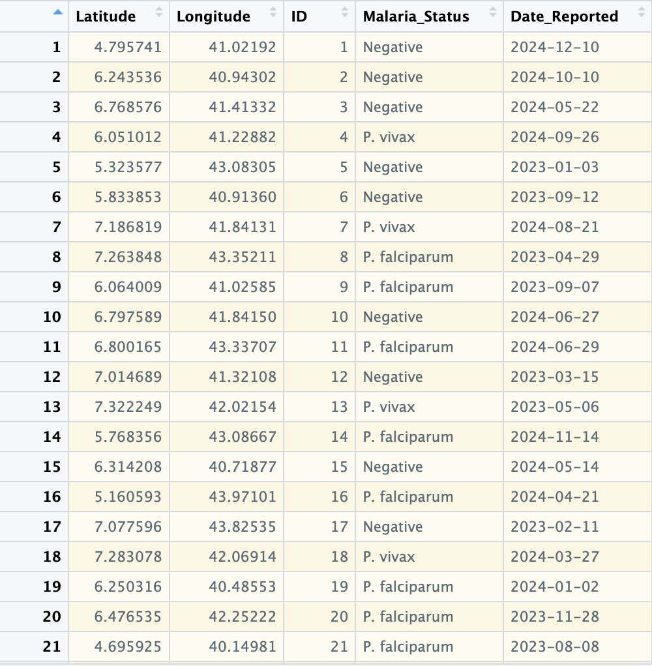
So… I had ChatGPT make up epidemiological data

Slide 9
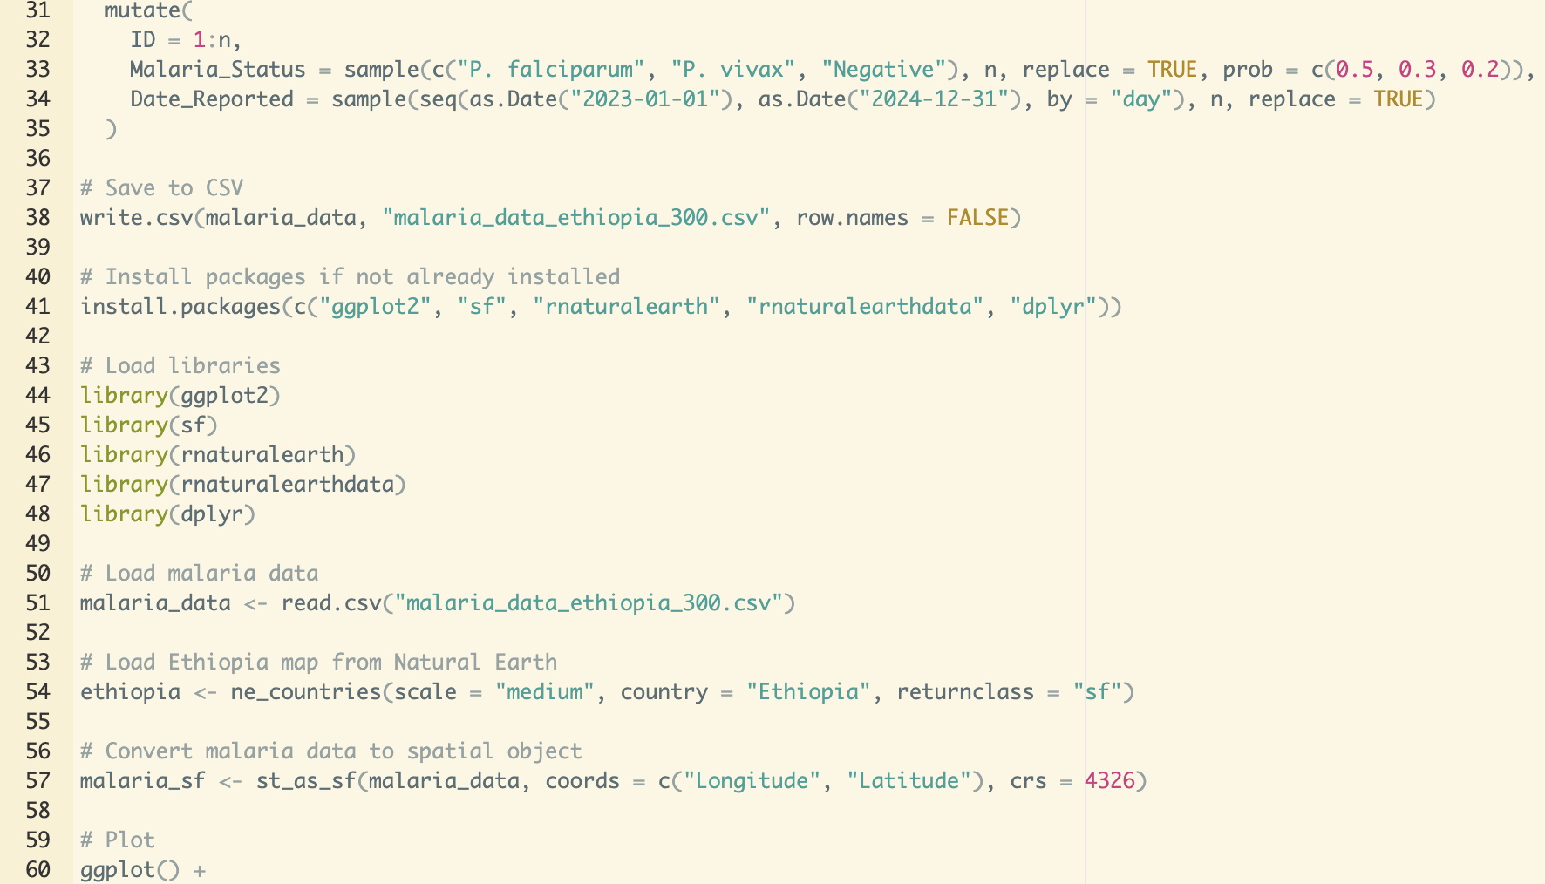
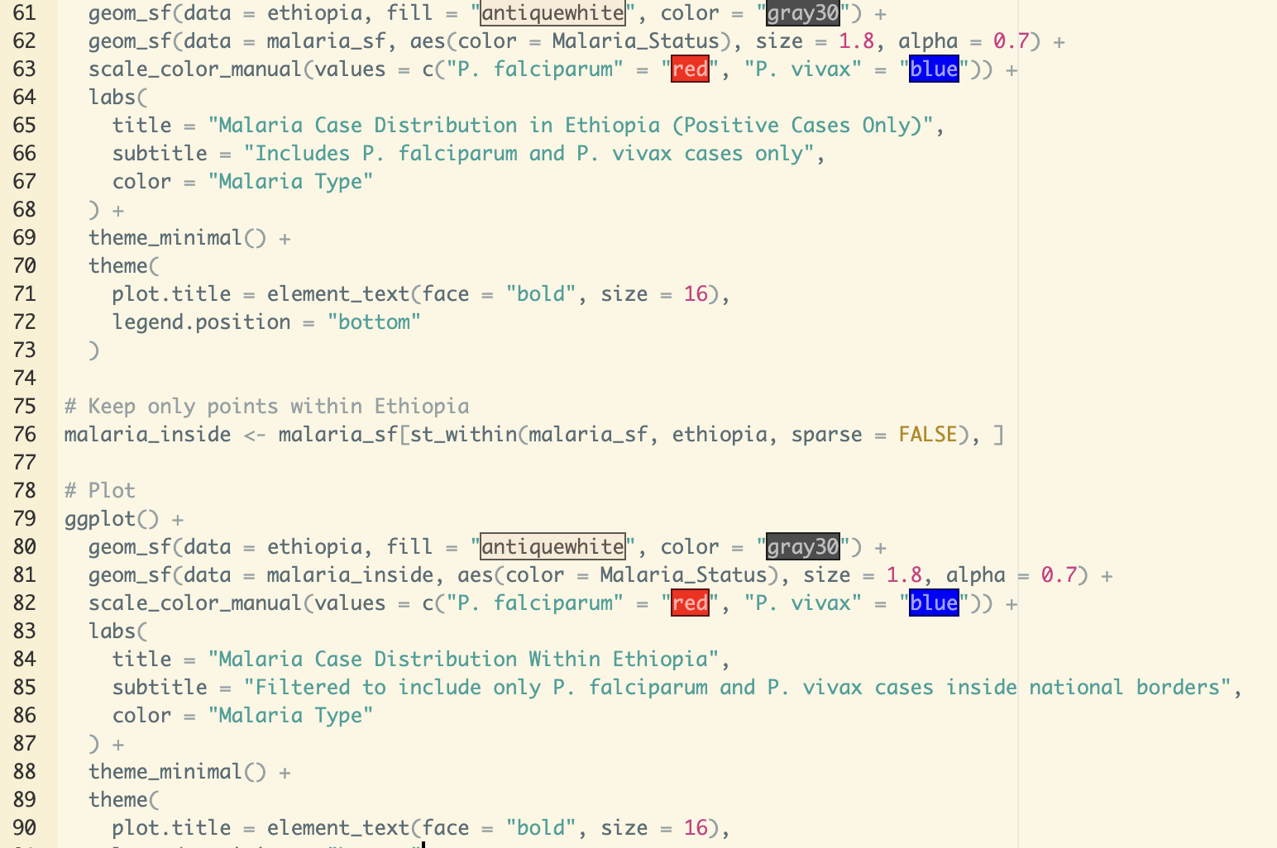
Code for R

Slide 10
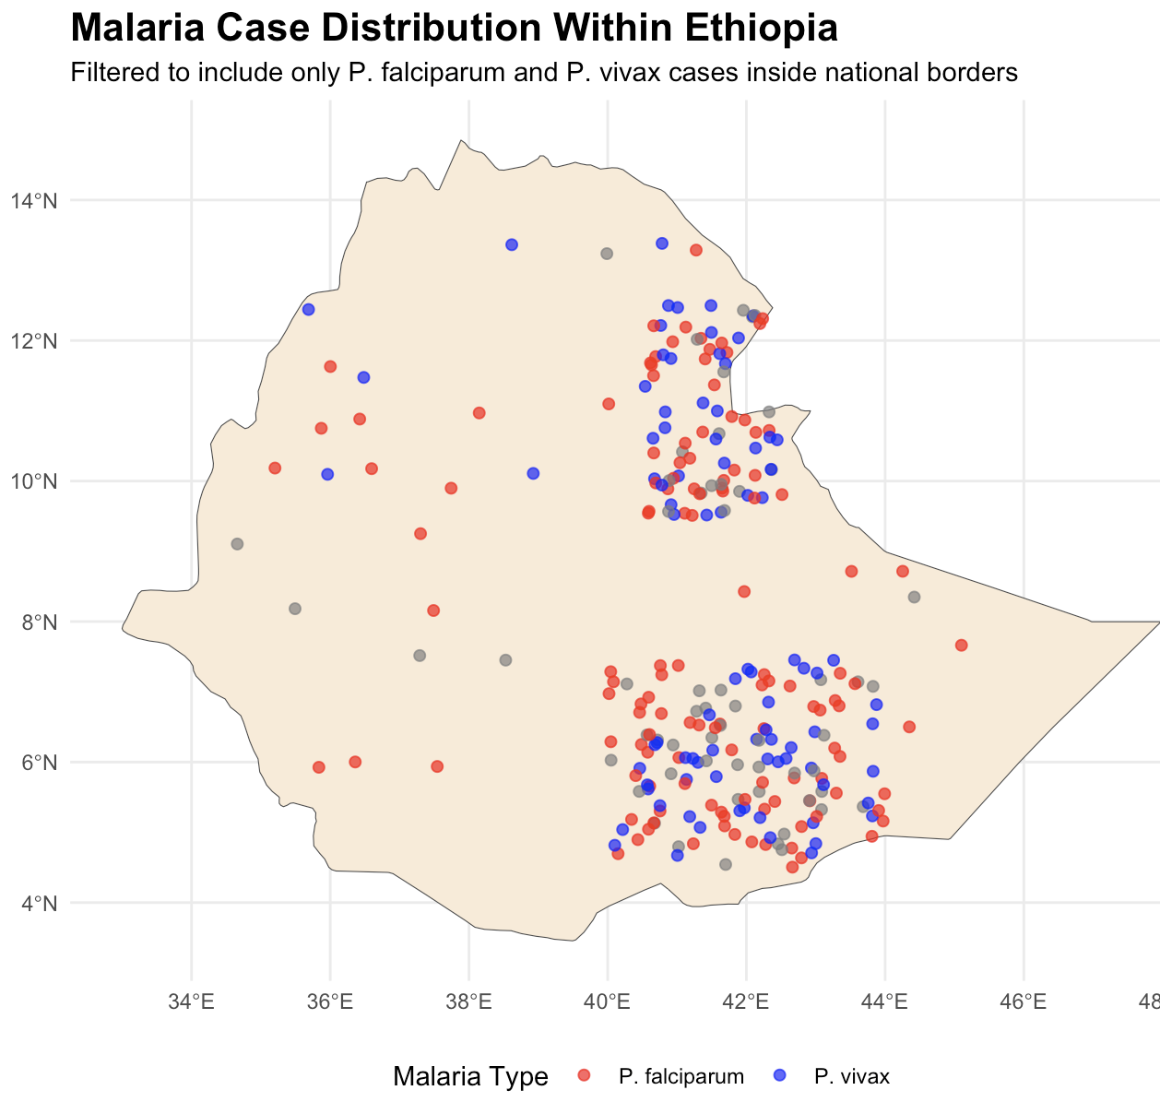
Distribution Map

Slide 11
Goal of project
Help identify potential links between the spread of An. stephensi and changes in malaria transmission
Identify high risk areas
Developing targeted intervention strategies

Slide 12
References
Balkew, M., Mumba, P., Dengela, D., Yohannes, G., Getachew, D., Yared, S., & others. (2020). Geographical distribution of Anopheles stephensi in eastern Ethiopia. Parasites & Vectors, 13(1), 35. https://doi.org/10.1186/s13071-020-3893-4
Carter, T. E., Yared, S., Gebresilassie, A., Bonnell, V., Damodaran, L., Lopez, K., ... & Balkew, M. (2018). First detection of the invasive malaria vector Anopheles stephensi in Ethiopia using molecular and morphological approaches. Acta Tropica, 188, 180-186. https://doi.org/10.1016/j.actatropica.2018.09.010
Merow, C., Serra-Diaz, J. M., Enquist, B. J., & Wilson, A. M. (2023). AI chatbots can boost scientific coding. Nature Ecology & Evolution, 7(7), 960–962. https://doi.org/10.1038/s41559-023-02063-3
Owens, H., Chamberlain, S., Ram, K., Hart, T., rOpenSci. (2023). spocc: Interface to Species Occurrence Data Sources. Retrieved from https://cran.r-project.org/web/packages/spocc/index.html
Perkel, J. M. (2023). Six tips for better coding with ChatGPT. Nature, 618(7964), 422–423. https://doi.org/10.1038/d41586-023-01833-0
R Core Team. (2024). R: A Language for Statistical Computing. https://www.r-project.org/
Yadav, C. P., & Sharma, A. (2022). National Institute of Malaria Research-Malaria Dashboard (NIMR-MDB): A digital platform for analysis and visualization of epidemiological data. The Lancet Regional Health. Southeast Asia, 5, 100030. https://doi.org/10.1016/j.lansea.2022.100030

Slide 13

Thank you

