Slide 1
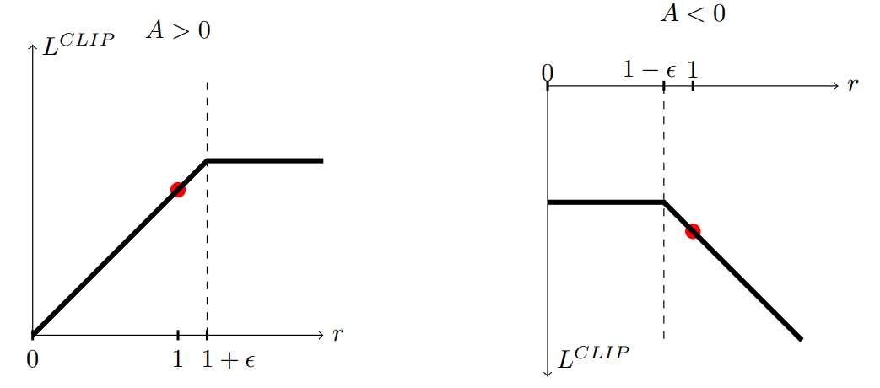
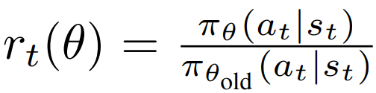
PPO
Clipped Surrogate Objective Function

Slide 2
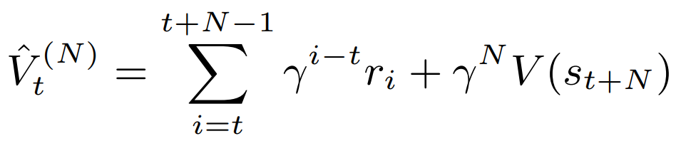
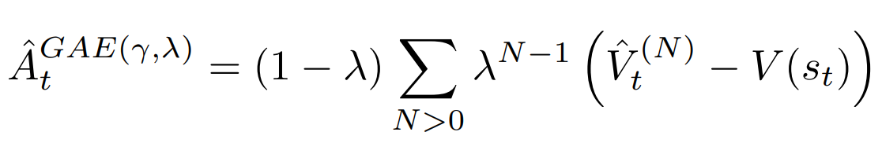
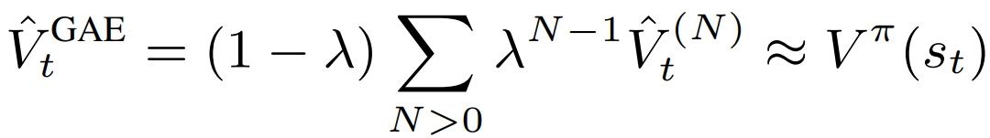
GAE
TD(N) target
GAE as
EWA of TD(N)
Value targets for the Value network

Slide 3
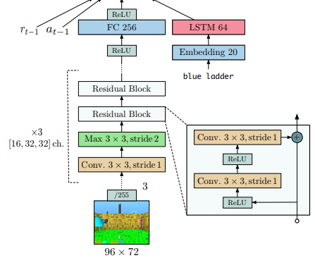
IMPALA CNN architecture
2 separate networks for policy and value
Experiments:
2 or 4 successive frames stacked
Network capacity [16, 32, 32] or [32, 64, 64]
Batch normalization (off)
Global average pooling before classifier (off)
Squeeze & Excitation block (off)

