Slide 1
Cyclist Bike-Share Case Study
Understanding Rider Behavior to Drive Membership Growth
Edon Lata• Cuny college of Staten island • Business Information Systems & Informatics

Slide 2
Cyclist’s success depends on converting casual riders into members.
Chicago’s bike-share program serves thousands daily.
Riders split into Casual (per-ride) and Member (annual).
Goal: increase membership to grow lifetime value (LTV).
Our analysis uncovers usage differences and conversion opportunities.

Slide 3
Two quarters, two datasets — unified for insights.
2019 Q1 + 2020 Q1 Divvy Trip data.
Cleaned, standardized, and merged in R (tidyverse, lubridate).
Engineered variables: ride_length, day_of_week, hour.
Removed invalid durations, HQ QR rides.

Slide 4
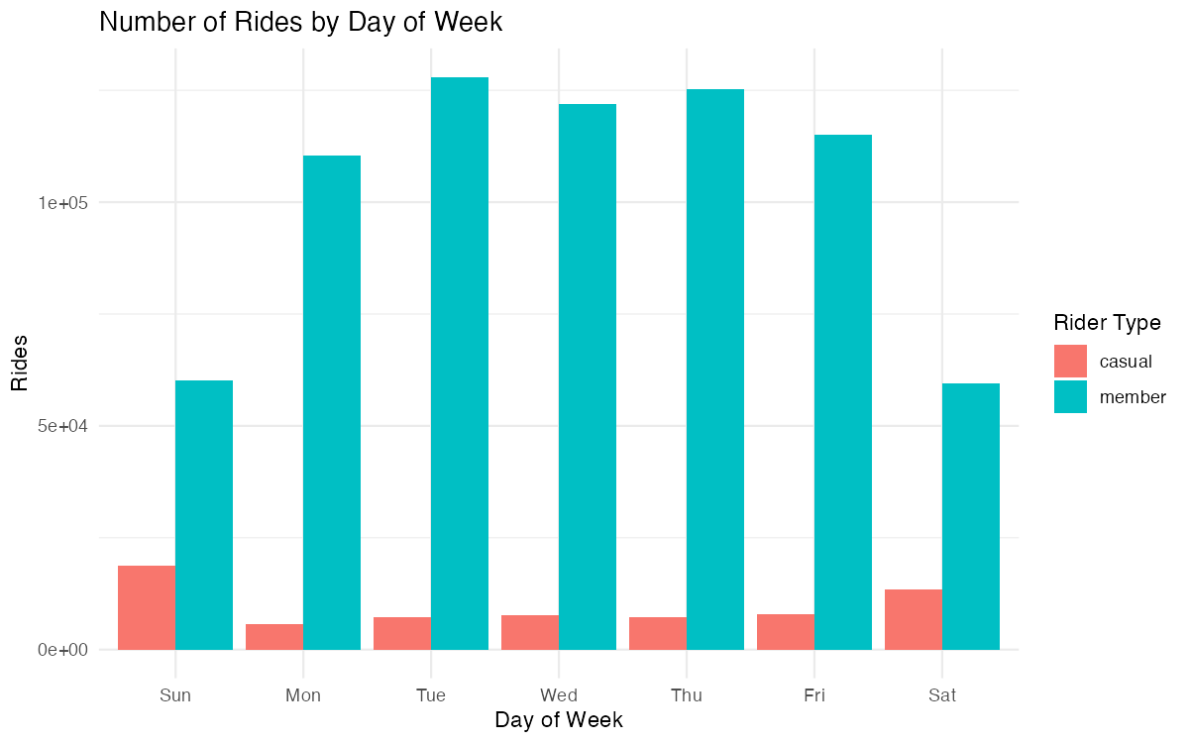
Members ride to work. Casuals ride for fun.
Members peak Monday – Friday (commuting).
Casuals peak Saturday – Sunday (leisure).
Weekends show > 2× more casual activity.

Slide 5
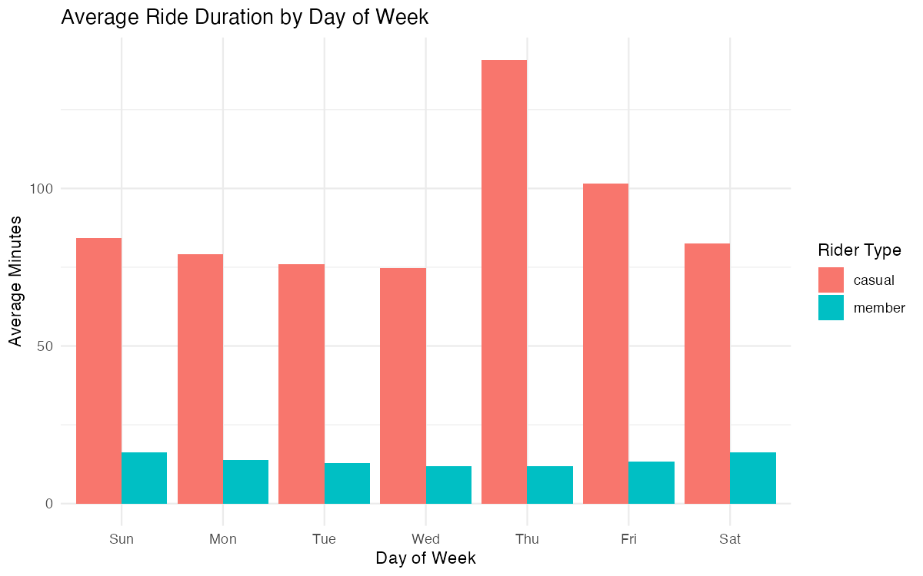
Casual rides last longer — leisure and exploration
Casual mean ride ≈ 25–30 min vs Members ≈ 12 min.
Members maintain short, consistent patterns.
Reinforces “tourist vs commuter” split.

Slide 6
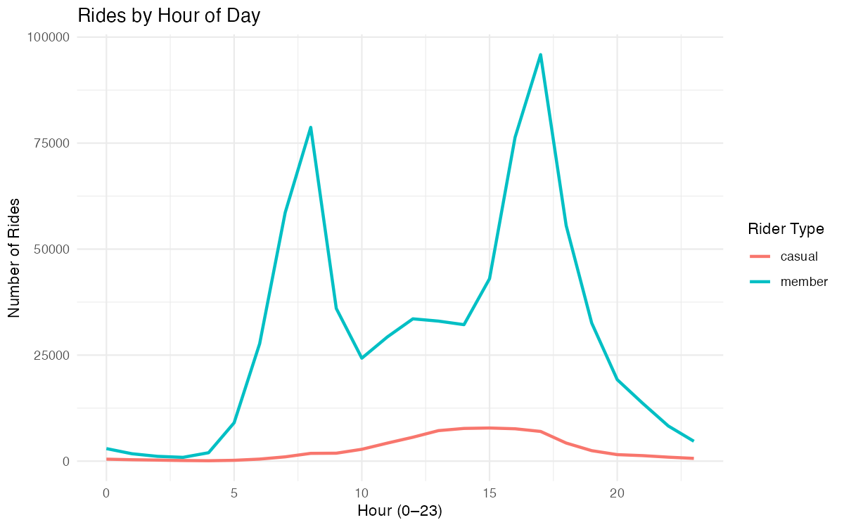
Distinct daily rhythms by rider type
Members peak 8 AM & 5 PM (commute hours).
Casuals peak 10 AM – 5 PM (weekend leisure).
Marketing window: late morning – afternoon weekends.

Slide 7
Where rides begin reveals intent
member_casual | start_station_name | rides
member | Canal St & Adams St | 13799
member | Clinton St & Washington Blvd | 13434
member | Clinton St & Madison St | 12891
member | Kingsbury St & Kinzie St | 8720
member | Columbus Dr & Randolph St | 8515
member | Canal St & Madison St | 7957
member | Franklin St & Monroe St | 7010
member | Michigan Ave & Washington St | 6686
member | Larrabee St & Kingsbury St | 6467
member | Clinton St & Lake St | 6439
Casual starts cluster near lakefront / tourist zones.
Member starts around transit corridors / business districts.
Location informs ad placement & on-site offers.

Slide 8
Casuals favor new, flexible ride options
Casuals → higher share of dockless / electric bikes.
Members → steady usage of classic bikes.
Infrastructure planning can mirror this split.

Slide 9
What drives the gap between riders
Category | Members | Casuals
Ride timing | Weekdays AM/PM | Weekends midday
Purpose | Commute | Leisure / tourism
Duration | Short | Long
Start zones | Work hubs | Tourist zones
Bike type | Classic | Dockless / Electric
Behavior shows who they are — our data shows how to convert them.

Slide 10
Turn insights into membership growth.
Weekend Conversion Offers — QR promos at tourist stations.
Commute-Value Messaging — push cost/time savings to frequent casuals.
Time-of-Day Targeting — ads during weekend midday peaks.
Bike-type Personalization — feature electric-bike perks in membership ads.

Slide 11
Driving higher lifetime value
More weekend riders converted → higher recurring revenue.
Rebalanced demand improves weekday fleet utilization.
Predictable member revenue = stronger long-term equity.
  Visual: simple 3-step funnel: Casual → Converted → Member → LTV Growth.

Slide 12
Where do we go from here?
Today | Tomorrow | Next Year
Complete full-year analysis | Launch targeted pilot offers | Automate LTV dashboards
Validate peak times & stations | Measure conversion lift | Integrate predictive models

Slide 13
Supporting Data & Code (Appendix)
Capstone1.R
rides_by_weekday.png
avg_duration_by_weekday.png
rides_by_hour.png
bike_type_share_by_type.png
summary_by_weekday.csv

