Slide 1
Bellabeat Case Study: Smart Device Usage Insights
Google Data Analytics Capstone Project
Edon Lata
11-17-25

Slide 2
Introduction
What is Bellabeat?
A high-tech wellness company that creates smart products designed for women.
Objective
Analyze smart device data to understand user behavior and create actionable marketing recommendations.

Slide 3
Business Task
Primary Question:
How can Bellabeat use smart device data to improve marketing strategy and grow product engagement?
Key Deliverables
Identify trends in daily activity, sleep, and movement
Generate insights using data visualizations
Recommend high-level marketing strategies

Slide 4
Data Sources
Fitbit Public Dataset (CC0 License)
30 users
Daily activity, steps, calories
Sleep logs
Heart rate (unused)
Minute-level detail
Tools Used
Tableau Public
R (for minor preparation)

Slide 5
Data Preparation
Steps Performed
Imported CSV files
Cleaned and combined activity + sleep datasets
Created calculated fields:
  Weekday
  SleepHours
  ActiveMinutes
  StepsCategory

Slide 6
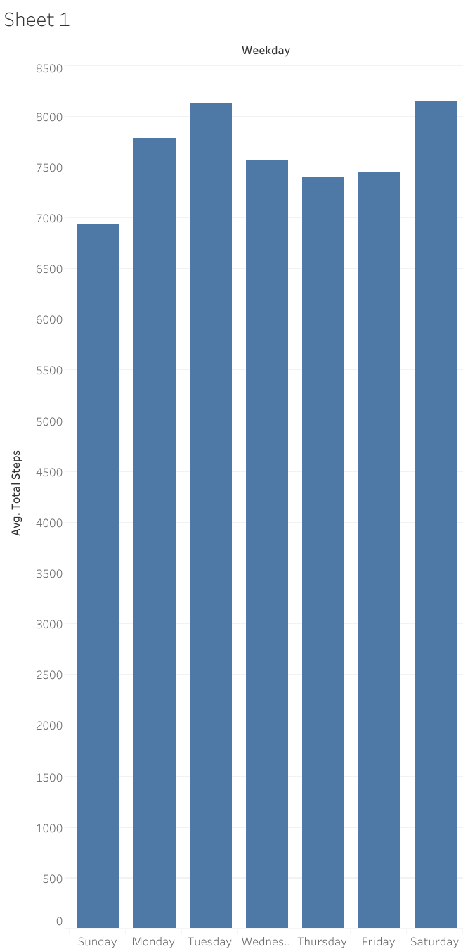
Average Steps by Weekday
Activity varies by day. Users are most active mid-week and least active on Sunday.
→ Opportunity: targeted “Move More” push notifications on low-activity days.

Slide 7
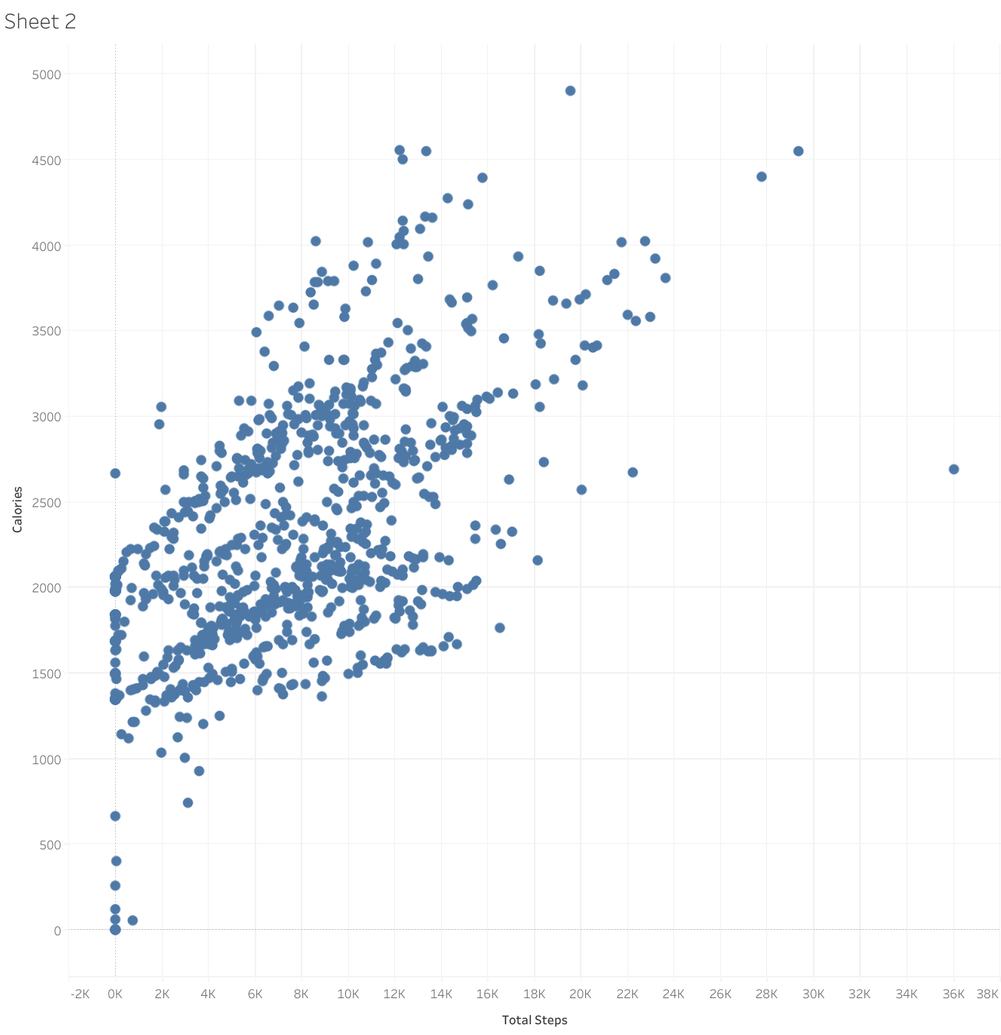
Steps vs Calories (Correlation)
Clear positive relationship: more steps = more calories burned.
→ Opportunity: gamify daily step challenges and energy goals.

Slide 8
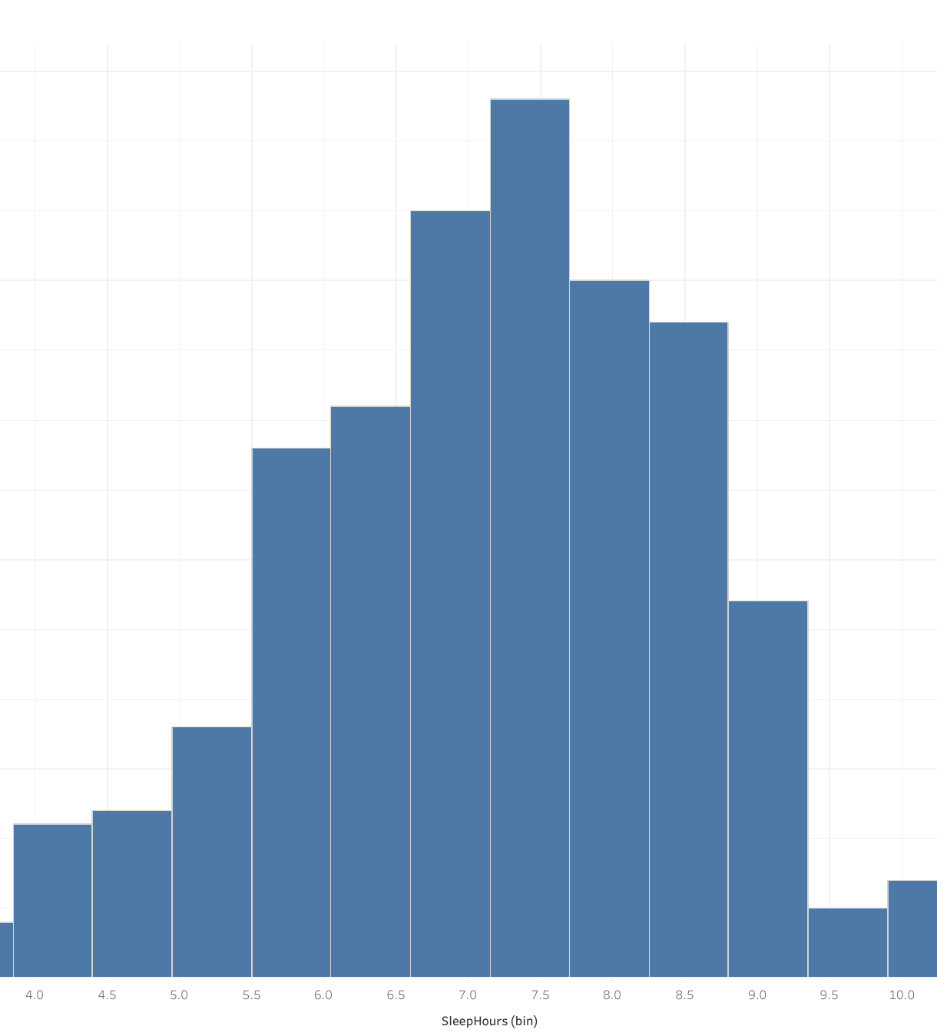
Sleep Hours Distribution
Many users consistently sleep < 7 hours.
→ Opportunity: promote Bellabeat sleep coaching, bedtime reminders, and wellness tips.

Slide 9
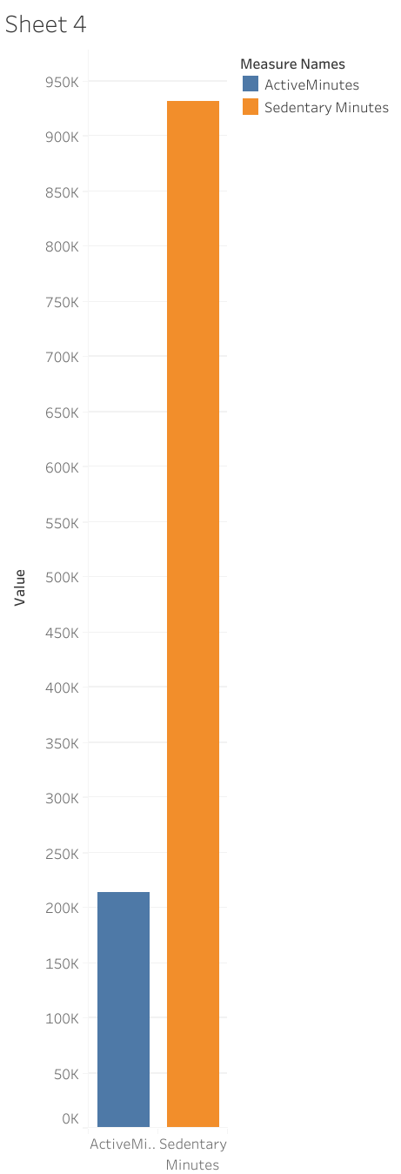
Active vs Sedentary Minutes
Users spend significantly more time sedentary than active.
→ Opportunity: Bellabeat Time watch can deliver inactivity alerts or “movement nudges.”

Slide 10
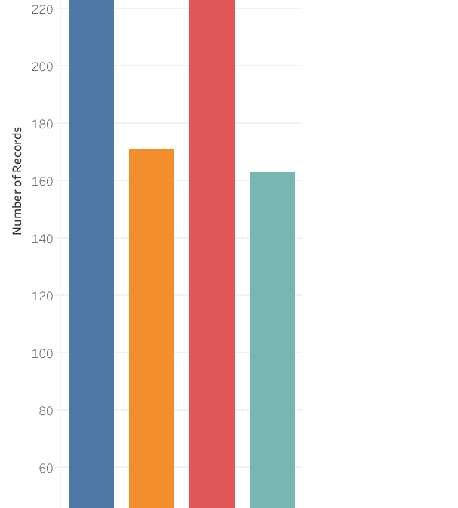
Daily Steps Categories
A majority of days fall in “Low” or “Moderate” categories.
→ Opportunity: introduce personalized step goals and progress tracking.

Slide 11
User Behavior Trends Identified
Steps increase during weekdays
Activity and calorie burn strongly linked
Sleep deficiency is common
Sedentary time dominates
Most people are not hitting 10k steps

Slide 12
Marketing Recommendations
1. Personalized Notifications
Remind users to move during sedentary periods
Sleep tips before bedtime
Morning step-goal alerts
2. Step Challenge Campaigns
Weekly competitions
Reward streaks
Social sharing options
3. Promote Bellabeat Membership
Daily wellness guidance
Personalized activity + sleep plans
Mindfulness sessions

Slide 13
Product-Specific Strategy
Bellabeat App
Insights dashboard + personalized reminders
Bellabeat Leaf / Time Watch
Optimize for:
step goal coaching
inactivity alerts
sleep tracking enhancement
Bellabeat Spring Water Bottle
Pair hydration reminders with activity level (move → hydrate).

Slide 14
High-Level Recommendation
Bellabeat should target user engagement by focusing on:
Daily movement
Better sleep behavior
Personalized coaching
Habit-forming challenges
This leads to improved retention and increased membership conversions.

Slide 15
Next Steps
Add more recent wearable datasets
Integrate demographic data
Conduct A/B tests on reminder features
Build predictive models for user engagement

