Slide 1
NCAA Men’s Basketball Case Study
Evaluating Team Performance for Endorsement Potential
By: Edon Lata

Slide 2
Executive Summary
Objective: Identify NCAA teams with the strongest long-term endorsement potential
Method: Multi-season performance analysis using R
Focus: Consistency, efficiency, improvement, and conference strength
Output: Data-driven recommendations for sports marketing decisions

Slide 3
Business Question
Core Question
  Which NCAA basketball programs demonstrate the strongest performance trends and future potential for endorsement partnerships?

Slide 4
Key Metrics Evaluated
Win Percentage
Offensive & Defensive Efficiency
BARTHAG (Power Rating)
Efficiency Margin
Year-over-Year Improvement
Conference Strength
Postseason Performance

Slide 5
Dataset Overview
Source: Kaggle College Basketball Dataset (cbb.csv)
Coverage: 350+ teams, multiple seasons
Variables: Wins, efficiencies, tempo, shooting %, BARTHAG, postseason results
Format: Clean, structured, multi-year historical dataset

Slide 6
Data Preparation
Standardized all column names
Filtered to modern seasons (2013–present)
Converted all numeric and categorical fields
Addressed missing or incomplete data
Validated team and conference accuracy

Slide 7
Data Processing Workflow
Created new performance metrics
Aggregated yearly stats
Computed trend-based metrics
Segmented teams by conference
Exported summary files for visualization

Slide 8
Analysis Approach
Multi-year trend evaluation
Team-level aggregation (long-term strength)
Seasonal improvement analysis
Conference-level benchmarking
Visual pattern identification

Slide 9
Top Performance Indicators
Teams were evaluated on:
Consistency across seasons
Efficiency margin (offense – defense)
Strength of schedule & conference
Tournament impact
BARTHAG power rating stability

Slide 10
Key Findings: Overall Performance
A small set of teams consistently rank at the top in BARTHAG
Elite teams maintain strong defensive and offensive efficiency
High power ratings correlate strongly with long-term success
Traditional powerhouse programs continue to dominate

Slide 11
Key Findings: Improvement Trends
Several mid-tier programs show rapid year-over-year gains
Improvement metrics identify emerging endorsement opportunities
High upward movement signals strong future potential

Slide 12


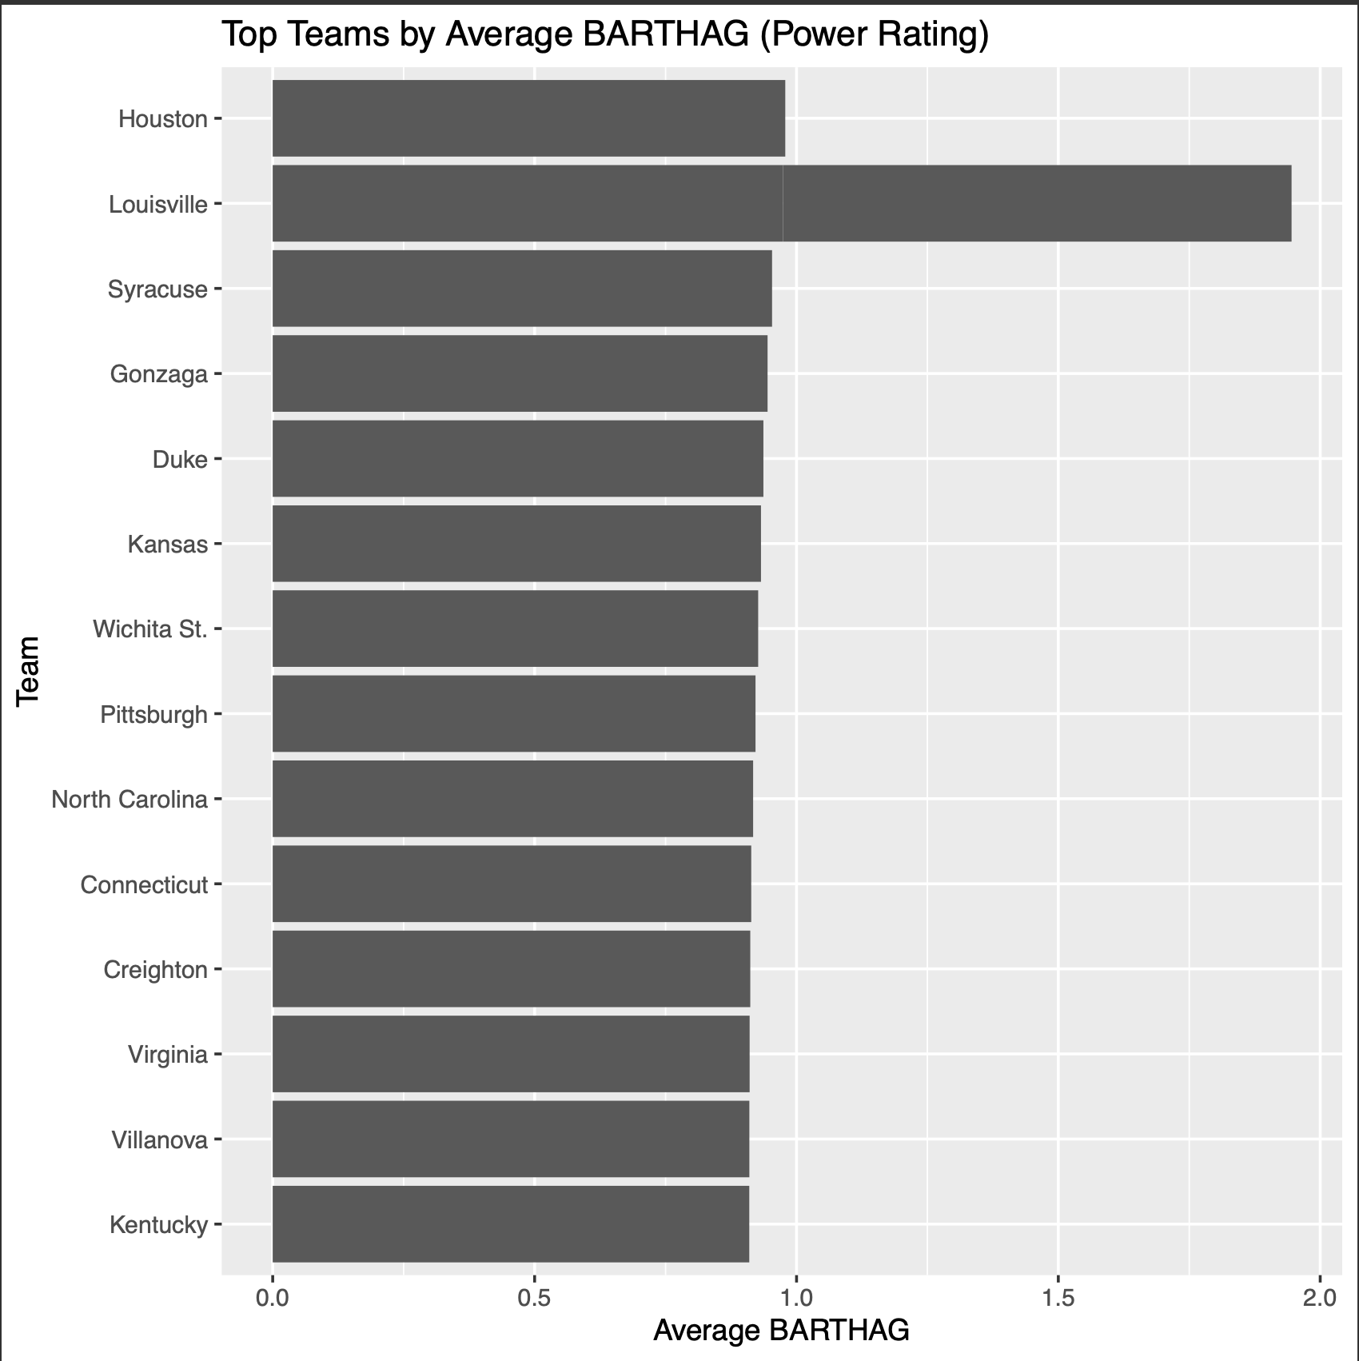

Visualization Example: Top Teams
Demonstrates long-term consistency
Highlights strongest endorsement candidates

Slide 13
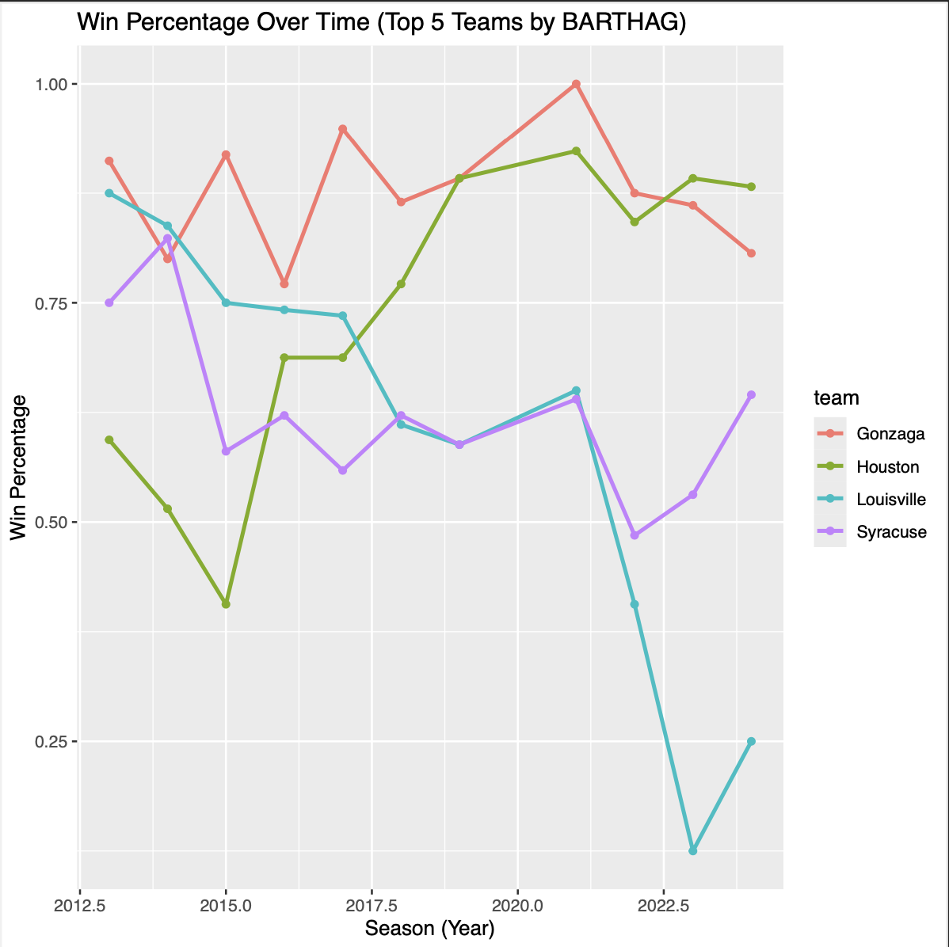
Visualization Example: Trends
Shows stability and growth patterns
Useful for identifying rising programs

Slide 14
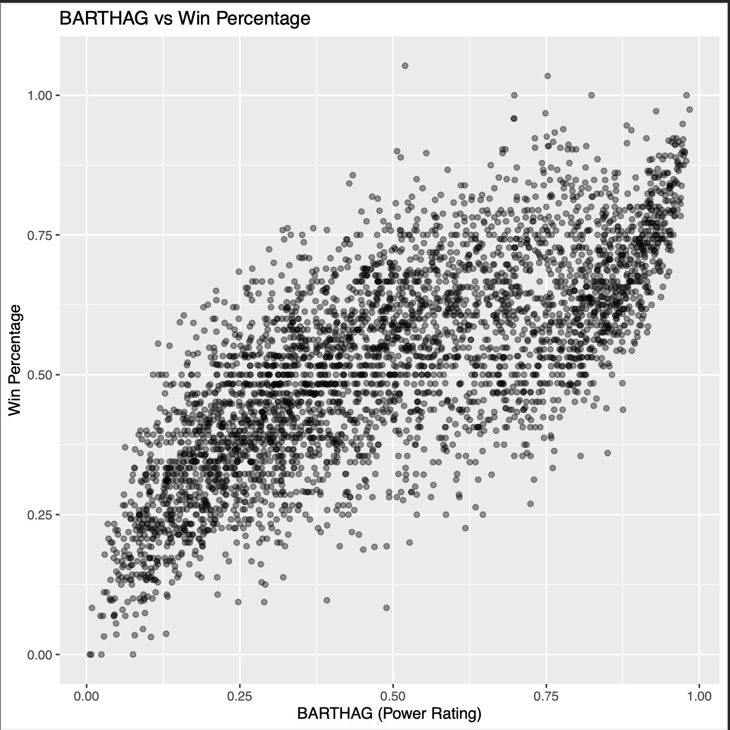
Visualization Example: Efficiency
Strong correlation
Confirms validity of power rating as a key metric

Slide 15
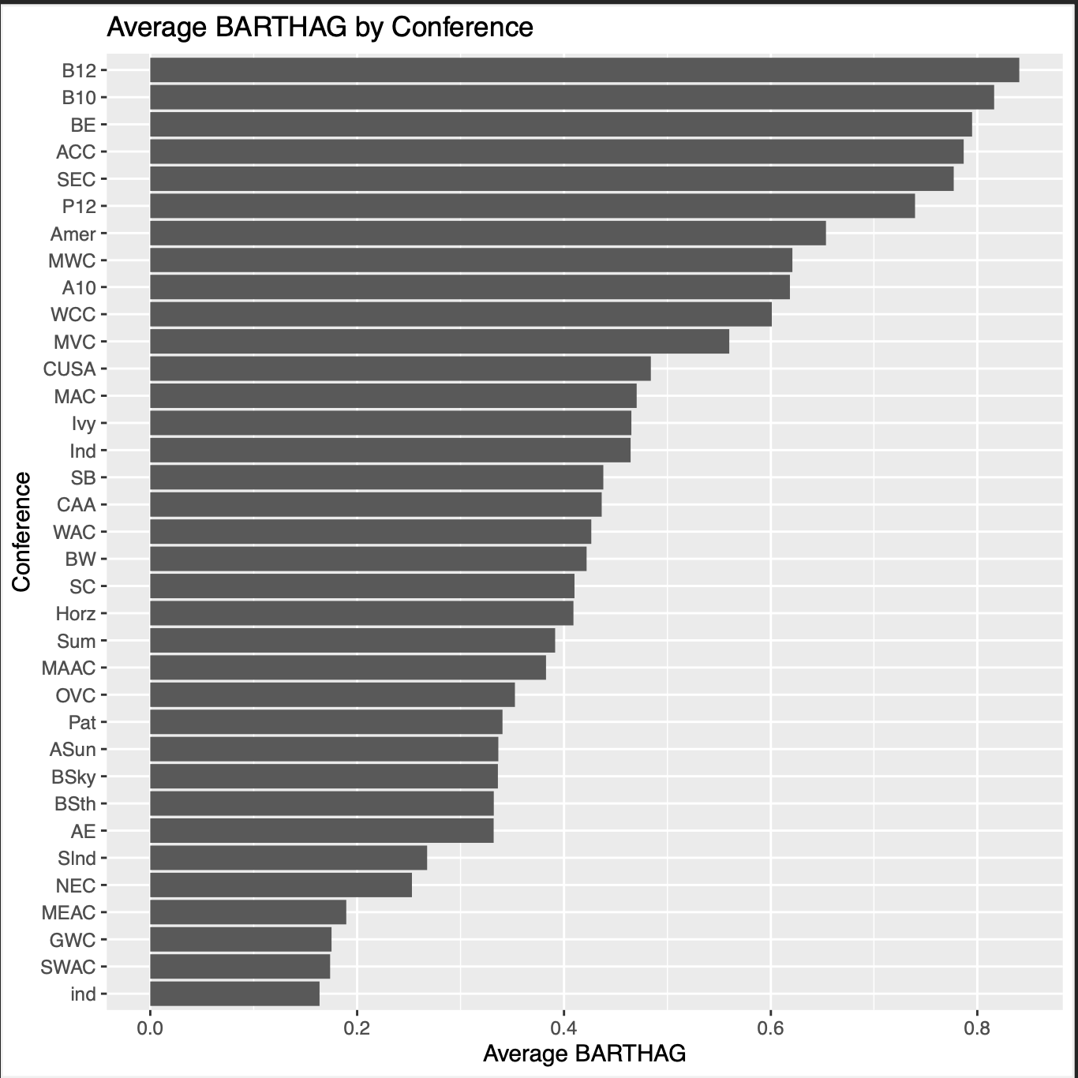
Visualization Example: Conference Impact
Confirms powerhouse conference dominance
Important context for endorsement decisions

Slide 16
Insights
Consistent top-performing teams represent the safest endorsement choices
Emerging programs present high-upside opportunities
Efficiency metrics provide a more reliable indicator than wins alone
Conferences play a significant role in long-term performance

Slide 17
Recommendations
Prioritize established elite programs for immediate partnerships
Build early relationships with fast-improving programs
Integrate NIL social metrics into next-level evaluation
Expand analysis to include women’s NCAA teams
Consider predictive modeling for future endorsement identification

Slide 18
Next Steps
Merge performance + NIL social engagement data
Build predictive modeling (R or Python)
Monitor yearly updates to performance metrics
Expand scope to athlete-level insights

Slide 20
Tools & Methodology
R (tidyverse + ggplot2)
Multi-season statistical modeling
Summary tables and visual analysis
Cleaned and consistently-structured data outputs

Slide 21
Appendix
R code
Charts
Csv File

