Slide 1
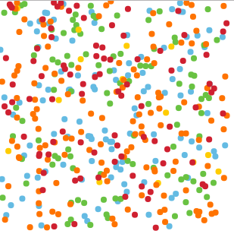
Main School
Notes:
Voiceover: “Students at the same school have different characteristics. Let’s make a peer group for one student.”
Note: There are more than 5 different types of students, but this is a simplified version.
TO DO:
-Try to make dots fill shape instead of in square
-Animate one dot to get larger to show we are making a peer group for one student
-List characteristics of one student we are making a peer group for

Slide 2
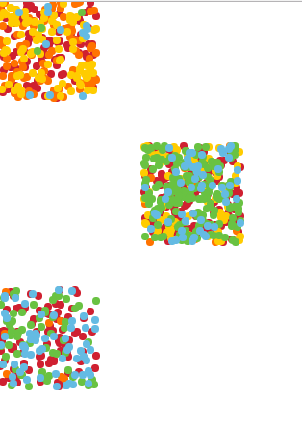
Other schools in NYC
Notes:
Voiceover:
Notes:
TO DO:

Slide 3
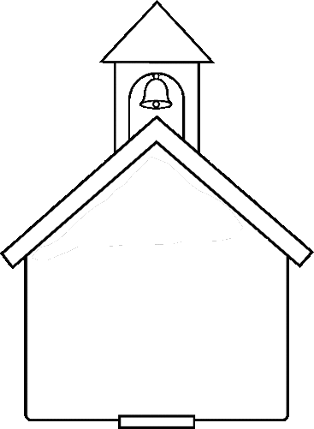
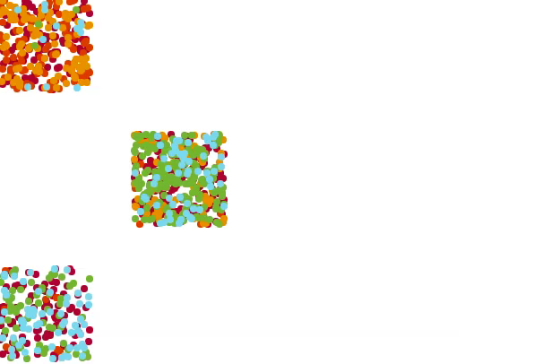
Other schools in NYC
Main School
Matching Students
Notes:
Voiceover: Students at other schools that are similar to our main student form his group of matching students, which can be any size. Note that students similar to our main student at his own school are not included in the matching group.
Notes:
TO DO:
-Make points the same size
-Make points not overlap so much
-Emphasize blue dots before the move
-Move blue dots into cloud shape instead of same position?
-Change size of school buildings to show higher/lower enrollment?
-Deal with dots showing up as darker in screencast than in screenshot

Slide 4
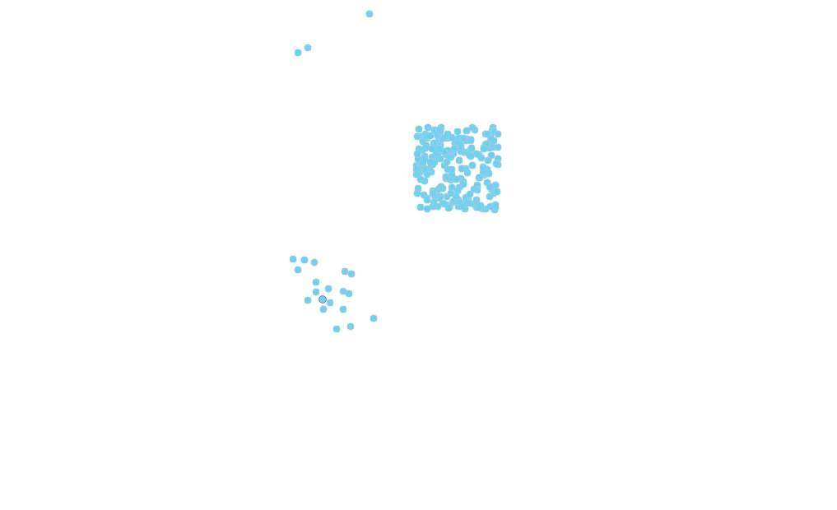
Matching Students

