Slide 1

UAVs on ugv pursuit
A.Y. 2021/22 - Robotics and Control 2 Final project
Group 11 - Ambrosin Gioele, Andreoli Jacopo, Pastorello Edoardo

Slide 2
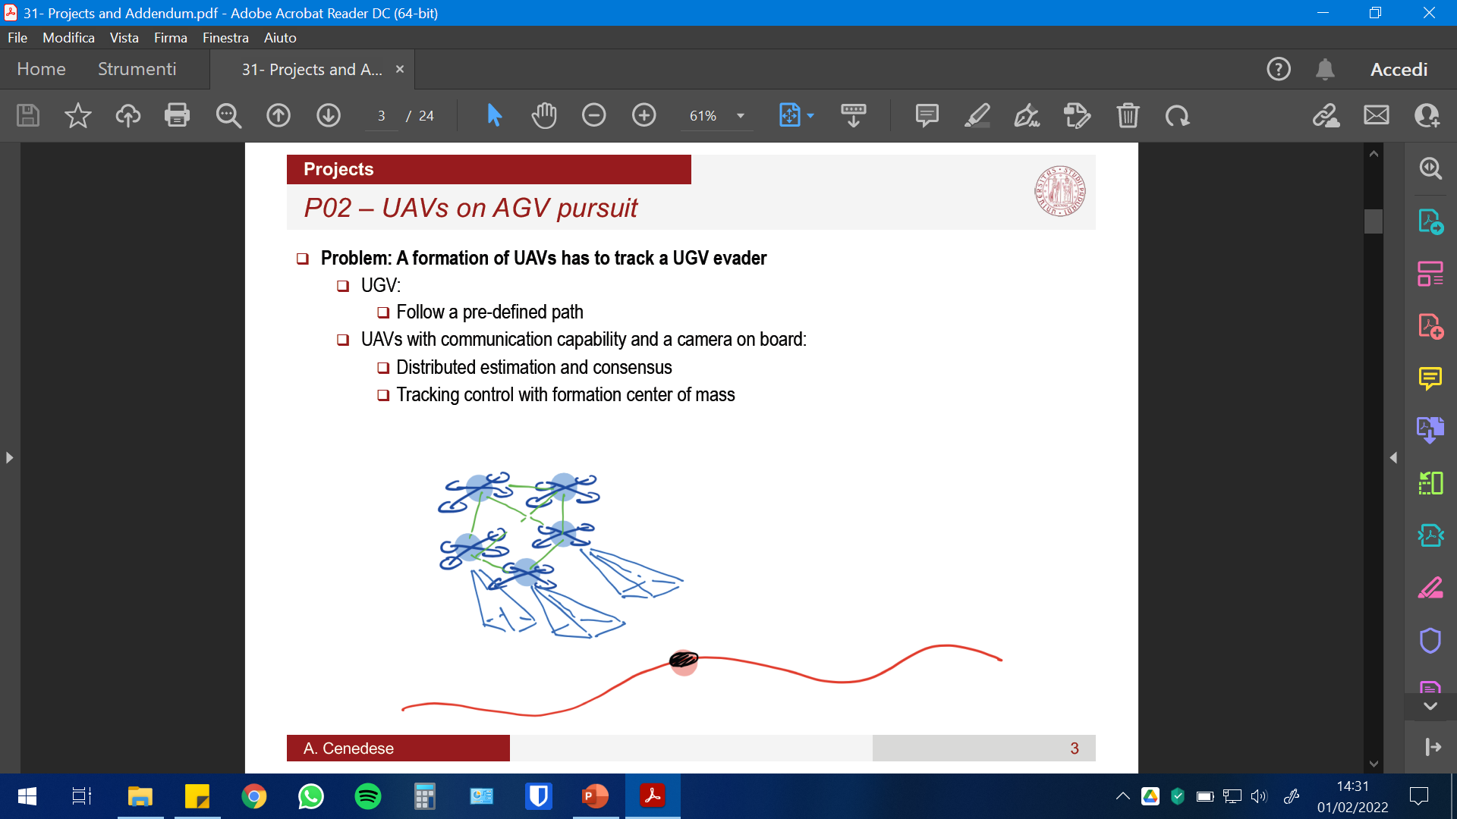
Summary
Introduction to the problem, applications and proposed solution
Full description of project, methods and assumptions
Simulink models, controllers and test trajectories
Consensus on the UAV network
Camera model and pose reconstruction
Consensus on camera measurements
Generation of UAV trajectories
Extra (Communications, faults, etc.)
Results and issues
Future developments

Slide 3
Introduction and motivation
Problem: A formation of UAVs has to track a UGV evader, that is following its own trajectory
Each UAV is provided with a camera to retrieve its relative position wrt the UGV
Consensus used for:
Formation control
UGV motion estimation
Applicable whenever an independent agent has to be followed: motion picture industry, security…

Slide 4
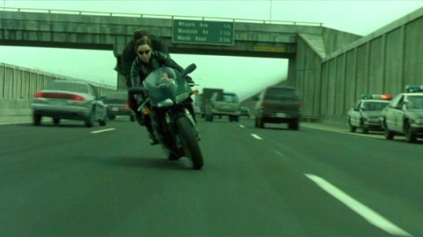
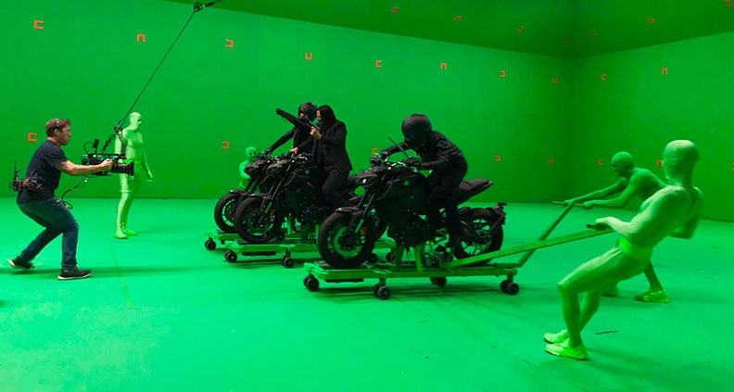
Applications 1/2
Cinema: how to recreate a car chase (or car spots)?
Green screen – CGI
Driven vehicles with staff on board – not safe
Our solution: markers (removable) + automatic drones for multiple framing

Slide 5
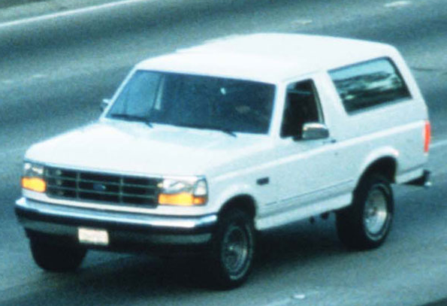
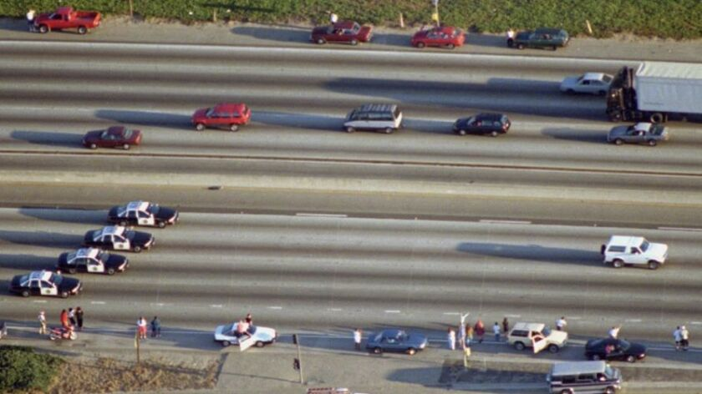
Applications 2/2
Security: police chase (need for high performance drones)
Need additional feature extraction and learning techniques for agent recognition

Slide 6
Proposed solution
Leader following strategy only for orientation (leader kept in front of UGV)
At least 4 markers on the UGV to retrieve relative UAV-UGV position, and keep fixed distance wrt the agent (P4P problem)
Given relative positions, the drones try to maximize their relative distances wrt the 2 neighboring drones (no one knows how many drones are there -> Consensus). All info on position given by the camera, not by communications between single drones
After the UGV has moved, each drone estimates the direction of motion -> new consensus for common measurement
Common motion. After N steps, repeat consensus

Slide 7
The project

Slide 8
1.a Simulink models
testo

Slide 9
1.b Controllers and trajectories
testo

Slide 10
2. Consensus
testo

Slide 11
3. Pose reconstruction
testo

Slide 12
4. Consensus on measurements
testo

Slide 13
5. Generation of trajectories (UAV)
testo

Slide 14
6. Extra
testo

Slide 15
Results and issues

Slide 16
Results
testo

Slide 17
Issues
testo

Slide 18
Future developments

Slide 19
Further development
testo

Slide 20
Thank you

