Slide 1

UAVs on ugv pursuit
A.Y. 2021/22 - Robotics and Control 2 Final project
Group 11 - Ambrosin Gioele, Andreoli Jacopo, Pastorello Edoardo

Slide 2
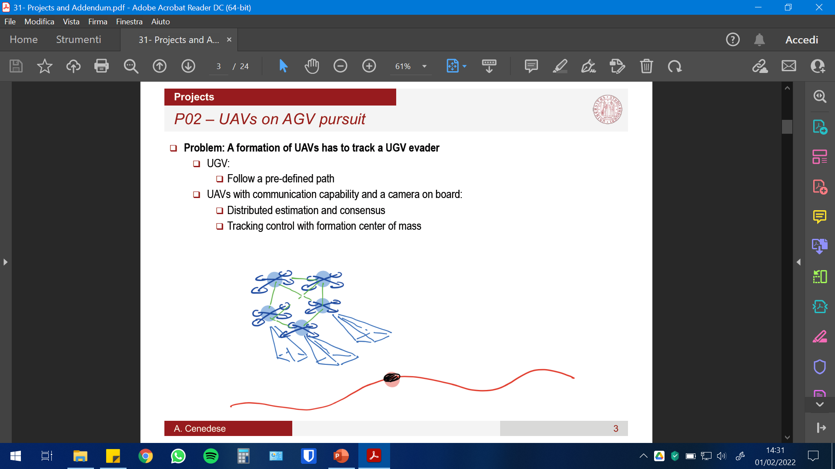
Summary
Introduction to the problem, applications and proposed solution
Full description of project, methods and assumptions
Simulink models, controllers and test trajectories
Consensus on the UAV network
Camera model and pose reconstruction
Consensus on camera measurements
Generation of UAV trajectories
Extra (Communications, faults, etc.)
Results and issues
Future developments

Slide 3
Introduction and motivation
testo

Slide 4
Proposed solution
testo

Slide 5
The project

Slide 6
1.a Simulink models
testo

Slide 7
1.b Controllers and trajectories
testo

Slide 8
2. Consensus
testo

Slide 9
3. Pose reconstruction
testo

Slide 10
4. Consensus on measurements
testo

Slide 11
5. Generation of trajectories (UAV)
testo

Slide 12
6. Extra
testo

Slide 13
Results and issues

Slide 14
Results
testo

Slide 15
Issues
testo

Slide 16
Future developments

Slide 17
Further development
testo

Slide 18
Thank you

